Slide 1





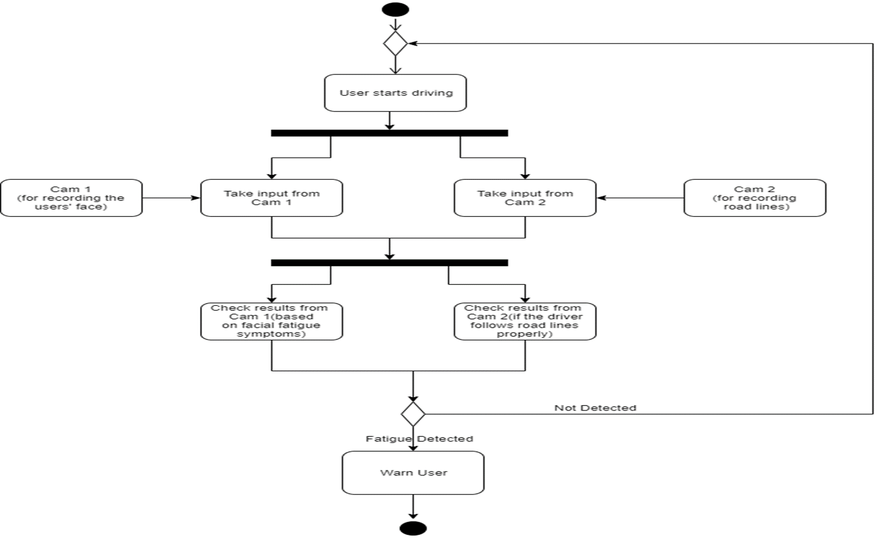
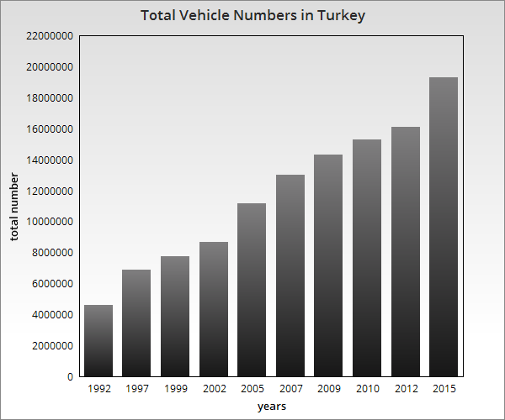
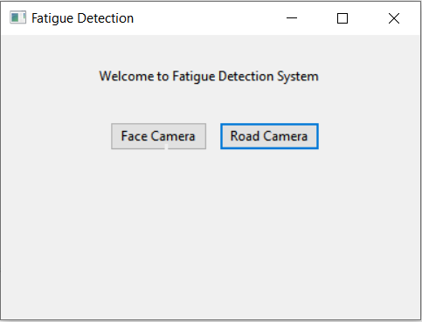
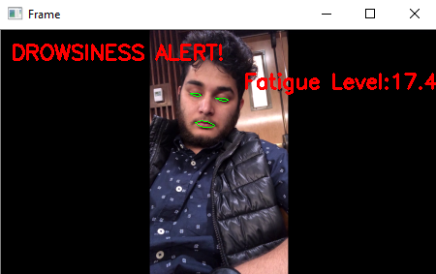
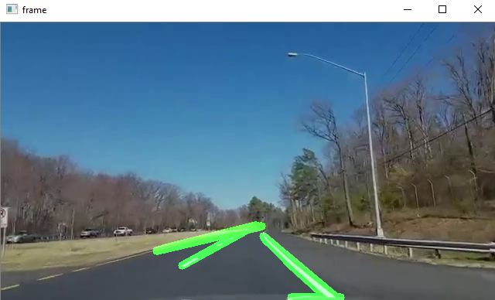

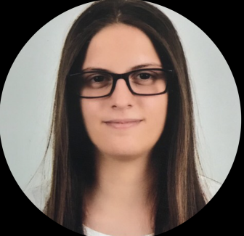

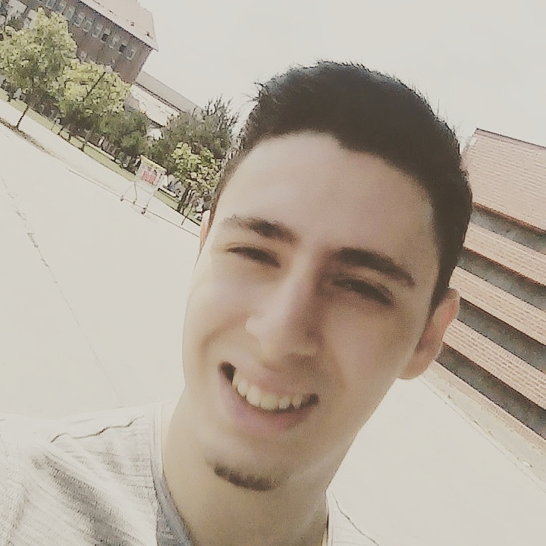

FATIGUE DETECTION
İrem KAYMAKÇILAR-Damla Ebru PARLAK
Berkay EKEBAŞ-Hümeyra ÜNAL
Advisor:Abdül Kadir Görür
Çankaya University, Department of Computer Engineering
Abstract
In recent years with the increase in the number of vehicles in traffic , road accidents have increased significantly. Driver fatigue is one of the major cause of these traffic accidents. Accidents involving sleepy drivers tend to be particularly serious since the sleepy driver doesn’t have a quick enough reaction time, and is too slow to attempt to avoid an accident. Due to these situations, giving drivers early warning that they need to take a break is vital for safe travel. Therefore, there is a need for a system to measure the fatigue level of driver and alert him when driver feels drowsy
to avoid accidents.
Introduction
Fatigue is generally defined as a feeling of the lack of energy and motivation that can be physical or mental. Driver fatigue is a major cause of traffic accidents.We are aiming to find a crucial solution to save passenger lives due to that is the major cause of traffic accidents. Giving drivers early warning that they need to take a break is vital for safe travel. Our aim is to place two cameras into the car and check the face expression, road lines at the same time while drivers are driving. According to these inputs, the system will give a result that can be referred
to as the fatigue level of
the driver.
Solution
To create a solution we need to use a two recordings,first one is the recording of a fatigued person and the second one is taken from the windshield of a moving vehicle. We preferred to develop our project with phyton using the PyCharm platform. The system will detect the driver’s fatigue from facial expressions using OpenCV and increase the value that is for holding the fatigue level. With
the help of our GUI(fig.3,4,5) we’ll test our system.
Figure 1 - Comparison of
Total Vehicle Numbers in Turkey by Years
Figure 2-Activity Diagram
Figure-3,4,5
GUI
Fig-3 Main Screen
Fig-4 Facial Camera
Fig-5 Vehicle Camera
Results and Coclusions
While developing our project, we have aimed to detect
fatigue symptoms and combine the results of these symptoms to get a value called «fatigue level». After our researches we came with a plan. Our plan was to focus on the main symptoms of fatigue such as yawning, blinking etc.
We were able to create a system that recognizes the driver’s face, road lanes and symptoms to a certain level. In the end, system is still unfinished in some aspects and
can be improved further in the future.
Acknowledgement
We are grateful for the support and the guidance we
Received from our advisor Dr. Abdül Kadir Görür during these hard times.

