Slide 1


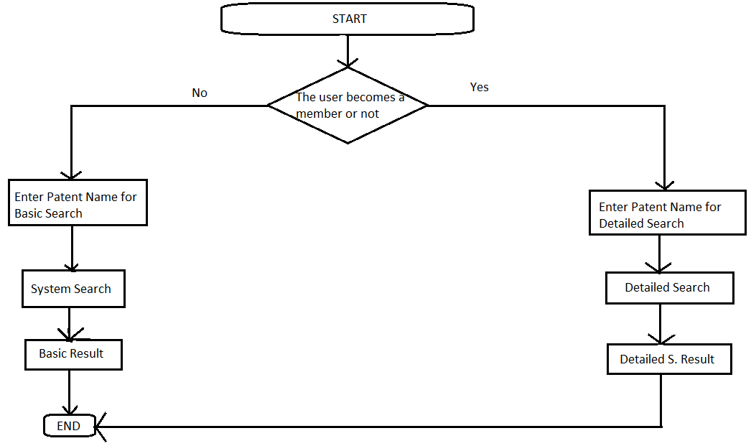
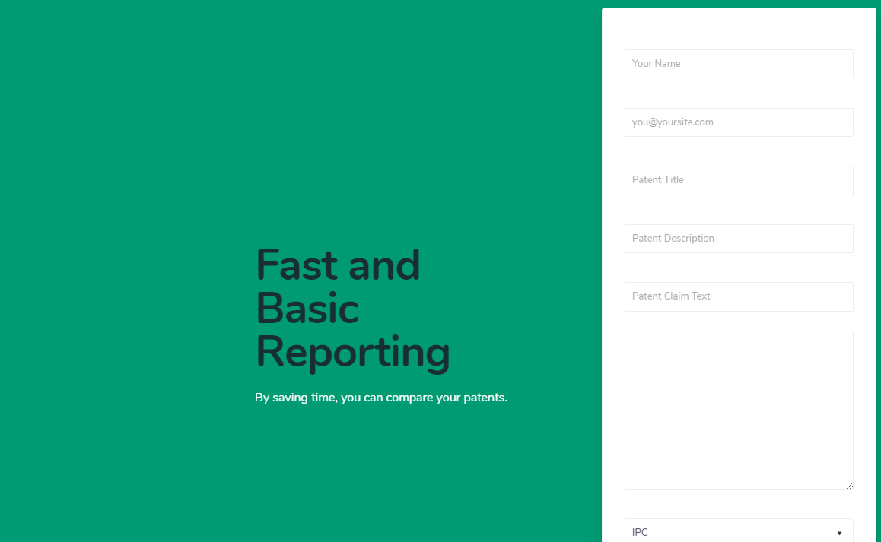
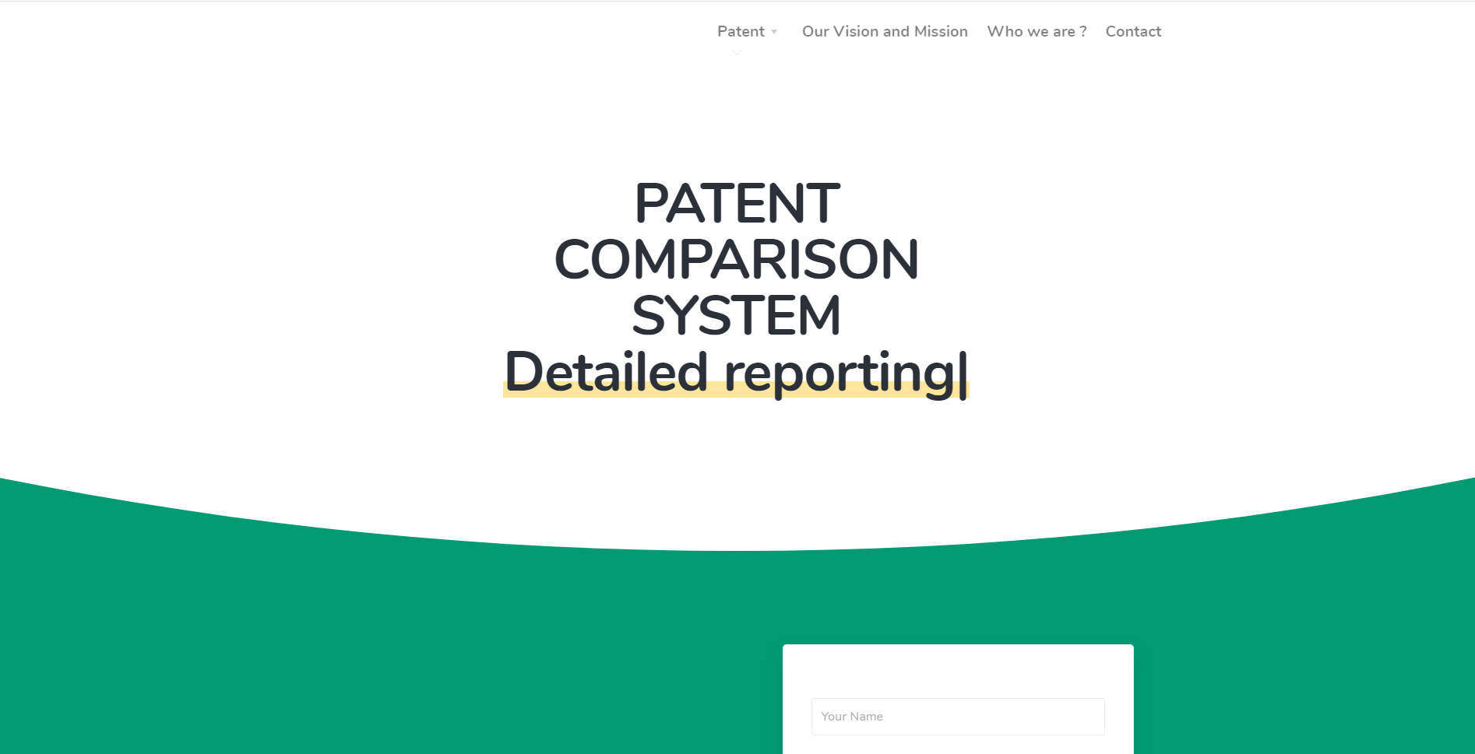
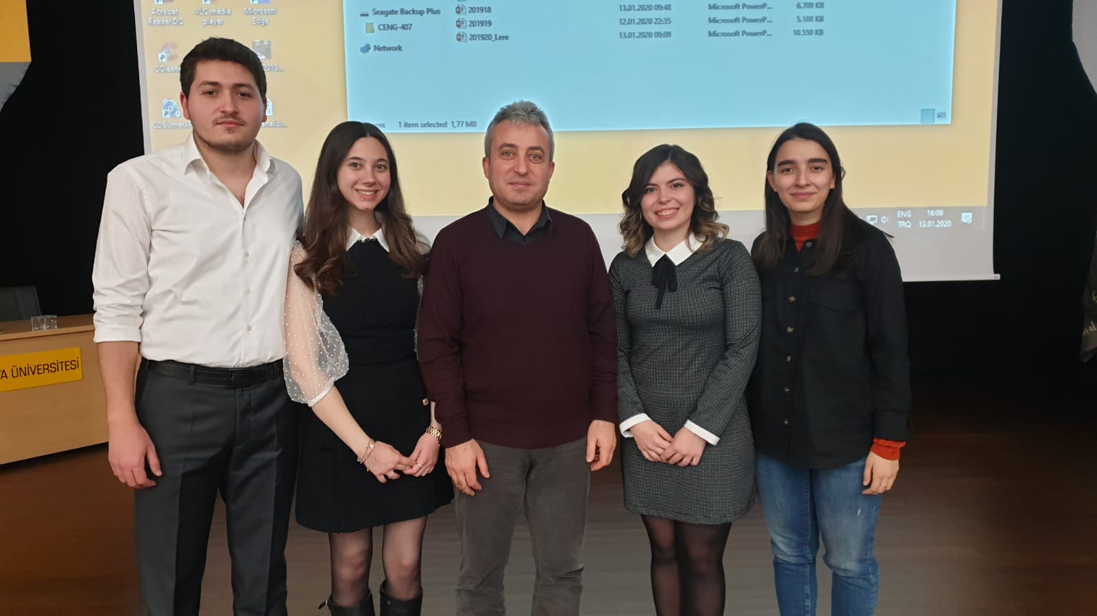

PATENT COMPARISON SYSTEM
Özlem Simay CELKAN Neval Zeynep GÜNDEŞLİ
Öznur ÖZTÜRK Mert KIZILDAĞ
Advisor: Dr. Öğr. Üyesi Murat SARAN
Çankaya University, Department of Computer Engineering
Abstract
This project aims to increase the quality of the patent search process in terms of time and accuracy in the researches conducted in the Turkish Patent Institute. This project also aims to enhance the limited comparison features of existing patent comparison systems by developing an alternative, more advanced patent comparison system. In this project, we first investigate the extensive Patent Comparison literature to see the current status in the patent comparison field.
Used technologies
In this project, multiple different technologies were used to complete the system. These :
Django
Python
MongoDB
Figure 1 - Flowchart
Conclusion
In this project that we are currently working on, some specific points can not be handled as a whole instead they should be dealt in parts. The most important thing among these parts is how much a patent is similar to related patents. The first thing that we will do is correctly classify the patents according to their IPC numbers. After the classification, the titles and content of the patents will be compared with each other. The basis will be critical similarity level that we have defined after the results obtained from a survey that targets patent holders. A report containing similarity levels of the patents will be presented to the user. In today's world researches for patents are still carried out by humans. This project aims to decrease the required manpower and time that is allocated to this business.
Introduction
There is currently no program to compare the patent. Our goal is to make the patent classification based on the title and content. Patent comparison relates to comparing a patented product to a product intended to be produced. Patent Analysis and Comparison is indispensable for preventing the negative material - spiritual consequences that may be encountered later and for correct R & D structuring. In our project, we aim to program with Java or Python. Once our data set is provided by our company, our first job will be to process this data into the database. In doing so, we will explore several classification and clustering algorithms. If we want to give a few examples; k-means, Bayes Classifier ex. Thanks to the structure we have established, we aim to carry out our transactions quickly and accurately.
Figure 2 – Finished Product
Figure 3 – Finished Product
Acknowledgement
We would like to thank our consultant Murat Saran for helping us to design and implement this project. We believe that we will be more successful in this project with the advices of our advisor. We would also like to thank our other instructors who assisted and advised in this process. Finally, we would like to thank Onur Engineering for believing in us and for giving us this project.
[ company logo ]
http://yazilimgelistirmemerkezi.com/

