Slide 1


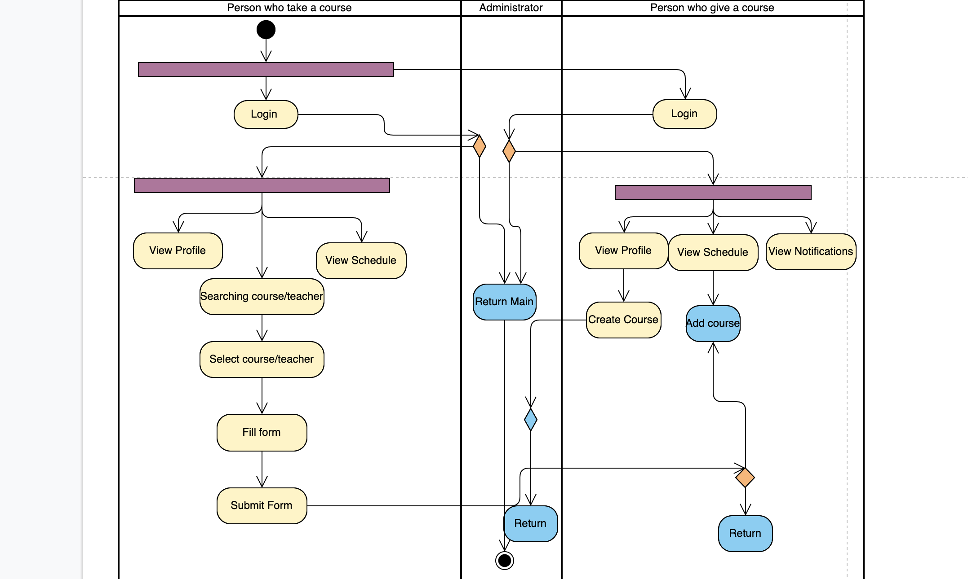
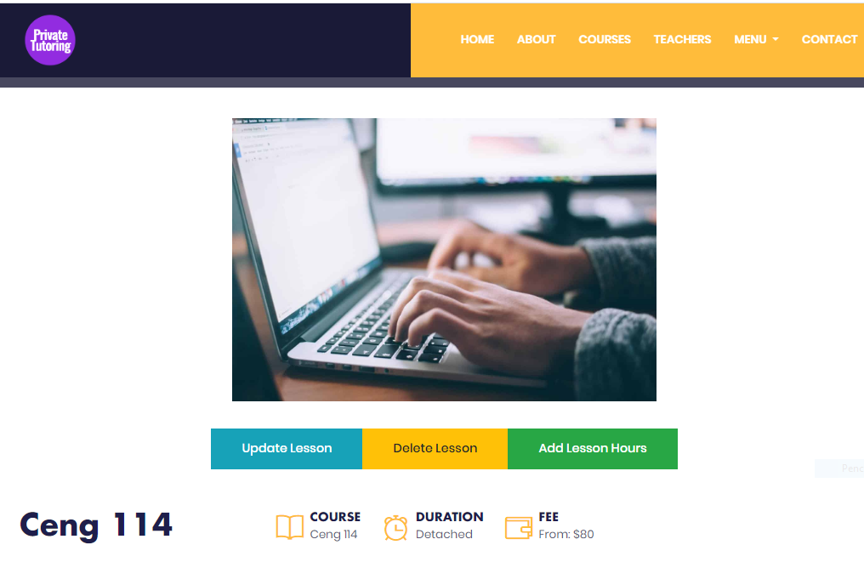

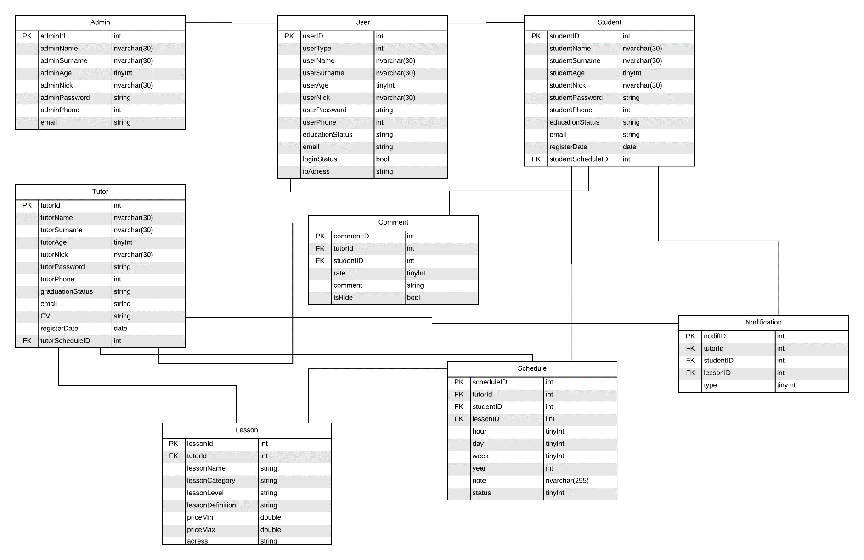

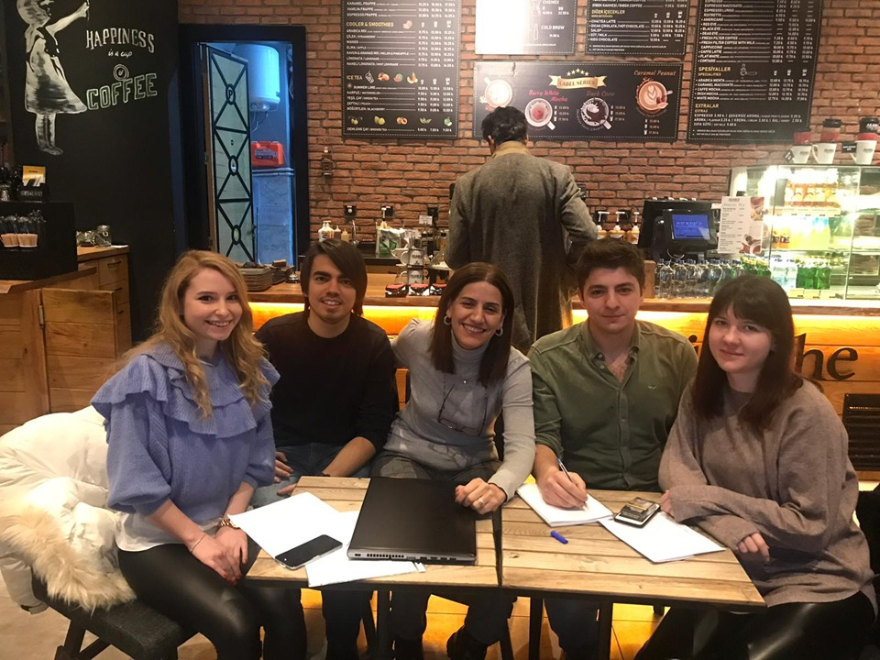

Private tutoring application
Serhat CENKAYOĞLU – Damla YILDIRIM
– Hande AYDIN – Eyüp Can TURGUT
Advisor – Instructor Dr. Roya CHOUPANI
Çankaya University, Department of Computer Engineering
Abstract
Teachers who want to give private lessons and students who want to take private lessons have difficulty finding each other. We noticed this problem and decided to make a web project to provide a solution. Students will be able to reach the teachers with the criteria they want after they register to the site and choose courses according to their curriculum. In this project, we found certain search criteria from similar sites we looked at.
Key Words:
Tutoring, Web application, Curriculum, Search by criteria, Teacher, Student.
Figure 5 – Screenshot 3
Figure 6 – Screenshot 4
Figure 1 - Activity Diagram
Introduction
Students who want to take private lessons have problems finding teachers. They find it difficult to find teachers that meet their own criteria. Teachers, on the other hand, give private lessons, posters and so on. tools. Our goal is to create a useful platform to solve this problem. Our overall goal is to provide a convenience in the field of education and to design a website accessible to all audiences.
Acknowledgement
We would like to thank Dr. Roya CHOUPANI and Dr. Faris Serdar TAŞEL for helping us to develop this project. We are grateful for their support to us throughout the project.
Figure 2 – Data Base
Solution The aim of our project is to bring people who want to take private lessons and give private lessons. Enrolled teachers can add courses to their curriculum. After the students register to the site, according to the location, education level, wage range, the teacher will search; teachers who have received votes at the rate they want, can send requests to the appropriate spaces in their curriculum by looking at their comments. Students or teachers may postpone the existing courses in the curriculum and add notes.
Figure 3 – Screenshot 1
Figure 7 – Group Picture
Figure 4 – Screenshot 2

