Slide 1

appDermis
TEAM MEMBERS
MERVE TALAKACI
DENİZ ÇINAR
ELİF BAŞAK KOÇ
İLAYDA SELİN TÜRK ADVISOR GÜL TOKDEMİR CO-ADVISOR ROYA CHOUPANI

Slide 2
Content
What have we learned as a result of our researches?
To sum up
Our
References
Problem
Solution
Prototype
Results
&
Conclusion
References
Analysis
What brought us here?
What we decided to use, how to develop appDermis?
Prototype of the appDermis

Slide 3
PROBLEM
Skin cancer is usually visible on the body. Unlike other type of cancers that develop inside the body, skin cancers are formed outside the body and are usually noticable.

Slide 4
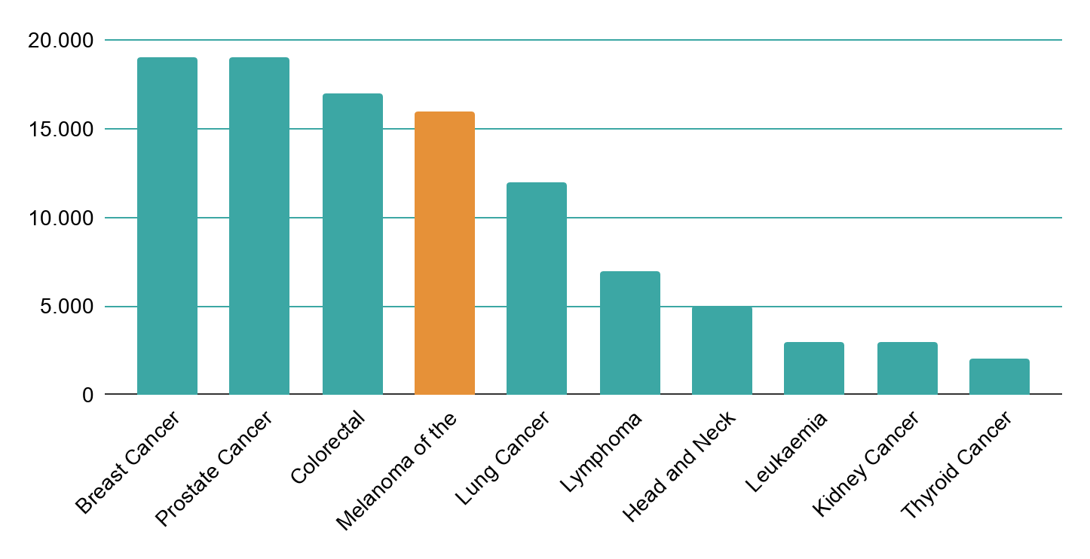
PROBLEM
192,310
new cases
of skin cancer!

Slide 5
To save time and speed up the treatment!
01
Skin Exam
02
Staging
03
Testing/Pathology
04
Treatment
05
Observation
06
Lifelong follow-up

Slide 6
Analysis
We examined the Skin Cancer Detection literature and identified more than 15 works determined by using PubMed, Google Scholar search tool, IEEE Xplore Digital Library conferences and journals.

Slide 7
Suitable Datasets
ISBI2016
dermweb.com
PH2
HAM10000

Slide 8
Analysis
ASYMMETRY
BORDER
COLOR
A
B
C
D
E
DIAMETER
EVALUATION

Slide 9

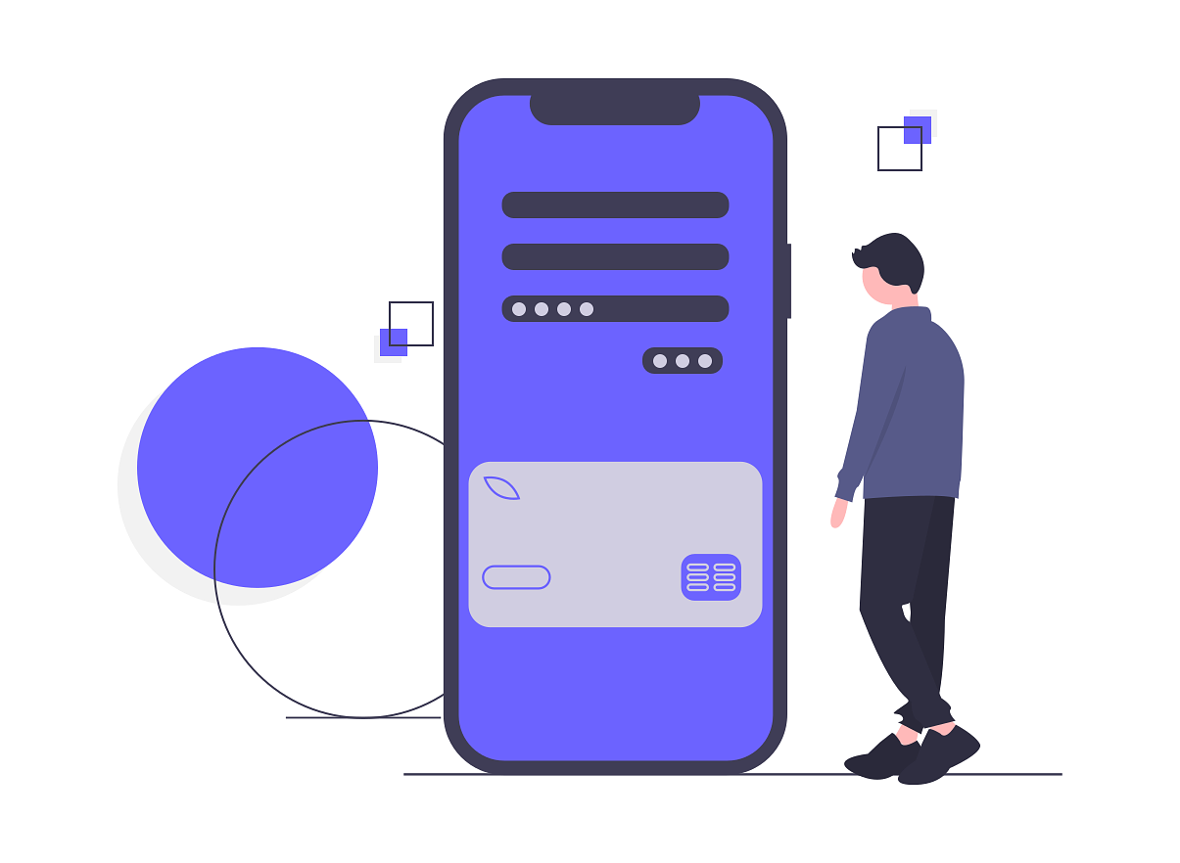

Solution
Our solution proposes a mobile application to be guide to people who are at risk of melanoma.

Slide 10
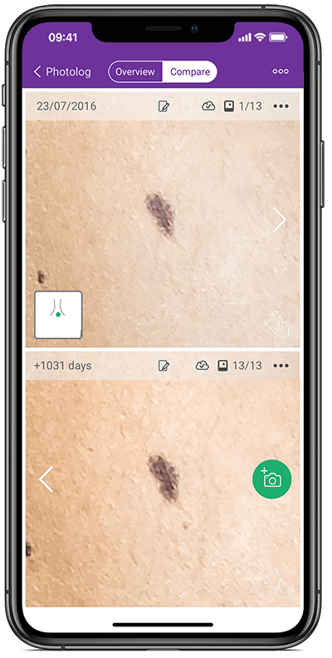
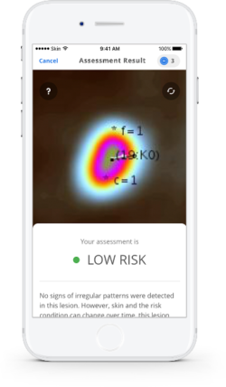
OTHER APPLICATIONS

Slide 11






Solution
TensorFlow&Keras
React Native
OpenCV
Python
PostgreSQL
What we will be using

Slide 12
Conclusion
Avoid medical expenses
Avoid waiting times
Follow-up your skin
Early Detection

Slide 13
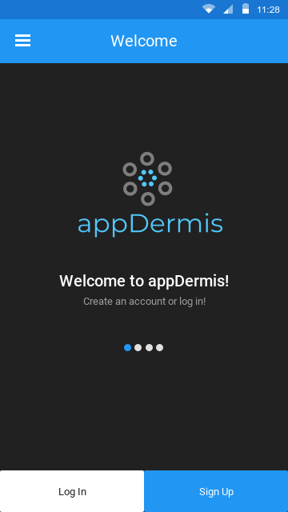
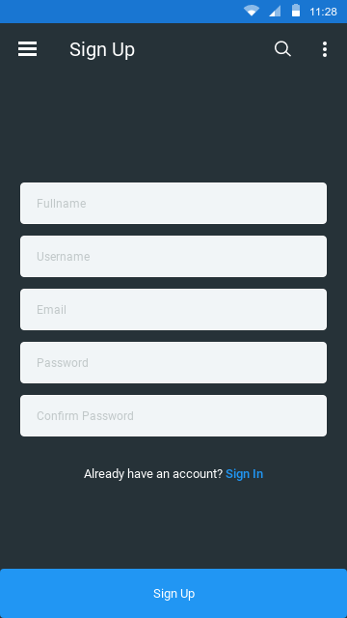
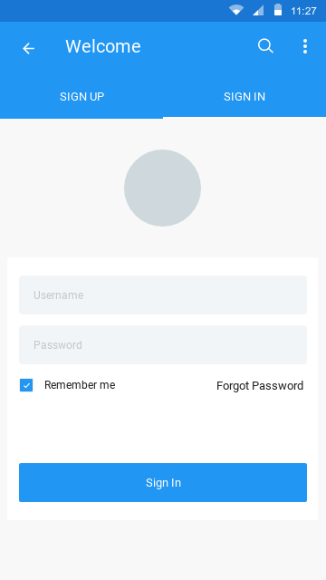
Prototype

Slide 14
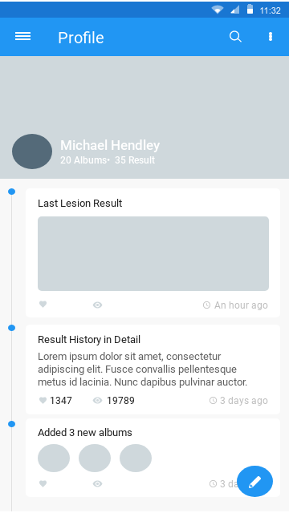
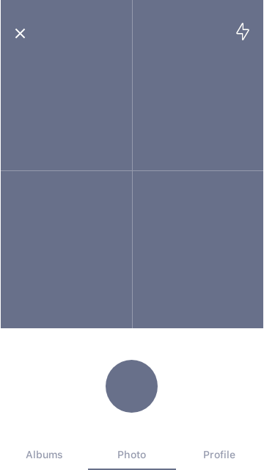
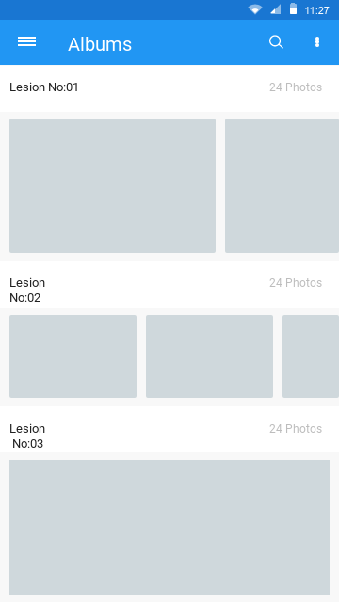
Prototype

Slide 15
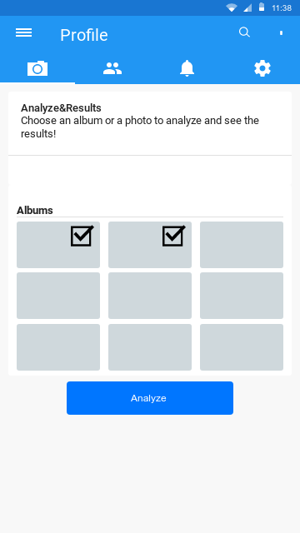
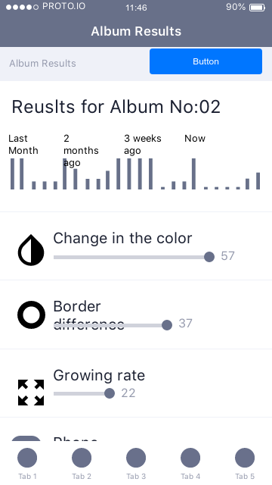
Prototype

Slide 16
REFERENCES
American Cancer Society, ” How to Spot Skin Cancer ,2019 from https://www.cancer.org/latest-news/how-to-spot-skin-cancer.html
Uzma Bano Ansari, Tanuja Sarode “Skin Cancer Detection Using Image Processing”, International Research Journal of Engineering and Technology , Vol. 4, Issue 4, 2017
Novel Approaches for Diagnosing Melanoma Skin Lesions Through Supervised and Deep Learning Algorithms (J. Premaladha & K. S. Ravichandran), 2016

Slide 17
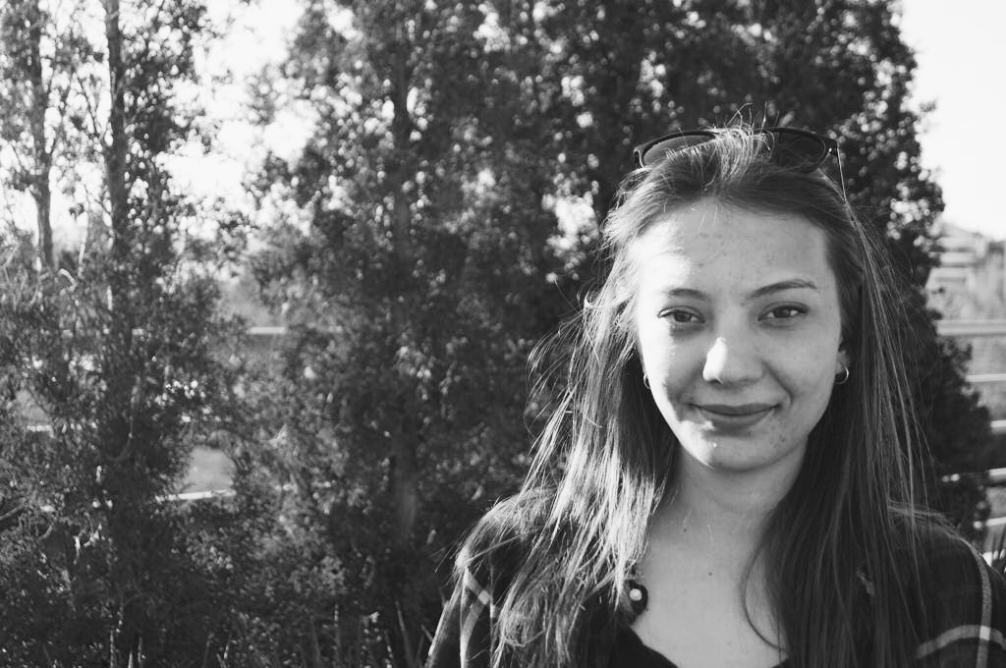
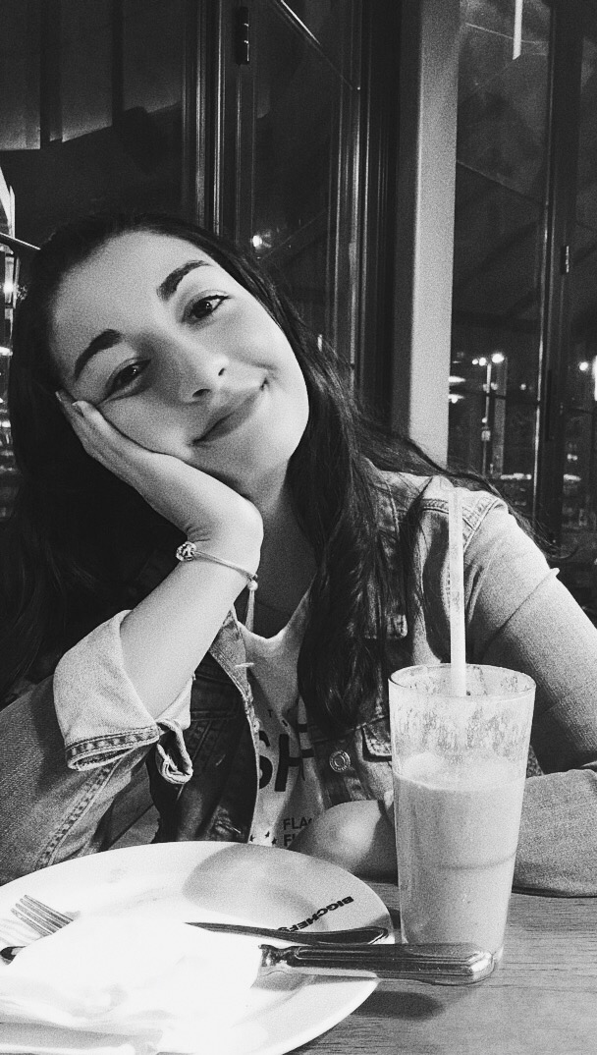
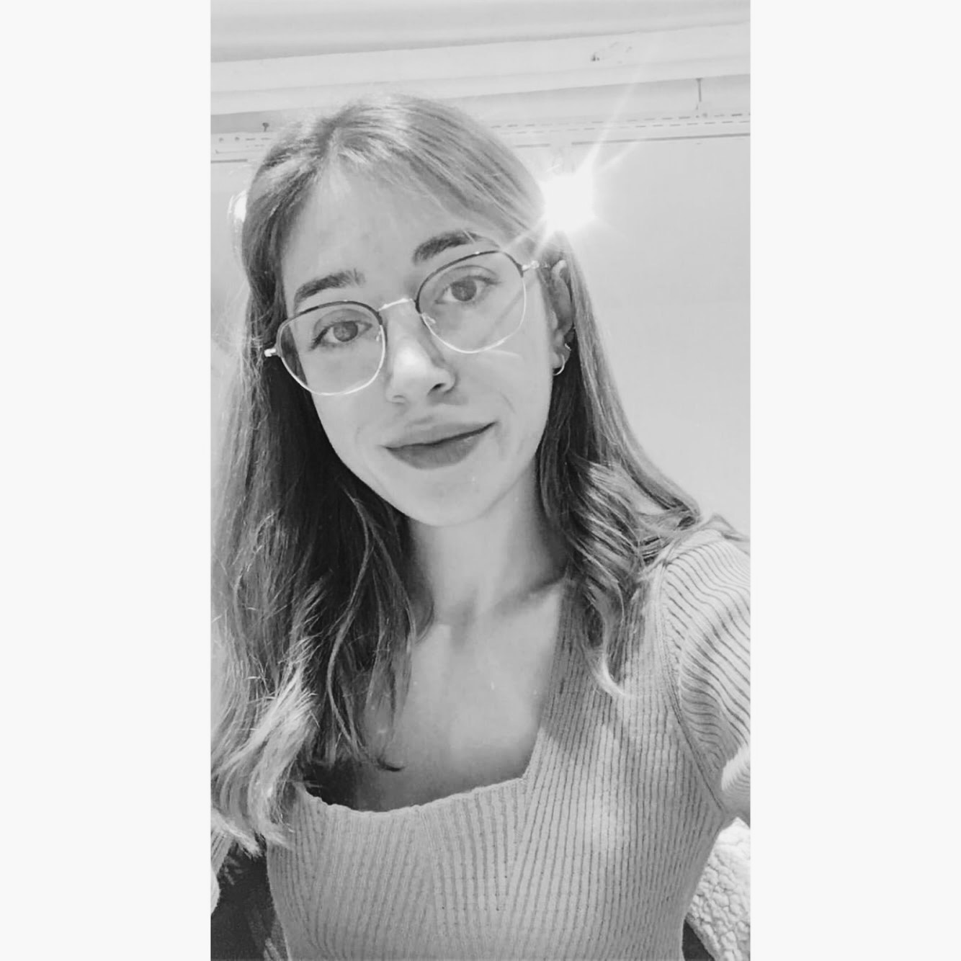
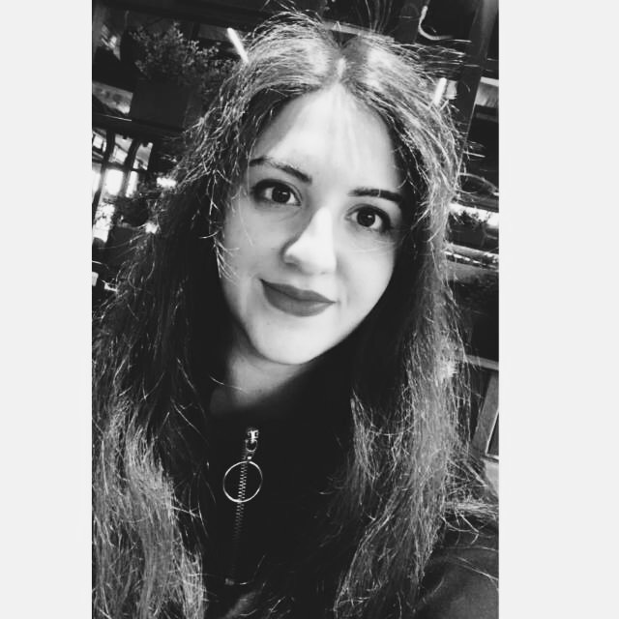
OUR TEAM
thanks!
MERVE TALAKACI
DENİZ ÇINAR
ELİF BAŞAK KOÇ
İLAYDA SELİN TÜRK

