Slide 1
MOBILE RESERVATION LIBRARY SYSTEM
PROJECT MEMBERS
BEYZA YÜKSEL - 201611066
BURCU BİTER - 201512015
EDA GÜL SÜMER - 201611050
ADVISOR
DR. SERDAR ARSLAN

Slide 2

Contents
● Problem
● What is Mobile Library Reservation System?
● Why MLRS is Necessary?
● Previous Similar Works and Contribution
● Solution
● Technologies
● What Happens After MLRS?
● User Interface Design
● Conclusion
● References

Slide 3
Problem
Waste of time
Loss of library cards
Difficult to access
Wait in line
Cannot control all libraries in city
Notes:
WASTE OF TİME - Günümüzde kütüphanelere yer seçebilmek ve giriş yapabilmek için insanların kütüphanede bulunması gerekiyor.İnsanlar ,kütüphanenin doluluk oranını bilemediği için kütüphaneye gitse bile tamamen dolu olduğu zaman giriş yapamıyorlar.Bu olayda zaman kaybına yol açıyor. Biz projemizde bu problemi çözmek için doluluk oranı görülecek şekilde hazırladık.Bu sayede insanlar kütüphanelerin doluluk oranını görüp tamamen dolu olan kütüphane yerine başka bir kütüphaneyi seçip rezervasyonlarını sağlayabilecekler.Nowadays, in order to choose a place and enter the libraries, people need to be in the library. Since people do not know the occupancy rate of the library, even if they go to the library, they cannot entry when it is completely full. This leads to a waste of time. In order to solve this problem in our project, we have prepared the occupancy rate so that people can see the occupancy rate of the libraries and choose another library instead of the fully full library and make their reservations.
LOSS OF LİBRARY CARDS - Günümüzde birçok kütüphaneye kütüphane kartı ile giriş yapılabilmektedir. Kütüphane kartları almak oldukça zordur ve bir çok evrak ve belge gereklidir.Bütün sorunlar bunlarlada bitmiyor , kütüphane kartı aldıktan sonra kaybolabiliyor yada yanımıza almayı unutabiliyoruz ve bu nedenlede kütüphaneye giriş yapamıyoruz.Uygulamamızdaki rezervasyon sonrası kişiye özel atanan qr kod sayesinde kartsız giriş yapılabilmektedir.Today, many libraries can be accessed with a library card. It is very difficult to get library cards and a lot of documents and documents are required. All problems do not end with them, we can get lost or forget to take it with us and for this reason, we cannot log in to the library.
DİFFİCULT TO ACCESS- Kütüphanelere erişim sadece çalışma saatleri içerisinde olmaktadır.Uygulamamız sayesinde 24 saat online erişim sağlanabilir,rezervasyon yapılabilir ve kütüphane içerikleri görüntülenebilir.Access to libraries is only during working hours. Thanks to our application, online access is available 24 hours a day, reservations can be made and library contents can be viewed.
WAİT İN LİNE - Kütüphanelerde uygulanan bir rezervasyon sistemi olmadığı için insanlar giriş yapabilmek için kütüphane önlerinde sıra bekliyorlar.Buda insanların hayatlarını zorlaştırıyor.Oysa bizim uygulamamız online hizmet vermektedir. Bu sayede sıra beklemeden mobil telefon üzerinden önceden rezervasyonunuzu kolaylıkla sağlayabilirisiniz. Since there is no reservation system applied in libraries, people are waiting in front of the library to enter. This makes people's lives difficult. However, our application provides online service. In this way, you can easily make your reservation on your mobile phone without waiting in line.
CANNOT CONTROL ALL LİBRARİES İN CİTY - Şehirdeki tüm kütüphaneler tek bir yerden kontrol edilemiyor . Bizim uygulamamız Ankara ilindeki bütün kütüphaneleri kapsıyor .Ankaradaki bütün kütüphanelere erişim sağlanabiliyor , kontrol edilebiliyor , listelenebiliyor ve silinebiliyor.

Slide 4
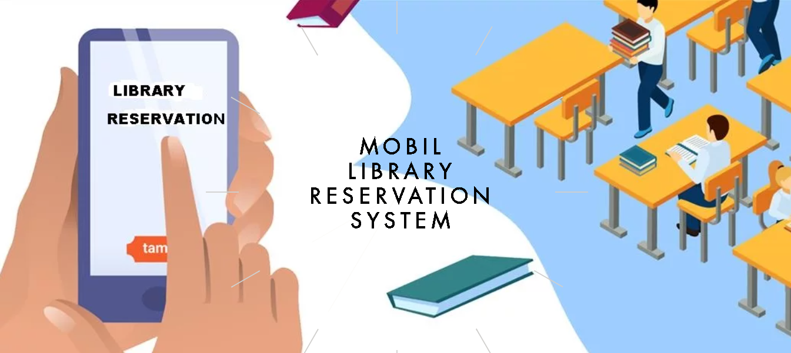
MLRS is a mobile library reservation system.
This project aims to prevent the users from waiting in the library queue by making a reservation in advance and to enable them to choose the table they want to work on.
What is MLRS?
Notes:
In addition, a QR code is created on the mobile application specifically for each reservation. In this way, users will not need to use a library card. Users' compliance with the reservation time will be checked by the QR codes that they read to the QR code reader at the entrance and exit of the library.

Slide 5

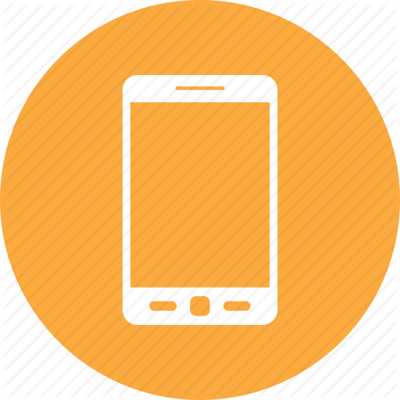
Why MLRS is Necessary?
Easy to Access Library Always
Not Need Library Card
Not Waiting in Line
Avoiding Waste of Time
,
Notes:
Easy To acces library always-
Not need library card-
Not waiting in line-
Avoiding waste of time

Slide 6
Previous Similar Work
PROJECT NAME | AREA | ACCESS | AIM OF PROJECT | PRIVACY | QR CODE
Hong Kong University of Science and Technology Library in China | Library | Web Based | Study Room Reservation for Groups | X | ✓
ODEON E-ticket - ODEON Cinemas in UK | Cinema | Web/Mobile Based | E- Ticket for Movies | ✓ | ✓
Hospital Reservation System in Turkey | Hospital | Web/Mobile Based | Appointment from Hospital | ✓ | X
QR Code Train Ticket Booking in India | Train | Web/Mobile Based | Booking for Train Ticket | ✓ | ✓

Slide 7
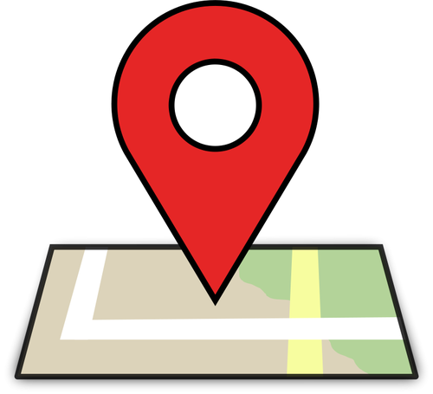

Solution
Developing a mobile application that:
çmzf<md
Providing reservation opportunity regardless of and
Cares about user privacy
Removes the library card with the use of QR code
Accessible by using mobile phone
Viewing the occupancy rate of libraries in the city

Slide 8




Technologies

Slide 9
What Happens After MLRS?
Not waiting in the library queue.
Many reservations can be made easily without going to the library.
Reservation cancellation.
Not carrying a library card.
Providing security with personalized QR code.

Slide 10
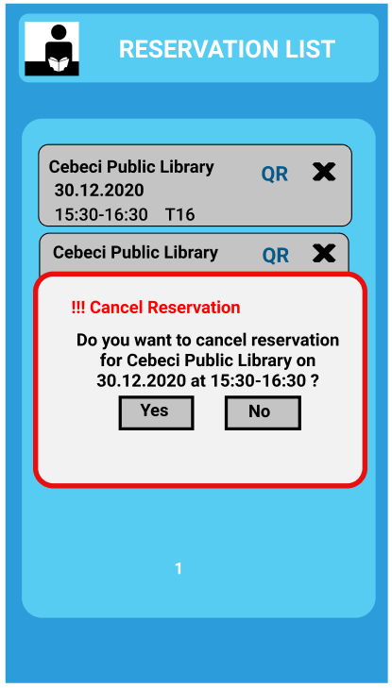
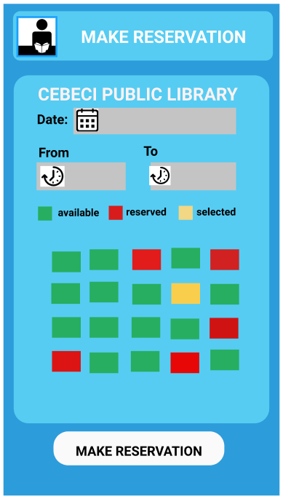
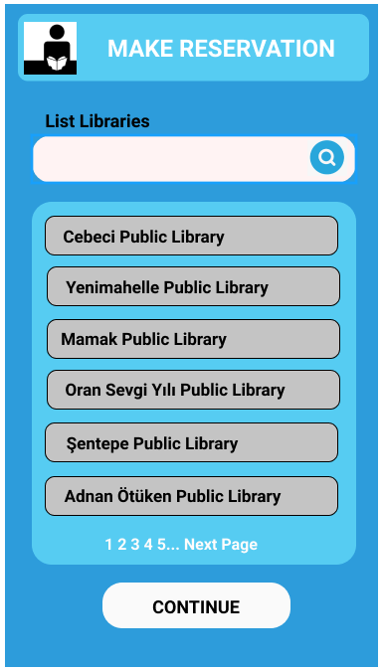
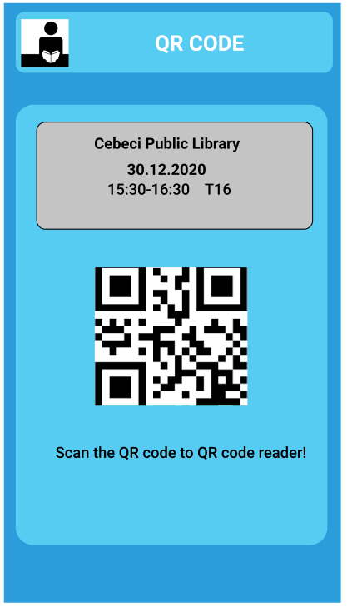
User Interface Design - Library Member

Slide 11
User Interface Design
Librarian Admin

Slide 12
Conclusion
As a result, we will be able to make reservations easily and quickly from the library we want with our project, which we developed by examined previous similar working.
In addition, since this application will be running on many operating systems, it will also appeal to a wide audience.

Slide 13
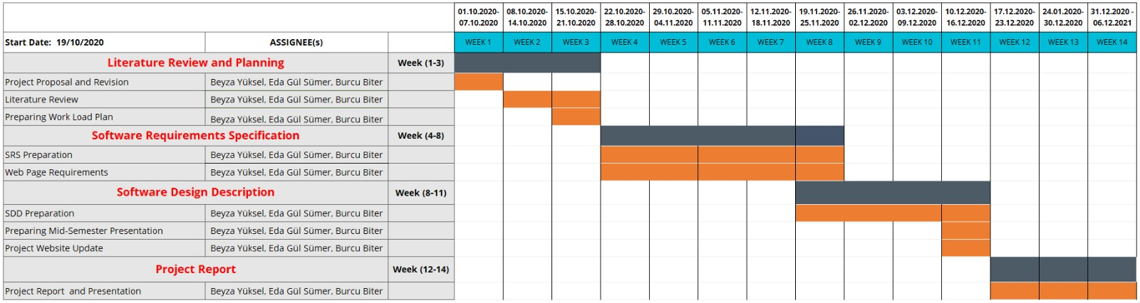
Work Plan

Slide 14
References
[1] Hong Kong University Science and Technology Library Blog https://library.ust.hk/blog/2010/11/15/my-account-for-mobile-devices/
[2] QR Codes for Study Room Booking System used by Hong Kong University Science and Technology Library https://www.youtube.com/watch?reload=9&v=8nY3_1Cl7PE
[3] ODEON E-Tickets https://www.odeon.co.uk/e-ticket/
[4] CDAS Mobile Application for IOS https://apps.apple.com/tr/app/mhrs-mobil/id589804718
[5] MHRS Mobile Application for Android https://play.google.com/store/apps/details?id=tr.com.innova.fta.mhrs
[6] UTS - Centre for Railway Information Systems https://apps.apple.com/in/app/uts/id1357055366
[7] QR Code for Train Ticket Booking https://www.irctchelp.in/qr-code-for-train-ticket-booking/

Slide 15
THANK YOU FOR LISTENING

