Slide 1

A Platform For Music, Book and Movie Recommendation
By
Yaren İpek
Enzel Ege Sarı
Pelinsu Serimer
Ege Varolgüneş
Advisor: Abdül Kadir Görür

Slide 2
CONTENTS
Introduction
Development
Work Plan
Conclusion

Slide 3
INTRODUCTION

Slide 4
Project Description
Building a platform which makes recommendations for music, books and movies

Slide 5
Motivation
People use recommender systems to find items that match their preferences. But they have to use different applications for different subjects.

Slide 6
Aim
Improving existing recommendation systems by combining three different systems into a single platform

Slide 7
Objective
Reducing the number of applications and time taken to get recommendations for three different subjects

Slide 8
DEVELOPMENT

Slide 9



Recommender System
Collaborative Filtering (CF) based methods use the ratings given by the users as the main source of the behaviors to make a recommendation.

Slide 10
Deep Learning
Convolutional Neural Networks (CNN) based recommendation is also a feed forward neural network like the MLPs but there are convolution layers and pooling operations included.
Restricted Boltzmann Machines (RBM) based recommendation method is a two layered neural network model

Slide 11

Web Development
REST (Representational State Transfer) is an architectural style which provides a fast client-server communication.
API (Application Programming Interface) is a set of definitions and protocols for building and integrating application software.

Slide 12

Mobile Development
Native development aims to develop software applications for use on a particular target platform or device. Major mobile development platforms are iOS by Apple, Android by Google, and others, such as Microsoft Windows phones or RIM Blackberry

Slide 13





Technologies Used
Vue.js
Spring Boot
postgreSQL
Kotlin
Tensorflow

Slide 14
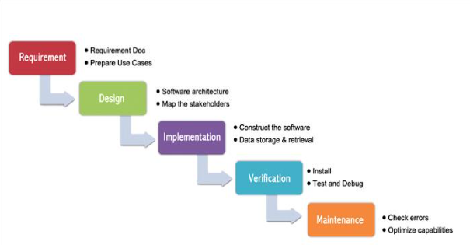
Development Methodology

Slide 15
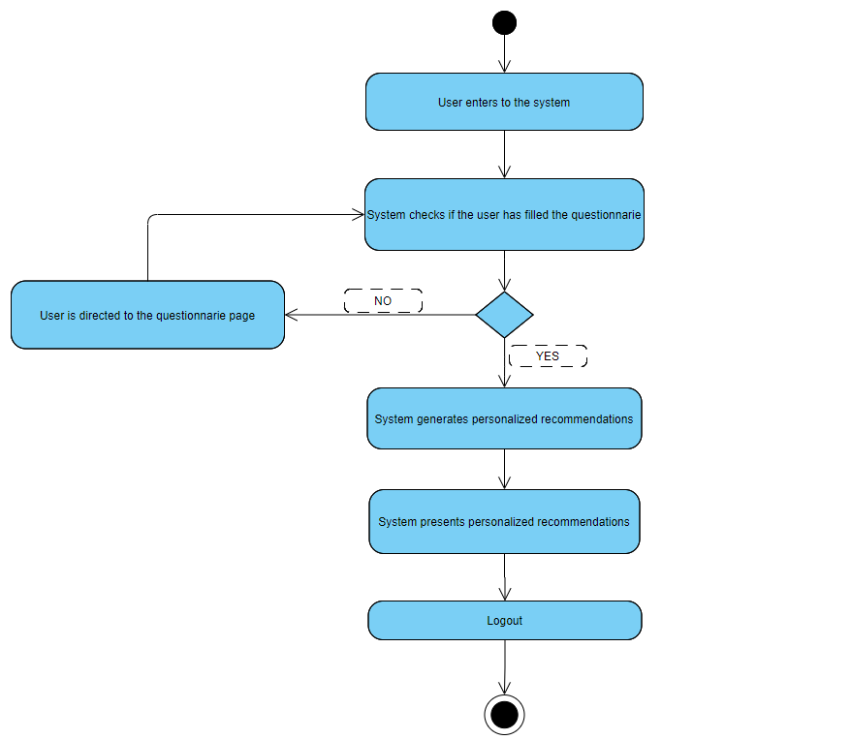
User
The user will use the platform to receive recommendations for any kind of music, books and movies, according to their preferences.

Slide 16
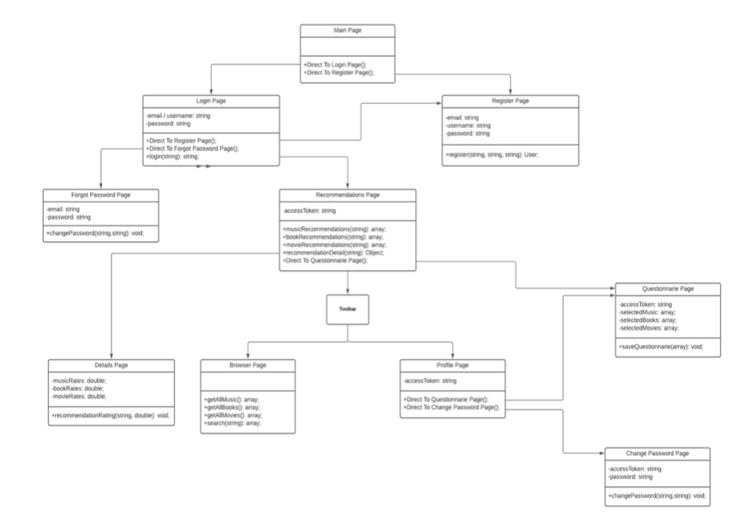

Slide 17
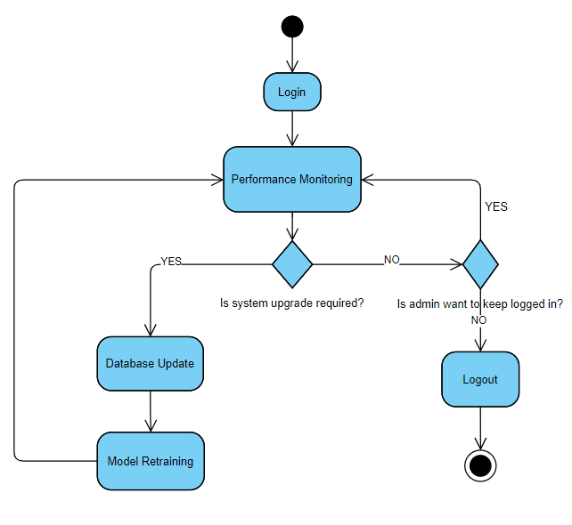
Admin
The admin will be responsible for observing the recommendation performances and maintaining the quality of the platform by operating necessary updates on the system.

Slide 18
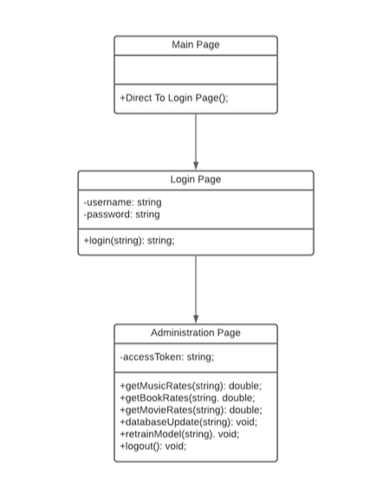

Slide 19
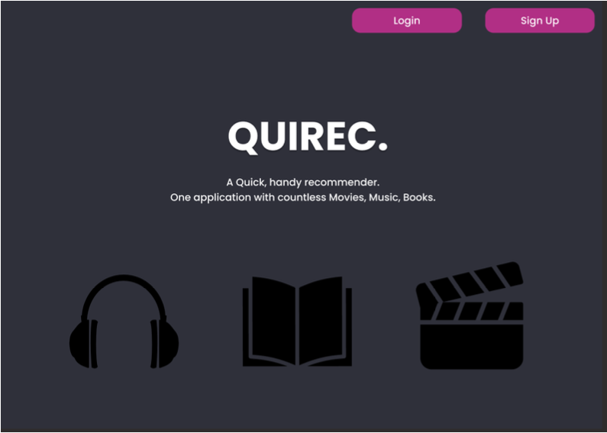

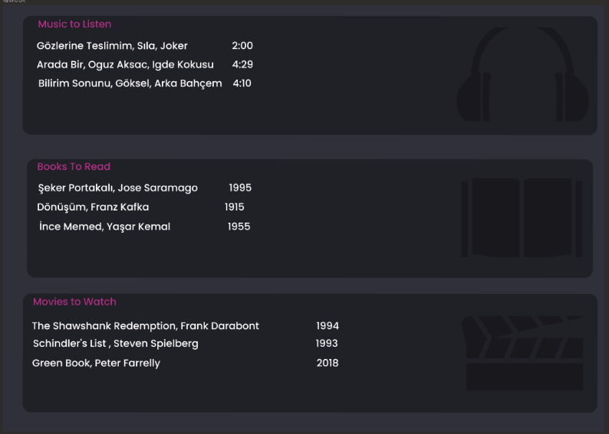
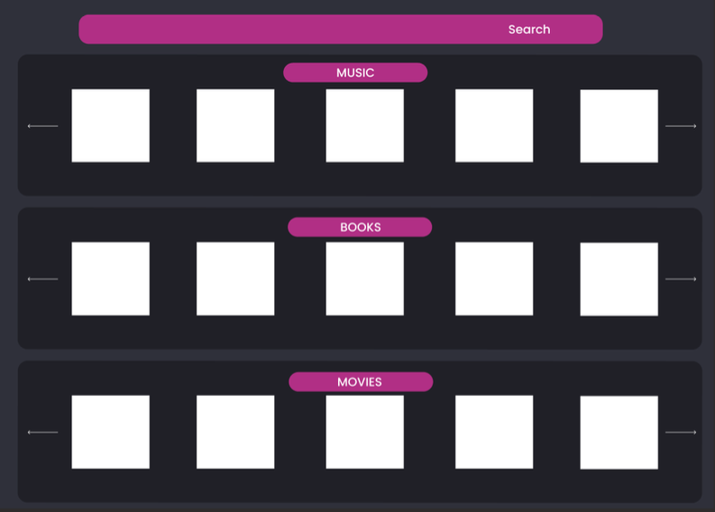
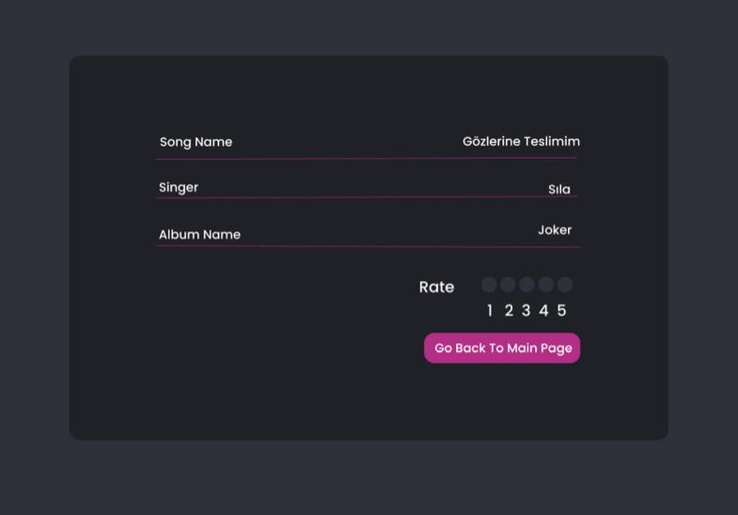
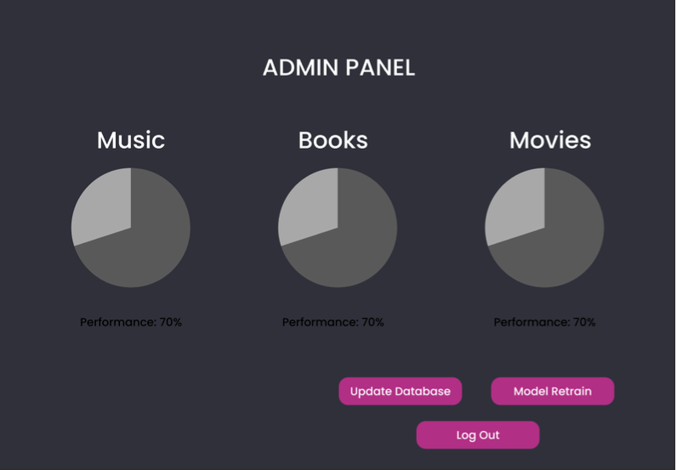
Preview

Slide 20
WORK PLAN

Slide 21
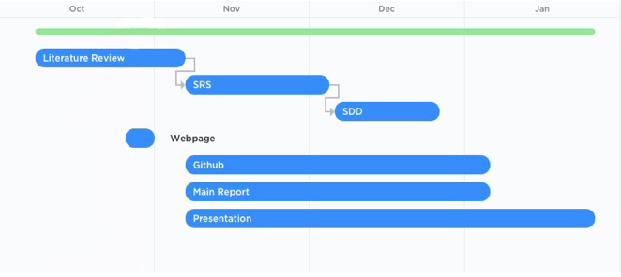

Slide 22
CONCLUSION

Slide 23
How QuiRec Will Recommend?
Get customer preference
Run the Recommendations through Recommender system
Make recommendations based on the preference

Slide 24
Expected Risks
Bugs, Application crushes -> BugFix
Low performance on recommender system -> Recommendation algorithm improvements

Slide 25
Success Criteria
Working and Stable Application
Correct Recommendations

Slide 26
Thank You!
Any Questions?

Slide 27
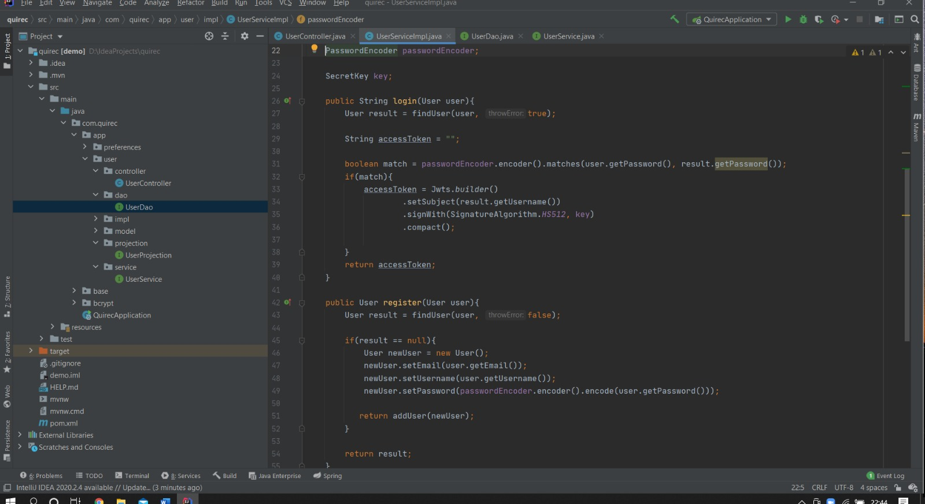

Slide 28
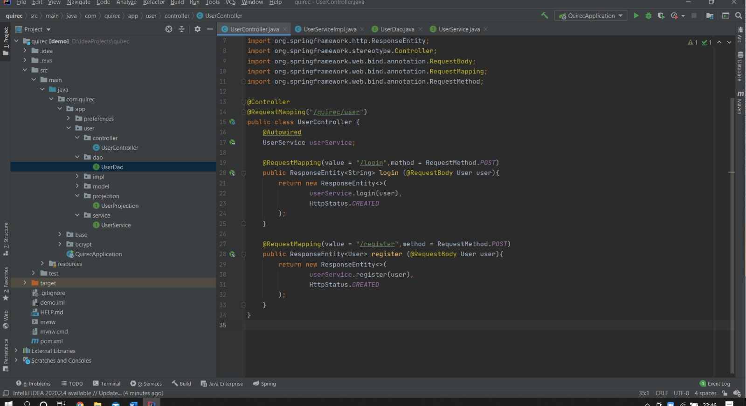

Slide 29
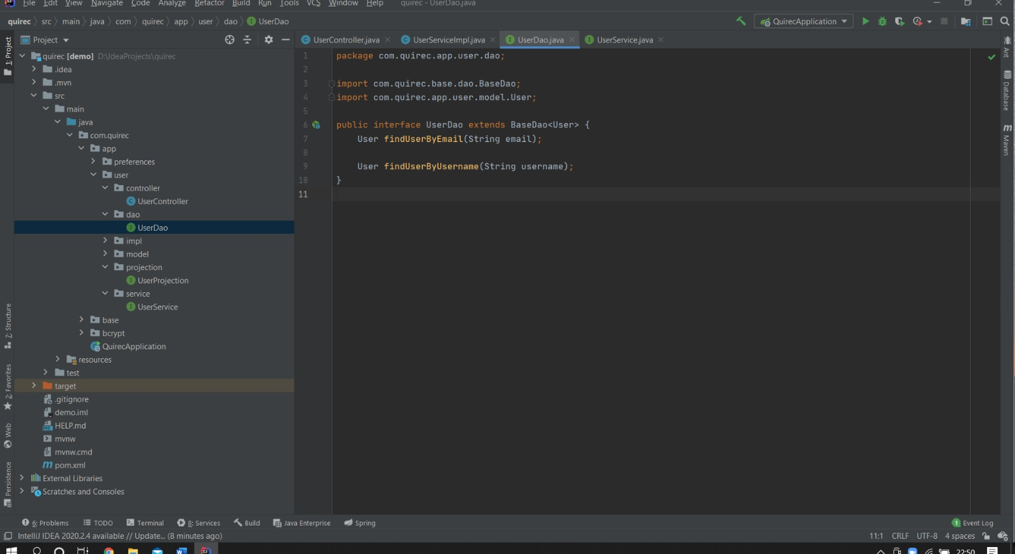

Slide 30
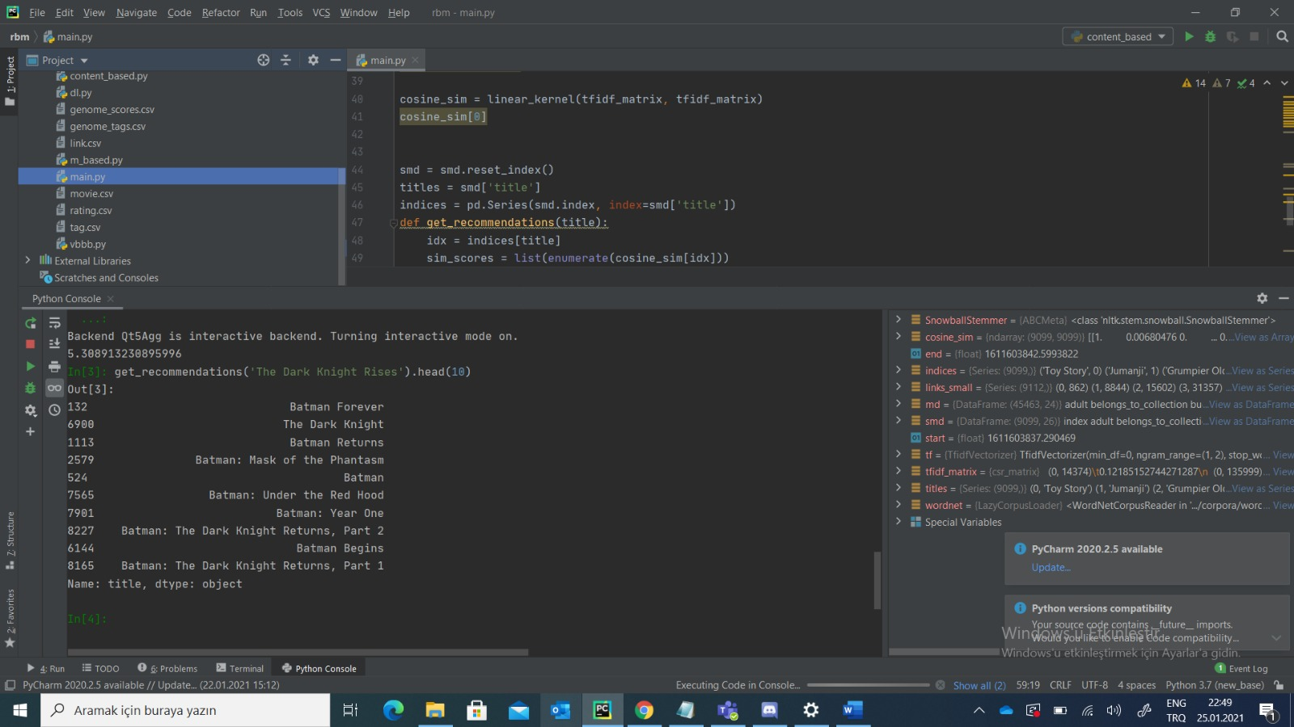

Slide 31
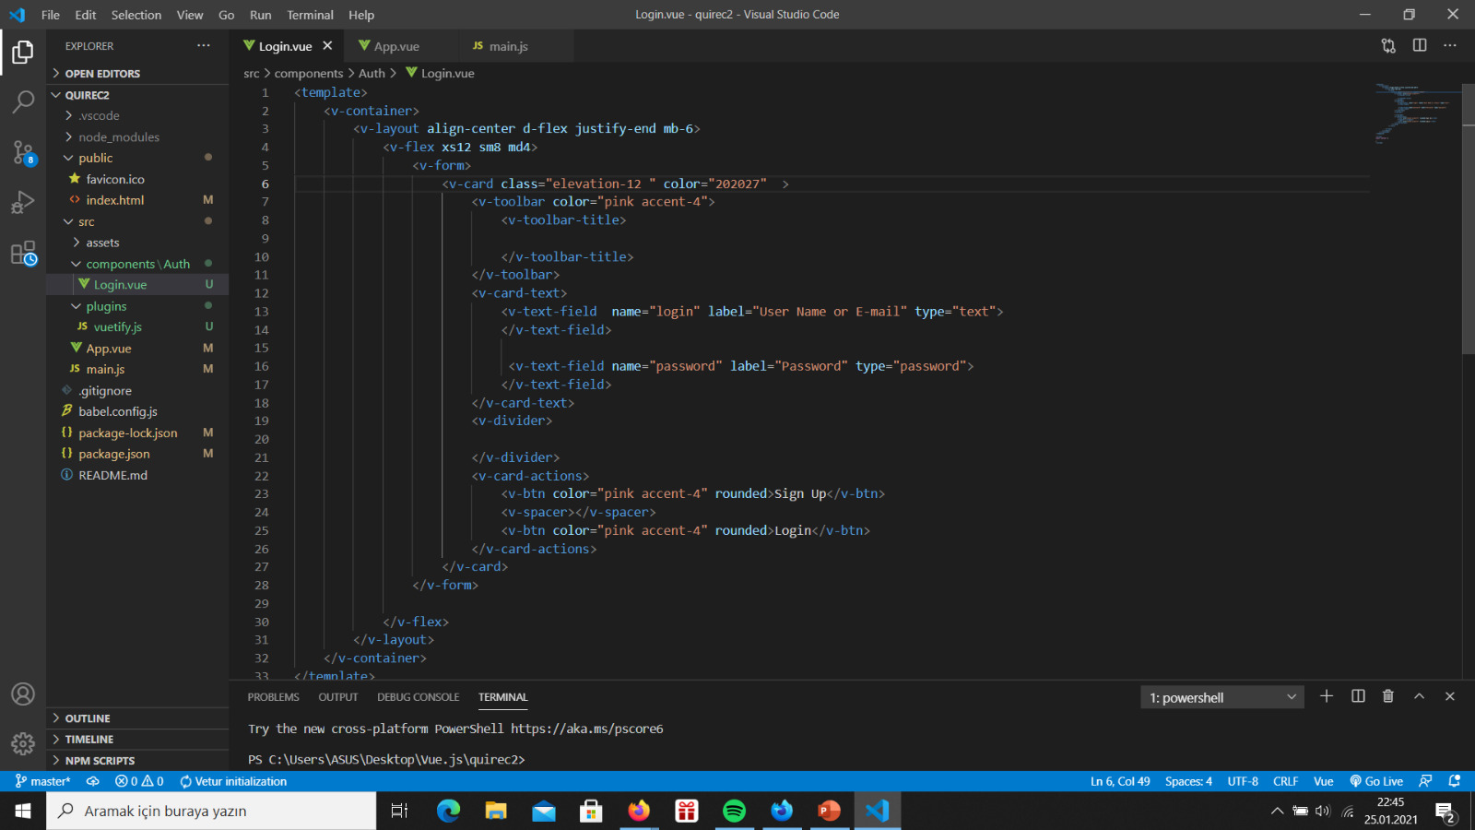

Slide 32
