Slide 1


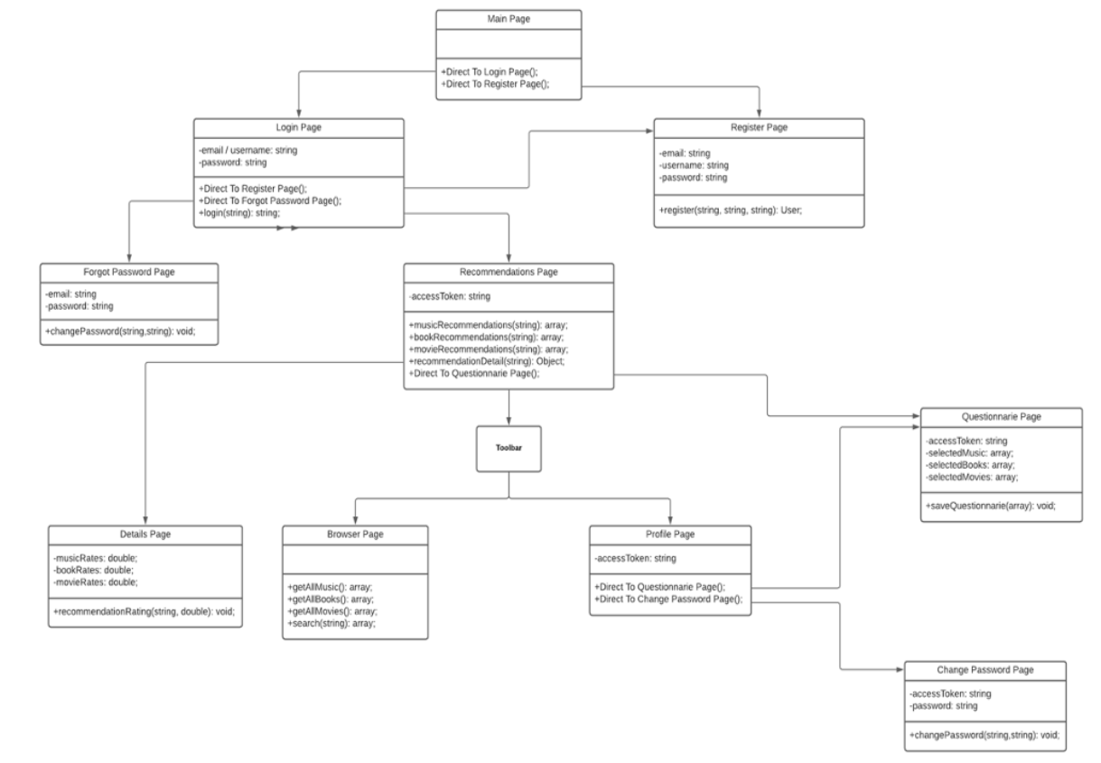
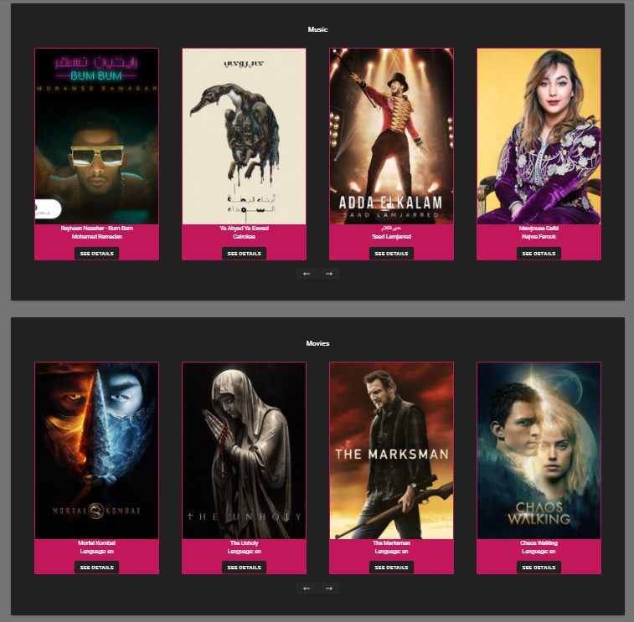
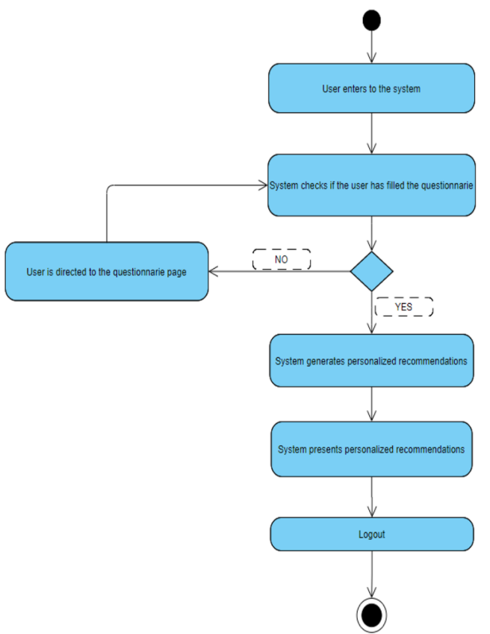
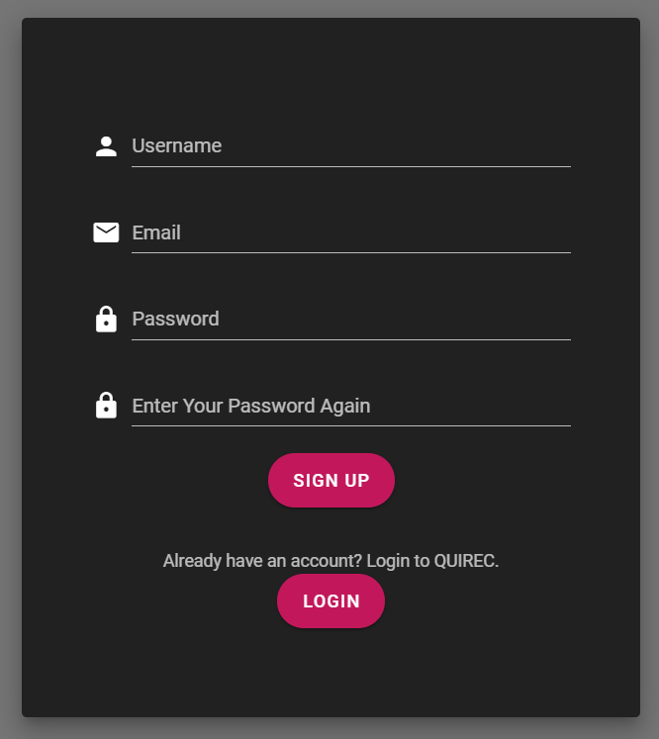
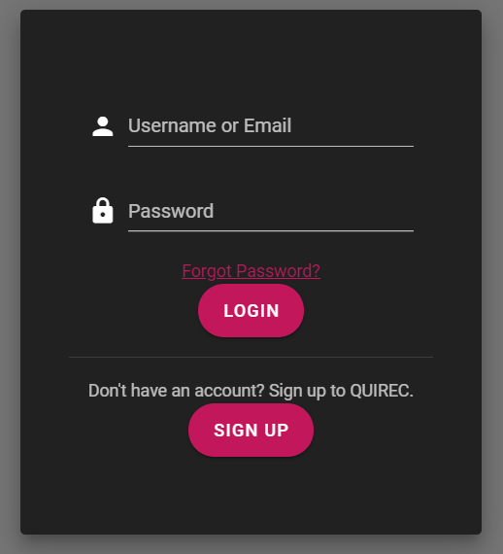
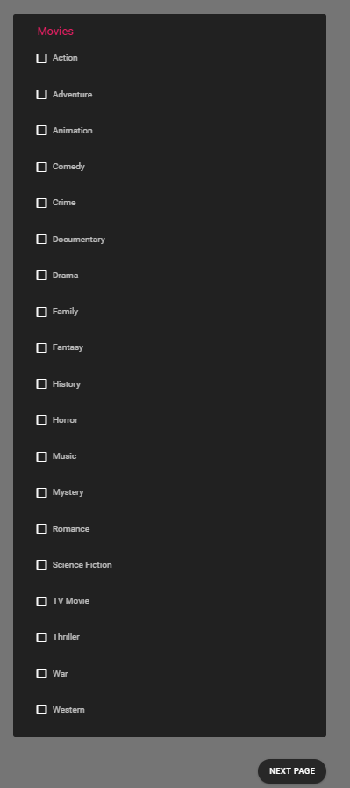
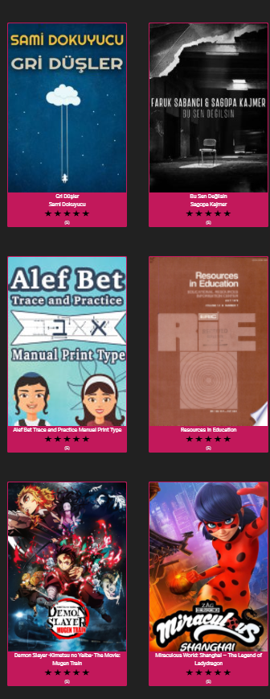
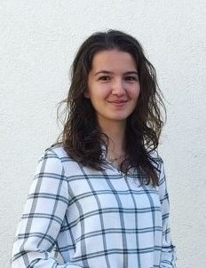
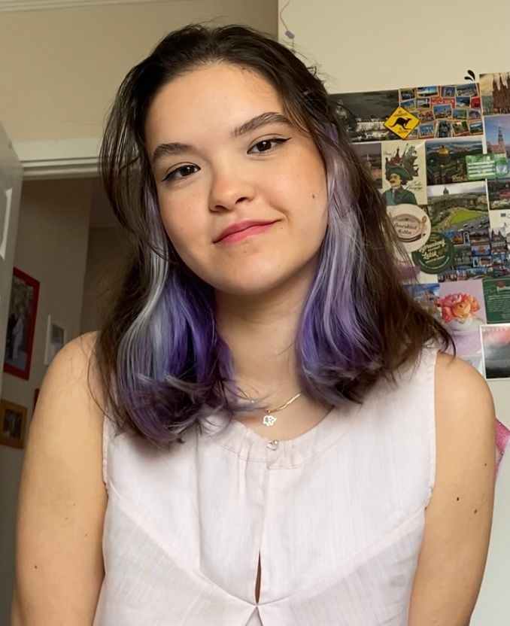

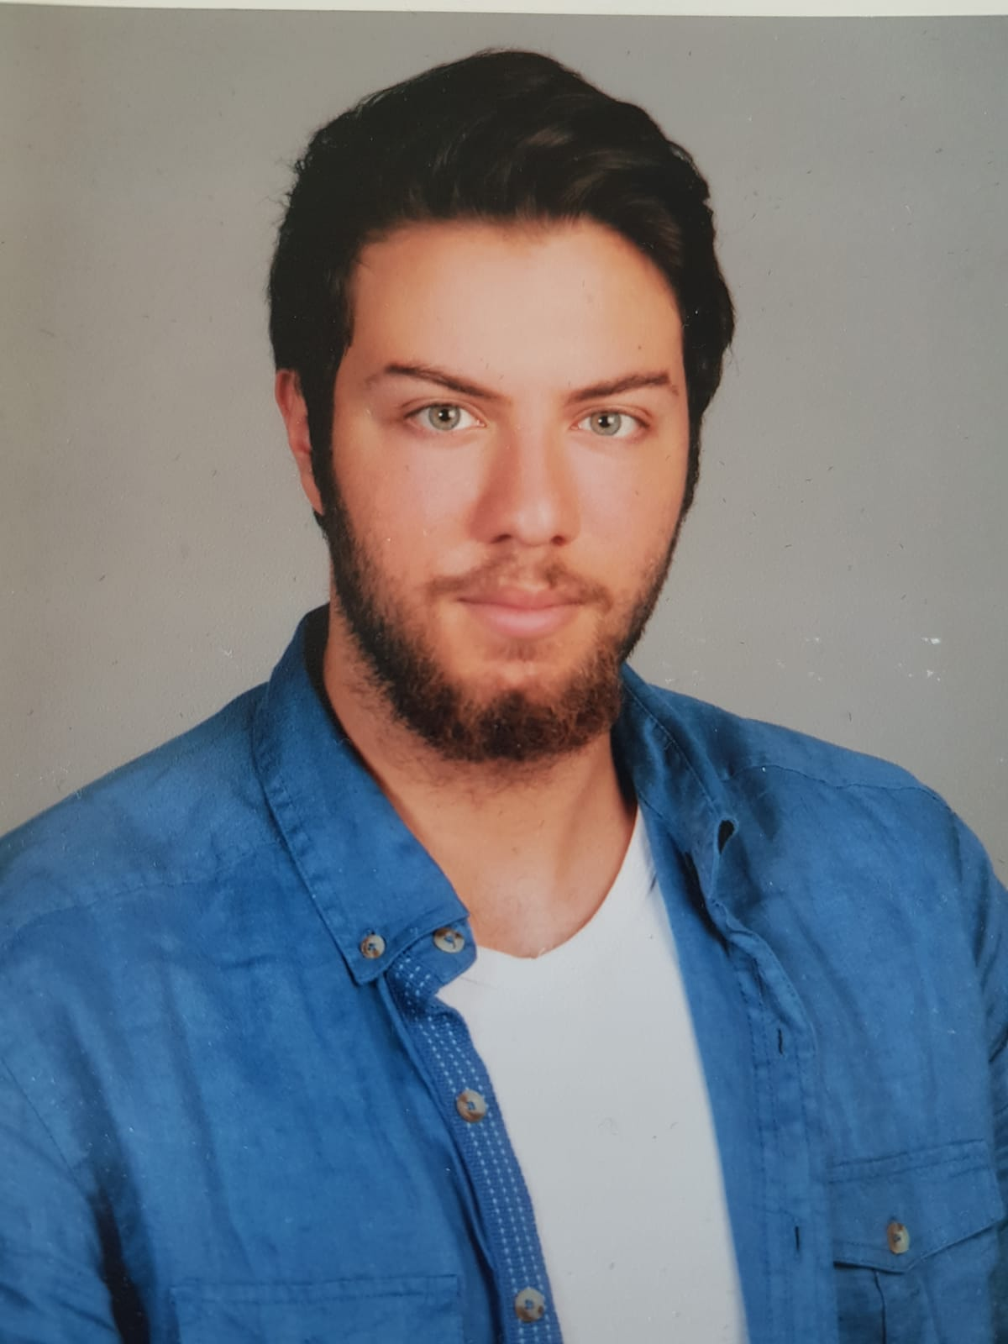
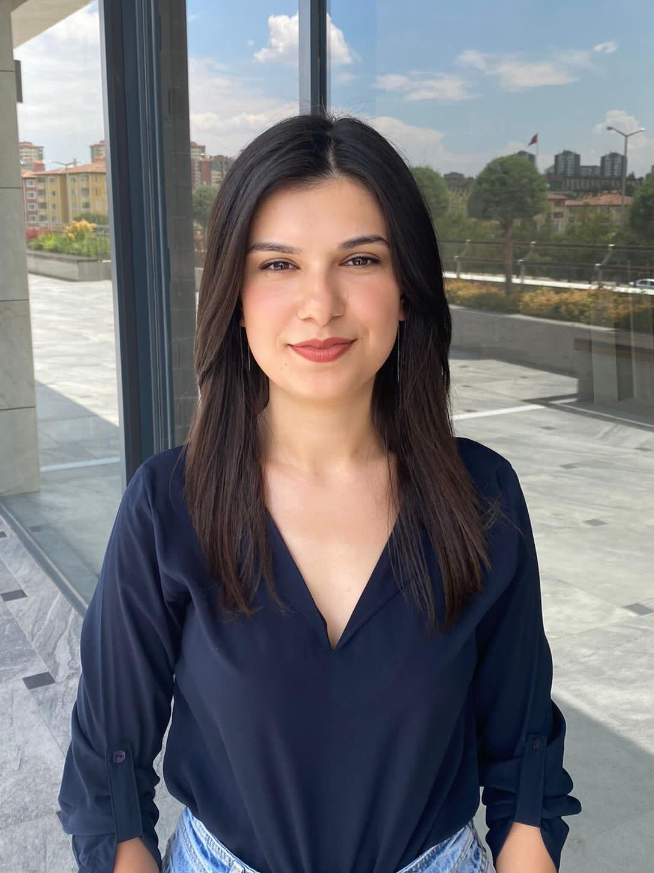
A PLATFORM FOR MUSIC
BOOK AND MOVIE RECOMMENDATIONS
Pelinsu Serimer – Ege Varolgüneş
Enzel Ege Sarı – Yaren İpek
Advisor: Dr. Abdül Kadir Görür
Çankaya University, Department of Computer Engineering
Abstract
Several modern recommender systems are developed to help users to devote more time to themselves by proposing relevant suggestions in the requested context. This project is designed with the aim of improving present recommender systems, by bringing multiple recommender systems which focus on different areas together in one platform.
Keywords: Software development, web application, recommender system
Figure 2 – Class Diagram
Figure 5 – Finished Product
Introduction
Since the recommender systems are in demand and gained importance through the industries, performance and time also became important. Currently, the users can get recommendations for books, movies and music from different platforms; which makes it hard for users to get fast suggestions. Using our recommendation platform, users will save the time spent to achieve recommendations to themselves.
Results & Conclusion
The popularization of different types of web services leads the recommender system concept to become popular and varied. Diverseness of the items that QuiRec presents will not only offer variety to the options proposed to the users, but also reduce the item searching period required by the users to find the right option. With the developed application, it is expected that the platform will be more appealing to users having different requests in context.
Figure 3 – Activity Diagram
Solution
The QuiRec project is a single recommendation platform developed as a web application for recommending music, books and movies to it's users according to their preferences and feedbacks. By combining these three components of recommendations, the time spent to achieve recommendations will be deducted significantly, compared to getting those recommendations from three different platforms and three different algorithms.
Acknowledgement
We would like to thank our advisor Dr. Abdül Kadir Görür for his acceptance of the group and the project, and substantial guidance through this project.
Figure 1 – Project Logo
Figure 4 – Finished Product
Figure 6 – Our Team

