Slide 1



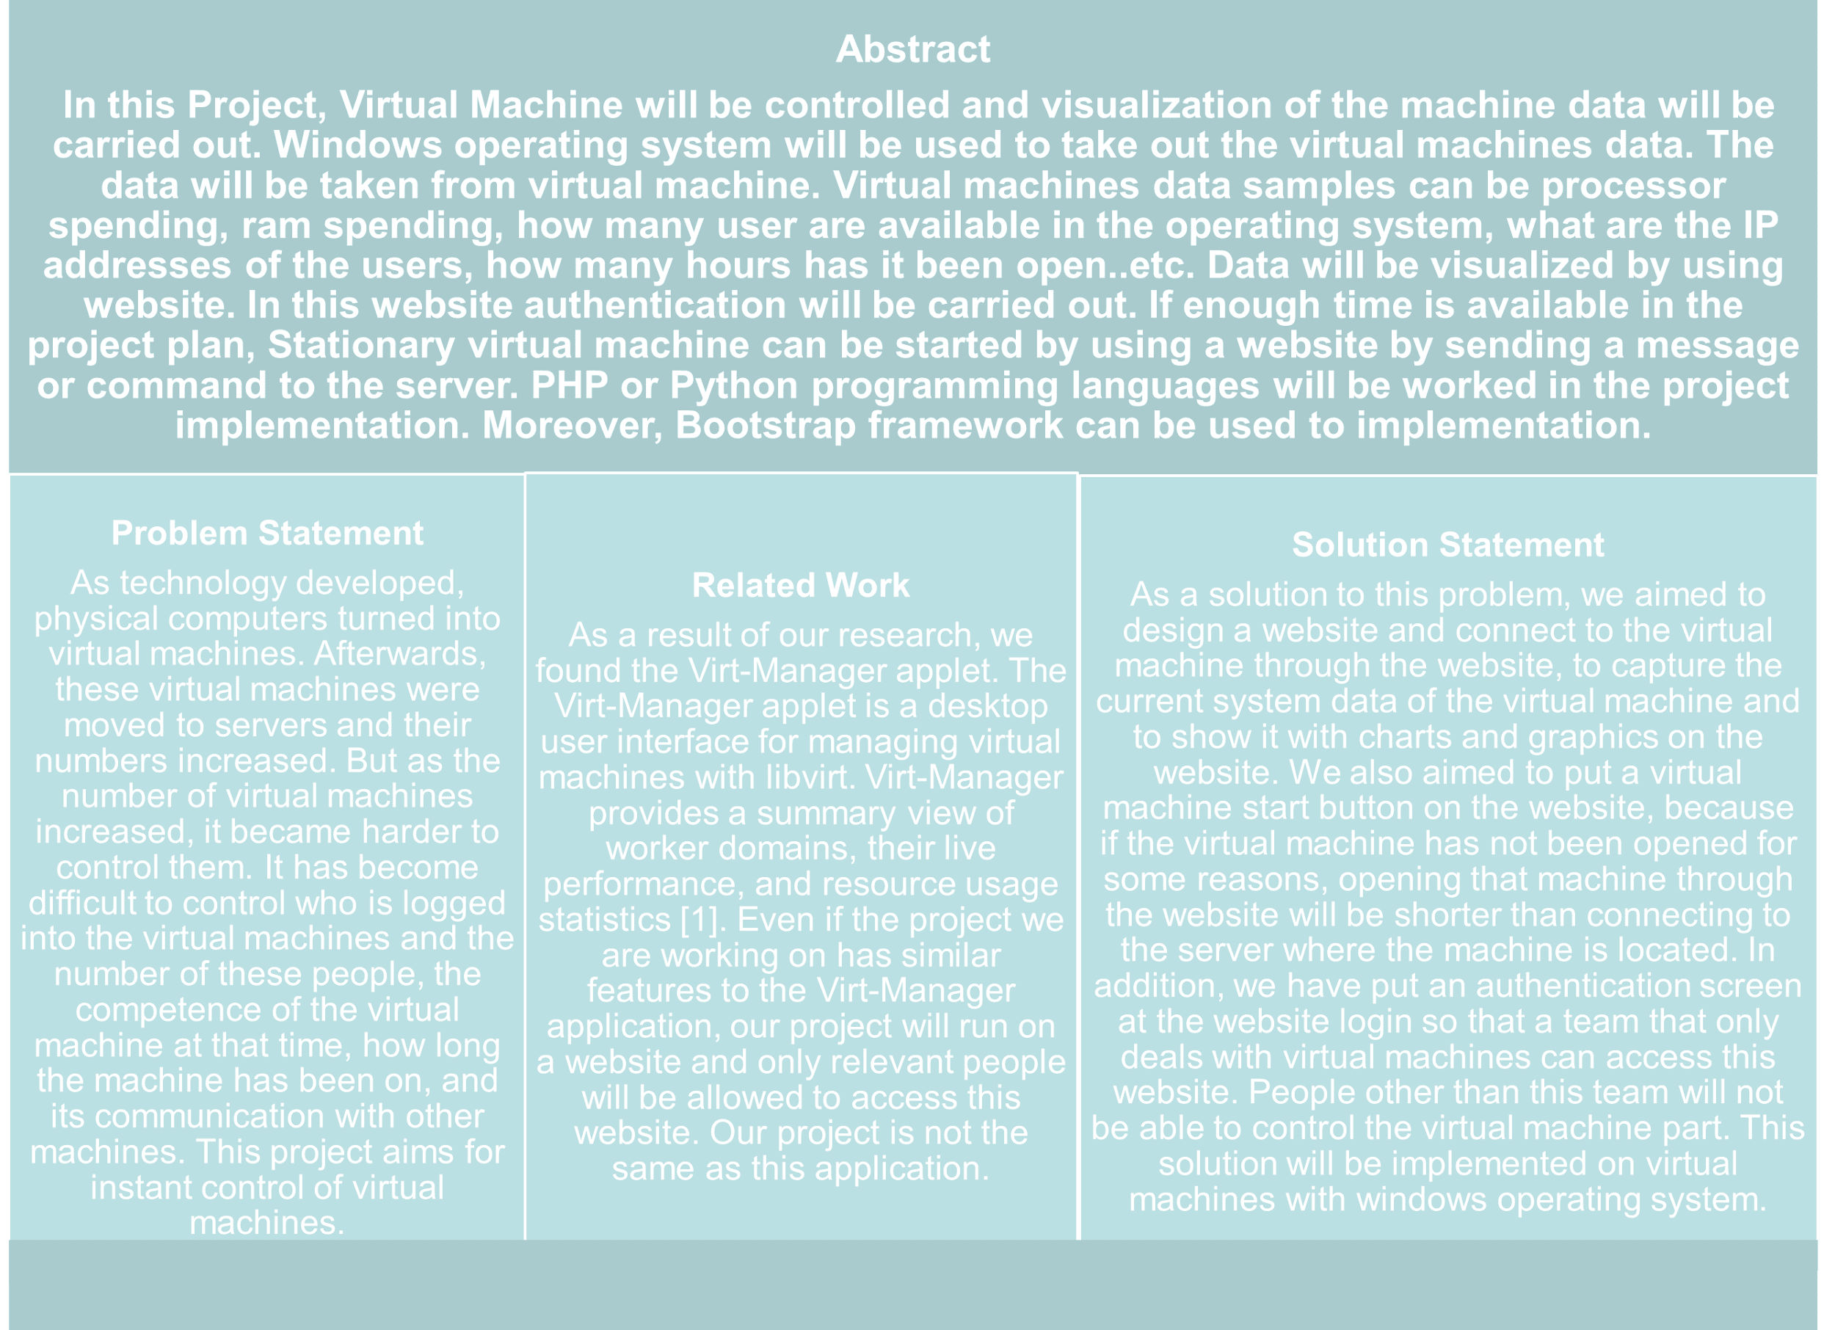
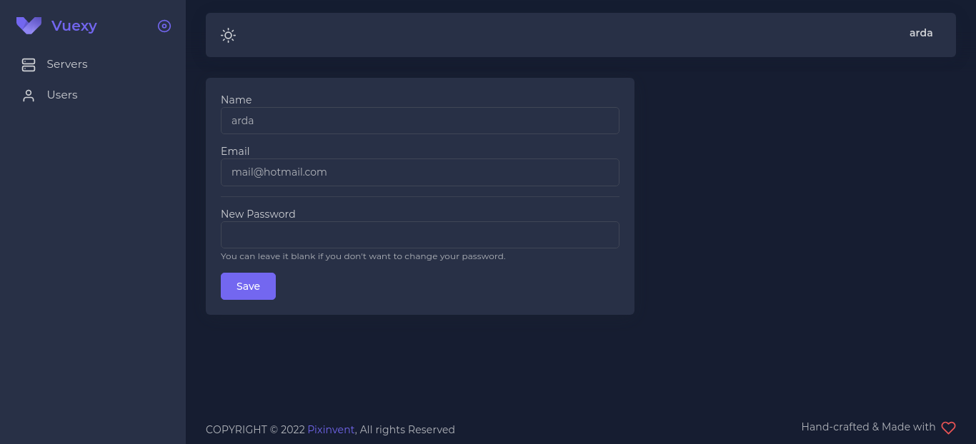
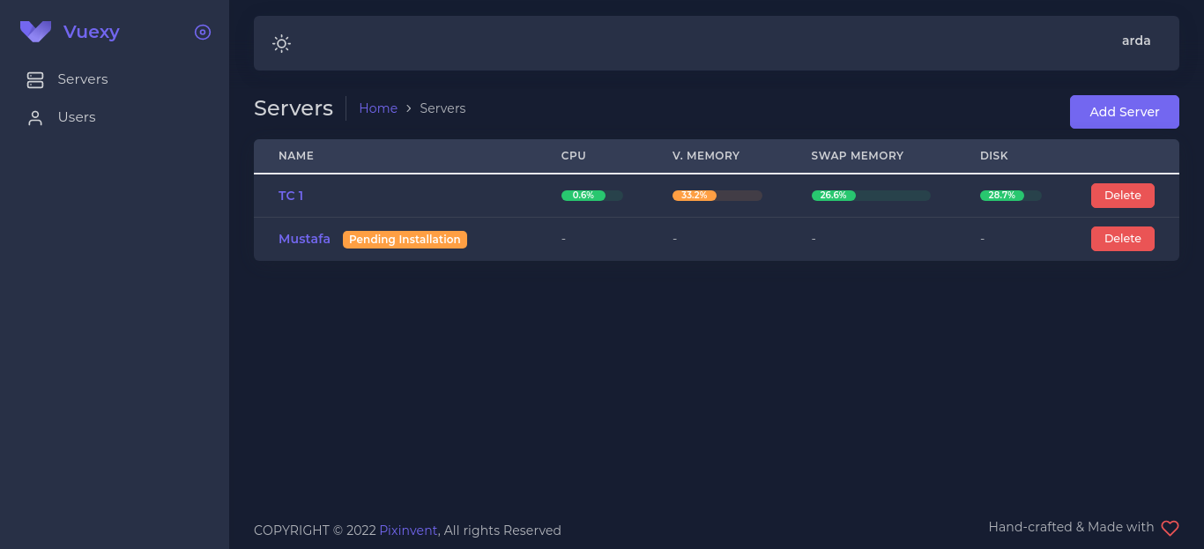
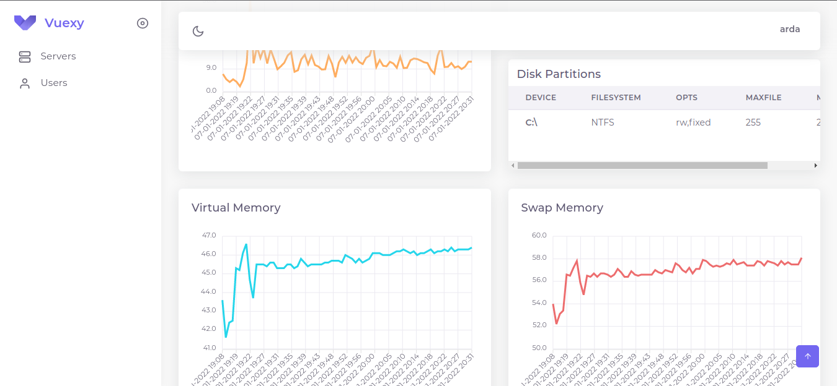
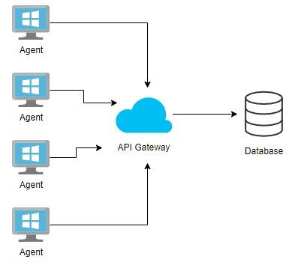
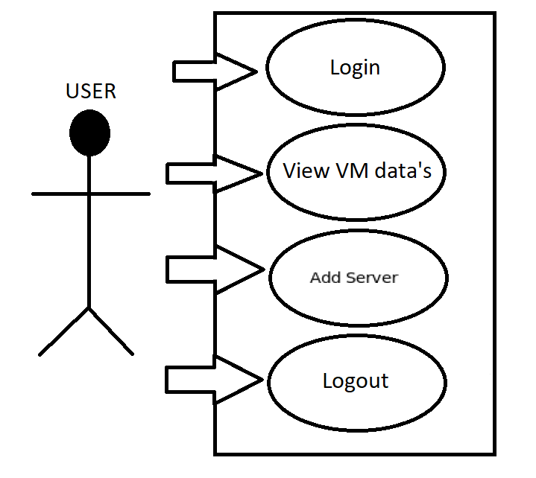

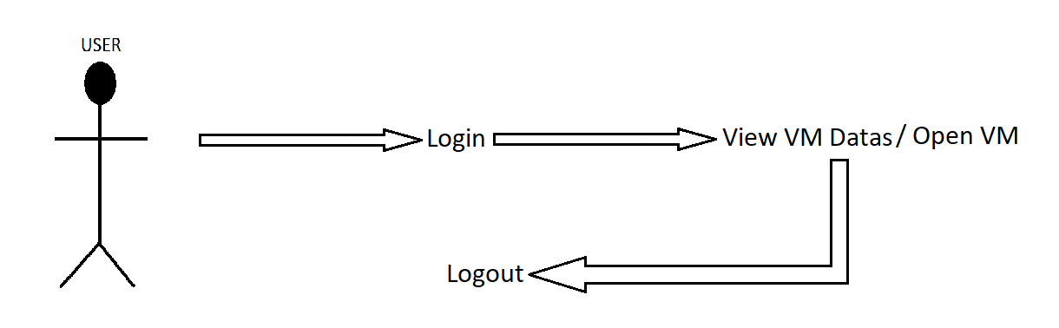
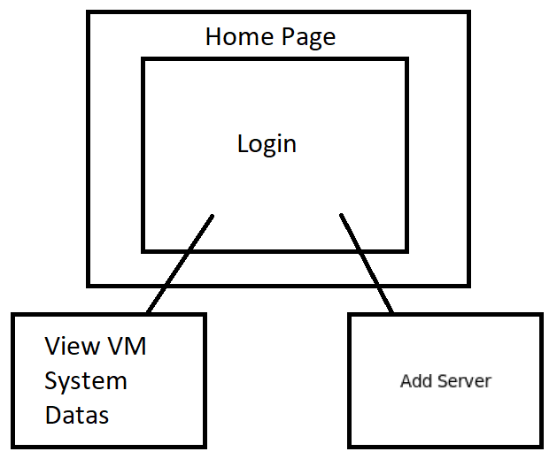
SYSTEM RESOURCE MONITORING AND VISUALIZATION
Füsun Funda AKAY, İbrahim Arda ACAR, Mustafa AYDEMİR and Abdül Kadir GÖRÜR
ÇANKAYA UNIVERSITY, FACULTY OF ENGINEERING, COMPUTER ENGINEERING DEPARTMENT
4.5.2.5. Dark Reset Password
4.5.2.7. Dark After Login Home Page
4.5.2.10. VM Datas
4.6. Process Design
1.Use Case
2.Sequence Diagram
TERM | DEFINITIONS
USER | Right to login to the website.
SRS | Software Requirements Specifications
IEEE | Institute of Electrical and Electronics Engineers
VMI | Virtual Machine Introspection
FRONT-DEN | BACK-END
HTML5 | PHP(To be determined)
CSS3 | Redis Cache
Javascript | Laravel
jQuery | Laravel Telescope
Vue.js | Laravel Horizon
ApexCharts Addition | Laravel Livewire
Vuexy Template
TERM | DEFINITIONS
User | Right to login to the website.
SDD | Software Design Description
IEEE | Institute of Electrical and Electronics Engineers
REFERENCES
FRONT-END | BACK-END
HTML5 | PHP
CSS3 | Redis Cache
Javascript | Laravel
jQuery | Laravel Telescope
Vue.js | Laravel Horizon
ApexCharts Addition | Laravel Livewire
Vuexy Template
4.5.1. Navigation
[1]. Manage virtual Machine Consolidation in Cloud Computing Systems, Sustainable
: 10.1016/j.suscom.2021.100524, https://www.sciencedirect.com/scienchttps://www.sciencedirect.com/scienc https://www.sciencedirect.com/scienc e/article/abs/pii/S2210537921000172
[3]. User Guide, Introduction to the Administration Panel, https://docs.cs-cart.com/latest/user_guide/admin_panel.html#:~:text=The%20Administrat
ion%20Panel%20(or%20the,store%20and%20do%20much%20more.
[4]. Temere, Befekadu, Responsive Web Application Using Bootstrap and Foundation, 01 June 2017, https://www.theseus.fi/bitstream/handle/10024/1305
24/Befekadu_Temere.pdf?sequence=1&isAllowed=y, https://www.theseus.fi/handle/10024/130524
[5]. 46 Free Bootstrap Admin Dashboard Templates For Your Web App 2021, https://colorlib.com/wp/free-bootstrap-admin-dashboard-templates
[6]. James E. Smith, Ravi Nair, Description in: Virtual Machines Versatile Platforms for Systems and Processes A volume in
The Morgan Kaufmann Series in Computer Architecture and Design, 2005, DOI: 10.1016/B978-1-55860-910-5.X5000-9, https:
//www.sciencedirect.com/book/9781558609105/virtual-machines#book-description
[7]. W. Chen, F. Guo, Fei-Yue Wang , A Survey of Traffic Data Visualization, IEEExplore, Volume: 16, Issue: 6, Dec. 2015,
DOI: 10.1109/TITS.2015.2436897, https://ieeexplore.ieee.org/abstract/document/7120975?casa_token=xc0vZNy_AVYAAAAA:u9yR02_
FmWz7VoWWnnWNn1G9RELNu5JV-yMf5t6QQq8kh4-M1BBbMdiAKQuPWTfY68-gysjAOQ
[8]. S. Çelik, E. Akdamar, Büyük Veri ve Veri Görselleştirme, Akademik Bakış Uluslararası Hakemli Sosyal Bilimler Dergisi, Volume , Issue 65, Pages 253 – 264, Year 2018,
https://dergipark.org.tr/en/pub/abuhsbd/issue/36059/404871
[9]. R. Vallat, E. Combrisson, J.-B. Eichenlaub, C. O'Reilly, T. Lajnef A. Guillot, P. Ruby, K. Jerbi , Sleep: A Python Open-Source
Software For Visualizing and Scoring Sleep Data, Sleep Medicine, Volume 40, Supplement 1, December 2017, Page e333,
DOI: 10.1016/j.sleep.2017.11.979, https://www.sciencedirect.com/science/article/abs/pii/S1389945717314120
[10]. Vuexy VueJS & Vue + Laravel Admin, 2021, https://pixinvent.com/demo/vuexy-vuejs-admin-dashboard-template/landing
[11]. Y. Hebbal, S. Laniepce, Jean-Marc Menaud, Virtual Machine Introspection: Techniques and Applications, IEEExplore, 24-27 Aug. 2015, DOI:
10.1109/ARES.2015.43, https://ieeexplore.ieee.org/document/7299979
[12]. https://standards.ieee.org/standard/1016-1998.htmlmachines with virt-manager, https://virt-manager.org
[2].R. Zolfaghari, A. Sahafi, A.M. Rahmani, R. Rezaei, Application of Computing: Informatics and Systems, Volume 30, June 2021, 100524,
DOIVirtual
.

