Slide 1
Creating a website with bootstrap
Project Members : Füsun Funda AKAY
İbrahim Arda ACAR
Advisor : Asst. Prof. Sibel Tarıyan Özyer

Slide 2
Contents
Project Description
Motivation
Problem
Analysis
Solution
Solution Flowchart
Advantages and Disadvantages
References

Slide 3

Project Description
Creating an admin panel and editing the analysis of the entered data with bootstrap.
[9]

Slide 4

Motivation
We are last class computer engineering students who are learning to make a more beautiful website using Bootstrap technology. In our project called "Create a website with Bootstrap", we aimed to free the data from complexity and to observe it in a more visual way.[5]
[8]

Slide 5

Problem
Understanding data is a big problem. If the data is misunderstood, it can be difficult to undo this mistake. Companies, schools, governments, markets, hospitals, etc. All institutions generally do their work based on data. This project will present the data with graphs and charts, reducing the difficulty of understanding the data.
[5]
[1]

Slide 6

Analysis
By this time, many companies have not been able to make the right decisions because they misunderstood the data.
[7]

Slide 7




Solution
Our solution is to collect all the data of the company on the website and the website shows this data to managers in a more understandable way using charts and graphs.
Technology Used: *Mssql
*Visual Studio
*Visual Studio Code
*Bootstrap
[6]
[4]
[2]
[3]

Slide 8
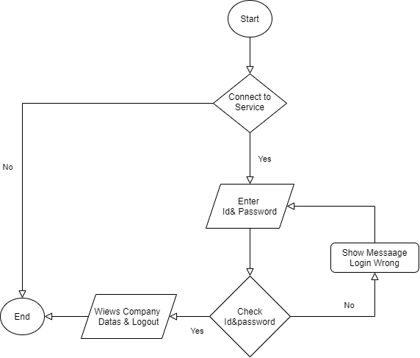
Solution Flowchart

Slide 9
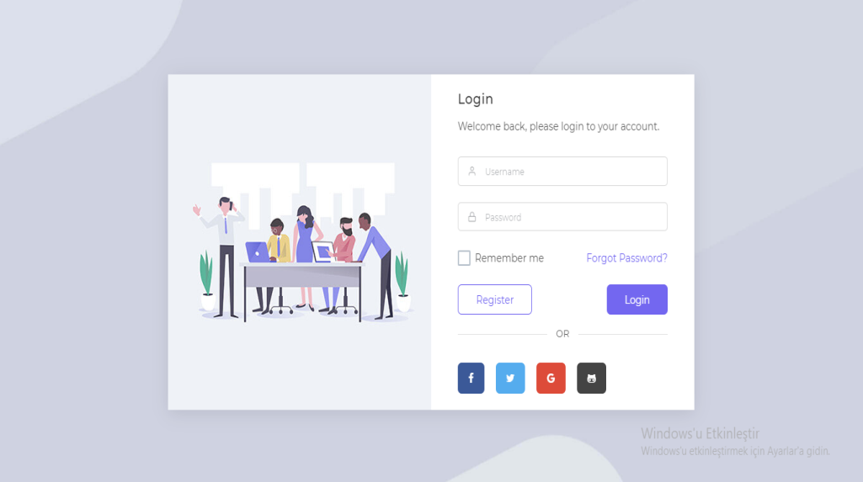
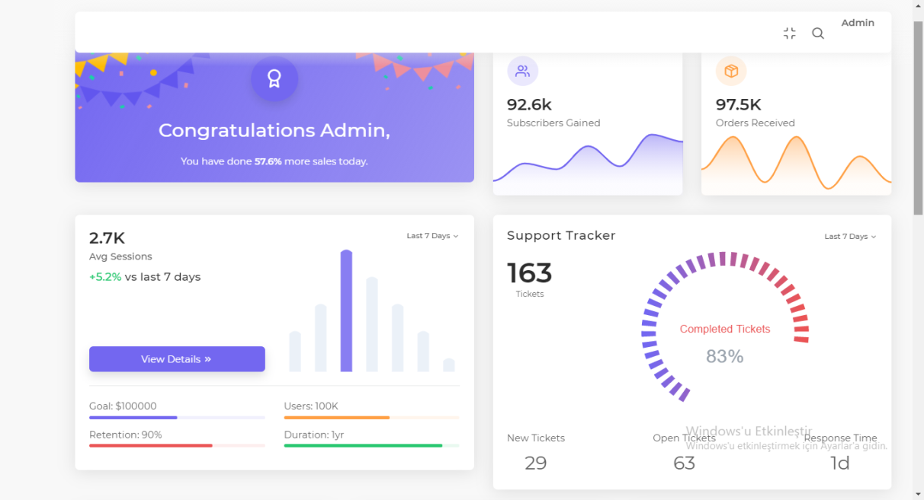
PREVİEW
Login Page
[5]
Index Page
[5]

Slide 10
Advantages and Disadvantages
Advantages
Disadvantages
The readability of the data will be easy and this will save time.
The project makes it easier for people to understand the data, but if the necessary protections are not taken, the data will reveal itself directly.

Slide 11
References
[1]. http://www.avrasyabir.org/kafasi-karisik-bir-adam/
[2]. https://seeklogo.com/vector-logo/274066/visual-studio
[3]. https://seeklogo.com/vector-logo/323431/visual-studio- code
[4]. https://dataera.com.tr/solutions/mssql/
[5]. https://github.com/CankayaUniversity/ceng-407-408-2020-2021-Creating-a-website-with- Bootstrap/blob/main/Ceng_407_Project_Report.docx?raw=true
[6]. https://medium.com/@sercanuygur/learn-bootstrap-4-in-10-min-9b8cfd29e96f
[7]. https://www.opexengine.com/are-you-dying-by-the-hands-of-analysis/
[8]. https://www.discprofiles.com/blog/2012/03/motivation-and-the-disc-profiles/#.YA_O8v0zbIU
[9]. https://barn2.co.uk/woocommerce-short-description/
http://cengproject.cankaya.edu.tr/wp-content/uploads/sites/10/2017/09/Project_Presentation_Long.pptx

