Slide 1


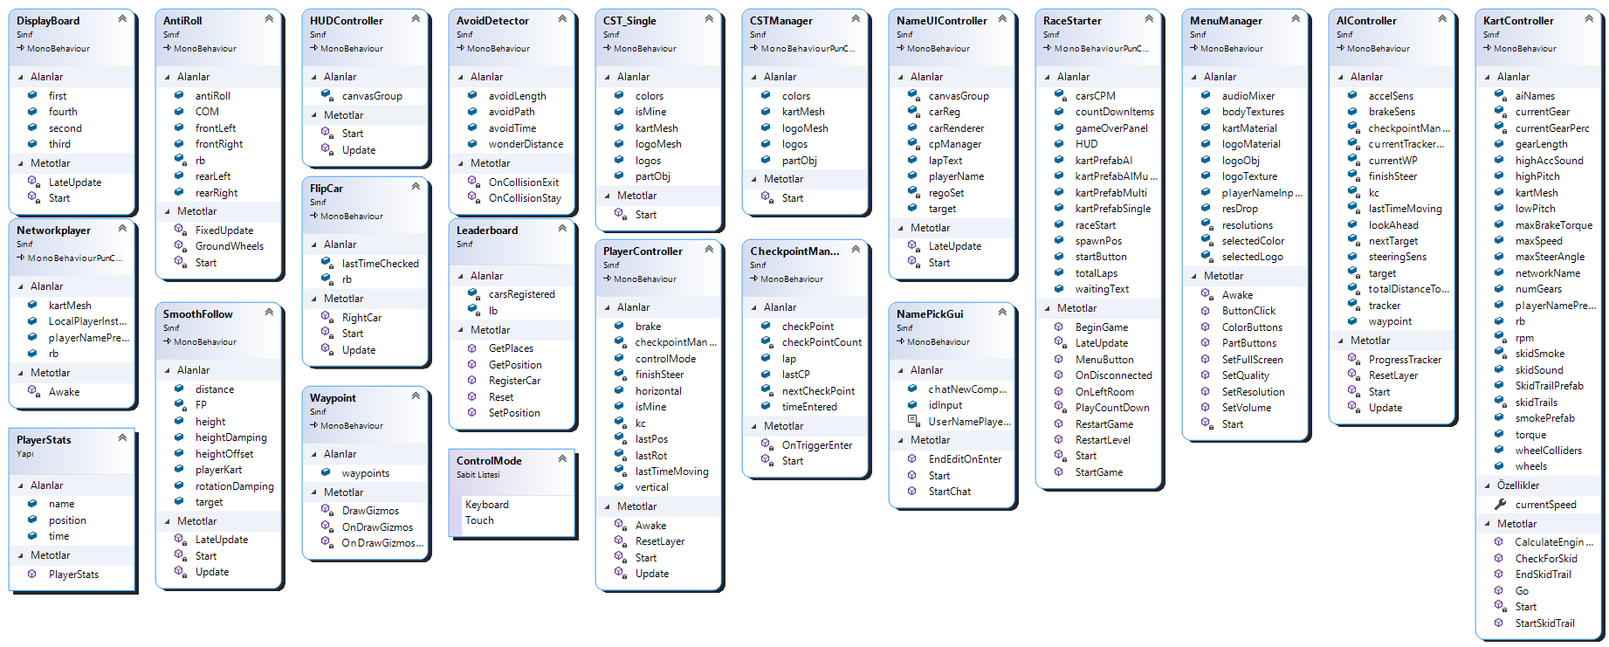
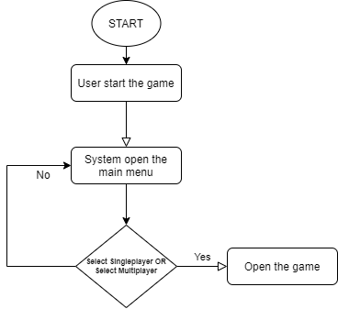
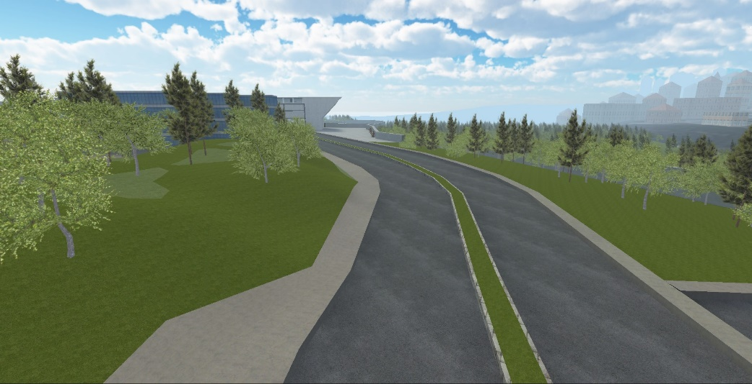
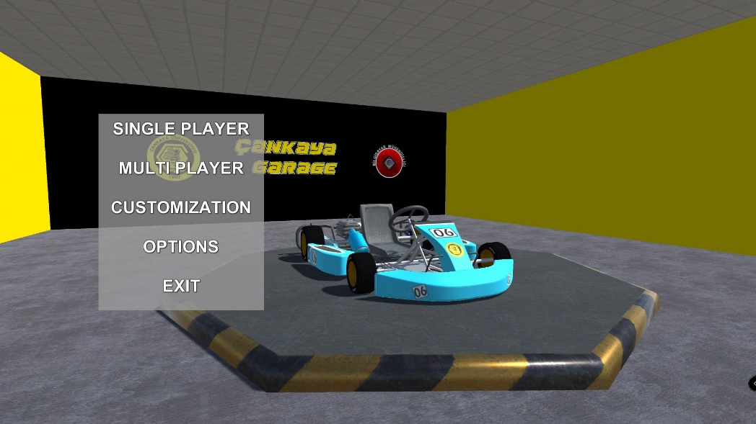
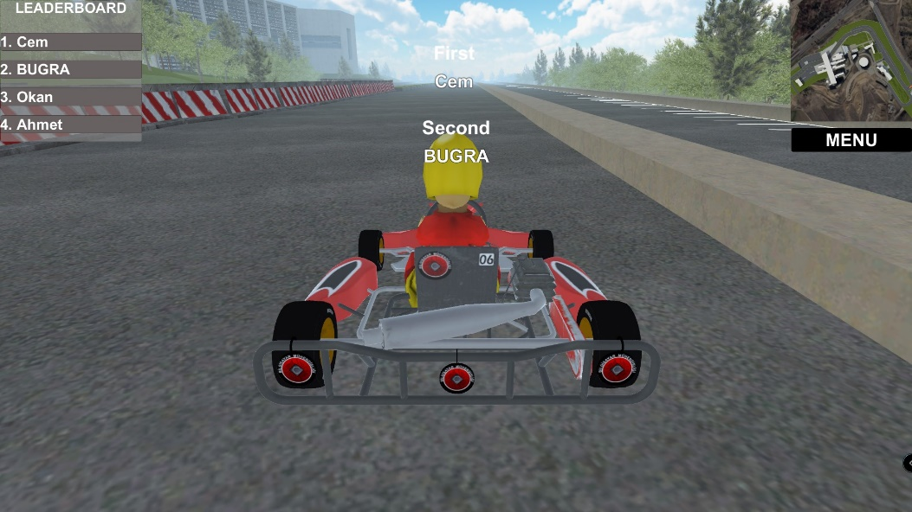
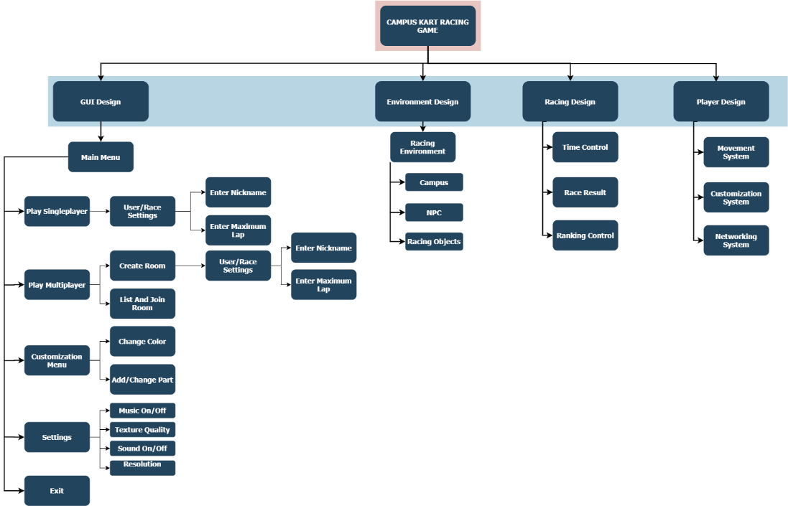
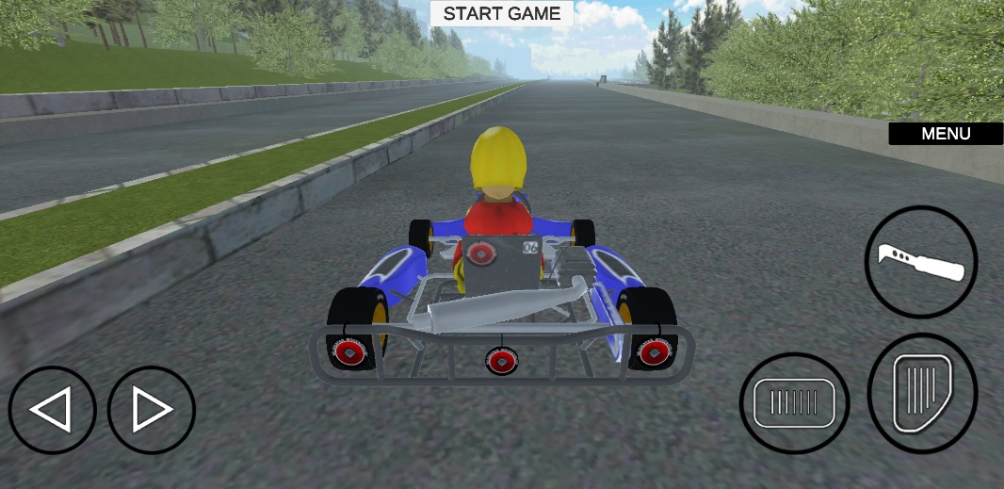

CAMPUS KART RACING GAME
Ozan Çetiner - Esra Şahin –
Buğra Doğan - N.Cem Altunbulduk
Murat Saran
Çankaya University, Department of Computer Engineering
Abstract
Today, the video game industry has become one of the biggest sources of entertainment for people. The gaming industry has surpassed many industries and has generated $150 billion in revenue in 2020. This means a significant increase of 9.3% according to 2019 data.Many game development companies want to keep their income level at the highest level by releasing their games with cross-platform and online features. Today, hundreds of games provide cross-platform support. 56% of the players prefer to play games online. And they spend an average of 7 hours playing with others online – an hour more than playing in person. In this review aims to inform multiplayer racing games, artificial intelligence in games, game engines and cross platform games.
Keywords:
Computer and Mobile games, Car Racing Games,Cross Platform Games,Online Games,Multiplayer and Singleplayer Games,Game Engines,Artificial Intelligence,Networking,C#
Figure 2 - Flowchart
Figure 2 – Class Diagram
Introduction
The racing game is a type of video game in which players compete with land, air or sea vehicles. The history of racing games in the world dates back to the 1980s (such as Spy Hunter series (1983), Autoduel (1985)) and has always been the focus of attention. With the advent of computer technology, computer games have also gained an important place in our lives. It has even become an integral part of everyday life for many people. As computer languages, internet and visual effects developed over time, computer games were made realistic and more complex.These games, which started to be of higher quality, attracted the attention of wider audiences. A game that comes to mind when it comes to computer games and has the largest player mass in the world is racing games. Among these games, the most popular and one of the oldest games is the car racing game.
The Turkish game market is developing slowly and opening up to the world. A few top selling companies have built their expertise on combat, RPG or action. However, there has not been much work done on racing games yet. By evaluating this gap, we want to bring an untouched genre to the sector and to create a fun competition environment among universities for domestic users.
This article explores the dynamics of racing games and important sub-issues that need to be developed to make a racing game. At the same time, the article highlights the reasons for choosing the right game engine and why cross platform games are preferred.
Figure 3 – Flowchart
Figure 7 – Finished Product
Results & Conclusion
In this project, while choosing the map, we thought that a racing game on our campus would attract attention. Thus, we aimed to increase the interest in the game. We have tried to keep the number of 3D model polygons very low, as we will release our game to both mobile and computer platforms. We used the 3Ds Max program for 3D modeling. We used the Unity game engine for this project. The point of doing this is to have high availability and to mess with Unity before, albeit arbitrarily. Since we chose the Çankaya University campus as the map in our game, we tried to make the environment models as similar as possible. Thus, we aimed to increase the visual pleasure. For a smooth gaming experience, we put specific game settings on each computer. We also brought additional features such as vehicle customization, leaderboards for greater adoption of the game. We preferred servers close to our country for the multiplayer mode. Finally, because our game is single and multiplayer, players can play against their friends or AI powered NPCs..
Solution
The system consists of a main component and this component has its own subsystem. GUI design enables interaction between player and system. We aimed to increase the user's interaction with the game by using the GUI system. The player can customize his game and vehicle. He can adjust settings such as resolution, texture quality, and also change the color of his vehicle or add new parts. There are two modes in the game, single player and multiplayer.
Figure 4 – Finished Product
Figure 5 – Finished Product
Acknowledgement
We thank our advisor Murat SARAN for assistance during the development of the project.
Figure 6 – Finished Product
Figure 1 – Modularization of System

