Slide 1
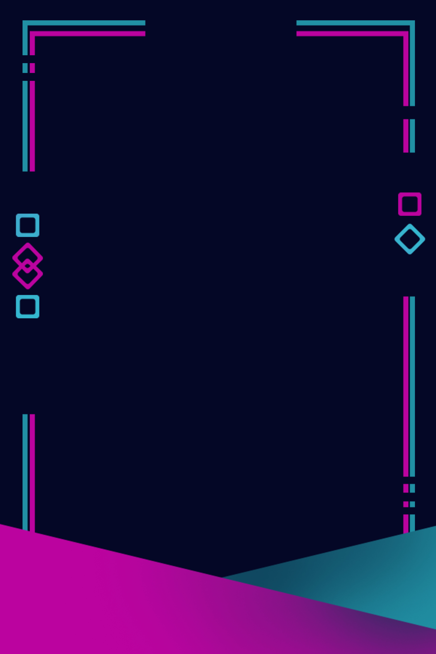


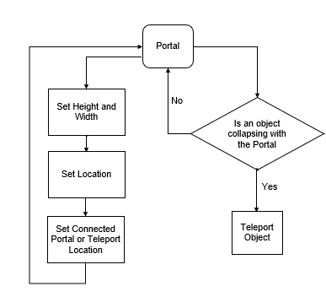
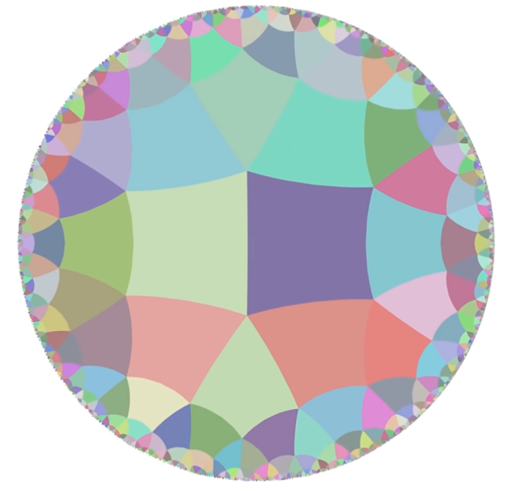
Non-Euclidean Game Engine
Barış Mert
Ozan Bayraktar
Ömer Buğra İnce
Advisor: Dr. Faris Serdar Taşel
Çankaya University, Department of Computer Engineering
Abstract
Nowadays, most game engines and for this reason most of the games use Euclidean geometry as a base for their development. Euclidean games as we describe them do not bend space and time. As these games continue to get developed, non-Euclidean games also started to get popular because things you can do with non-Euclidean spaces are more mind blowing and confusing for us to perceive, therefore this creates a great field to discover both for developers and players. Our objective is to create a non-Euclidean game engine that will contain non-Euclidean features to help game developers create their own games using these features as they see fit.
Keywords: Non-Euclidean geometry, Game engine
Solution
After our researches we understood that developing an asset pack for a popular game engine is better for accessibility. So, we choose to use Unity as our base application, which is one of the most used and most popular game engines.
Results & Conclusion
We managed and developed a small-scale project. During the development and management of this project, we learned how to communicate with team members better and how to use Unity & GitHub more in-depth. Our aim was to develop a set of pre-written code and objects that can be used in development non-Euclidean games with ease, we accomplished what we aimed for and it may be further developed to be better and more inclusive of different functionality as it only covers mainstream part of non-Euclidean games and geometry.
Figure 1 – Portal Flowchart
Introduction
Game engines are created and used to develop new games or remake existing ones. They make complex game development processes simpler by providing tools to make normally big tasks done easily, while the game engine does all the work in the back.
Since the creation, or even idea, of the first video game, developers have mainly used Euclidean geometry to represent their games. Because, Euclidean geometry is what we use in tasks we perform in our daily lives.
Video games always try to introduce new concepts to draw people into their game's "alternative reality". Game developers were interested in the idea of non-Euclidean geometry. Thus our objective is to give game developers some tools they can use to develop this type of games.
Acknowledgement
We are grateful to our advisor Faris Serdar Taşel for guiding us through this project, answering our questions and helping us understand parts we don’t know about. We are also grateful to other researches and game developers who shared their researches and experiences on the matter.
Figure 2
How a non-Euclidean
Geometry Looks

