Slide 1




MOBILE SCHOOL MANAGEMENT SYSTEM
Burak Emrullah GÜNEŞ – 201611026
Oğuz GÜL – 201411025
Furkan TÜRKMEN – 201511064
Advisor : Murat SARAN, Assist. Prof. Dr.

Slide 2
Contents
Definition and Main Features
Problem
Pros and Cons
Work Plan
Materials and Methods
Solution

Slide 3
Mobile School Management System
Main Features
Definition
Through Mobile School Management Application students and parents will be able to communicate much more closely and easily and any time they want with their schools.
Access syllabus
Access news about school
Check grades
Give feedback
Get notifications
Multi-Corporation
3

Slide 4
Problem
Today's web-supported and mobile education platforms do not provide adequate use. MSMS incorporates many features in this area. Interactive mobile education systems on the market are used for their own institution, while MSMS can serve multiple institutions thanks to multiple profiles.

Slide 5
Pros and Cons - MSMS vs EDUPAGE
 | MSMS | EDUPAGE
Interactive Education | X | ✓
Systematic Notification | ✓ | ✓
Feedback | ✓ | ✓
Parent Teacher Communication | ✓ | ✓
Homework Tracking | ✓ | ✓
Interactive Calendar | ✓ | ✓
5

Slide 6
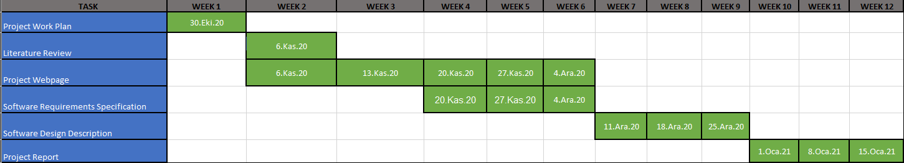
Work Plan
6

Slide 7
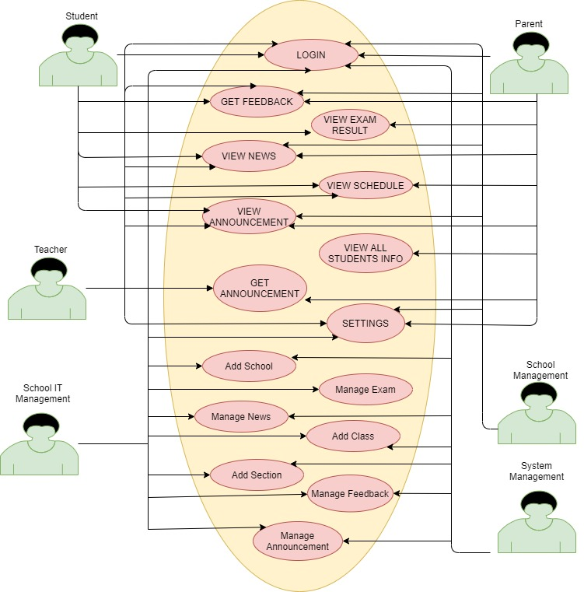
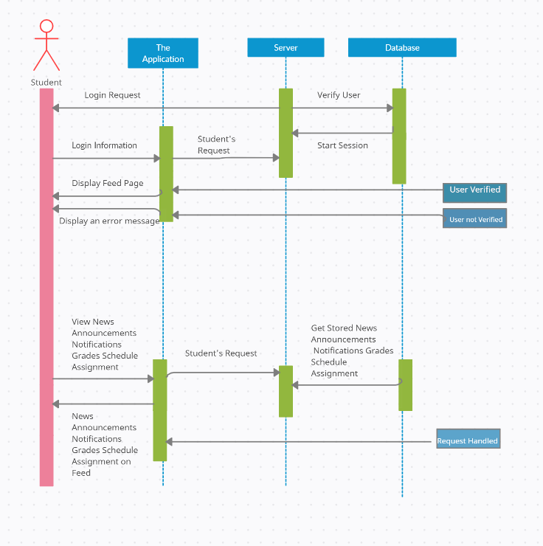
Materials and Methods
7

Slide 8




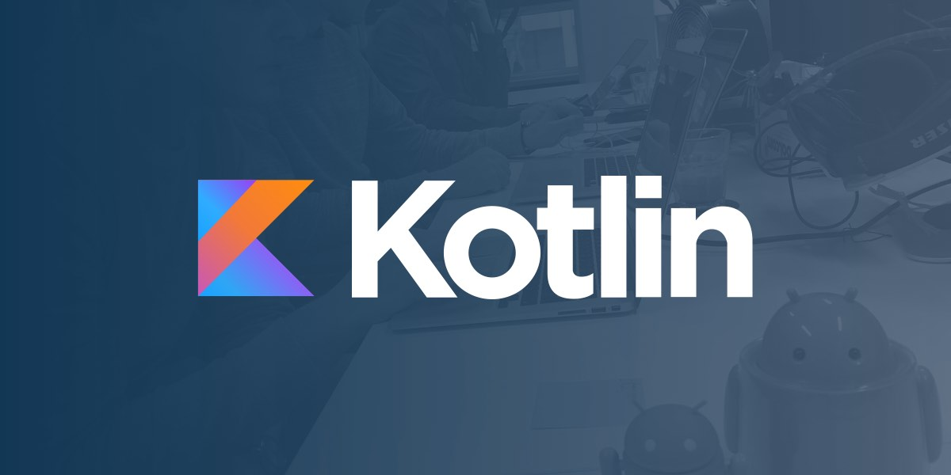
Solution

Slide 9
Thank You For Listening…

