Slide 1


Sign Language Recognition with Machine Learning
Team Members:
Batuhan BAYRAKTAR
Bersu OĞUZ
Numan SÜME
Öznur ÜSTÜNDAĞ
Group ID: 202004
Advisor: Dr. Sibel TARIYAN ÖZYER

Slide 2
Contents
Main Features
Definitions
Previous Work
Workplan
Problem
Analysis
Flowchart Diagram
Environment and Tools Planned to Used
Comparasion
Design Concept
Results and Conclusion
References

Slide 3
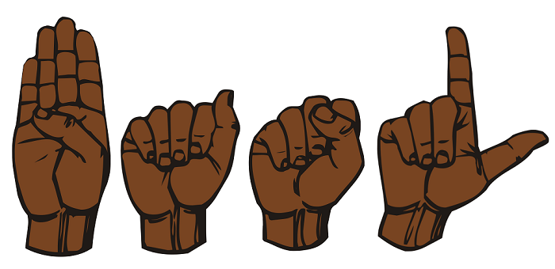
Main Features
Graphically translate Turkish text into sign language
Convert sign language to Turkish text with camera
Works on android and web environment

Slide 4
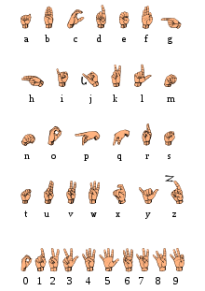
Definitions
The Sign Language is a type of communication for people who suffer from Hearing loss and related diseases. For communication, the expression of fingers and sometimes face expressions are used. Each letter is expressed with a finger expression.

Slide 5
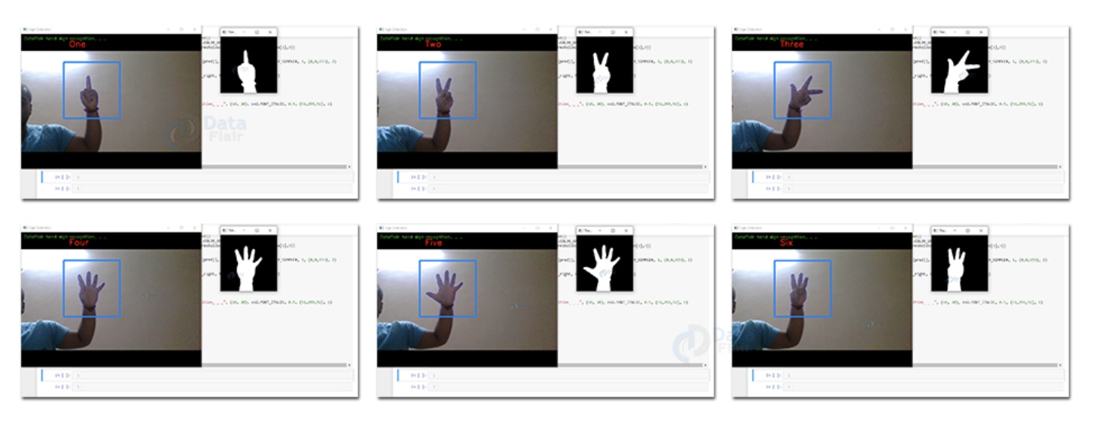
Previous Works

Slide 6
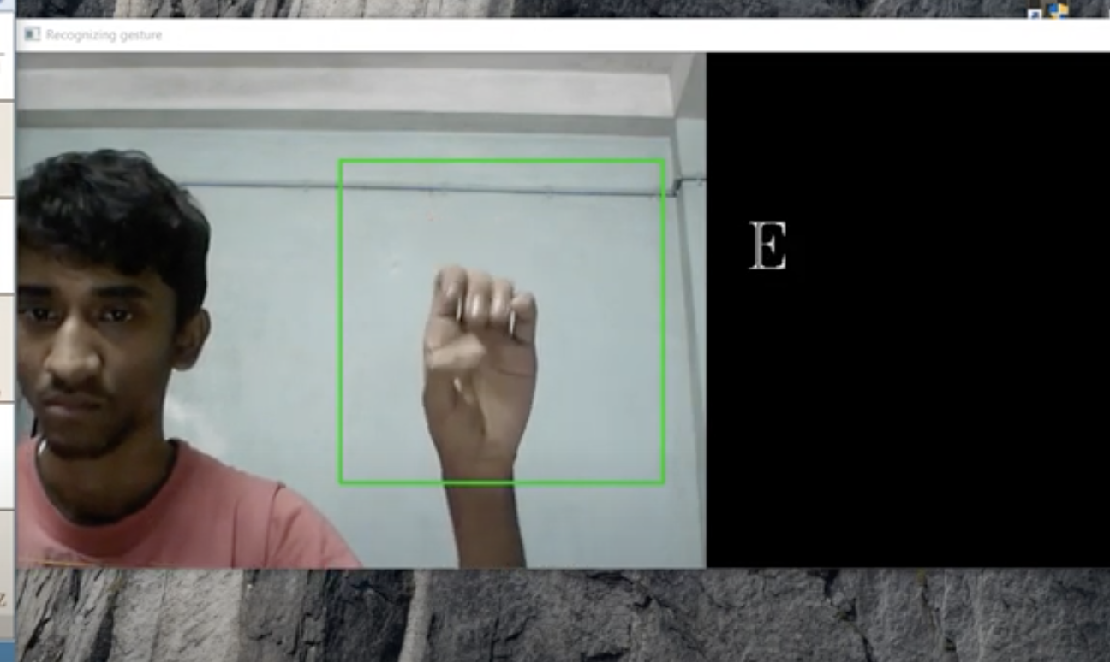
Previous Works

Slide 7
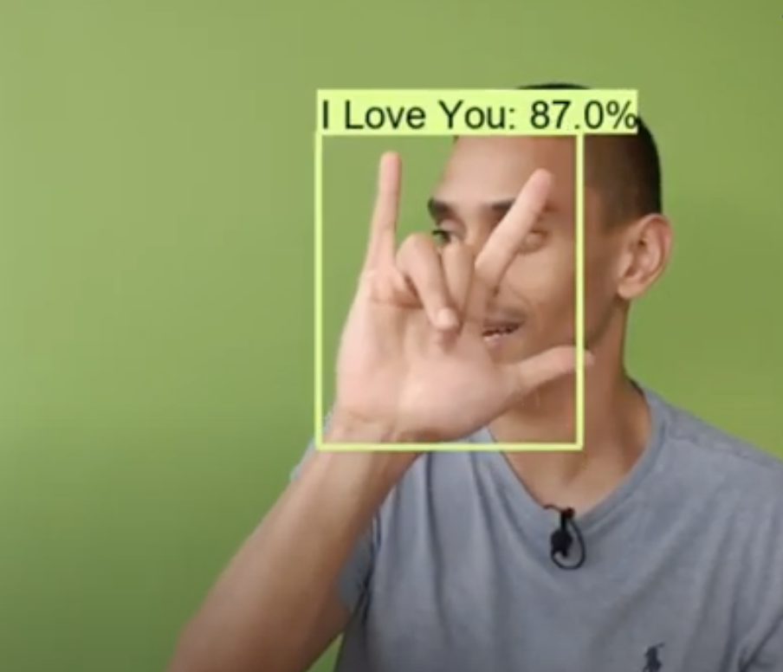
Previous Works

Slide 8
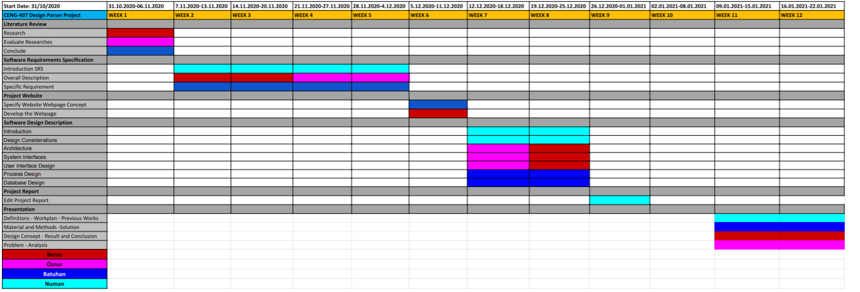
Workplan

Slide 9
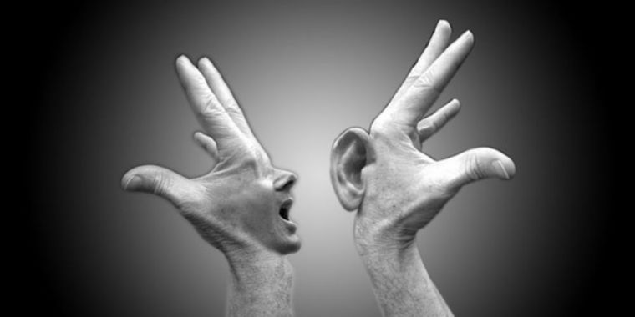
Problem
There are lots of people who suffer from hear loss and related diseases.
Most deaf people do not have a hearing aid.
Sign language is a good alternative, but there is no Turkish application in the world that will both detect the movements of the user and transform the user's writing into a sign language simulation.

Slide 10
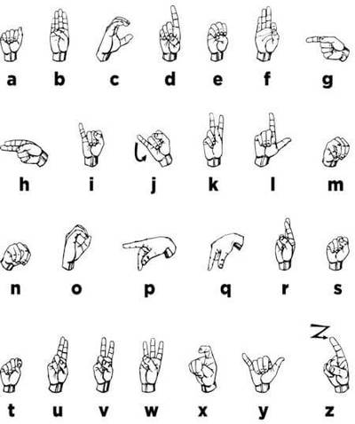
Analysis
Our goal is to make it easier for the deaf to communicate with their environment.
According to the results we reached in the literature review:
The applications in the previous solutions work in English and translate the image as word.
Gloves are used in most of the applications.

Slide 11

Analysis
The difference of our project is that we only communicate with a mobile phone or computer without the need for any tools.
The application both translates the text into sign language with a simulation and converts the sign language to written text and users can read the text.

Slide 12
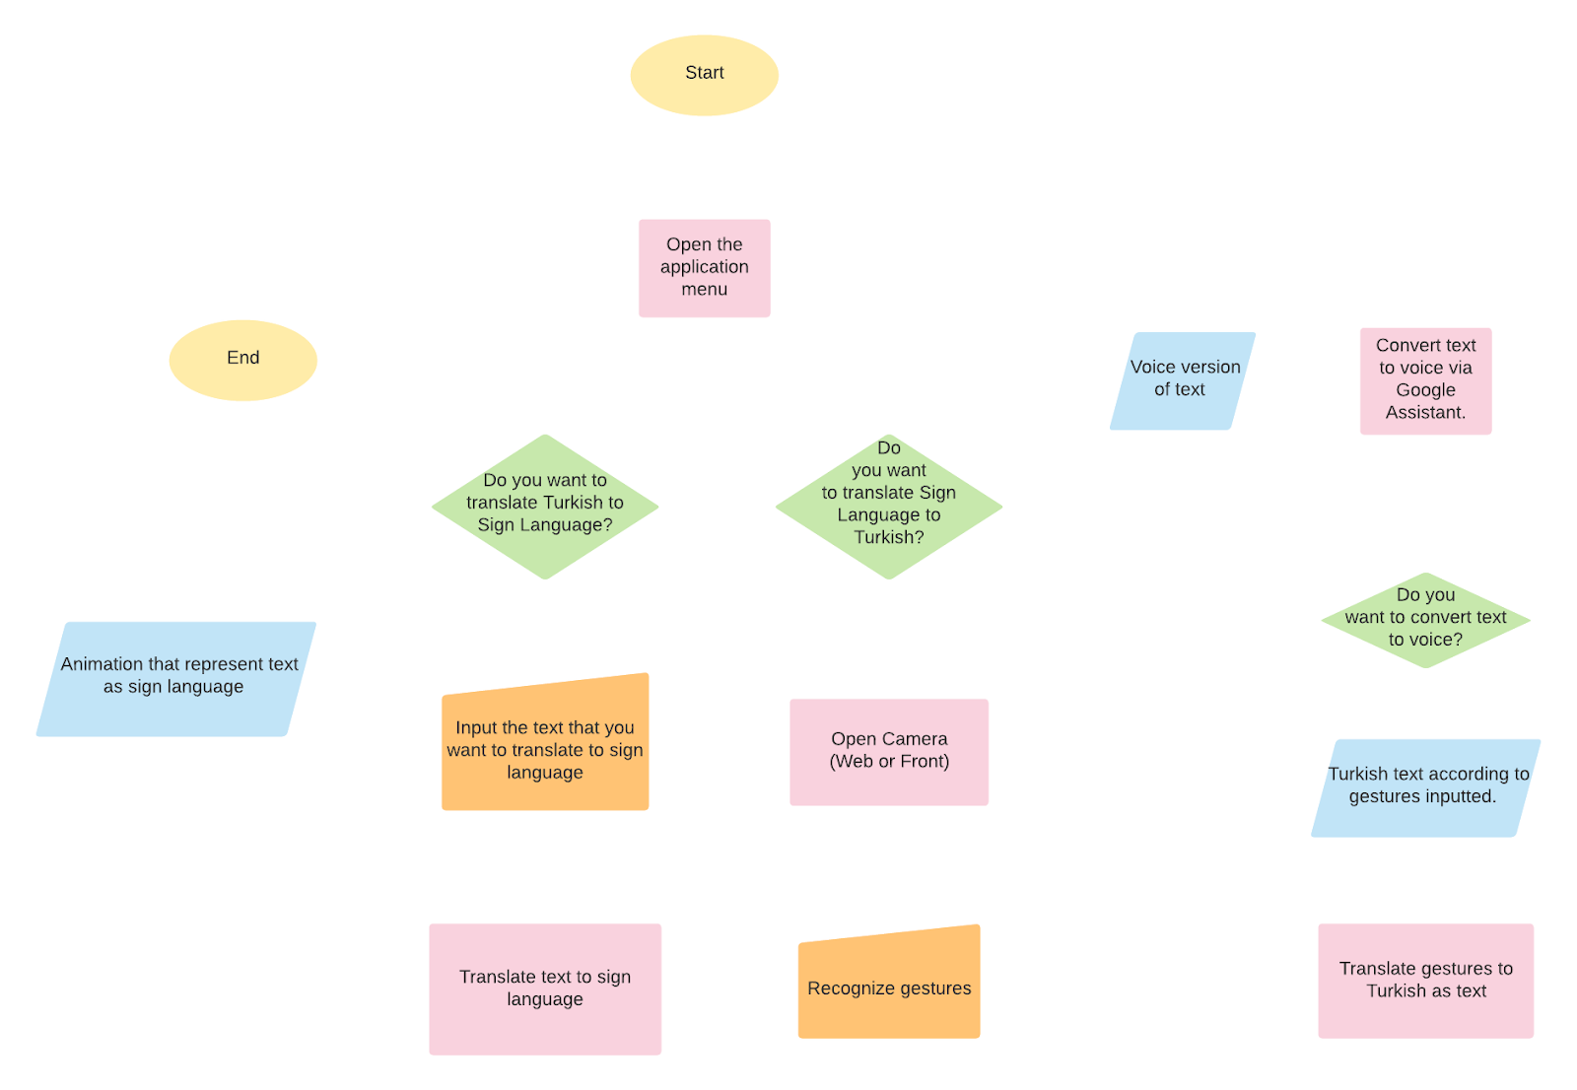
Flowchart Diagram

Slide 13


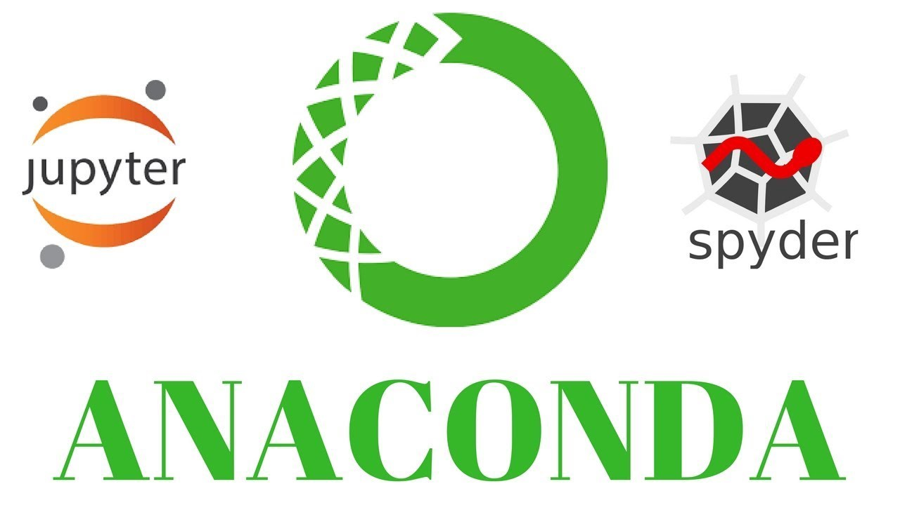
Environment and Tools Planned to be Used
Anaconda
OpenCV, PyTorch and Onnx
Keras
Tensorflow

Slide 14
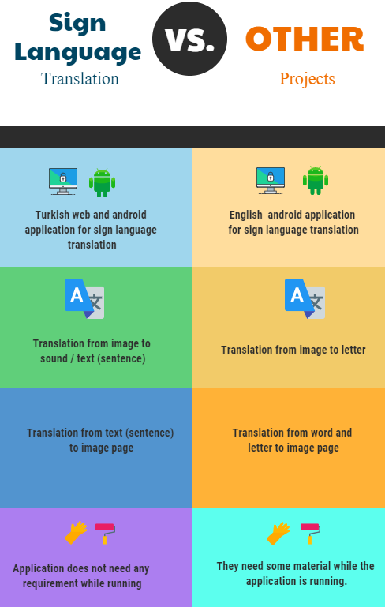

Slide 15
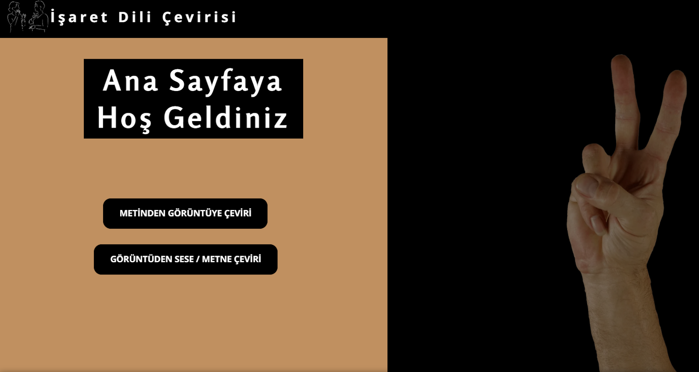
Design Concept
Home Page

Slide 16
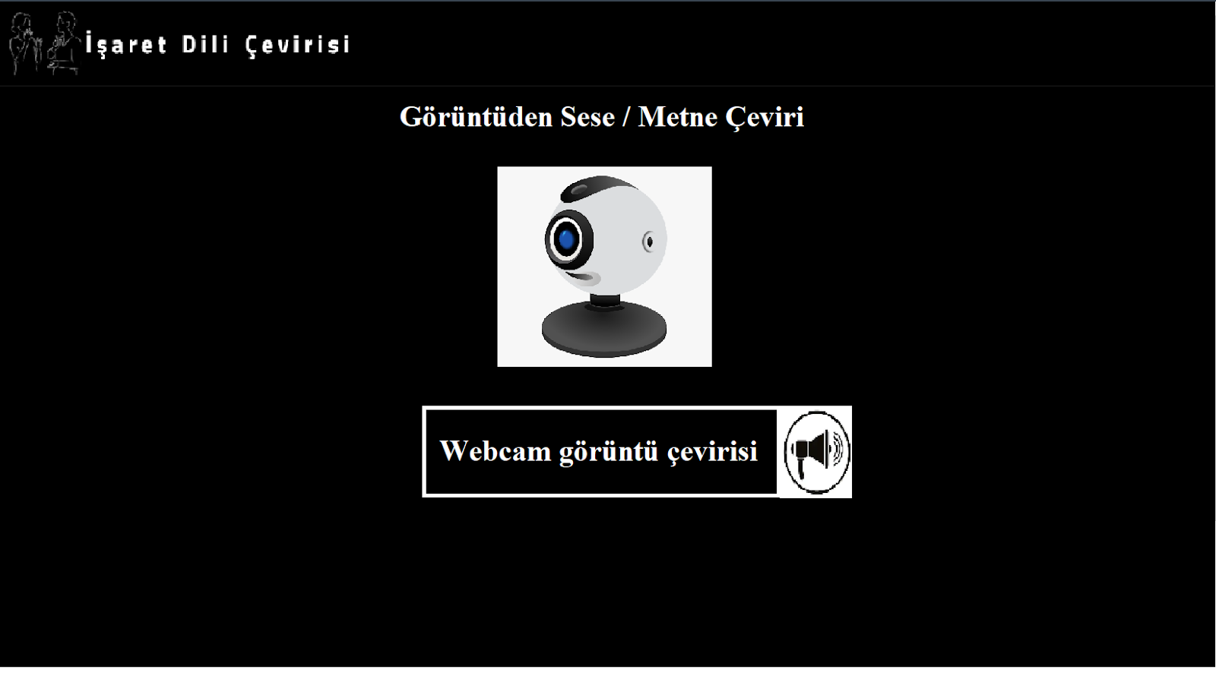
Design Concept
Translation From Image to Sound / text Page

Slide 17
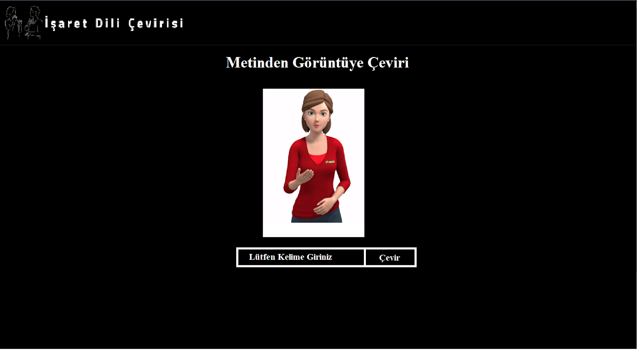
Design Concept
Translation From Text to Image Page

Slide 18
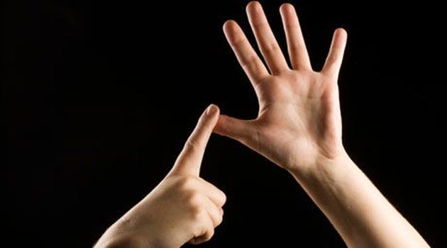
Results and Conclusions
Helping deaf people to communicate.
Bringing the chance to get the equivalent of sign language both in voice and in writing with a single application.
Possibility to visually see the sign language corresponding to the written text entered as a sentence.
Next term, we will work to create a data set of this project we designed and to implement the web-android application.

Slide 19
References
https://github.com/Evilport2/Sign-Language
https://github.com/nicknochnack/RealTimeObjectDetection
http://cengproject.cankaya.edu.tr/templates/
https://webonline.cankaya.edu.tr/pluginfile.php/219979/mod_resource/content/0/CENG407-408_Y%C3%B6netim_Plan%C4%B1.pdf

