Slide 1


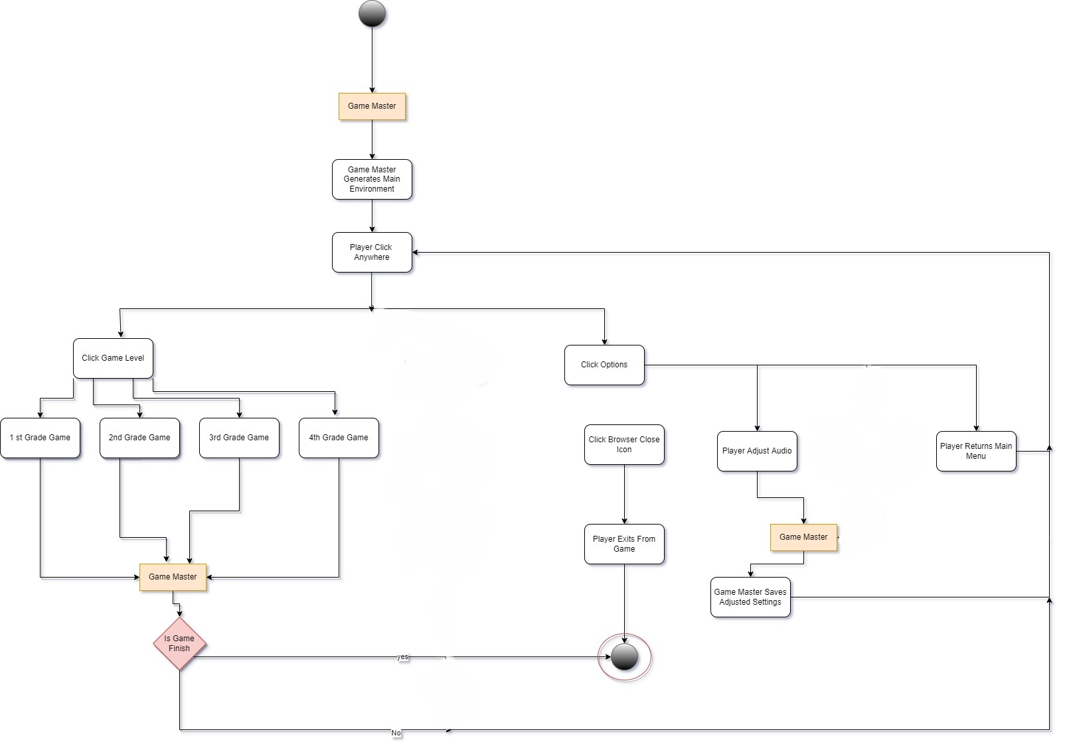
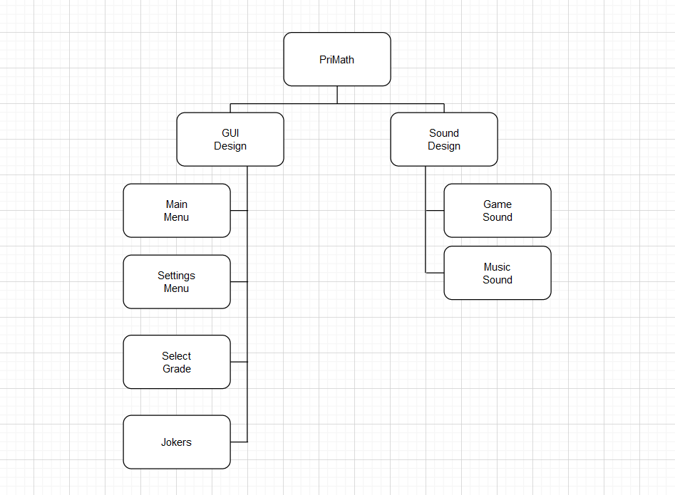
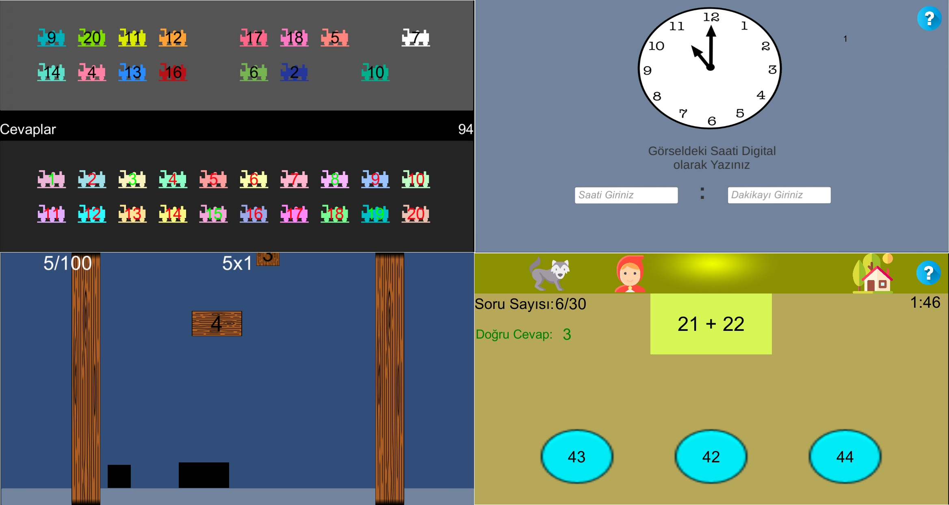
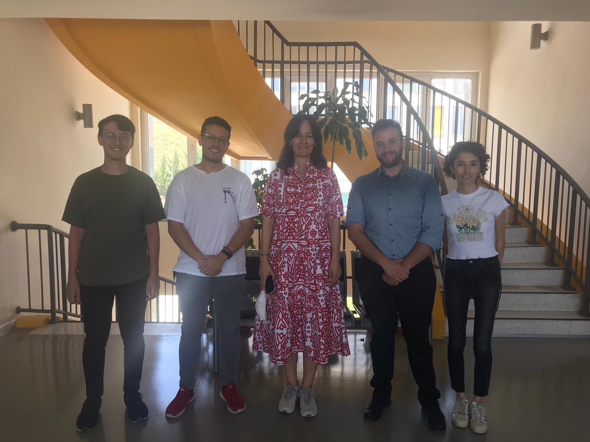

An Educational Game Platform for Primary School Children
Muhammed Emre KURT – Oğuz HAZNECİ
Sinem İlayda YÜCEL – Ziya Can ERANDAÇ
Advisor: Gül TOKDEMİR
Çankaya University, Department of Computer Engineering
Abstract
Nowadays, the role of educational games in learning is becoming serious. The proliferation of distance education with Covid-19 has shown how useful and effective educational games are during this period, in some cases mandatory. STEM subjects have an important role in the earlier education phase and more specifically at the elementary school level. In this report, we explored how we can reduce the subjects that children have the most experimental difficulties in lessons to an easier level to understand with the help of educational play.
Keywords: Serious games, Misconception in Education, Role of Educational Games in Math
Company Info
Activate Bilişim Teknolojileri A.Ş. was launched as a software company in 2012. By prioritizing R&D awareness in software, it aims to meet the software needs of our country with domestic production. By analyzing the training needs of an institution and gathering them under a single structure, it provides both consultancy and technical infrastructure services.
Figure 1 – Activity Diagram
Introduction
The main problem of this project is to help children understand the subjects by supporting them with games, in a way that children can learn while having fun, on mathematics topics that are suitable for the curriculum that children have difficulty in understanding.
Thus, when children understand the subjects, they do not understand, their self-confidence will increase and they will participate in the mathematics lesson in a more motivating way.
Results & Conclusion
"PRIMATH" is a digital platform which contains different type of serious games to improve children's math mindset. There are many educational mini games for 4 different classes. Thanks to the question mark bubbles in the game, it allows the children to give more specific information about what the buttons do and more specific information about the game. Games are suitable for the mathematics misconception all the 4 classes, "PRIMATH" aims the help teachers to well teach these misconceptions of mathematic. There is an also time limit for each game to improve competition among the children so they will their best to make a better score from their friends. The time limit decreases the learning time.
Figure 2 – Use Case Realization
Solution
We have developed this game application for our children to participate in math lessons more motivated. This application should not be called just a game, this application can be checked by the parents, and they will be able to follow what gains the student has gained. Our games are all about learning and having fun. One of our main goals is to make an application where students can have a pleasant time without getting bored.
Figure 3 – Screenshots from Games
Acknowledgement
We would like to express our sincere thanks to Assist. Prof. Dr. Gül Tokdemir for guiding us through the software phase of the project and helped us with her feedback, and Meltem Koca from Activate Bilişim Teknolojileri A.Ş. for showing us the principles of educational practice and giving her feedback.
Team Members and Advisor

