Slide 1
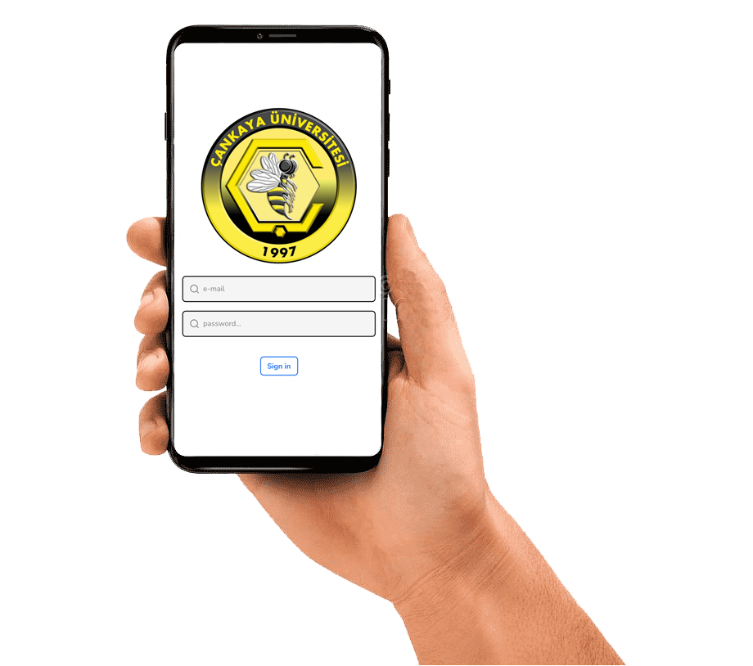
CankayaMobileApp
Project

Slide 2
Table of Contents
Introduction
Problem and Solution
Similar Projects
Technologies Used
User Interface
Database
Project Work Plan
Conclusion
References

Slide 3
1. Introduction
We aim to develop CankayaMobileApp that includes solutions for some of the problems we encounter at our university.
In this application, there will be features such as QR Attendance, QR ID Check and Course Evaluation Questionnaires.

Slide 4
2. Problem and Solution
We aimed to:
Digitizing the attendance process, preventing paper waste, reducing the possibility of forgery in documents for QR Attendance.
Digitizing the ID Check process, minimizing the queue that occurs during identity checks at school entrances for QR ID Check.
Digitizing the Course Evaluation Questionnaires process, minimizing the use of paper and the loss of time in the process of entering the questionnaires into the system in CankayaMobileApp.

Slide 5
3. Similar Projects
The number of similar applications that have the features of our application is quite low. Universiti Teknologi Petronas (UTP) and Multimedia University in Malaysia, used the absentee tracking technology with this QR code.
Applications that use the QR code attendance feature are mostly developed only for android devices.
One of the projects developed on the Android system. After the application saves the barcode or QR code it reads to the database and stores it, it gives it to the user as XLS and CSV document output if requested. SQLite Database is used as database.
In another project, an application was developed that works on both android and iOS. There is MongoDB with NoSQL for database. It also uses Node.js, which is compatible with JavaScript and enables new updates.

Slide 6
4. Technologies Used
We aim to develop the application using JavaScript programming language, React Native framework and Firebase database.
We aim to take advantage of the fast and easy process opportunities provided by the QR code.
The CankayaMobileApp will be available on iOS and Android smartphones.

Slide 7
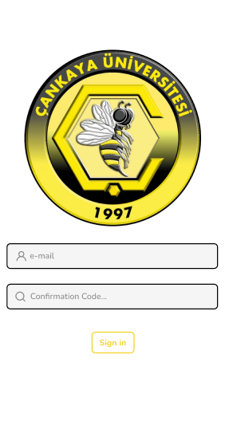
5.User Interface – Sign In Page

Slide 8
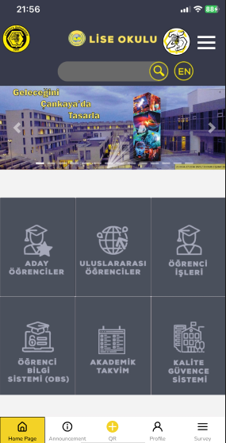
5.User Interface – Home Page

Slide 9
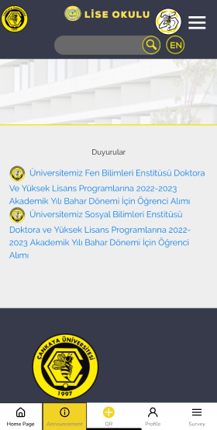
5.User Interface – Announcement Page

Slide 10
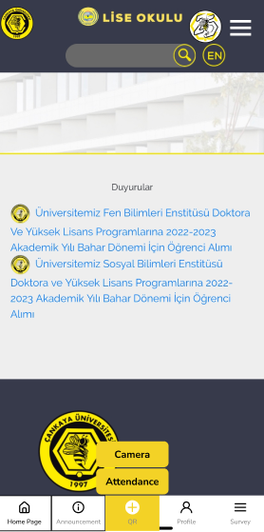
5.User Interface – QR Button (Available for only lecturer)

Slide 11
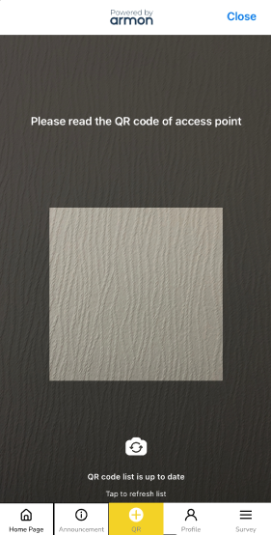
5.User Interface – QR Scan Page

Slide 12
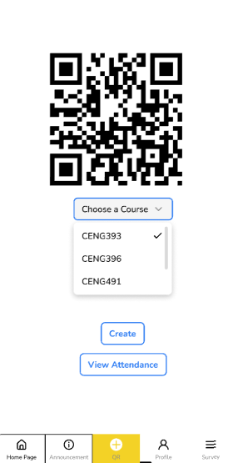
5.User Interface – Attendance Page (Available for only lecturer)

Slide 13
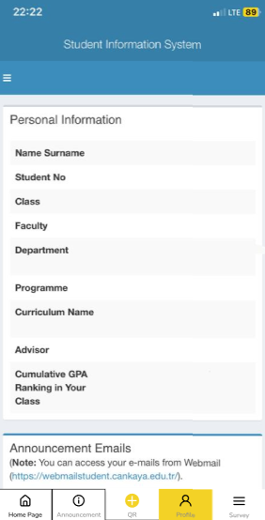
5.User Interface – Profile Page

Slide 14
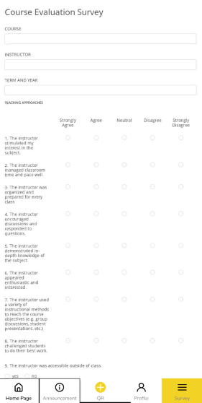
5.User Interface – Survey Page

Slide 15
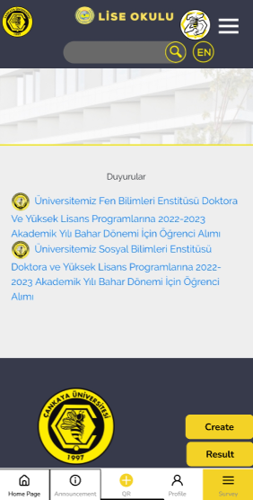
5.User Interface – Survey Page(Available for only lecturer)

Slide 16
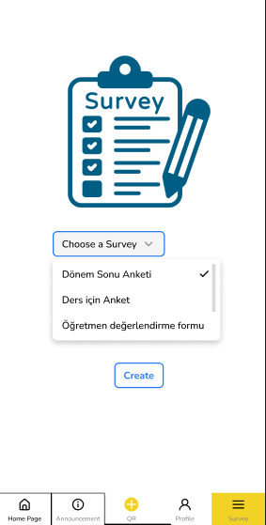
5.User Interface – Create Survey Page

Slide 17
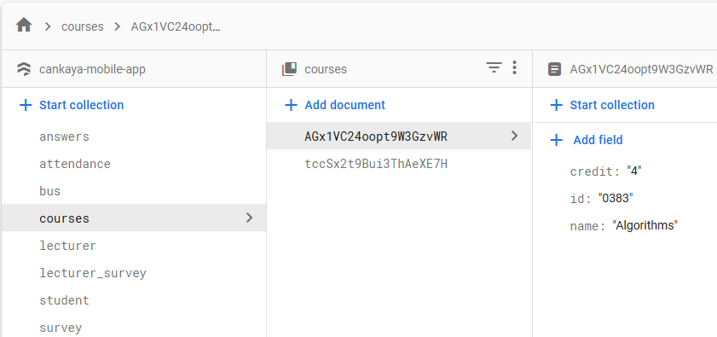
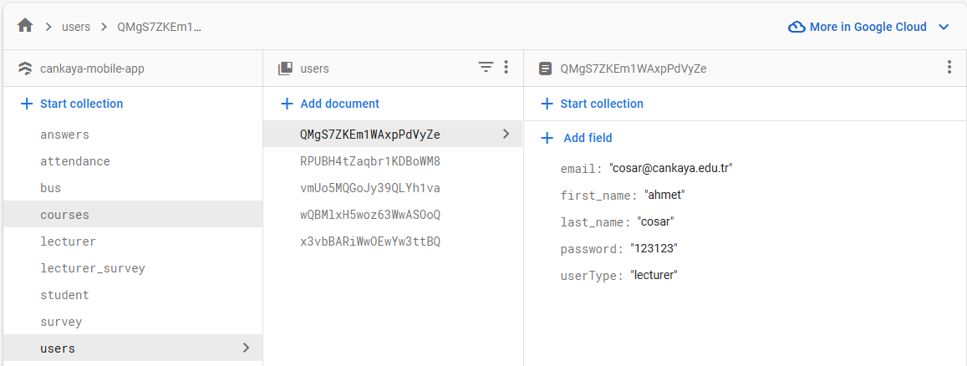
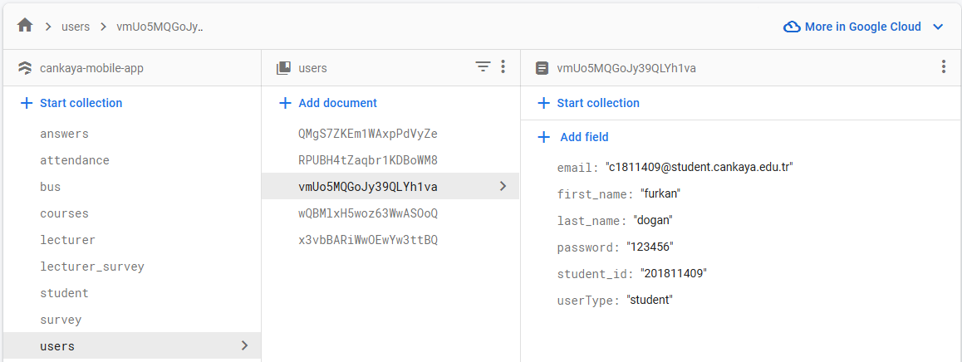
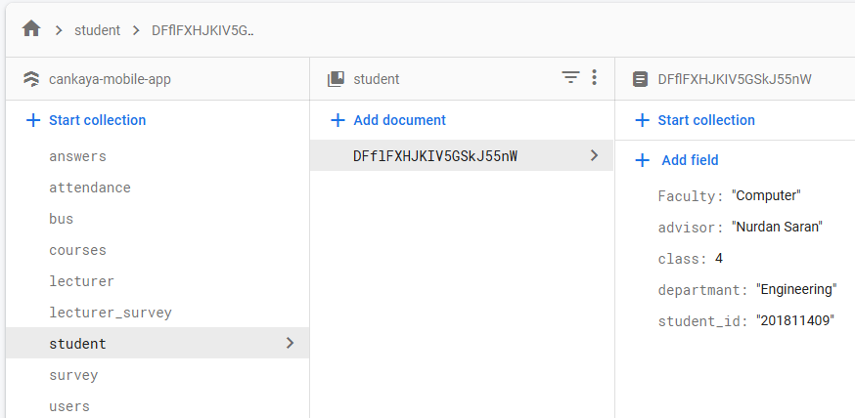
6. Database – Firebase/Firestore Example
1.Course information
2. Lecturer
3. Student
4. Student information

Slide 18
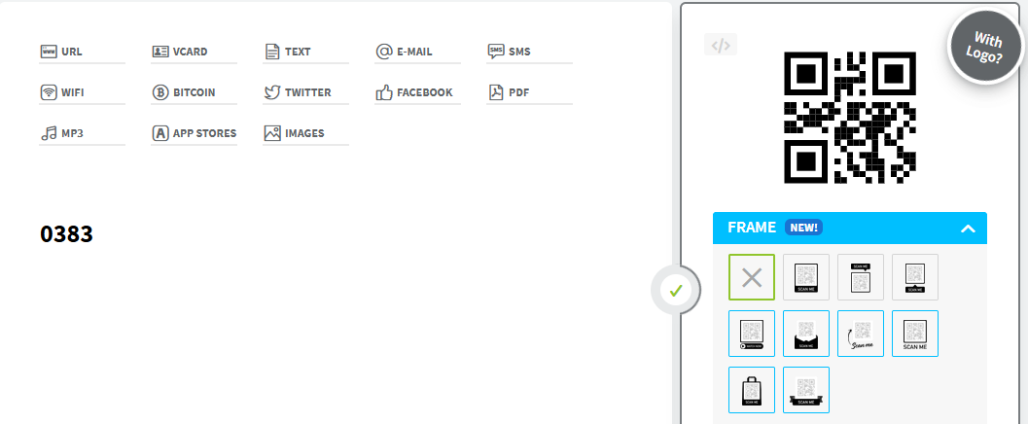
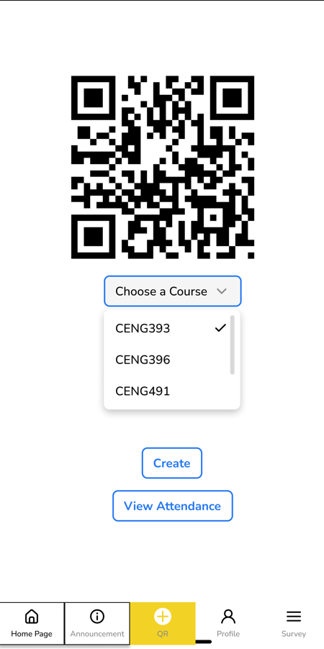
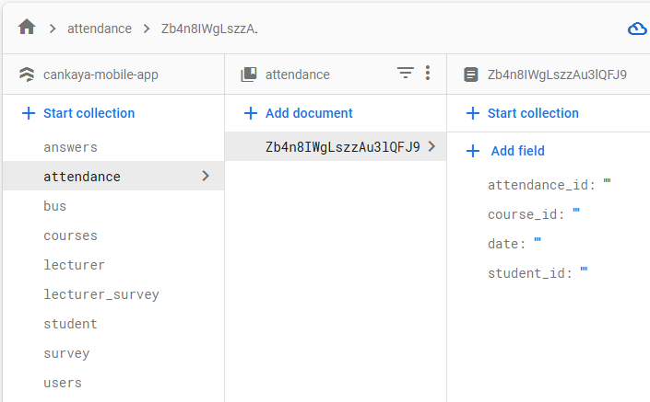
6. Database – QR Code for Attendance

Slide 19
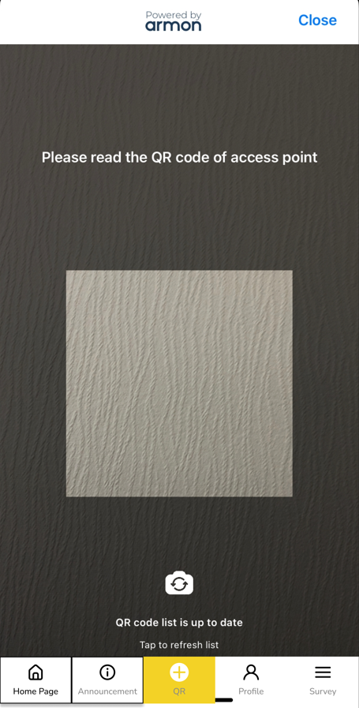
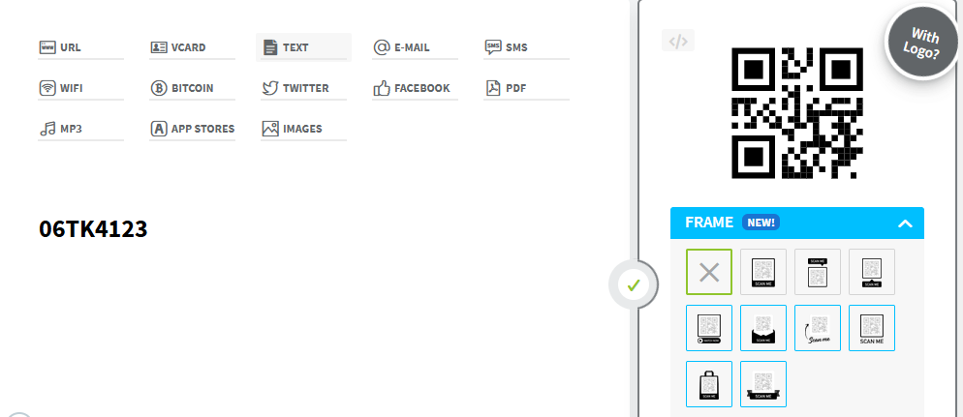
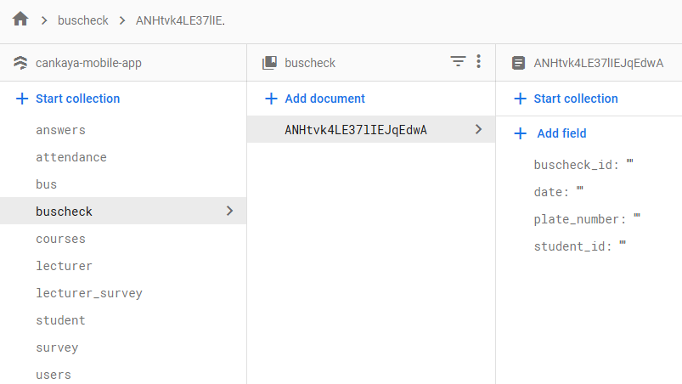
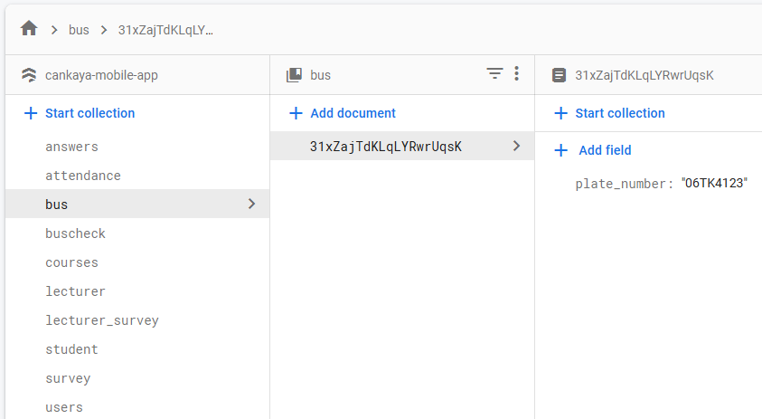

6. Database – QR Code for Bus

Slide 20
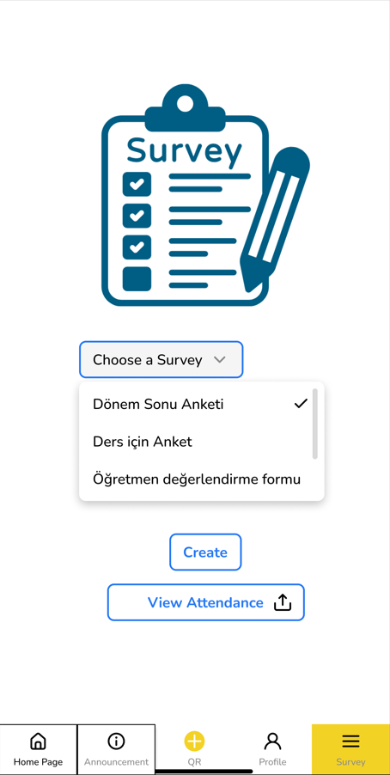
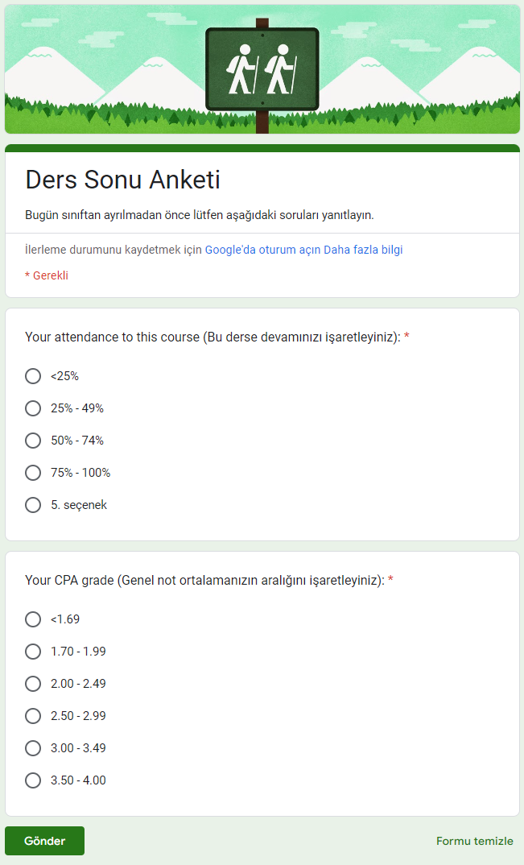
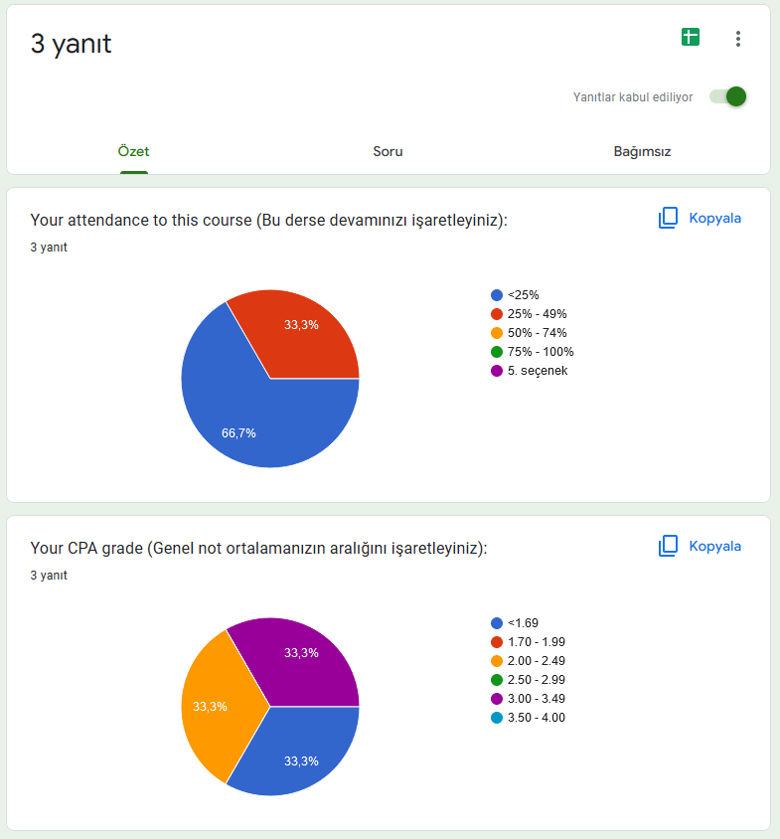
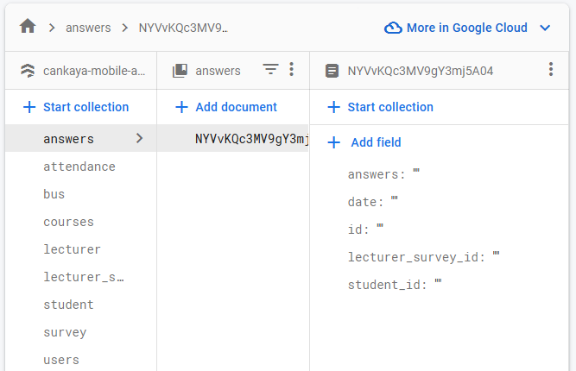
6. Database – Surveys

Slide 21
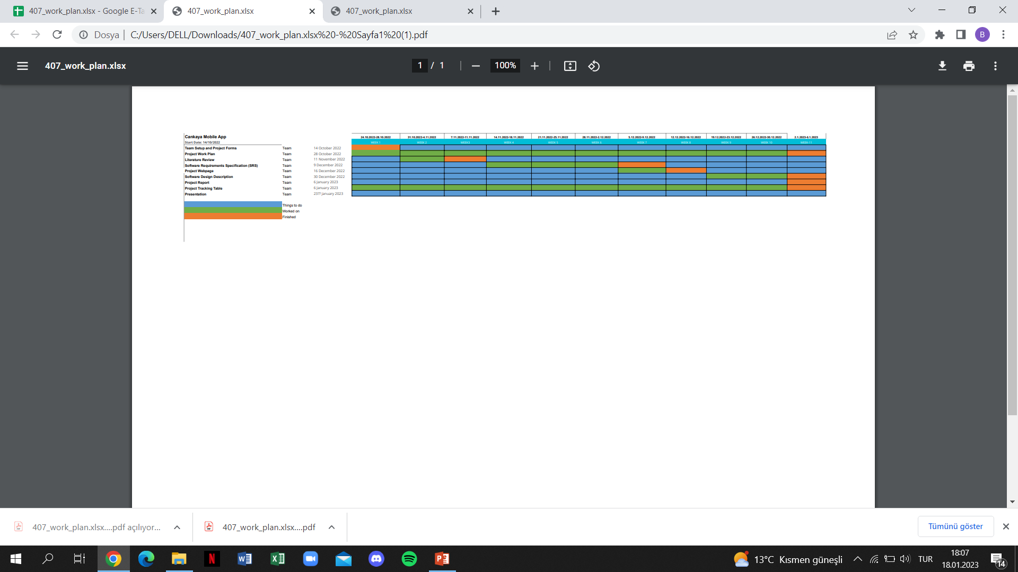
7. Project Work Plan

Slide 22
8.Conclusion
We aim to develop a solution-oriented, versatile application and to implement QR code technology in our project.
Since it works on Android and iOS systems, we will design an application that can be easily accessed by everyone.

Slide 23
9. References
https://www.researchgate.net/publication/318779349_QR_Code_Based_Smart_Attendance_System
https://dergipark.org.tr/en/download/article-file/2099062

