Slide 1


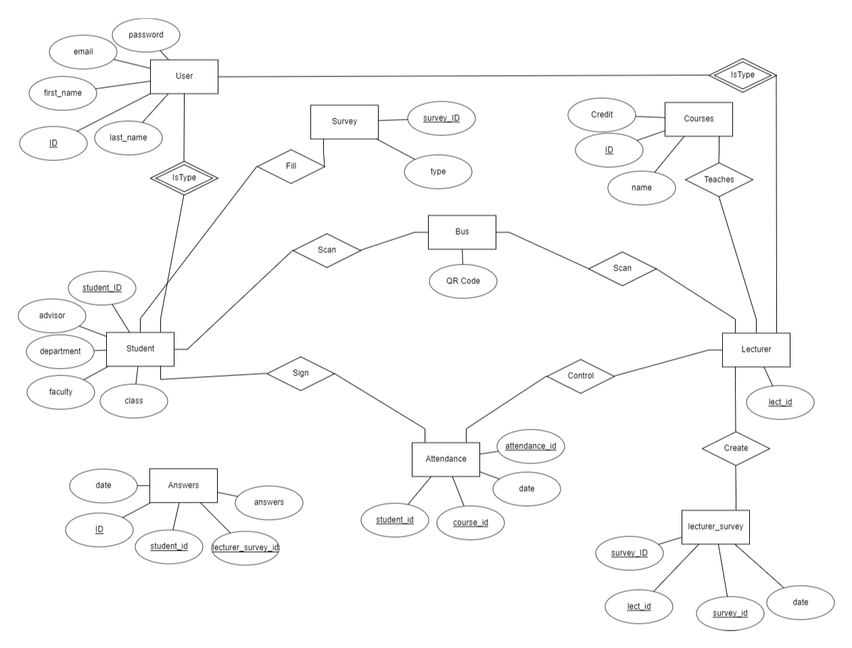
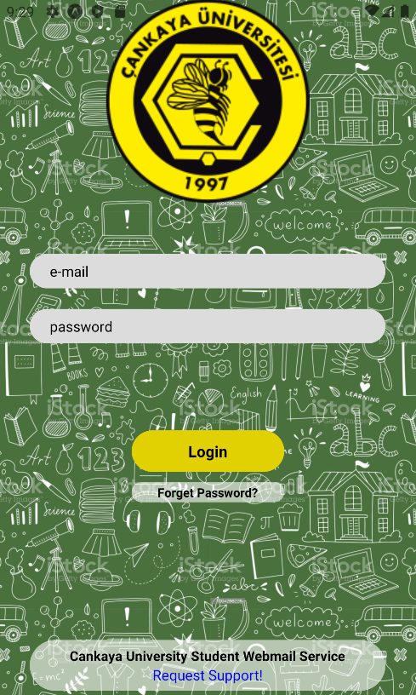
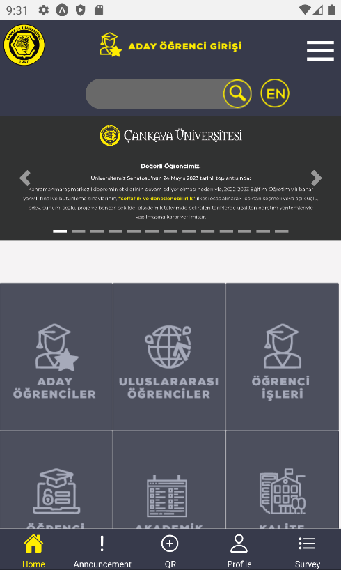
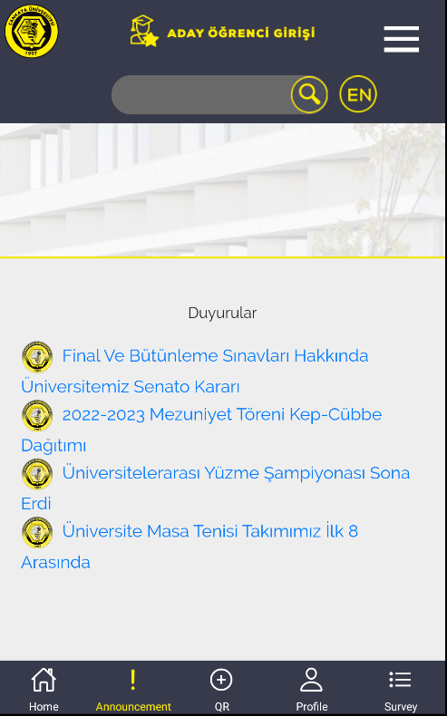
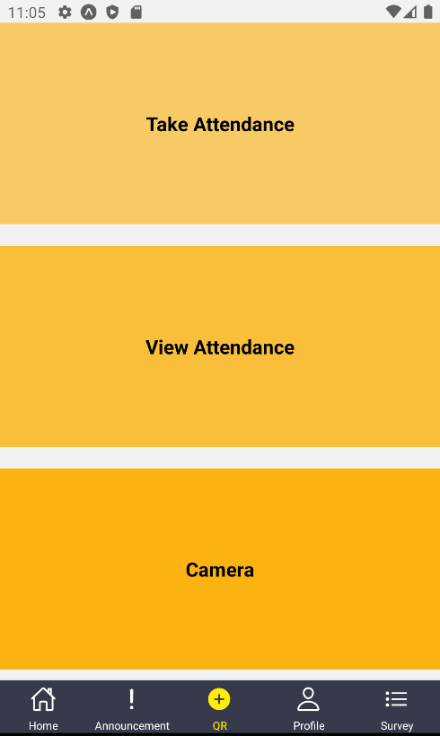
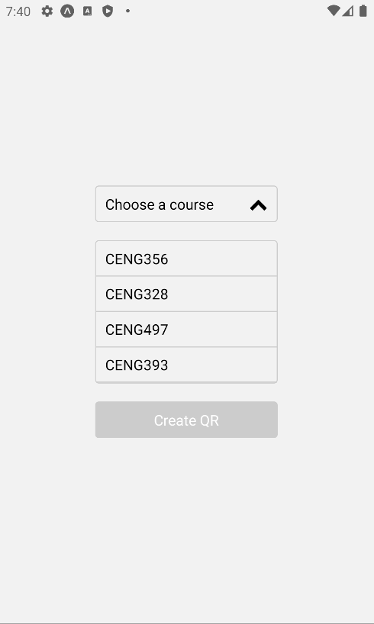
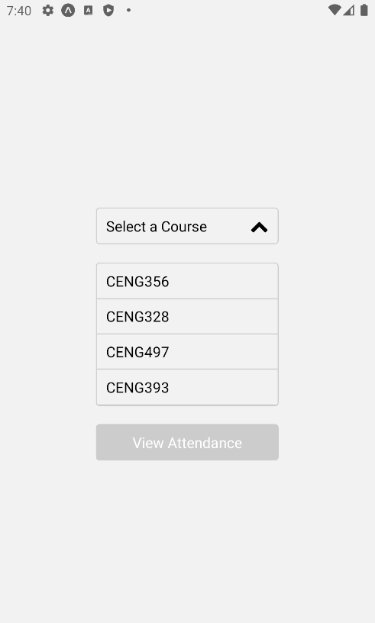
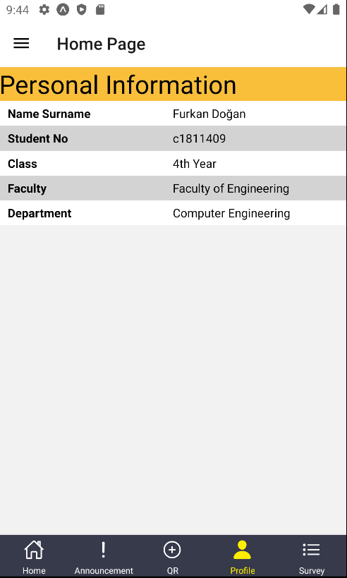
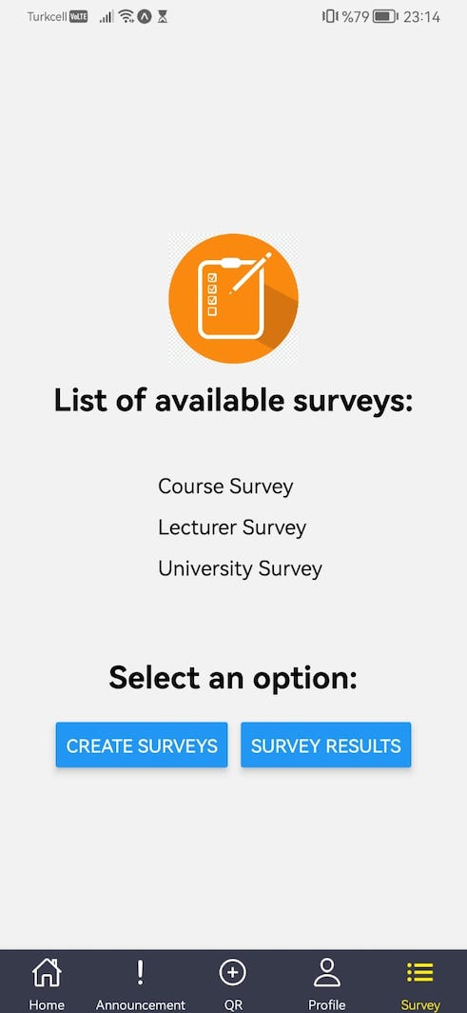
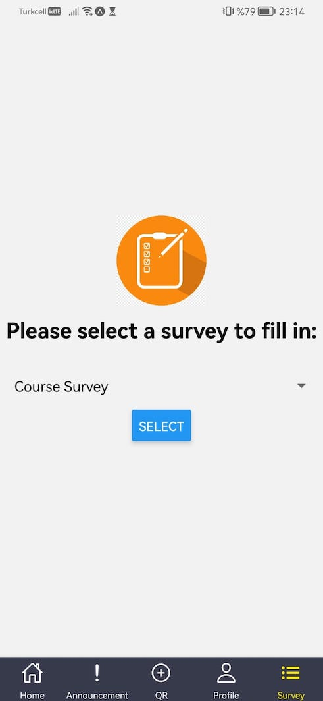
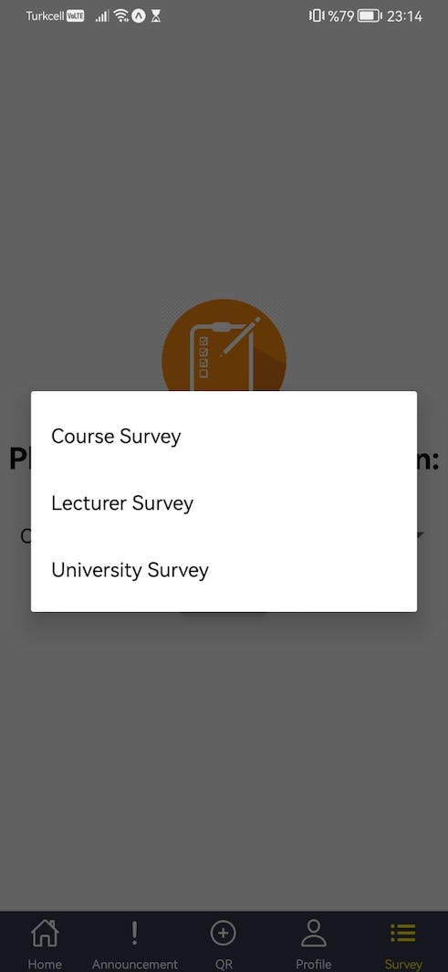
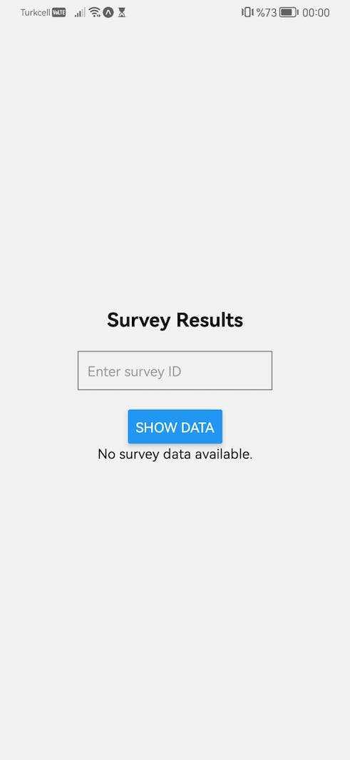
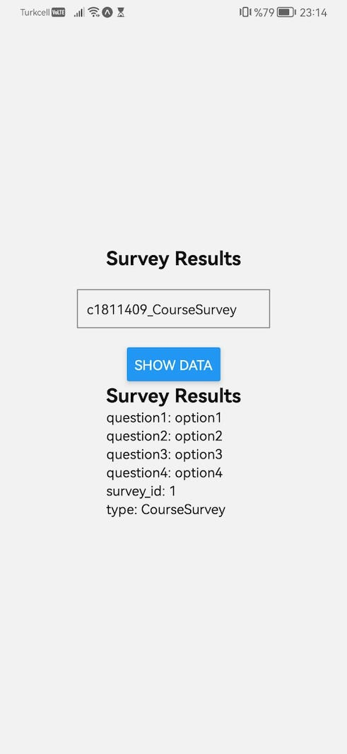
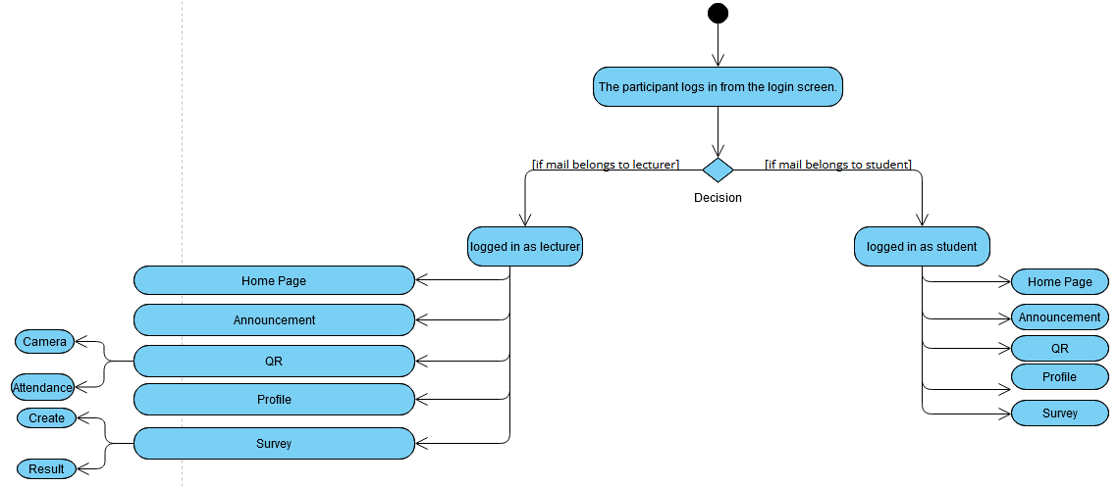
Cankaya Mobile App
Furkan Doğan
Beste Alptekin
Mertcan Şeyda
İrem Bakar
Advisor: Ahmet COŞAR
Çankaya University, Department of Computer Engineering
Abstract
The main purpose of creating the Çankaya University Mobile application is to overcome the difficulty of taking attendance to the courses we frequently encounter and to eliminate problems such as long bus queues at school entrances. When we addressed all these problems, we realized that the solution could be solved with QR codes, which are frequently used today. Another feature of our application is the questionnaires used for your complaints and suggestions about lessons and school.
Keywords: Attendance, Survey, QR, JavaScript, React Native
Introduction
Due to the development of technology day by day and the digitalization of our world, many old-fashioned works done with human power in many fields can now be done faster and more easily by computers. We have chosen the mobile application project that we aim to prepare for our school, taking this matter into consideration.
In our school, attendance and survey are taken with paper. This is an unbelievably great expense and waste of time for the school. Also, dealing with paper works is another tiring job.
Another issue is related to the identity check of students at school entrances by school buses. This is done by the security guards entering the services and having the identity of each student read to the device with the device in their hand. This process takes a long time because there are no devices and security guards in the buses that come to school at almost the same time every morning.
In order to minimize time loss in such transactions, we aim to provide identity control using QR technology within services.
Figure 1 – Activity Diagram
Solution
In terms of school absenteeism, when the student first logs into the application, some transactions are obtained by e-mail activation and the identity of the phone he uses, and the student is prevented from entering the school. application with another phone. Thus, a student can only register for one phone. Lecturer will create a QR for the course he/she wants to take absenteeism from our application, and we will quickly read and pass each lesson when the student leaves, thus we will save time and control.
For boarding the bus with QR, while the bus picks up the student from student’s home or at the bus stop, the student scans the QR code containing the bus's information from the mobile application and gets on the bus under the control of the bus driver. In this way, it is possible to pass a fast process without queues at school.
As for the questionnaire, when the lecturer activates the required questionnaire, the students receive the required questionnaire, and the student fills it easily and the teacher collects the results and provides the necessary information.
Take Attendance
View Attendance
Results & Conclusion
Every student, teacher, etc. registered in the school database. You can easily board the shuttle using the mobile application. Likewise, lecturers can take absenteeism much more easily and enable their students to easily participate and follow up. In surveys, lecturers can activate the survey, fill in the students, and see the survey results in the application.
Of course, there are some security vulnerabilities and missing situations, unfortunately, financial and experiential issues are required to overcome them.
Figure 2 – Finished Product
Acknowledgement
We would like to thank our advisor Prof. Dr. Ahmet Coşar for his guidance, and Dr. Faris Serdar Taşel for good advices.
Figure 3 – Activity Diagram

