Slide 1
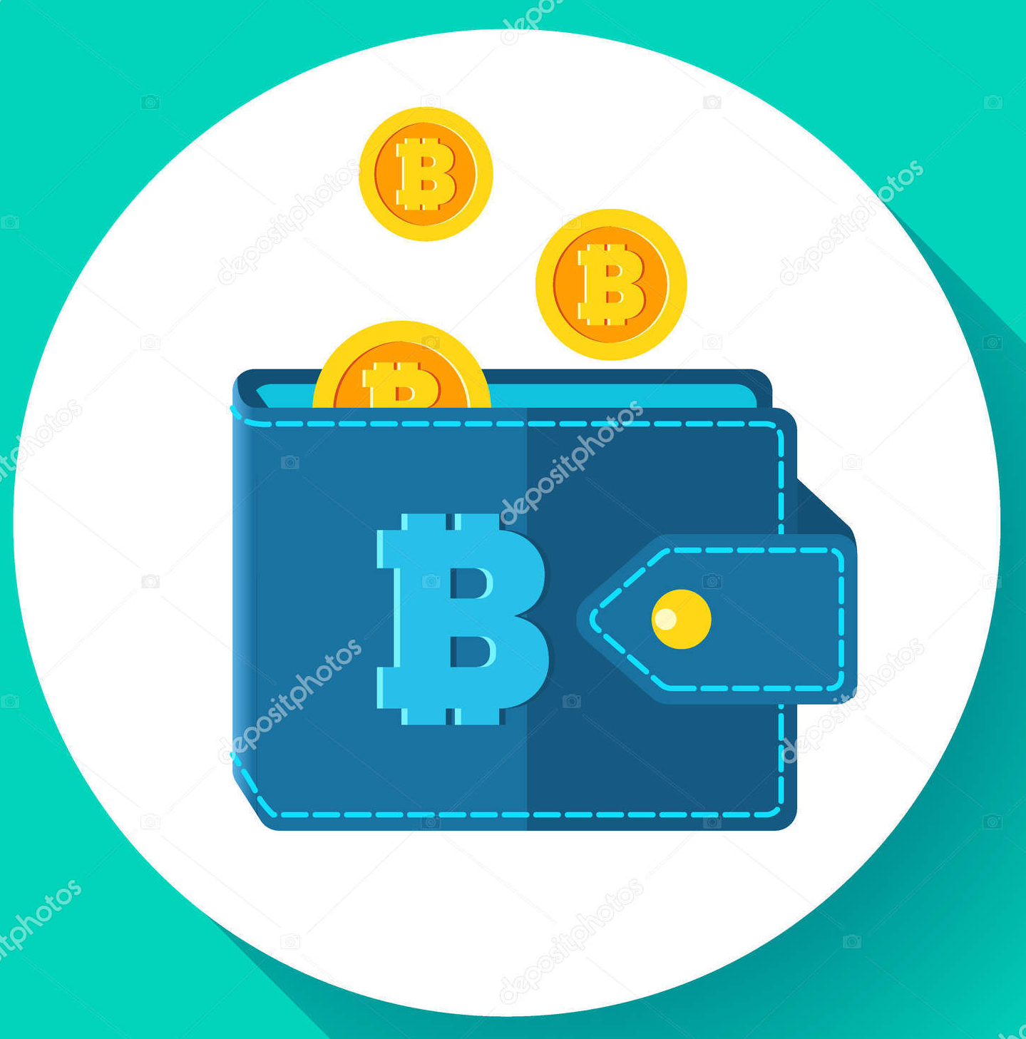
Crypto-currency, Transaction and NFT creation

Slide 2
Table of Contents
Our Team
Introduction
Our Aim
Current Technologies
User Interface
Work Plan
Conclusion
References

Slide 3



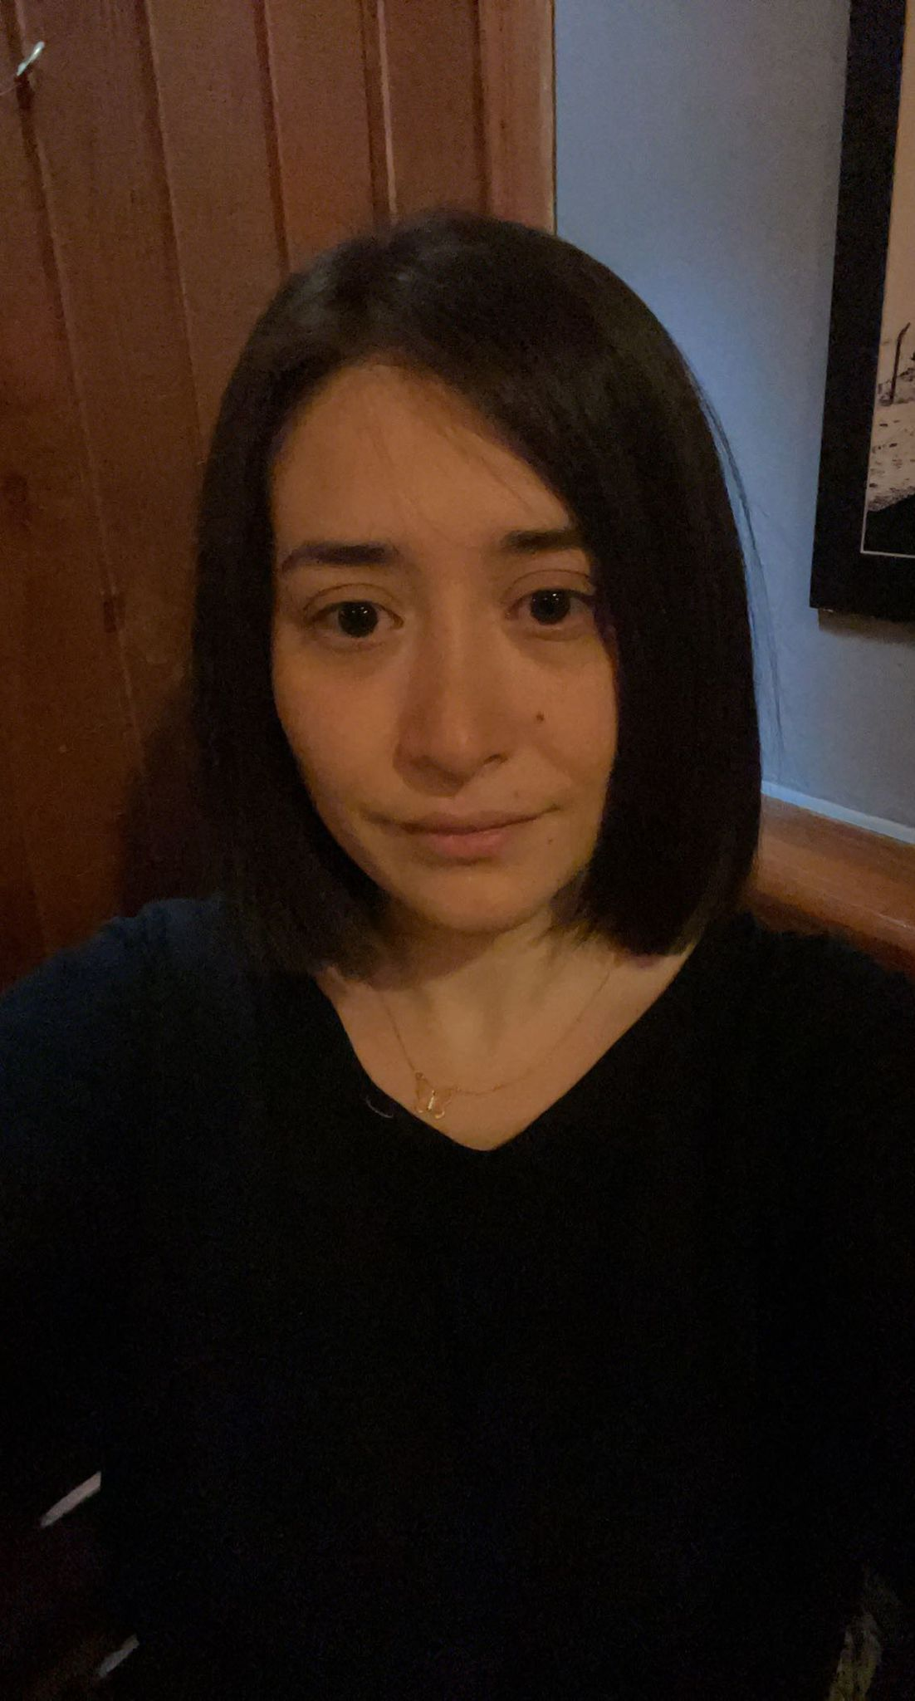
1. Our Team
Tan Karabudak
201911033
Eylül Aktuy
201811004
İdil Taşdan
201811055
Fatma Buse Çinkaya
201811019

Slide 4
2. Introduction
A blockchain is a network of computers that stores a digital ledger of transactions. Each block in the chain contains a number of transactions and a timestamp, and whenever a new transaction occurs on the blockchain, a record of that transaction is added to the ledger of every participant. A blockchain's distinguishing feature is that it is decentralized and distributed, which means that it is not managed by a single entity or organization. Instead, the blockchain's network of computers collaborates to validate and record transactions, ensuring that the ledger is accurate and up to date. Because blockchains are decentralized, it is nearly impossible for a hacker to corrupt the entire network.
Furthermore, blockchains employ cryptographic techniques to ensure that once a block is added to the chain, it cannot be changed or deleted. As a result, it is well suited to applications such as cryptocurrency transactions and supply chain management.

Slide 5
2. Introduction
Cryptocurrencies are digital currencies that operate on a decentralized network and rely on cryptography. They enable secure financial transactions in the absence of a centralized authority. Bitcoin, Ethereum, and Litecoin are a few examples.
A cryptocurrency wallet is a piece of software that stores private and public keys and interacts with various blockchains to allow users to send and receive digital currency while also monitoring their balance. A digital wallet is required if you want to use Bitcoin or any other cryptocurrency.
Non-fungible Tokens (NFTs) are unique digital assets that make use of blockchain technology. They cannot be exchanged for other assets of the same type and are frequently used for items such as artwork and collectibles. NFTs can be purchased and sold through online marketplaces.

Slide 6
3. Our Aim
We aim to create a new Crypto-currency (inside an Ethereum Testnet, which means these tokens will not have any value),
A Crypto wallet web application using ASP.NET with Mongo DB,
and publish our own NFTs inside a marketplace (maybe NFTICALLY Testnet).
We believe that this project will teach us about the fundamentals of how blockchains and cryptocurrencies work and how these new technologies are developed.

Slide 7
4. Current Technologies
In field of Crypto-currencies, many examples can be said, such as Bitcoin, Ethereum, Tether, FTX which filed for bankruptcy during 2022, and many more.
In field of Crypto Wallets, there are many different wallets, such as Metamask, Binance Wallet, Phantom Wallet, and many more.
There are many different NFT albums available in any NFT marketplace. Artists selling their art to a random kid selling his/her super rare card collection as an NFT collection. There are many examples out there

Slide 8
5.User Interface
Next 3 slides shows our basic user design implementation which was made by Figma.
These UI designs were created in order to give Users a basic idea about our web wallet’s basic architecture.

Slide 9
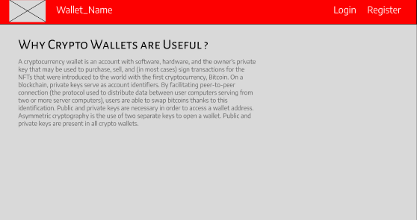
5.User Interface – Home Page

Slide 10
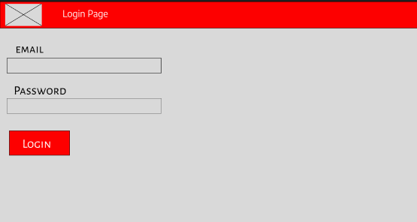
5.User Interface – Login Page

Slide 11
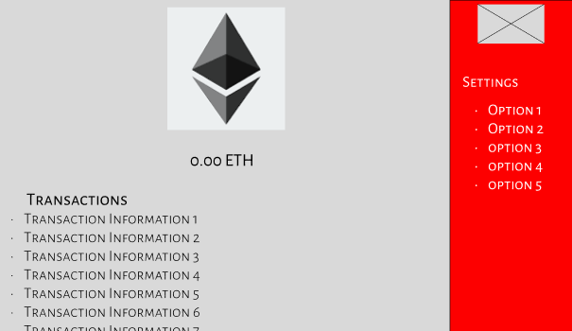
5.User Interface – Wallet Page

Slide 12
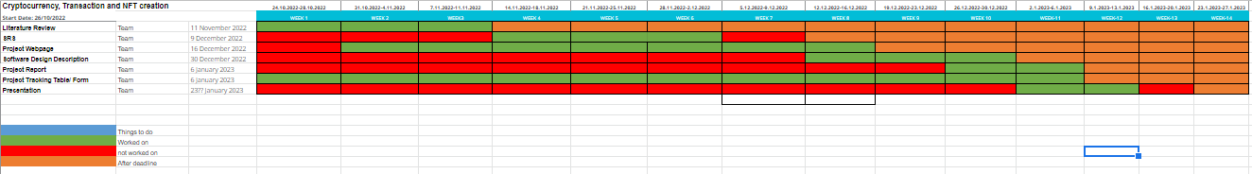
6. Work Plan

Slide 13
7.Conclusion
We aim to develop our technologies to understand how the current economic sensation, crypto currencies work with Blockchain, with Crypto wallets and with NFTs.
Though we develop our wallet as a web-only application, which acts as a simulation, with other languages such as Flutter-Dart, this web application can work on different platforms.

Slide 14
8. References
https://www.cnbc.com/2022/11/28/blockfi-files-for-bankruptcy-as-ftx-fallout-spreads.html
https://en.wikipedia.org/wiki/Cryptocurrency
https://en.wikipedia.org/wiki/Cryptocurrency_wallet
https://tr.wikipedia.org/wiki/NFT

