Slide 1


Çankaya University
Engineering Faculty
Department of Computer Engineering
FRIENDLY GAS
Group Members
Sertan Umut Gürel
Atakan Göknar
Atakan Taner Gül
Tonguç Berat Özel
Selin Deniz
Supervisor: DR. Faris Serdar Taşel

Slide 2
1
INTRODUCTION OF THE PROJECT
2
MAIN FEATURES
3
SIMILAR WORKS
4
MAIN CONTRIBUTION
GENERAL USE CASE
LOCATION USE CASE
FILTER USE CASE
PRESENTATION OF CONTENTS
5
TOOLS
6
CLASS DIAGRAM
7
ACTIVITY DIAGRAM
8
POTENTIAL RISK
9
EXPECTED OUTPUTS

Slide 3
INTRODUCTION OF THE PROJECT
Our project is a gas related website. Gas is one of the most used things in our age and our point is for the people who use it it can be quite beneficial for their personal economy if they use our project.

Slide 4
MAIN FEATURES
Finding the nearest and cheapest gas station
Benefiting people's economies
Helping people save time
Providing free access

Slide 5
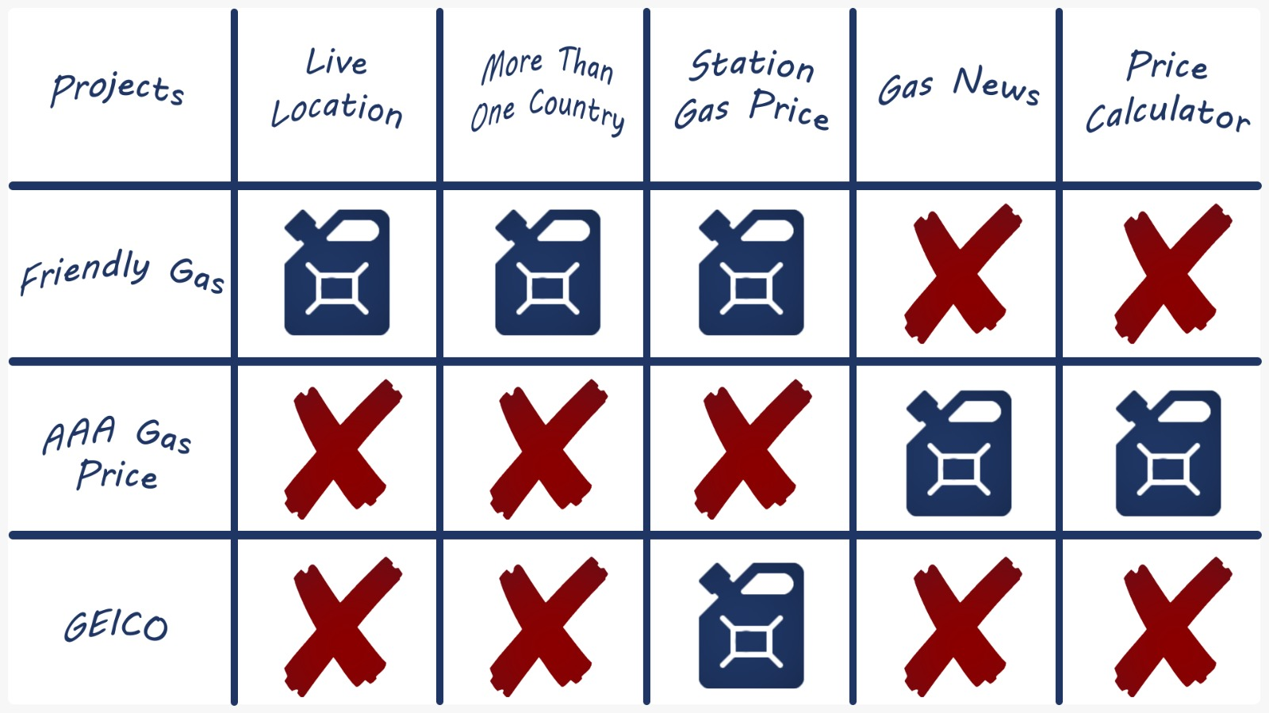
SIMILAR WORKS

Slide 6
MAIN CONTRIBUTION
This part contains general use case, location use case and filter use case.

Slide 7
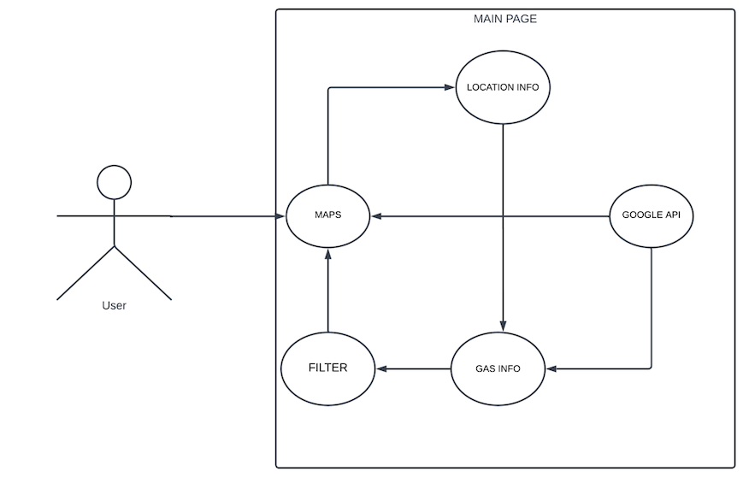
GENERAL USE CASE
MAIN CONTRIBUTION
General Use Case explains how our system works in general.

Slide 8
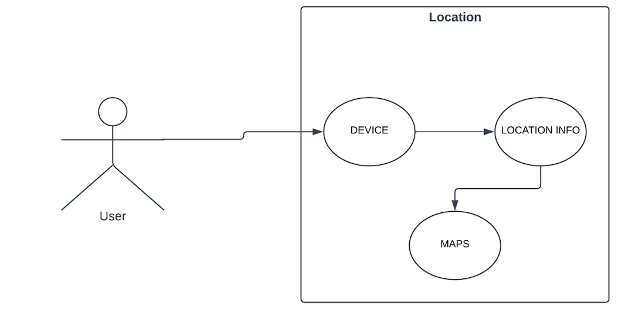
LOCATION USE CASE
MAIN CONTRIBUTION
Location Use Case shows how the location system works.

Slide 9
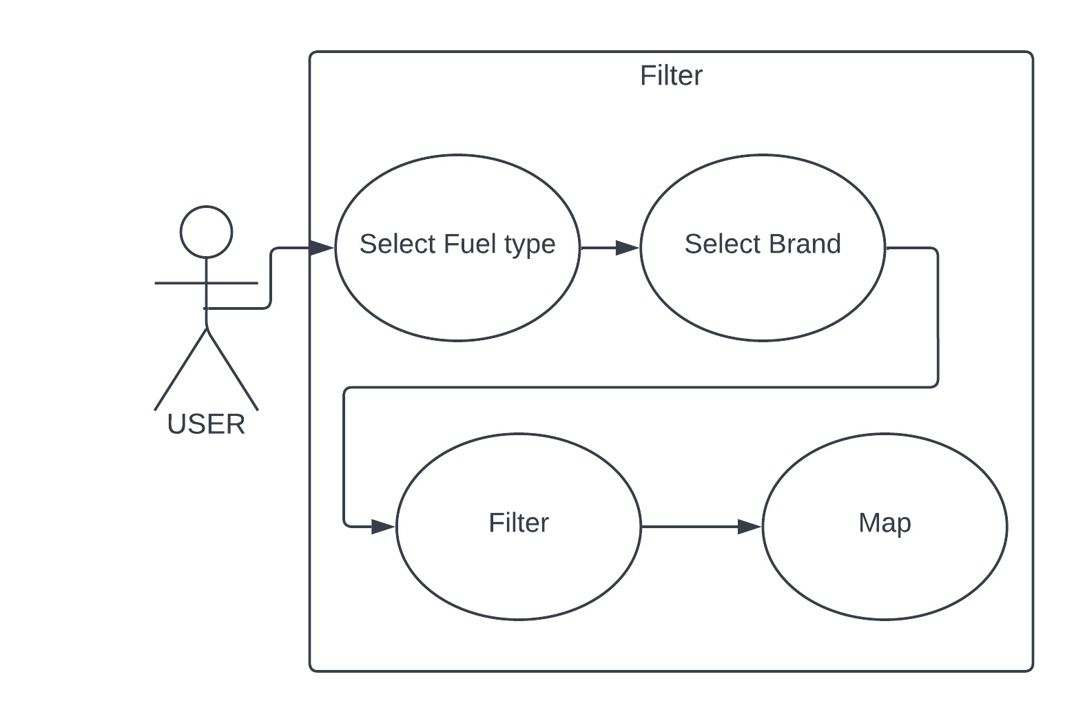
FILTER USE CASE
MAIN CONTRIBUTION
Filter Use Case shows how the filter system works.

Slide 10



TOOLS
Front-End
Back-End
Database
React
Java
Sql Server Management

Slide 11
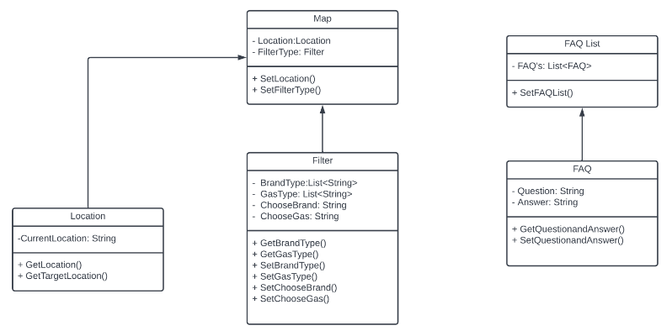
CLASS DIAGRAM

Slide 12
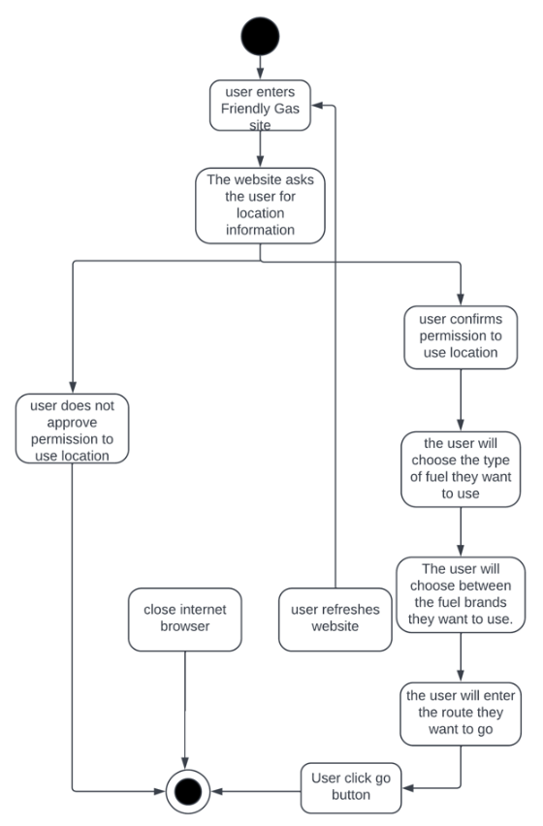
ACTIVITY DIAGRAM

Slide 13
POTENTIAL RISK
Google API PROBLEM
ACCESS PROBLEM
FILTER SYSTEM PROBLEM
INSTANT INFORMATION PROBLEM

Slide 14
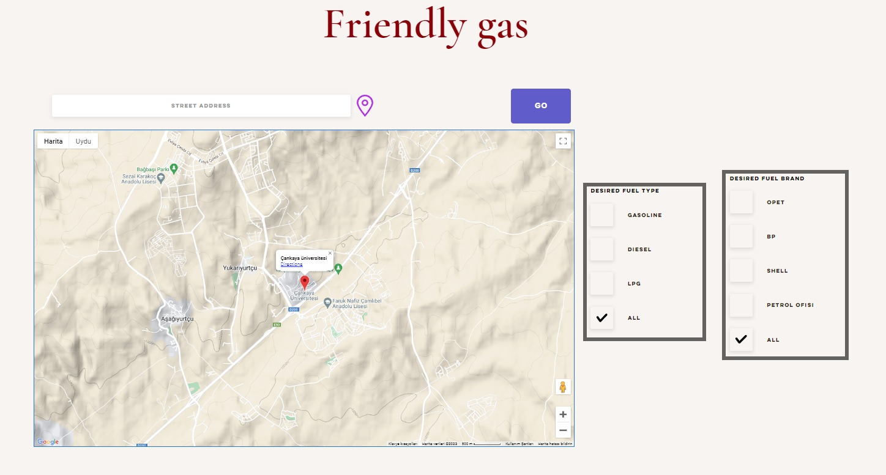
EXPECTED OUTPUTS

Slide 15
EXPECTED OUTPUTS
Location icon gives the instant location of the user. The user enters the address to go to the bar on the left.
The user selects the desired fuel type. If he does not choose one, all of them are selected by default.
The user selects the desired fuel brand. If he does not choose one, all of them are selected by default.
After the user has done all the operations, he/she reaches the result by pressing the GO button.

Slide 16
Any Questions ?
Thanks For Listening Us

