Slide 1

Exploratory Data Analysis

Slide 2
TEAM MEMBER’S DETAILS
Group Name: Banking Insights Squad
Group: Members: Canmert Demir & Joseph Pang
Names: Canmert Demir-Bank Marketing (Campaign) -- Group Project
Email: canmertdemir2@gmail.com
Country: Turkey
College/Company: Msc Bartin University-Applied Mathematics / Data Glacier
Specialization: Data Science
Name: Joseph Pang-Bank Marketing (Campaign) -- Group Project
Email: joseph302156@gmail.com
Country: United States
College/Company: University of California, Berkeley/ Data Glacier
Specialization: Data Science
Github Repository: https://github.com/Canmertdemir/DataGlacierWeek11

Slide 3
PROBLEM DESCRİPTİON
ABC Bank is set to launch a new fixed-term deposit product catering to clients seeking secure and profitable investment options. Leveraging extensive customer data and employing data analytics and machine learning techniques, the bank aims to understand customer behaviors deeply.
Their strategy involves analyzing past banking interactions to craft personalized marketing strategies aligned with specific customer preferences. This initiative not only seeks to introduce a new product but also aims to enhance customer satisfaction by offering tailored financial solutions.
ABC Bank's commitment to data-driven decision-making and customer-centricity underscores its tradition of delivering innovative financial products aligned with individual goals and aspirations.

Slide 4
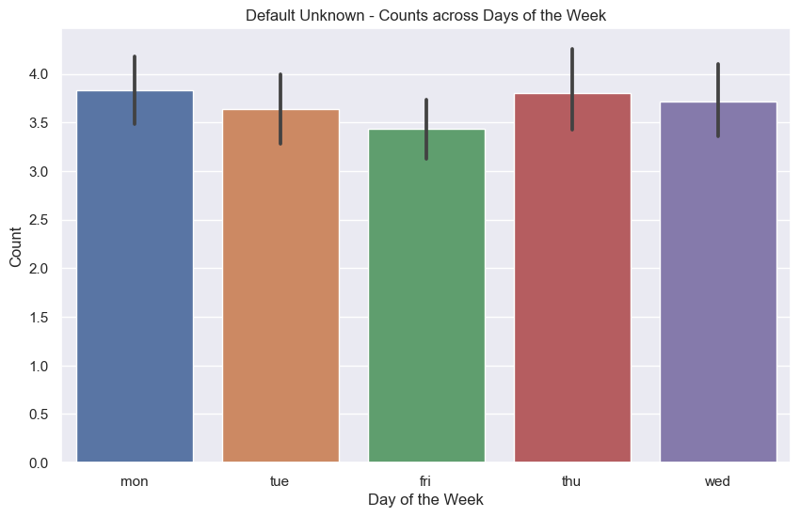
Exploratory Data Analysis
When examining the distribution of days concerning communication with customers in the context of the campaign, it is observed that almost an equal number of customers are contacted on a daily basis.
However, there is a significant decrease in communication on Tuesdays and Fridays. Those responsible for conducting the campaign should be informed to increase the number of calls made on Tuesdays and Fridays to customers.

Slide 5
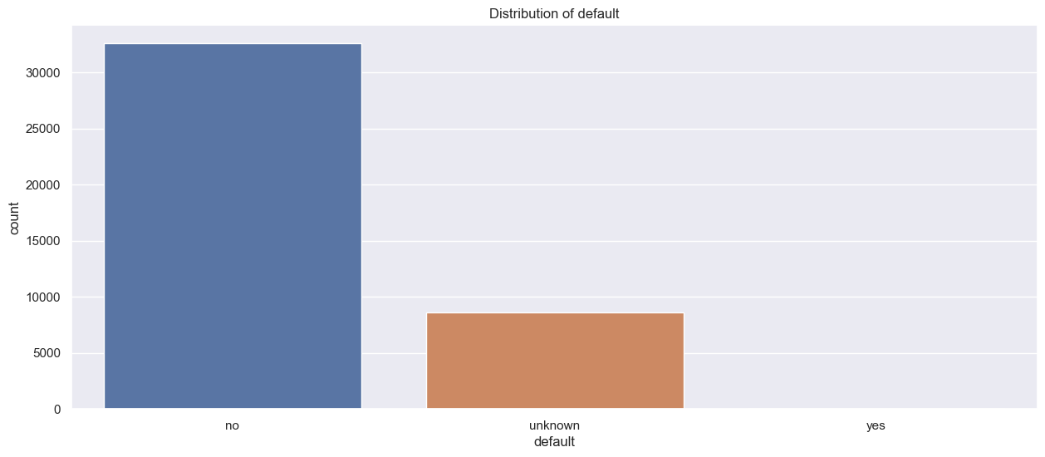
Exploratory Data Analysis
We have a segment that has not previously participated in the campaign, and there is also a significant portion whose campaign history remains undetermined.
Contacting this segment to clarify whether individuals have previously engaged with the campaign can lead to a more comprehensive analysis.

Slide 6
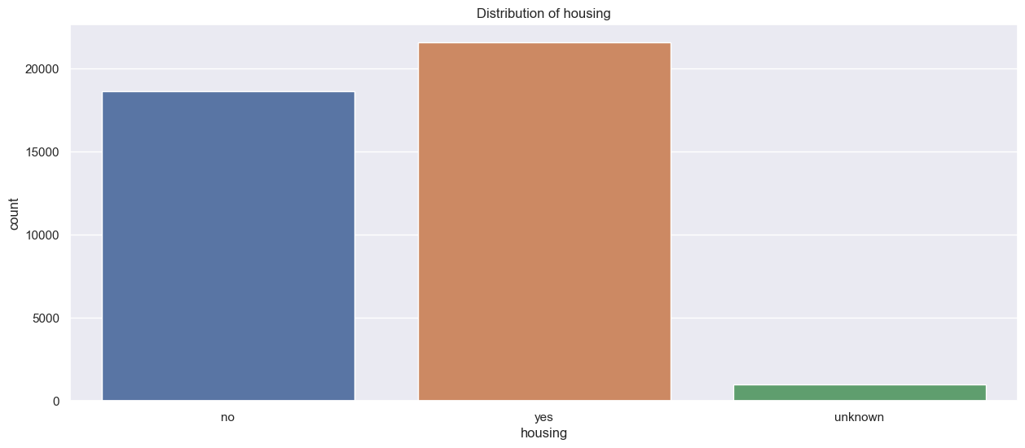
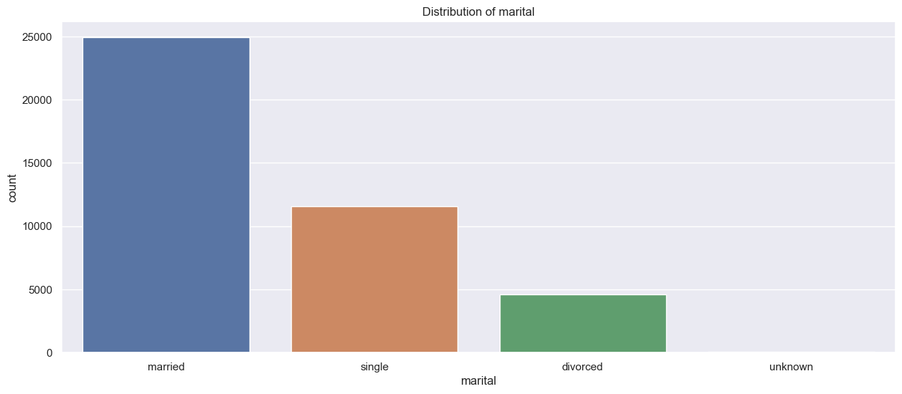
Profit Analysis
Exploratory Data Analysis
In a campaign audience evenly split between those with and without loans, different strategies are needed. Offering discounts, privileges to those with loans, and financial incentives for married individuals could emotionally connect them to the campaign, positively impacting participation. Tailoring strategies for each subgroup based on their financial status could make the campaign more appealing and effective.

Slide 7
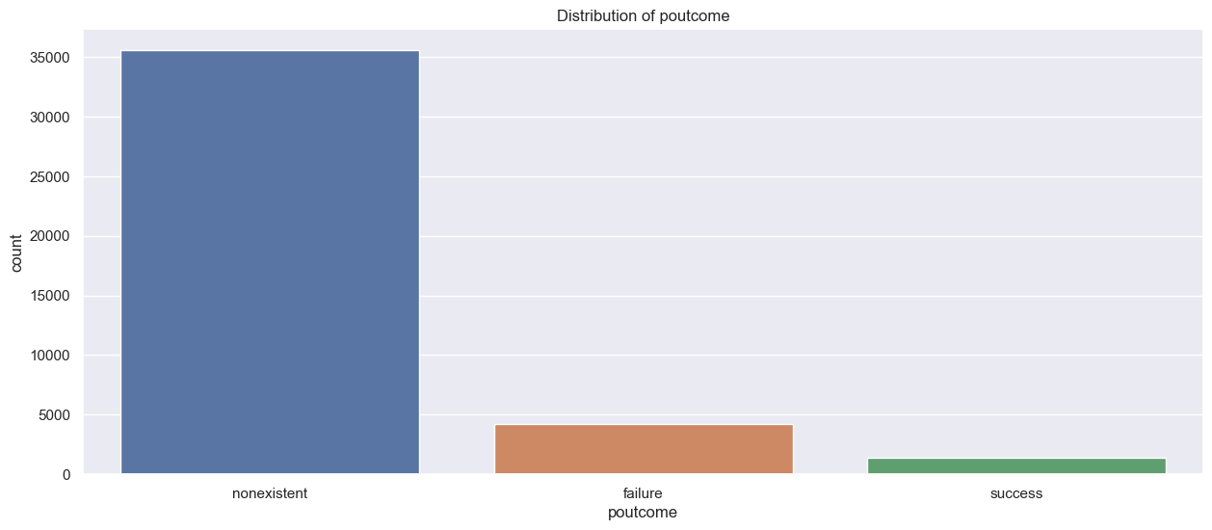
Exploratory Data Analysis
Having a high number of individuals who haven't participated in the campaign before is advantageous as it signifies no inherent bias against the campaign.
However, there is a significant group that previously experienced unsuccessful campaign sales. Regular calls and visits should be conducted with this audience to break through any negative perceptions they may hold. This approach aims to diminish past negative experiences and re-engage them with the campaign.

Slide 8
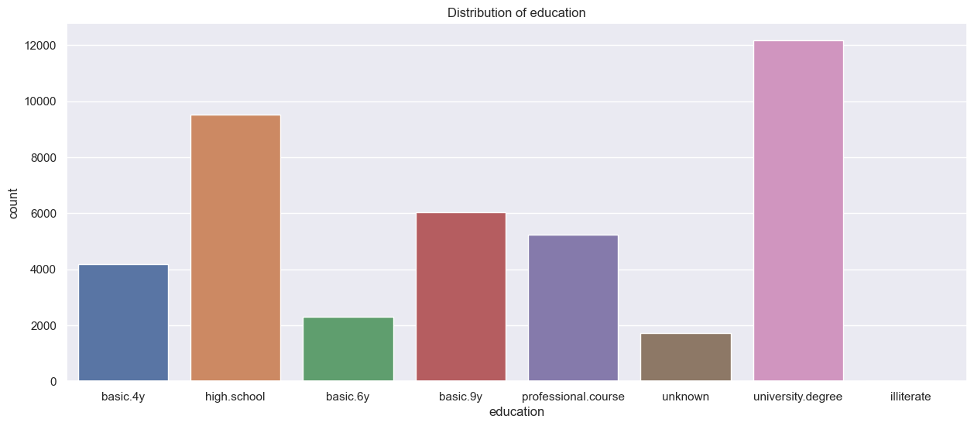
Exploratory Data Analysis
The campaign includes individuals with education levels ranging from basic 4 years to university degrees. Segmenting individuals based on their education levels is crucial for tailoring the campaign's explanation, conversation, and approach. However, the groups with high school and university education levels are predominant and should be the primary focus during the campaign.

Slide 9
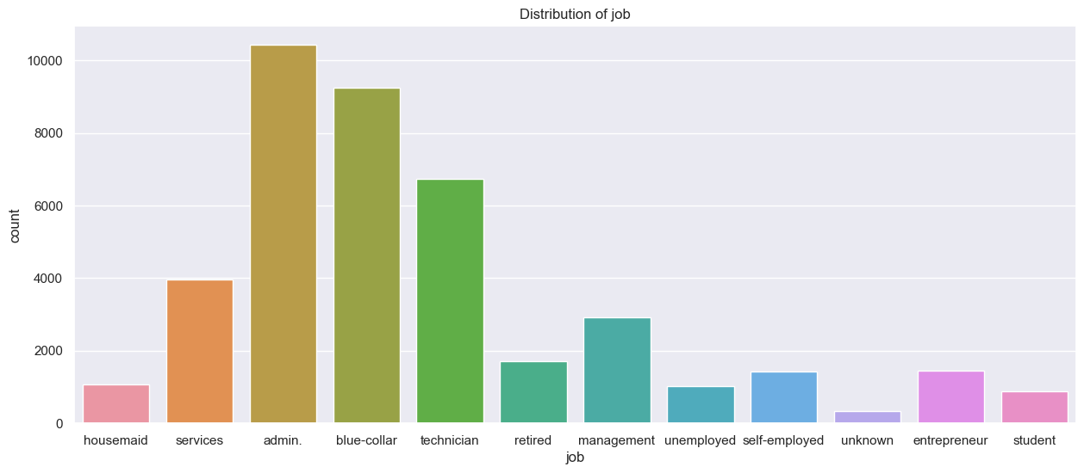
Exploratory Data Analysis
Left-skewed graph: "Cost of Trip" is typically characterized by central values that are generally lower, and this type of distribution is characterized by negative skewness.

Slide 10
Exploratory Data Analysis
Upon examining the graph in the previous slide, it's evident that job groups such as services, administration, blue-collar, and technician significantly dominate our audience. Particularly, focusing on the administration, blue-collar, and technician groups is crucial during the campaign process.

Slide 11
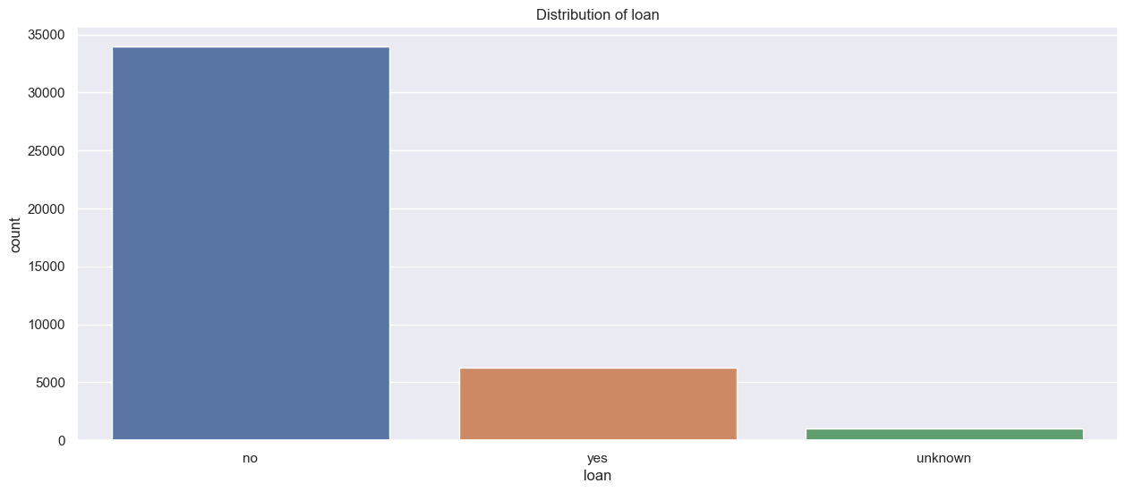
Exploratory Data Analysis
Our campaign audience mostly doesn't have a loan, which is advantageous for campaign sales. Especially for those without a loan, frequent calls should be made. By maintaining regular contact, we can create a positive perception about the campaign and ensure they have a good understanding of it.

Slide 12
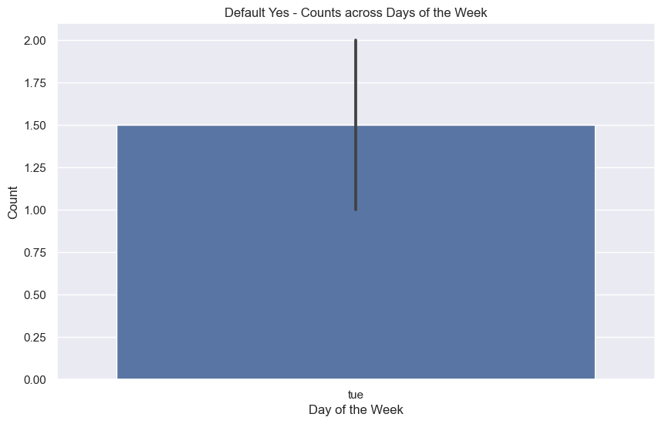
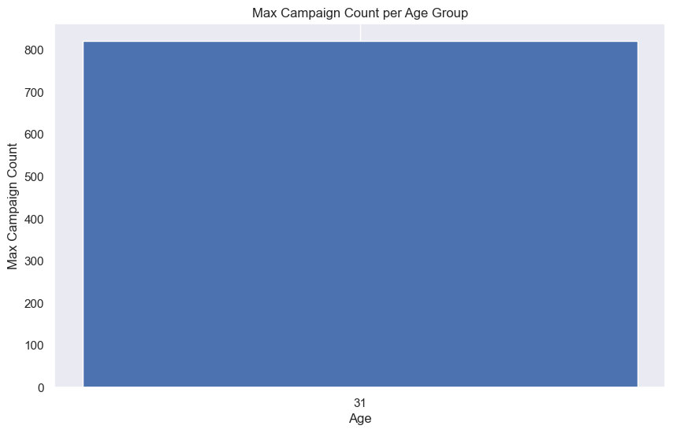
Interesting Results from Exploratory Data Analysis
The majority of individuals who previously purchased the campaign did so on Tuesdays. In the new campaign, increasing calls specifically on Tuesdays, for instance, reaching out to the campaign audience without loans, could be effective. Analyzing the age range, individuals around 31 years old show the most prevalent attitude, whether positive or negative, towards the campaign. Considering their age during outreach in the campaign process could be beneficial.

Slide 13
Exploratory Data Analysis
Presenting economic parameters through graphs is crucial for understanding the decision-making process during a campaign.
These graphs illustrate the performance and trends of the economy during a specific period and their potential impact on campaign strategies.
For instance, indicators such as unemployment rates or consumer price indices may be displayed to showcase their changes over time.
These data help in determining campaign strategies by understanding factors like the overall state of the economy, consumer confidence, and spending habits.
These graphs contribute significantly to grasping the economic conditions during a campaign and shaping strategies accordingly.

Slide 14
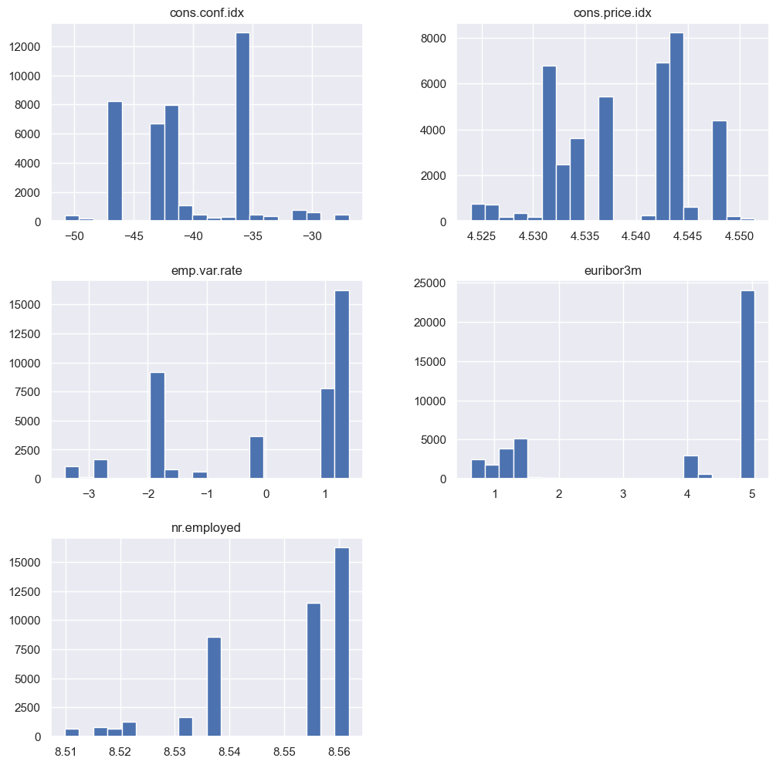
Exploratory Data Analysis

Slide 15
Exploratory Data Analysis
The CCI values are fluctuating in the negative range during the campaign period. This indicates that prices of specific goods purchased by consumers are generally lower nationwide. The country is in a period of deflation, which could positively impact the campaign process as an economic parameter.

Slide 16
Exploratory Data Analysis
The Consumer Price Index (CPI) fluctuates between 4.525 and 4.550. These variations suggest minor changes in specific consumer basket prices. If this range remains stable over time, it implies a consistent level of price fluctuation for consumers.Stable CPI values might not significantly alter consumer spending habits. However, sudden changes could impact campaign strategies. For instance, a sudden price increase might curb consumer spending.Overall, this CPI range reflects relative economic stability for campaign strategies, but long-term trends and stability are essential considerations.

Slide 17
Exploratory Data Analysis
The Employment Variation Rate fluctuates between -3 and 1, showing an increase during the campaign period. This value typically represents changes in the workforce.
Negative values are often associated with economic downturns or increased unemployment, while positive values indicate workforce expansion or economic growth.
If the employment variation rate is rising during the campaign, it could be a positive sign. Increased employment usually boosts consumers purchasing power. People finding jobs or earning more income can enhance their spending tendencies, positively impacting campaign sales.
However, understanding the reason behind the rise in the employment variation rate is crucial. For instance, whether the increased employment is temporary or which sectors experience job growth can significantly impact campaign strategies. These insights can affect potential customers' spending habits and campaign sales.

Slide 18
Exploratory Data Analysis
The Euribor 3-month interest rate started at 1 during our campaign, skipped values of 2 and 3, stayed at 4 for a while, and rapidly surged to 5. Let's interpret this in terms of campaign sales. Interest rates typically influence consumer spending and credit usage.
When the Euribor 3-month interest rate is low (around 1 or 2), consumer loans tend to be cheaper, encouraging spending. Hence, during the campaign, these lower interest rates might have positively impacted consumer spending, potentially boosting campaign sales.
However, a sudden and rapid increase in interest rates (such as from 4 to 5) could reduce consumer borrowing. Higher interest rates usually increase borrowing costs, limiting consumer spending. This could have negatively affected consumer spending during the campaign, potentially impacting campaign sales
.Therefore, while a rapid rise in interest rates might have dampened campaign sales, lower interest rates during the campaign could have boosted consumer spending. Considering these factors is crucial in shaping campaign strategies.

Slide 19
Exploratory Data Analysis
During our campaign, the number of employed individuals (nr.employed) increased from 8.51 to 8.56. This rise typically signifies economic strength and an improvement in the labor market. Such an increase during the campaign period could have positive implications.
An upsurge in employment often correlates with heightened consumer spending power, which, in turn, can positively impact campaign sales. Increased employment tends to instill consumer confidence, reflecting stability in the job market, potentially leading to increased spending and growth in campaign sales.
However, the impact of this situation on the campaign might be contingent on various factors. Understanding whether this employment rise is specific to particular sectors or directly relates to the campaign's target audience is pivotal in shaping our campaign strategies.

Slide 20
Recommended Models
Regarding the data distribution, logistic regression can yield favorable results and performance. Additionally, leveraging ensemble algorithms could prove advantageous given the dataset's inclusion of both categorical and numerical values.
Ensembles effectively leverage the strengths of different algorithms suited for either categorical or numerical values, contributing to a more robust analysis of the dataset.

Slide 21
Recommended Models
Recommended Models for Ensemble:
Logistic Regression
LightGBM
CatboostClassifier
The necessary hyperparameter optimizations have been anticipated to be applied to the aforementioned models, expecting a substantial increase in the AUC score. This anticipation suggests an enhancement in monitoring the campaign process and an increase in predictive accuracy.

Slide 22
Thank You

