Slide 1
Algorithmic Methods for Mathematical Models COURSE PROJECT Facultat d'Informàtica de Barcelona Master in Innovation and Research in Informatics
Can Beydogan - can.beydogan@estudiantat.upc.edu
Sefa Böyükdikmen - sefa.boyukdikmen@estudiantat.upc.edu
Fall 24
Barcelona, December 10, 2024

Slide 2
Contents
Problem Statement
Inputs, Outputs
Integer Linear Programming Model
Decision Variable
Objective Function
Constraints
Heuristic Algorithms
Greedy Constructive Algorithm
Greedy Constructive and Local Search Procedure
GRASP
Tuning the α parameter
Performance

Slide 3

Problem Statement : Inputs & Outputs
Inputs
D is the number of departments in the faculty.
n[1..D] is the array of size D, department p has exactly a number n[p] of participants in the commission.
N is the total number of faculty members.
d[1..N] the department of i will be denoted by d[i].
m[1..N][1..N] is a N x N matrix where each element m[i][j] is the compatibility between members i and j. The diagonal of the compatibility matrix consists of 1’s.
Outputs
The solution (if one exists) with optimal objective value.
The selection of faculty members, represented by the array x[1..N],

Slide 4




Integer Linear Programming Model
Objective Function
Constraints
Department Participation
Zero Compatibility
Conflict Mediation

Slide 5
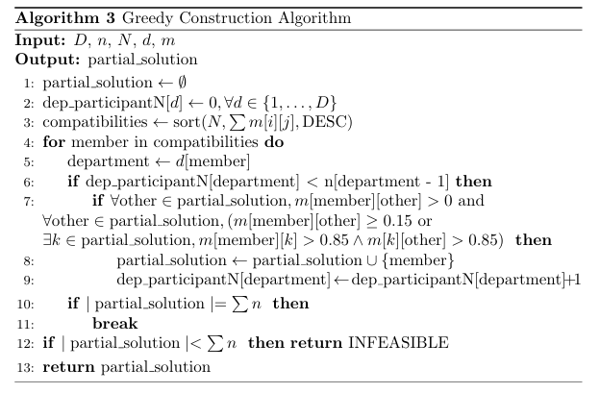
Heuristic algorithms Greedy Constructive Algorithm

Slide 6
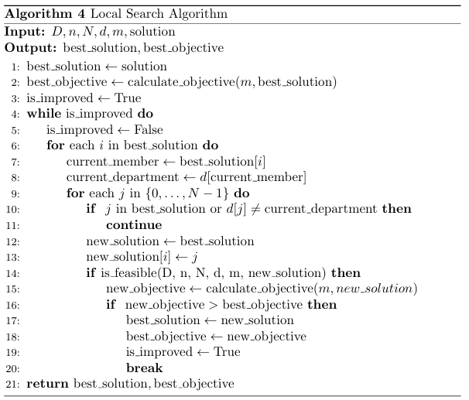
Heuristic algorithms Greedy Constructive and Local Search Procedure

Slide 7
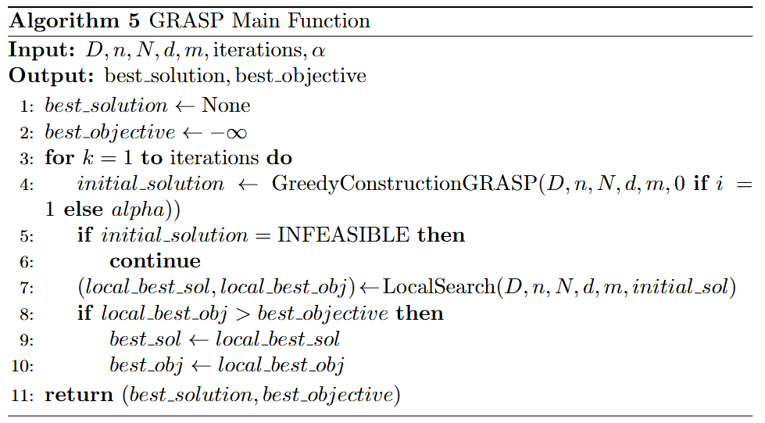
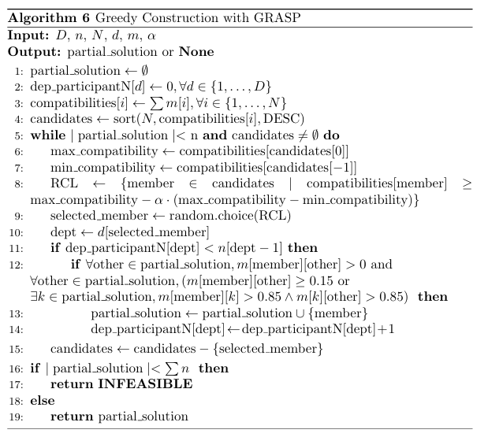
Heuristic algorithms GRASP

Slide 8
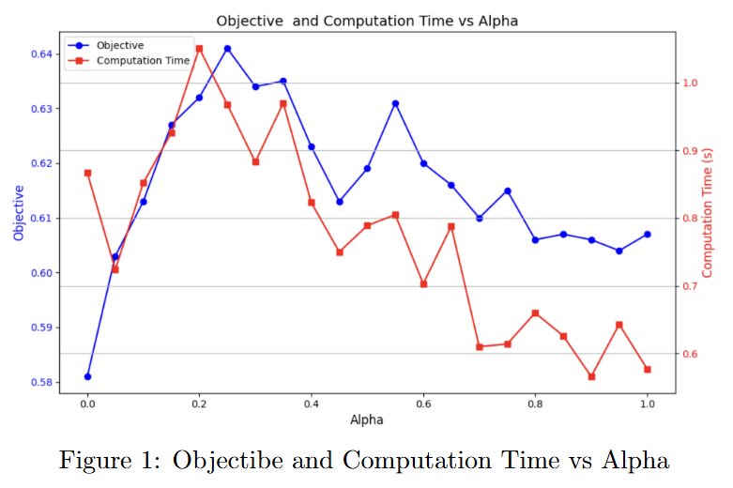
Tuning the αlpha parameter

Slide 9
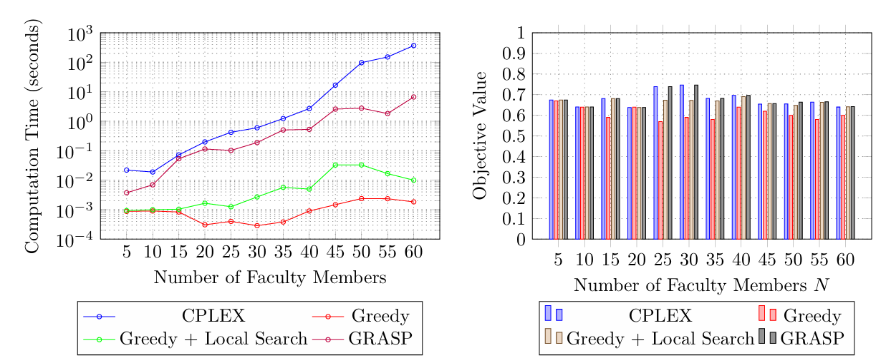
Performance

