Slide 1
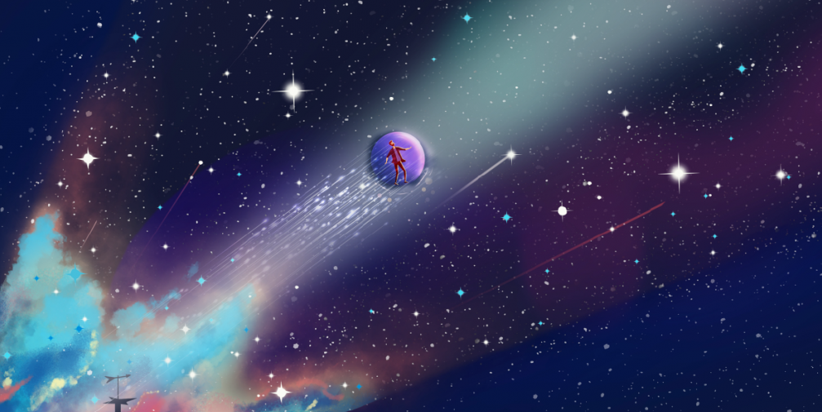
“Oh! Be A Fine Girl/Guy/Gender, Kiss Me!”
Stars by Kush, 13 October 2023

Slide 2
Today’s menu
What is a Star?
Human - Resource Development
Interesting stuff on the H-R D
PSA: The slides today are very simple. I apologise for the lack of extravagant animations. I might have been slightly busy while preparing this presentation.

Slide 3
S T A R
Section 1:

Slide 4
S T A R
omething
winkly
nd
ound

Slide 5
But seriously though, what is a Star?

Slide 6
But seriously though, what is a Star?
Any massive self-luminous celestial body of gas that shines by radiation derived from its internal energy sources (Britannica).
An astronomical object comprising a luminous spheroid of plasma held together by self-gravity (Wikipedia).

Slide 7
But seriously though, what is a Star?
A celestial object that is massive enough to start the fusion of elements in its core due to gravitational pressures.

Slide 8
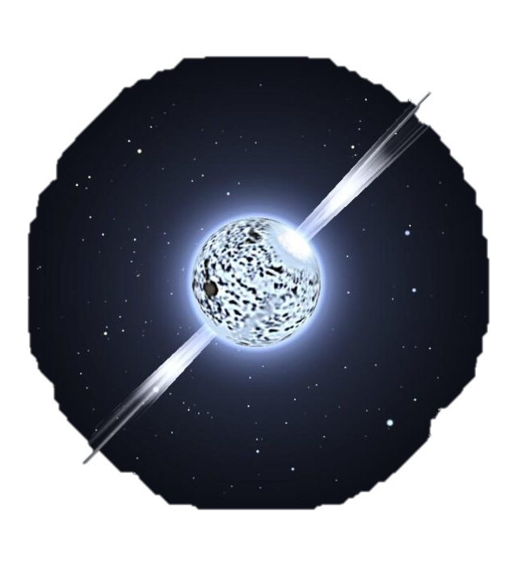
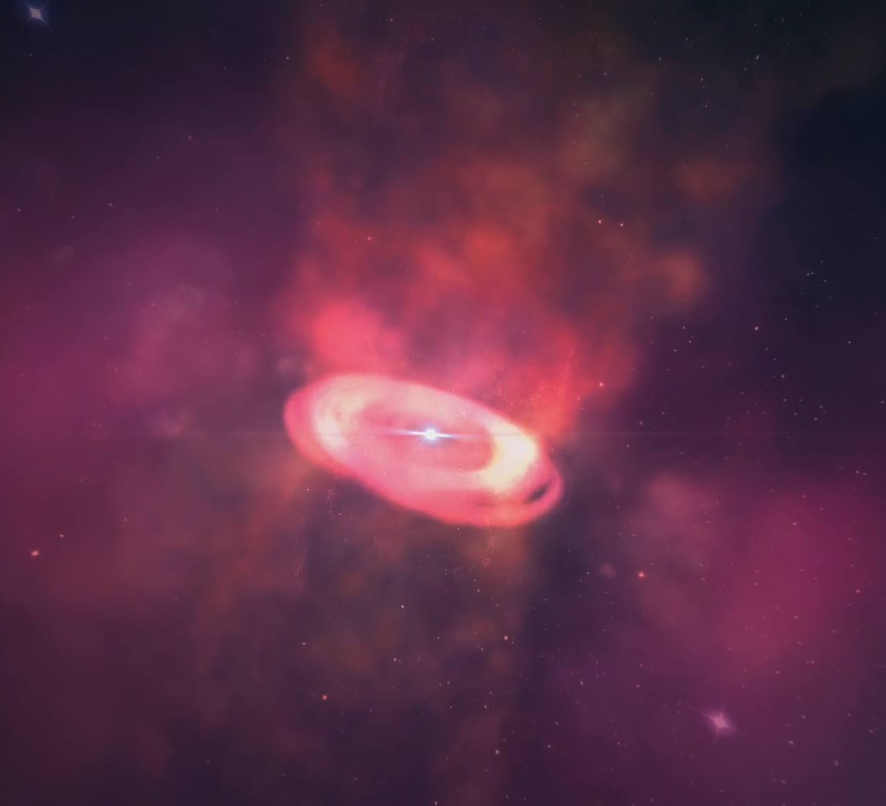
Est Stella?
Neutron Stars
Protostars
Neutron Stars

Slide 9
How can we quantify a star?

Slide 10
H-R D
Section 2:

Slide 11
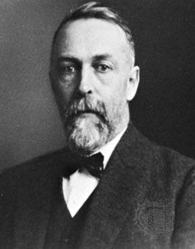
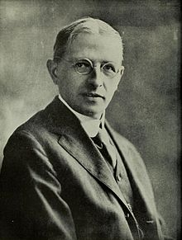
Hertzsprung – Russell Diagram
Ejnar Hertzsprung
Henry Norris Russell
My apologies but, why do they look like Death Eater?

Slide 12
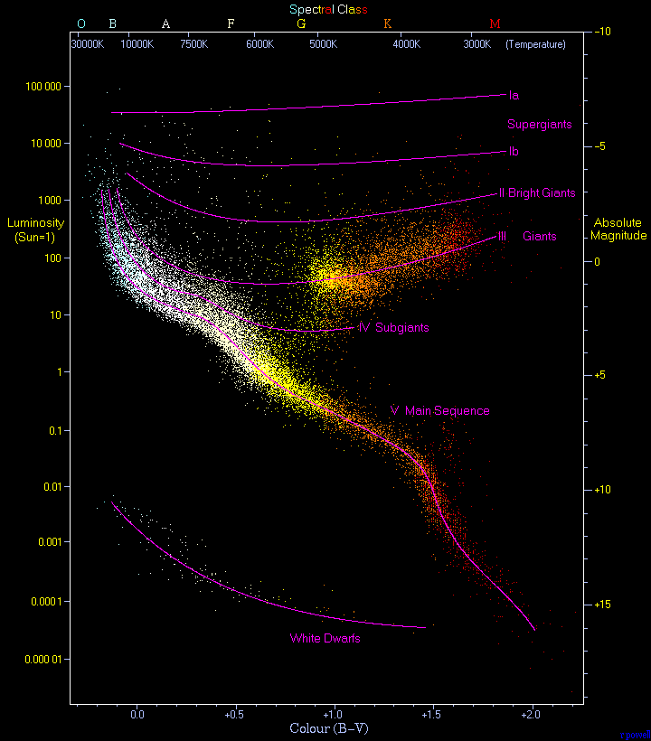
Hertzsprung – Russell Diagram

Slide 13
Hertzsprung – Russell Diagram
Harvard Spectral Classification
(Epitome of Misogyny)

Slide 14
Hertzsprung – Russell Diagram
Harvard Spectral Classification
O (>= 30k)
B (10k – 30k)
A (7.5k – 10k)
F (6k – 7.5k)
G (5.2k – 6k)
K (3.7k – 5.2k)
M (2.4k – 3.7k)
Temperature is related to the emission lines

Slide 15
Hertzsprung – Russell Diagram
Harvard Spectral Classification (Subdivided)
O[0,1,2,…,9] B[0,1,2,…,9] A[0,1,2,…,9] F[0,1,2,…,9] G[0,1,2,…,3] K[0,1,2,…,9] M[0,1,2,…,9]
0 has the highest and 9 has the lowest temperature

Slide 16
Hertzsprung – Russell Diagram
Blue
B-V (Color) Index
Green/Visual

Slide 17
Hertzsprung – Russell Diagram
Absolute Magnitude
The magnitude at 10 parsecs (~32.6 lys)

Slide 18
Hertzsprung – Russell Diagram
Luminosity
Energy output per unit time (Joules/seconds)

Slide 19
Hertzsprung – Russell Diagram
Morgan-Keenan Luminosity Classes
Ia-O – Extreme, luminous Supergiants
Ia – Luminous Supergiants
Ib – Less luminous Supergiants
II – Bright Giants
III – Normal Giants
IV – Subgiants
V – Main Sequence
VI – Subdwards
D – White Dwarfs

Slide 20
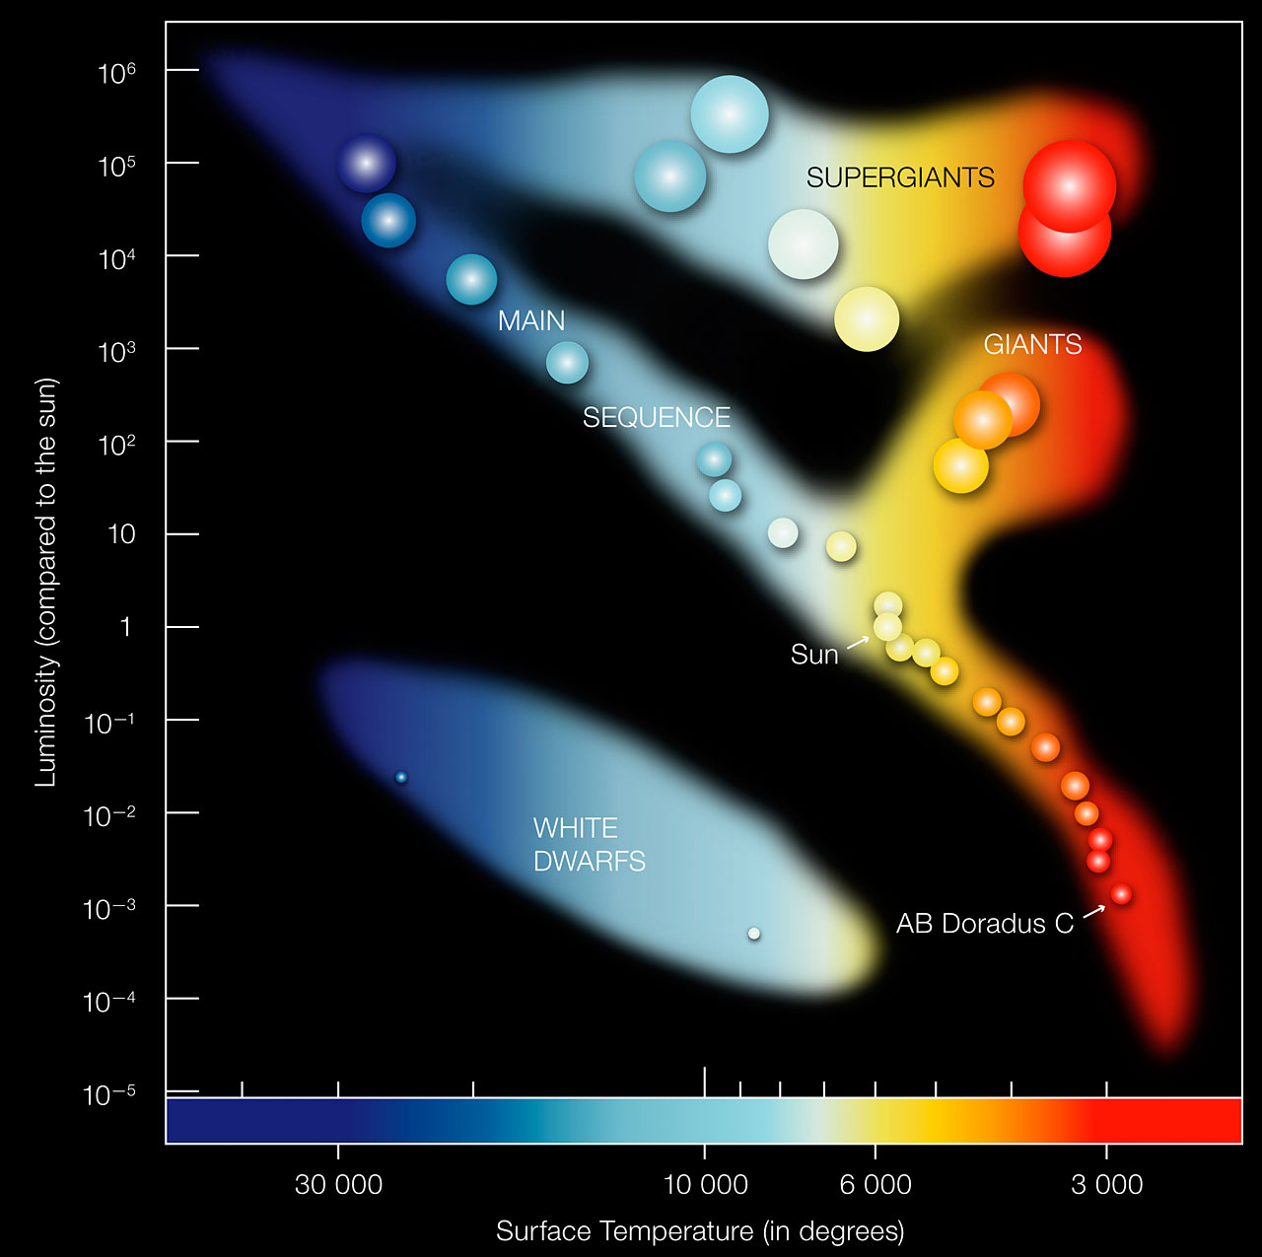
Hertzsprung – Russell Diagram
Harvard + MK
Sun is a G2V (3rd subdivision of Main Sequence)

Slide 21
Hertzsprung – Russell Diagram
Some Notes
There are other spectral classes now, L, T, S, C, etc
There is no standard version of the HR Diagram
This deserves a much more rigorous treatment (in which neither I have time nor expertise)

Slide 22
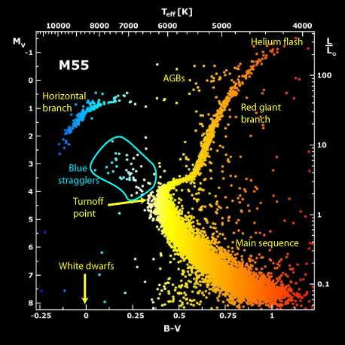
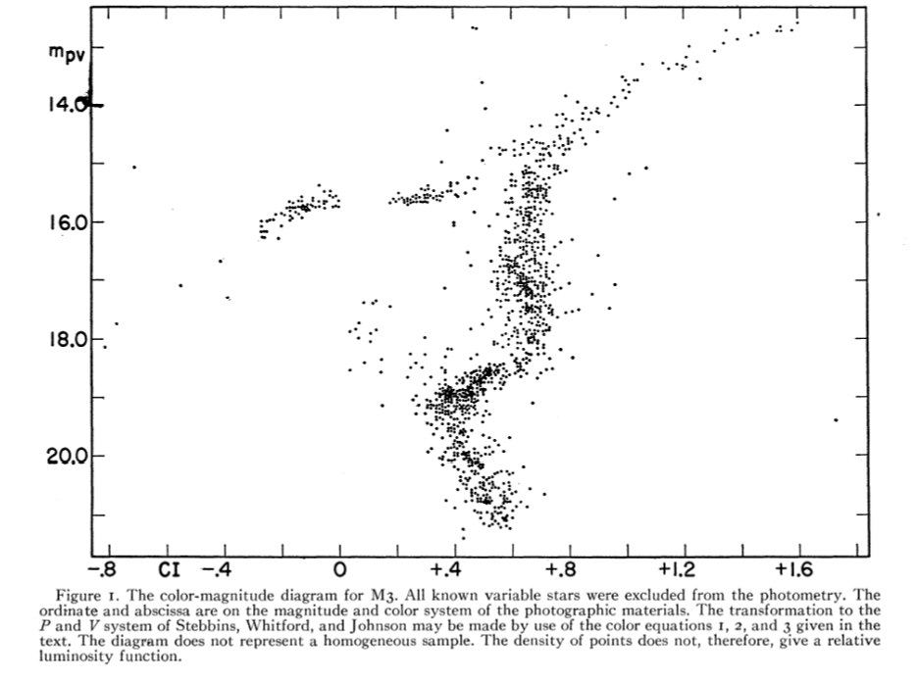
Hertzsprung – Russell Diagram
A cool finding: Blue Stragglers
M55 HRD
M3 HRD
(original paper screenshot)

Slide 23
The End
Thank you for bearing with the subpar slides
For any queries, please feel free to ask questions.
If you hate me, sad for you.

Slide 24
Same old, Same old…
GAYUM TIME

Slide 25
The sad sky
Instructions:
Draw today’s night sky
The top 3 drawing win prizes
You have 6.5 minutes
“If you win in team, you need to share the food. If you win individually, you can flex. Be a lone wolf.”

