Slide 1
Ways to Connect to OSG
Tuesday, Wrap-Up
Lauren Michael, CHTC

Slide 2
Overview
Types of HTC/OSG submit points
OSG Virtual Organizations
(members of OSG consortium)
Available to Anyone*!
OSG Connect
OSG via XSEDE
*affiliated with a U.S. institution/non-profit/etc.

Slide 3

Local HTC Submit Point
HTCondor Pool
(or other Cluster)
Submit Server

Slide 4
OSG School Submit (1yr access)
(learn.chtc.wisc.edu)
HTCondor Pool
(or other Cluster)
Submit Server
OSG
pool
Submit Server
OSG entry point
(osg-learn.chtc.wisc.edu)
(training.osgconnect.net)

Slide 5
OSG School Submit (1yr access)
(learn.chtc.wisc.edu)
HTCondor Pool
(or other Cluster)
Submit Server
OSG
pool
Submit Server
OSG entry point
(osg-learn.chtc.wisc.edu)
(training.osgconnect.net)

Slide 6

At UW-Madison’s CHTC

Slide 7
Overview
Types of OSG submit points
OSG Virtual Organizations
(members of OSG consortium)
Other OSG submit points
OSG Connect
OSG Connect Client
OSG via XSEDE

Slide 8
Accessing an OSG Submit Point – 4 Ways
 | Local VO | OSG Connect | XSEDE
Available to | users with a campus/org VO | affiliates of U.S. research orgs | users with XSEDE allocation
Cost | very unlikely | FREE | FREE (but need allocation)
Limit on CPU hrs | unlikely | NO | YES (per allocation)
Local Help | very likely (local staff) | unlikely | possibly* (Campus Champion)
Online Guides | likely | YES | limited
Submit Point Type | submit server (or direct OSG entry server) | direct OSG entry server | submit node to OSG entry server
*not all XSEDE Campus Champions will have experience with HTC or OSG

Slide 9
Virtual Organization (VO)
institution or research project that is part of the OSG consortium
accounts and access determined by local VO administrators
most offer user support or specialized interfaces for their specific setup and population of users
How do I determine whether my institution is/has a VO?

Slide 10
Using OSG through a VO
Determine whether there is a local VO for your institution/organization.
Get an account
Contact the administrators to get an account on their glidein server (or submit node tied to a glidein server).
Submit jobs
Follow site-specific guides and/or submit jobs as you have been at the OSG School.

Slide 11
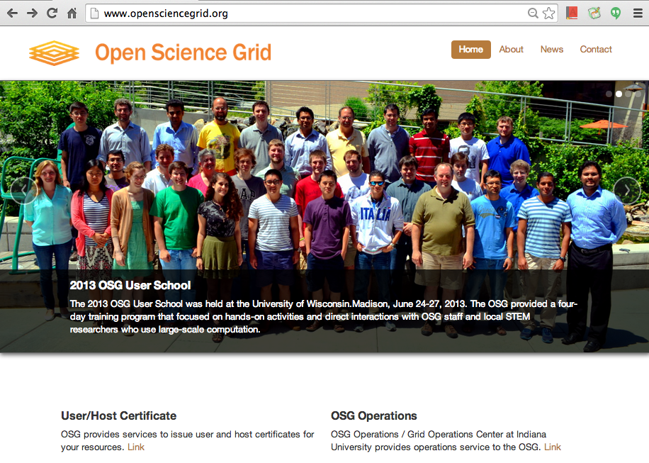
… to the real world

Slide 12

… to the real world

Slide 13
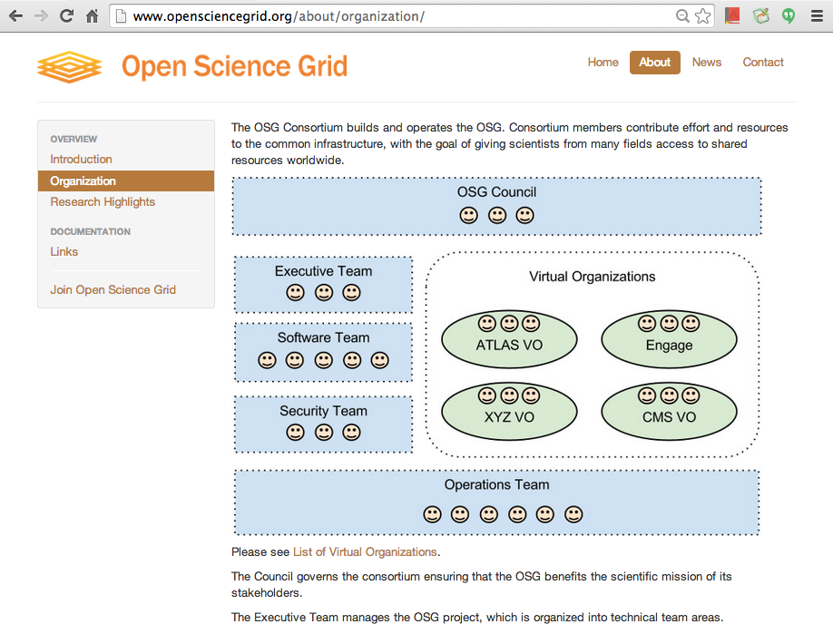
… to the real world

Slide 14
OSG Connect
Essentially, a VO available to those without a Local VO
Free for affiliates/partners of U.S. research institutions
Submit from OSG Connect server or use Connect Client on another cluster (e.g. Clemson)
Online guides, software support, and contact info

Slide 15
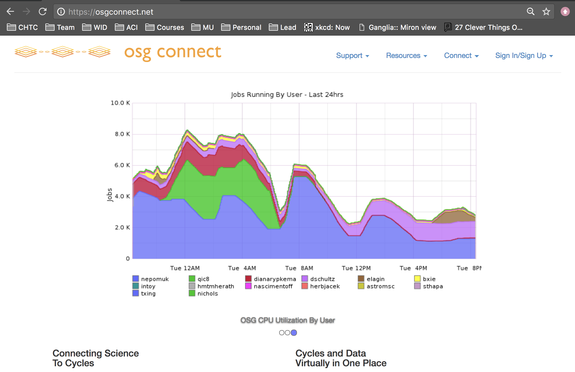

Slide 16
Details and hands-on exercises on Thursday morning!
(training.osgconnect.net)

Slide 17

Using OSG via
XSEDE:
a consortium of HPC clusters and other computational services available to academics in the U.S.
free accounts, but you must request an XSEDE allocation of compute hours
limited online guides specific to OSG-XSEDE, but similar to submission via osg-ss-glidein-submit

Slide 18
Using OSG via
Sign up for an XSEDE account.
Request an OSG allocation
via the XSEDE User Portal to request a startup (or long-term) allocation of compute hours for OSG.
Follow XSEDE’s guides for connecting to and using the XSEDE submit server.
Submit jobs as you have been at the school, making sure to indicate your XSEDE project name (allocation code).

Slide 19
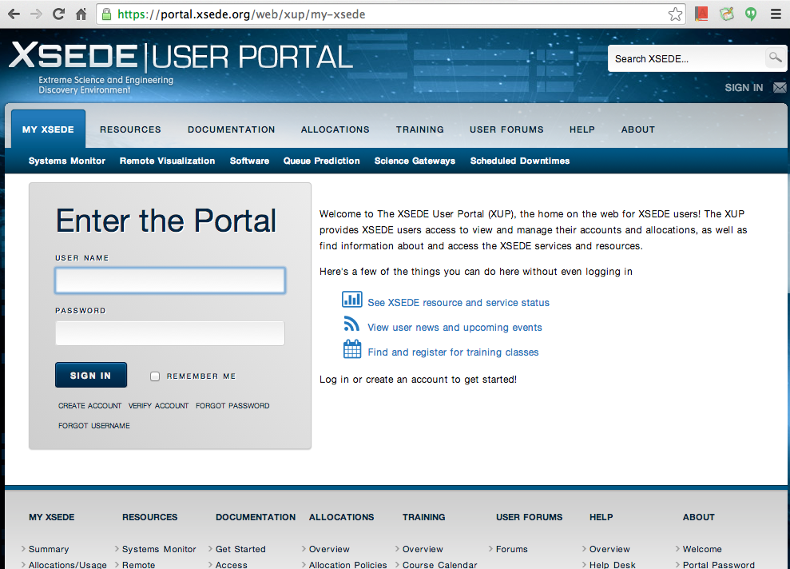

Slide 20
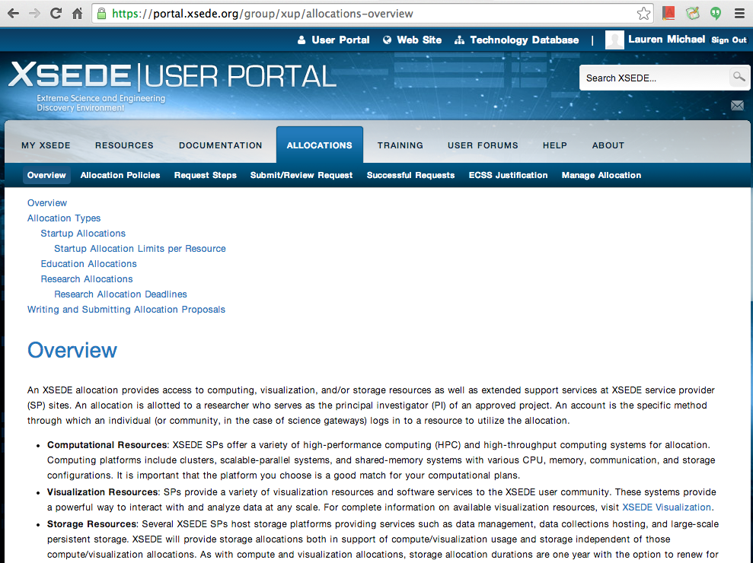
… to the real world

Slide 21
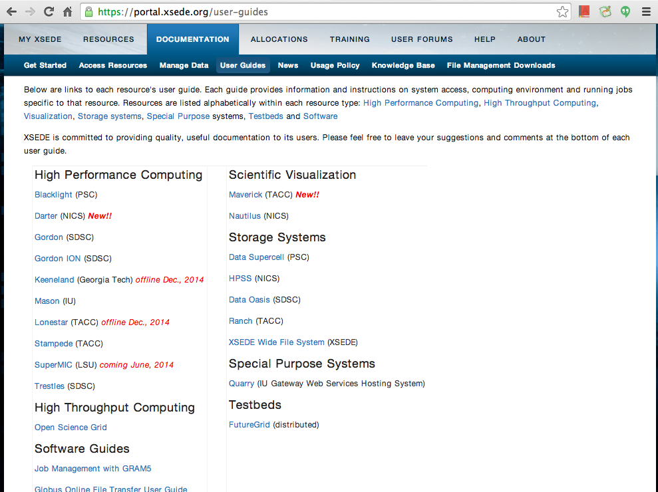
… to the real world

Slide 22
Overview
Types of HTC/OSG submit points
OSG Virtual Organizations
(members of OSG consortium)
Available to Anyone*!
OSG Connect
OSG via XSEDE
*affiliated with a U.S. institution/non-profit/etc.

Slide 23
OSG School Submit (1yr access)
learn.chtc.wisc.edu
HTCondor Pool
(or other Cluster)
Submit Server
OSG
(>120 sites)
Submit Server
OSG entry point
osg-learn.chtc.wisc.edu
training.osgconnect.net
(by VO)

Slide 24
Questions?
Feel free to contact me:
lmichael@wisc.edu
Next: Evaluate today!
More on Thursday:
Learn more about OSG Connect and supported software

