Slide 1
Large Input in DHTC
Thursday AM, Lecture 2
Brian Lin
OSG

Slide 2

Transfers
More Data
HTCondor
File Transfer
HTTP
Proxies
StashCache
Local
Storage

Slide 3
Hardware transfer limits
<10MB/file, 1GB total
exec server
exec server
exec server
submit server
HTCondor
exec server
<1GB/file and total
submit file
executable
dir/ input
output
(exec dir)/
executable
input
output

Slide 4
Reducing data needs
An HTC best practice!
split large input for better throughput and less per-job data
eliminate unnecessary data
compress and combine files

Slide 5
Large input in HTC and OSG
exec server
file size | method of delivery
words | within executable or arguments?
tiny – 100MB per file | HTCondor file transfer (up to 1GB total per-job)
100MB – 1GB, shared | download from web server (local caching)
1GB - 10GB, unique or shared | StashCache (regional replication)
10 GB - TBs | shared file system (local copy, local execute servers)

Slide 6
Using a Web Proxy
Place the file onto a local, proxy-configured web server
Have HTCondor download via HTTP address
proxy web server
submit server
exec server

Slide 7
Using a Web Proxy
Place the file onto a proxy-configured web server
Have HTCondor download via HTTP address
proxy web server
file
submit server
exec server

Slide 8
Using a Web Proxy
Place the file onto a proxy-configured web server
Have HTCondor download via HTTP address
proxy web server
proxy web cache
file
submit server
exec server

Slide 9
Using a Web Proxy
Place the file onto a proxy-configured web server
Have HTCondor download via HTTP address
proxy web server
proxy web cache
file
HTCondor
submit server
exec server

Slide 10
Using a Web Proxy
Place the file onto a proxy-configured web server
Have HTCondor download via HTTP address
proxy web server
proxy web cache
file
file
HTCondor
submit server
exec server

Slide 11
Using a Web Proxy
Place the file onto a proxy-configured web server
Have HTCondor download via HTTP address
proxy web server
proxy web cache
file
file
HTCondor
submit server
exec server
exec server
exec server

Slide 12
Downloading HTTP Files
HTCondor submit file: transfer_input_files = http://host.univ.edu/path/to/shared.tar.gz
Anywhere (in-executable, or test download)
wget http://host.univ.edu/path/to/shared.tar.gz
in-executable: make sure to delete after un-tar or at the end of the job!!! (HTCondor thinks it’s ‘new’)

Slide 13
Web Proxy Considerations
Managed per-VO
Memory limited, max file size: 1 GB
Local caching at OSG sites
good for shared input files, only
perfect for software and common input
need to rename changed files!!!
Files are downloadable by ANYONE who has the specific HTTP address
Will work on 100% of OSG sites, though not all sites will have a local cache

Slide 14
In the OSG (Ex. 2.1)
place files in $HOME/stash/public
address: http://stash.osgconnect.net/~user/shared.tar.gz
Stash server
proxy web cache
file
file
HTCondor
any HTC submit
exec server
exec server
exec server

Slide 15
Large input in HTC and OSG
exec server
file size | method of delivery
words | within executable or arguments?
tiny – 100MB per file | HTCondor file transfer (up to 1GB total per-job)
100MB – 1GB, shared | download from web server (local caching)
1GB - 10GB, unique or shared | StashCache (regional replication)
10 GB - TBs | shared file system (local copy, local execute servers)

Slide 16
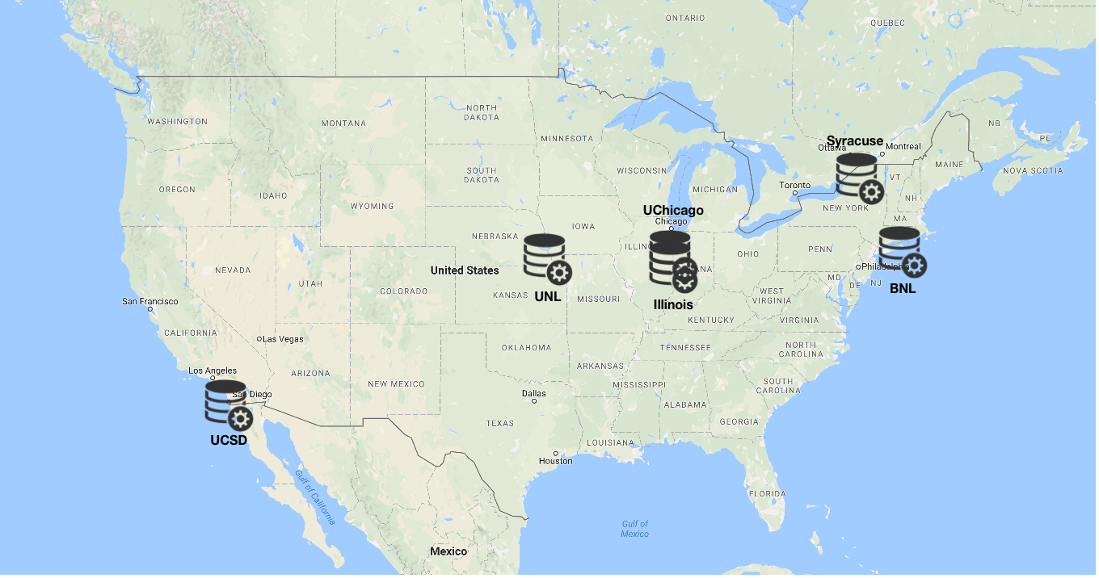
Using StashCache for Input
regionally-cached repository managed by OSG Connect

Slide 17
Placing Files in StashCache
Place files in /home/username/stash/public on osgconnect.net
osgconnect.net
“Stash” origin
regional cache
local server
file
/home/username/stash/public
any OSG submit
exec server
exec server
exec server

Slide 18
Obtaining Files in StashCache
Use HTCondor transfer for other files
osgconnect.net
“Stash” origin
regional cache
local server
file
file
/home/username/stash/public
HTCondor
any OSG submit
exec server
exec server
exec server

Slide 19
Obtaining Files in StashCache
Download using stashcp command (available as an OASIS software module)
login.osgconnect.net
“Stash” origin
regional cache
local server
file
file
stashcp
/home/username/stash/public
HTCondor
any OSG submit
exec server
exec server
exec server

Slide 20
In the Submit File
Require StashCashe sites in the submit file
+WantsStashCache
Require sites with OASIS modules (for stashcp)
Requirements = <OTHER REQUIREMENTS> && (HAS_MODULES =?= true)

Slide 21
In the Job Executable
#!/bin/bash
# setup:
module load stashcache
stashcp /user/username/public/file.tar.gz ./
<untar, then remove the tarball>
<job commands>
<remove all files from StashCache>
# END

Slide 22
StashCache Considerations
Available at ~90% of OSG sites
Regional caches on very fast networks
Max file size: 10 GB
shared OR unique data
Can copy multiple files totaling >10GB
Just like HTTP proxy, change name when update files

Slide 23
Large input in HTC and OSG
exec server
file size | method of delivery
words | within executable or arguments?
tiny – 100MB per file | HTCondor file transfer (up to 1GB total per-job)
100MB – 1GB, shared | download from web server (local caching)
1GB - 10GB, unique or shared | StashCache (regional replication)
10 GB - TBs | shared file system (local copy, local execute servers)

Slide 24
Other Options?
Some distributed projects with LARGE, shared datasets may have project-specific repositories that exist only on certain sites
(e.g. CMS, ATLAS, LIGO?, FIFE?, others?)
Jobs will require specific sites with local copies and use project-specific access methods
OASIS?
Best for lots of small files per job (e.g. software)
StashCache and web proxies better for fewer larger files per job

Slide 25
Cleaning Up Old Data
For StashCache AND web proxies:
make sure to delete data when you no longer need it in the origin!!!
StashCache and VO-managed web proxy servers do NOT have unlimited space!
Some may regularly clean old data for you. Check with local support.

Slide 26
Other Considerations
Only use these options if you MUST!!
Each comes with limitations on site accessibility and/or job performance, and extra data management concerns
file size | method of delivery
words | within executable or arguments?
tiny – 10MB per file | HTCondor file transfer (up to 1GB total per-job)
10MB – 1GB, shared | download from web server (local caching)
1GB - 10GB, unique or shared | StashCache (regional replication)
10 GB - TBs | shared file system (local copy, local execute servers)

Slide 27
Exercises
2.1 Using a web proxy for shared input
place the blast database on the web proxy
2.2 StashCache for shared input
place the blast database in StashCache
2.3 StashCache for unique input
convert movie files

Slide 28
Questions?
Next: Exercises 2.1-2.3
Later: Large output and shared filesystems

