Slide 1
Security in the OSG
Lil Nas X

Slide 2
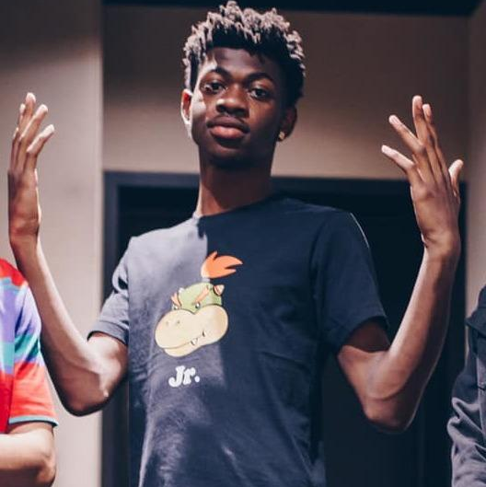
The Real Lil Nas X?
Image By DiFronzo - BiznessBoi, Lil Nas X & Boyband, CC BY 2.0, https://commons.wikimedia.org/w/index.php?curid=78262344

Slide 3
Security in the OSG
Brian Lin
OSG Software Team
University of Wisconsin - Madison

Slide 4
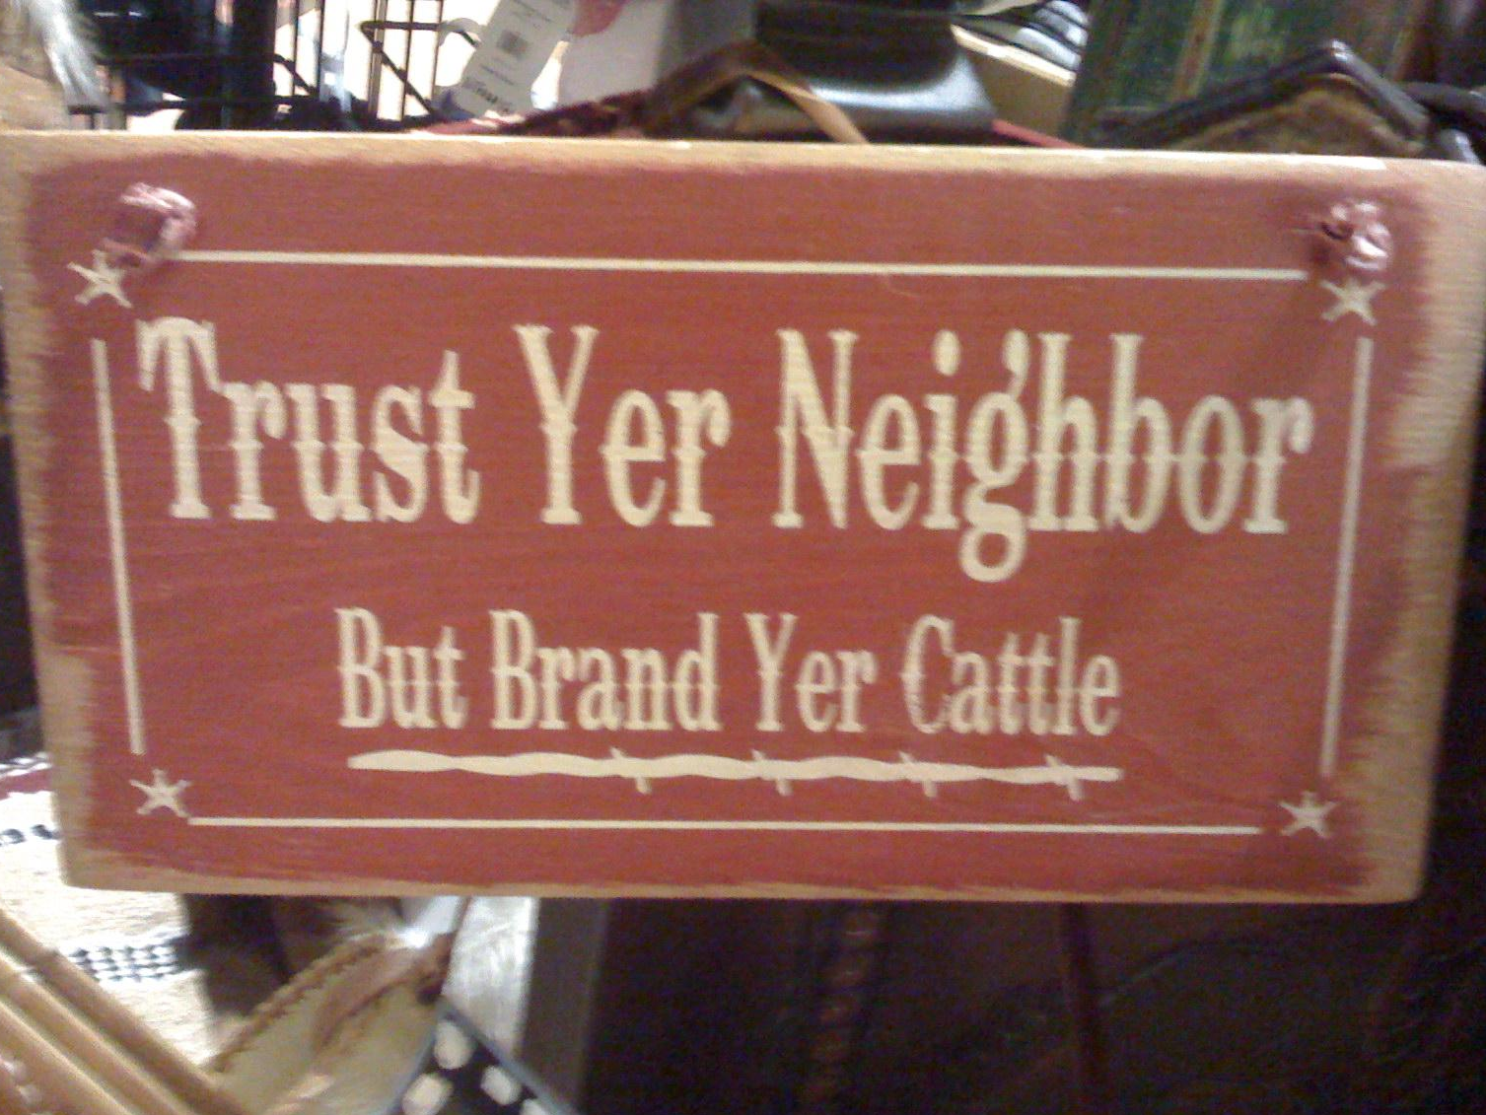
What is Trust?
Trust: reliance on the integrity or surety of a person or thing
Obtaining trust:
Prior knowledge and/or experience
Appeal to authority
Chains of trust
Photo by wfryerCC BY-SA

Slide 5
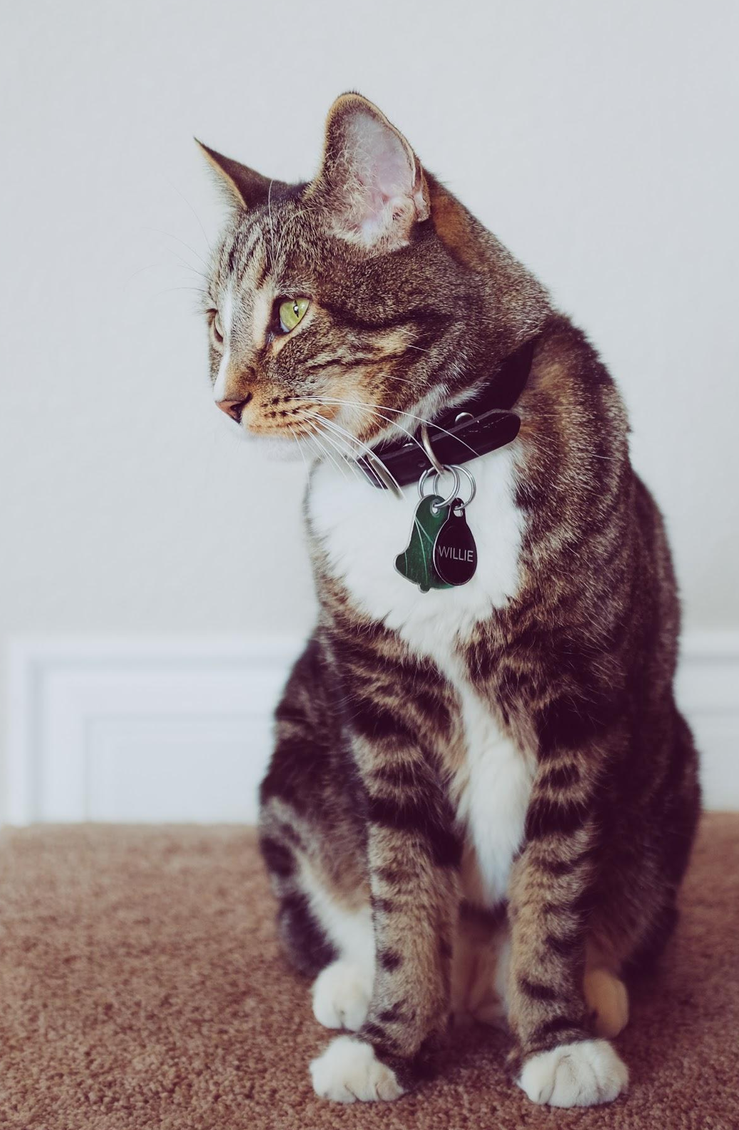
Identity and Identification
Identity: who someone is, Willie the Cat
Identification: proof of who someone is, Willie’s collar
Real word ID: photos, SSN, driver’s license, passport, etc.
Internet ID: usernames (1i1nasx), certificates, tokens
Photo by NeONBRAND on Unsplash

Slide 6
Trust and Identities
Authentication: trusting identification
Username + password, shared secret (public key cryptography), two-factor, tokens, etc.
Authentication online often goes both ways
HTCondor authenticates both users and machines
Authorization: trusting identities
A description of the privilege level of an identity
What are you authorized to do on our submit nodes?

Slide 7
OSG Security
Certificate-based security for pilots jobs and servers
Jobs run under the same Unix user due to the pilot job model; Singularity containers can provide some separation between VO users
VOs vet users; system administrators vet servers
The OSG Security Team tracks software vulnerabilities and responds to security incidents

Slide 8
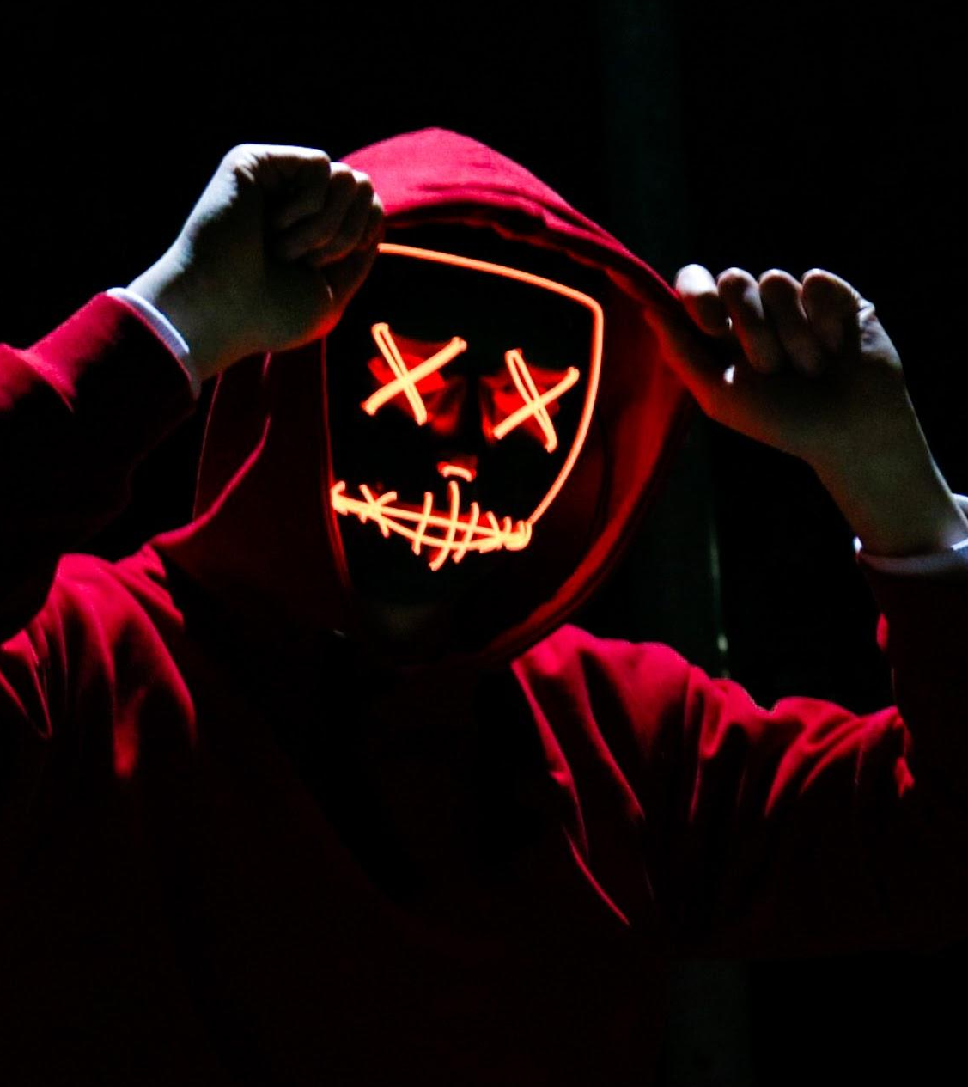
Is Your Data Secure?
You are using a shared computer that you don’t own so take basic precautions:
No sensitive data
No word-writable files
Photo by sebastiaan stam on Unsplash

Slide 9
So What Can You Do?
Protect your account
Do not share your account
Use good passwords
Even better, use a password store like KeePass or LastPass
Use SSH keys wherever possible
Trust but verify
Spot checking
Reproduce your results

Slide 10
Questions?
Coming next:
12:15 - 1:15 Lunch
This afternoon: Working with real software

