Slide 1
Software Modules and Licenses
Christina Koch (ckoch5@wisc.edu)
Research Computing Facilitator
University of Wisconsin - Madison

Slide 2
Expanding Our Horizons
Previously, we were using simple, open source code and building software ourselves.
This presentation discusses two different cases:
Using software modules
Licensed software

Slide 3
Modules

Slide 4
Pre-existing Software
The ideal for DHTC is to package and bring along your own software, but...
You can use pre-existing software installations if the computers you’re running on have your software installed (or access to a repository with the software).

Slide 5
Pre-existing software via OSG Connect
On the Open Science Grid, jobs submitted from OSG Connect have access to a software repository maintained by OSG Connect staff.
The software repository is available across the OSG.
Software is accessed using “modules”.

Slide 6
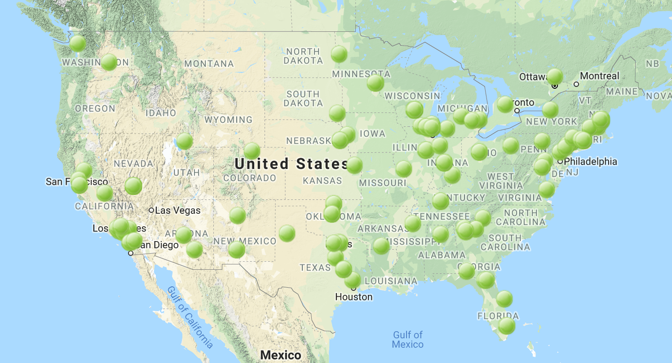



Software across the OSG
OSG Connect

Slide 7
Module Commands
See what modules are available
Load a module
See loaded modules
[~]$ module avail
[~]$ module spider lammps
[~]$ module load lammps/20180822
[~]$ module list

Slide 8
Module Workflow
Find a module for your software
Write a wrapper script that loads the module and runs your code
Include requirements to ensure that your job has access to modules
requirements = (HAS_MODULES =?= true) && (OSGVO_OS_STRING == “RHEL7”) && (OpSys == “LINUX”)

Slide 9

Module Workflow
Execute server
Submit server
wrapper script
software modules

Slide 10
Licensing

Slide 11
Licensing
Many scientific software programs are licensed.
Licenses are restrictive, particularly for high-throughput computing

Slide 12
License Variations
Per machine or 'single-install’
Per running instance of the software (per “job”)
Per username / user
Via a license server
can support 1 - 1000s of concurrently running processes (“seats”)

Slide 13
Licensing implications for DHTC
Per machine or 'single-install': can’t be used for DHTC
Per job: restrictive, limits the number of jobs you can have running, how do you access licenses from execute servers?
Username: restrictive, could only run jobs on one system where your jobs run as *your username*

Slide 14
Matlab
Wait a minute…isn’t Matlab licensed?
Yes, when interpreted on your computer using a normal Matlab installation.
However, Matlab code can also be compiled.
Once compiled, the code can be run without a license using a (free) set of files called the Matlab runtime (which acts like the interpreter).

Slide 15
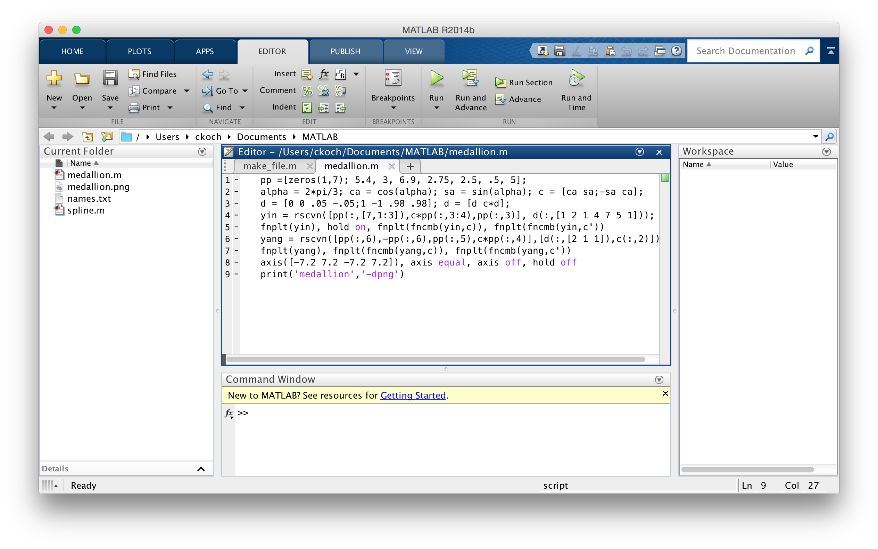
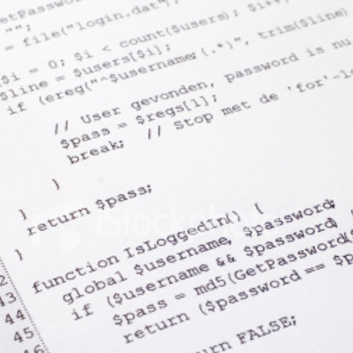




Matlab contrast
Running Matlab on your computer
Uses license per instance
Running Matlab on DHTC
Uses license once, runs many instances for free
Matlab script(s)
compiled w/ Matlab
compiler (uses license)
Compiled binary
interpreted by
Matlab Runtime (free)

Slide 16
Matlab on DHTC
Compile Matlab code using the Matlab compiler (mcc) on the same operating system (Linux)
requires a license
Prepare a copy of the Matlab runtime
download for free from Mathworks
Write a script that “installs” the runtime
The Matlab compiler actually writes most of this script for you
Use the runtime install to run the compiled Matlab code

Slide 17
Approaches
Seek out open source alternatives
Python or R packages that emulate specific software behavior
If you can’t replace entire workflow, substitute free software where you can
License-free workarounds (Matlab) or special research agreements
Choose the least restrictive license possible

Slide 18
Exercises
Exercise 1.1: Try an OSG Connect software module
Exercise 1.2: Compile and run Matlab code
Feel free to catch up with materials from Monday/Tuesday or start implementing your own software

Slide 19
Questions?
Now: Hands-on Exercises
9:30-10:30am
Next:
10:30-10:45am: Break
10:45am-12:15pm: Software Containers
12:15-1:15pm: Lunch

