Slide 1

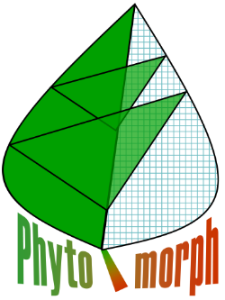
Measuring Plant Phenotypes with High Throughput Computing
Edgar Spalding
Department of Botany
www.botany.wisc.edu/spalding.htm

Slide 2
Natural Phenotypic Variation
within 160 Ler X CVI recombinant inbred lines enables QTL mapping

Slide 3
Recombinant inbred lines to scale up to the genome level
Populations useful for mapping phenotype to genotype have been created in many species. They are genetically well defined. The current bottleneck is the rate of trait measurement.
×
Cvi
Ler
F1
F2
…
Self fertilize
8 X
…
Recombinant
Inbred
Lines
(RILs)
1
2
3
4
5
6
7
8
9
…
1 2 3 4 5 6 7 … 160
Alonso-Blanco et al. The Plant Journal 14, 259-257 (1998)

Slide 4
A single QTL plot
(seed area is the phenotype)
Moore CR, Gronwall DS, Miller ND, Spalding EP (2013) Mapping quantitative trait loci affecting Arabidopsis thaliana seed morphology features extracted computationally from images. G3: Genes, Genomes, Genetics 3: 109-118

Slide 5
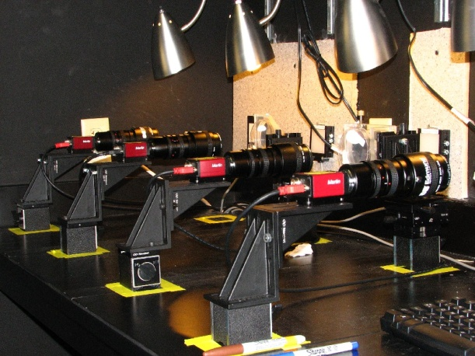
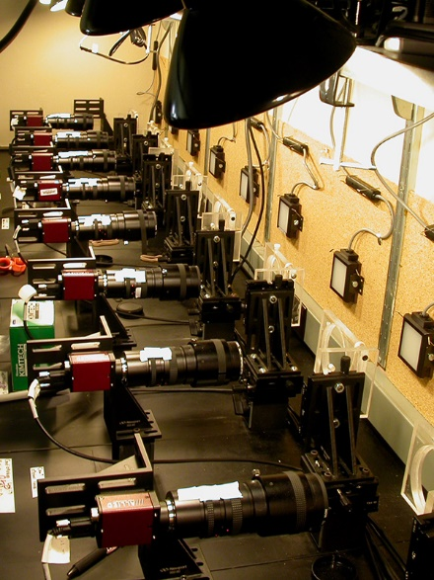
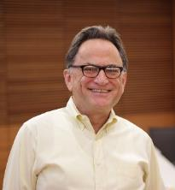

Banks of computer-controlled CCD cameras
Images are automatically submitted as HTCondor jobs for distributed processing
Miron Livny
a.k.a Captain Condor
Director of CHTC

Slide 6
Instead of a static phenotype like seed size, how about mapping dynamic traits like root gravitropism?

Slide 7
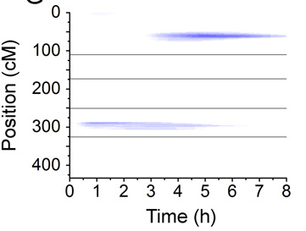
A result of Broman and Kwak’s method:
It may find fewer QTL but you can be more sure of them, and there are fewer discontinuities.

Slide 8
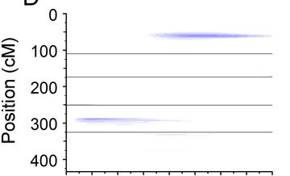
Parent A
Parent B

Slide 9


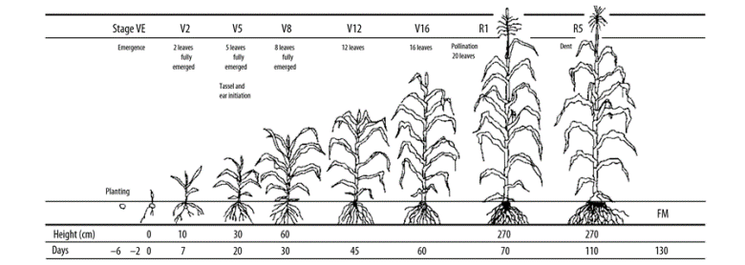
Measuring maize across the life cycle

Slide 10
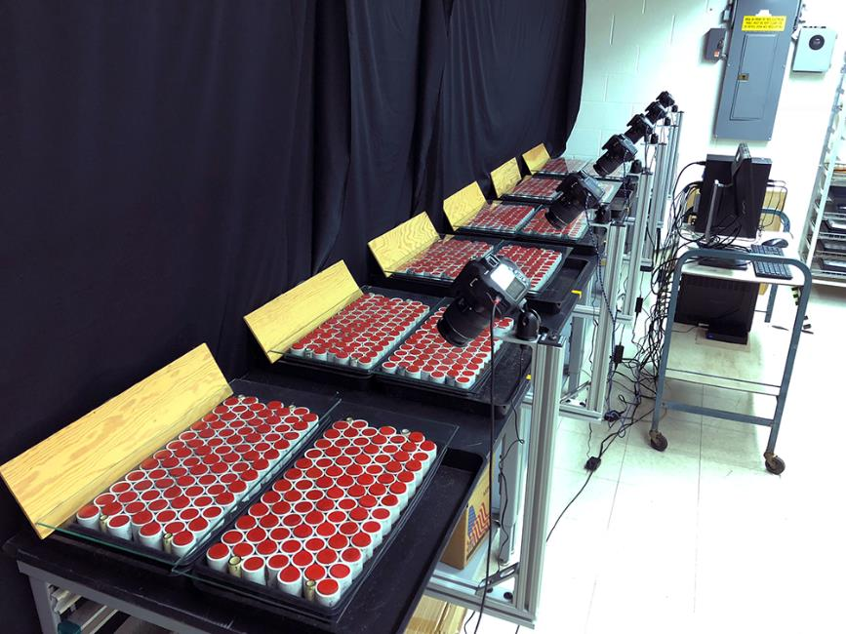
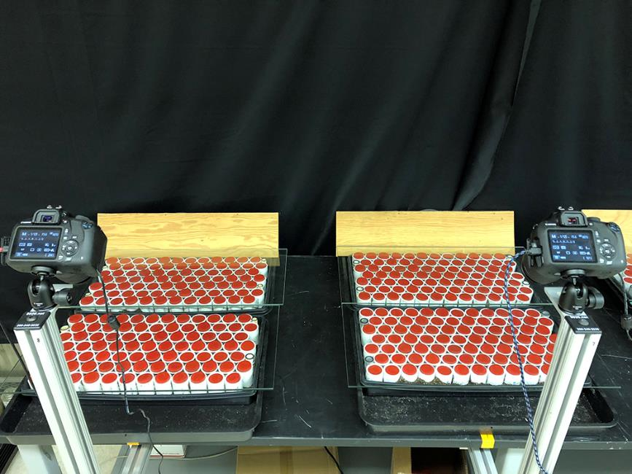
Seedling emergence set up at the Wisconsin Crop Innovation Center

Slide 11
Automated Emergence Assay

Slide 13
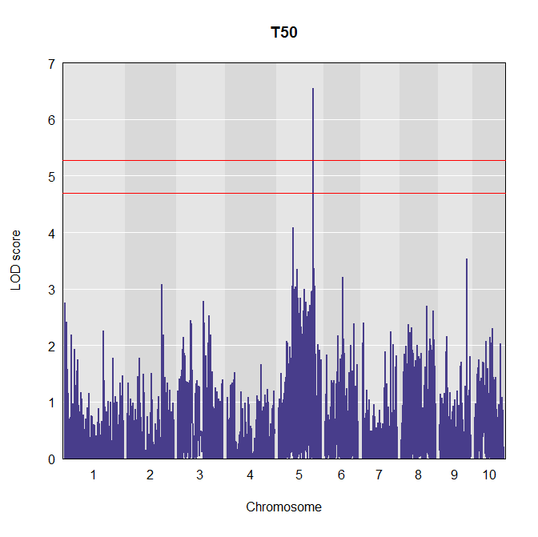

Slide 14
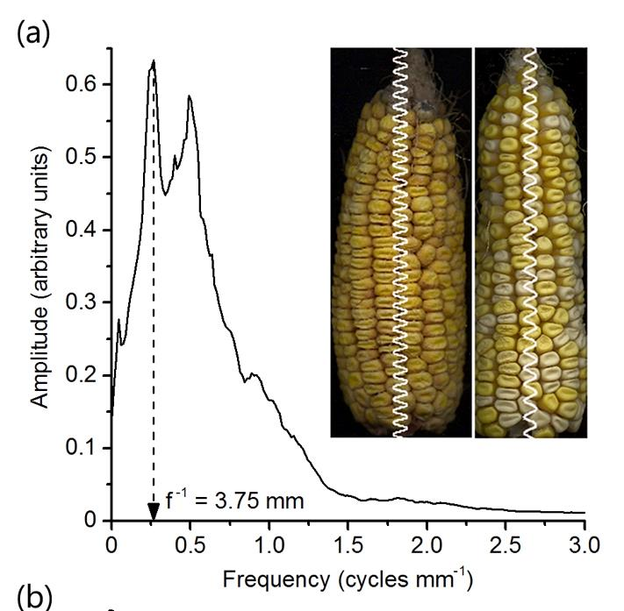
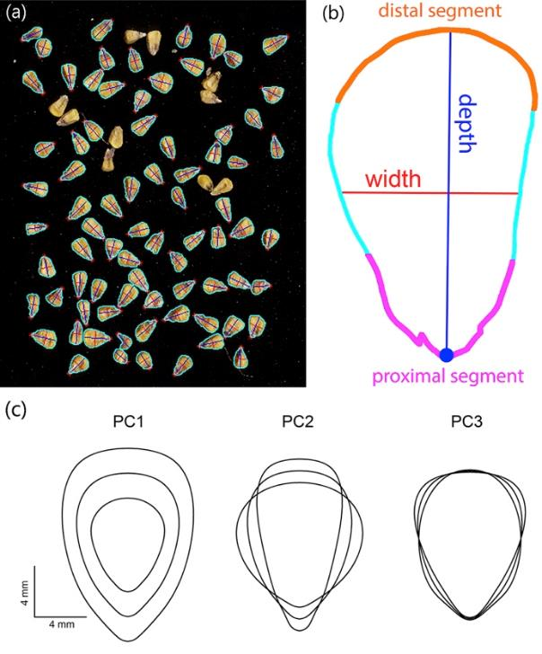
Corn ear and kernel traits measured by image analysis
PBPG Ph.D. student Nick Haase was brave enough to apply this method in a large-scale study for his thesis.
Miller ND, Haase NJ, Lee J, Kaeppler SM, de Leon N, Spalding EP (2017) Plant Journal 89: 169-178

Slide 15
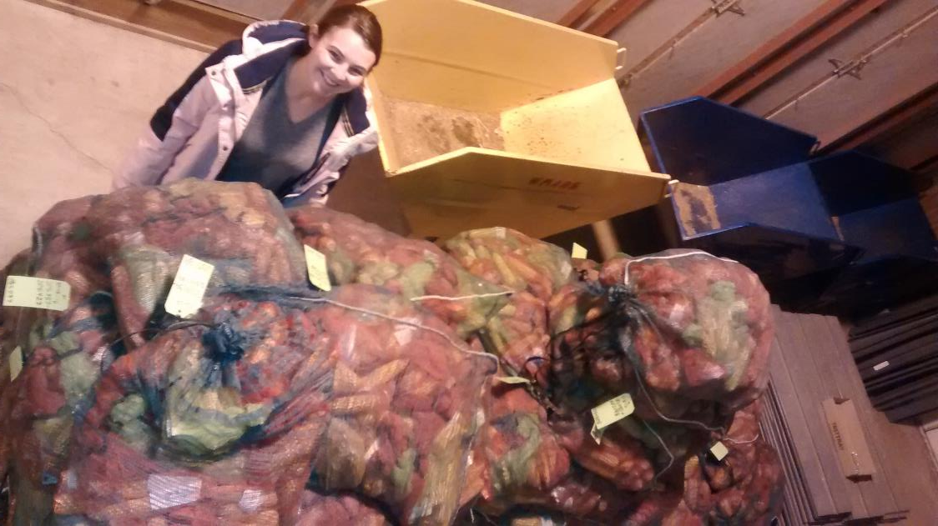
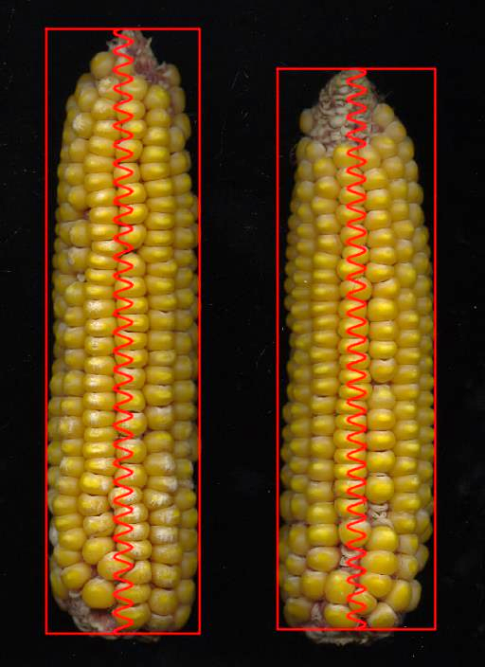
PBPG PhD student Kathryn Michel with one of her mountains of ears.
PBPG PhD student Mike White is another power user of the method.
They have collectively scanned many 10⁵ ears and cobs and kernel samples.

Slide 16
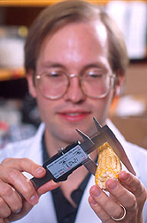
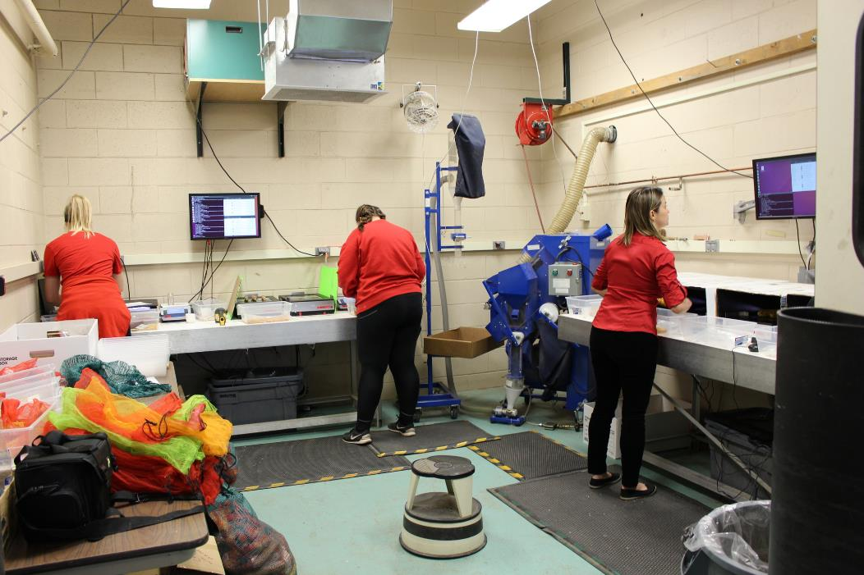
The method we were motivated to replace
The Scanning Team at work in the WCIC
“Geneticist Ed Buckler measures a maize ear for statistical analysis.”

Slide 17
Hey, we are here to learn about computing, not plants!

Slide 18
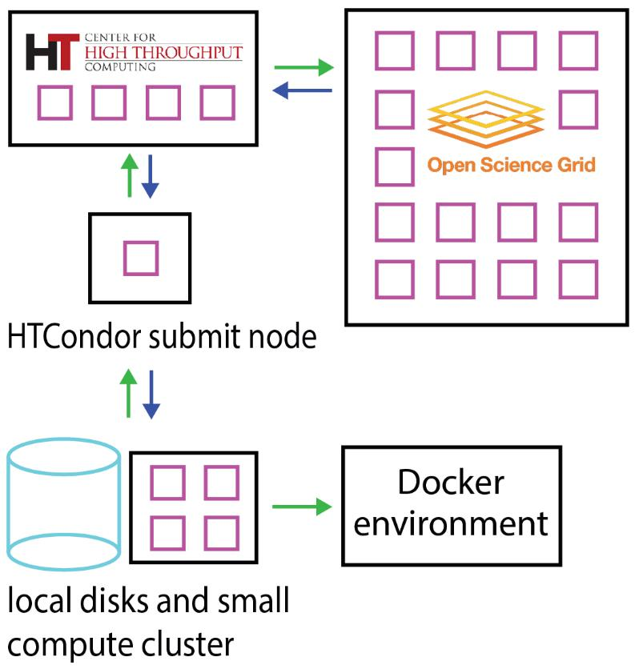
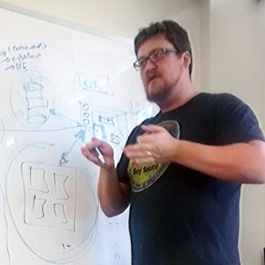
Cyber infrastructure for our work
Nathan Miller

Slide 19
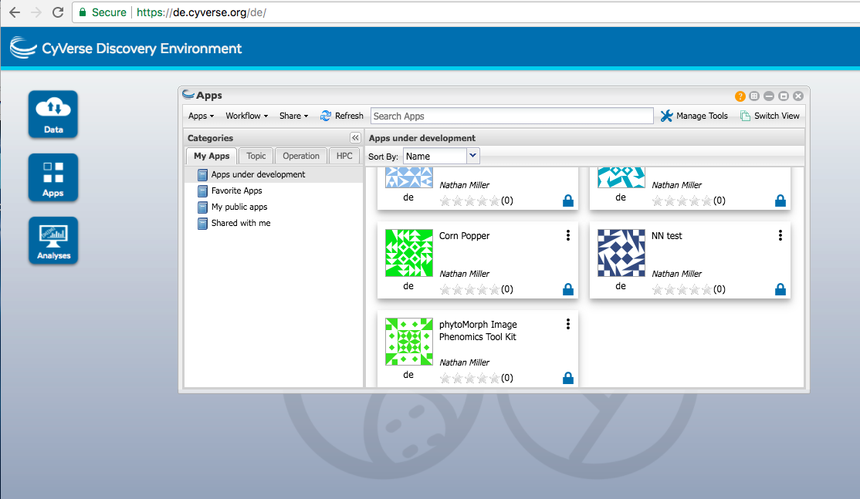
Phytomorph App through the Discovery Environment
de.cyverse.org
Has >50 k runs as of Jan 2018

Slide 20
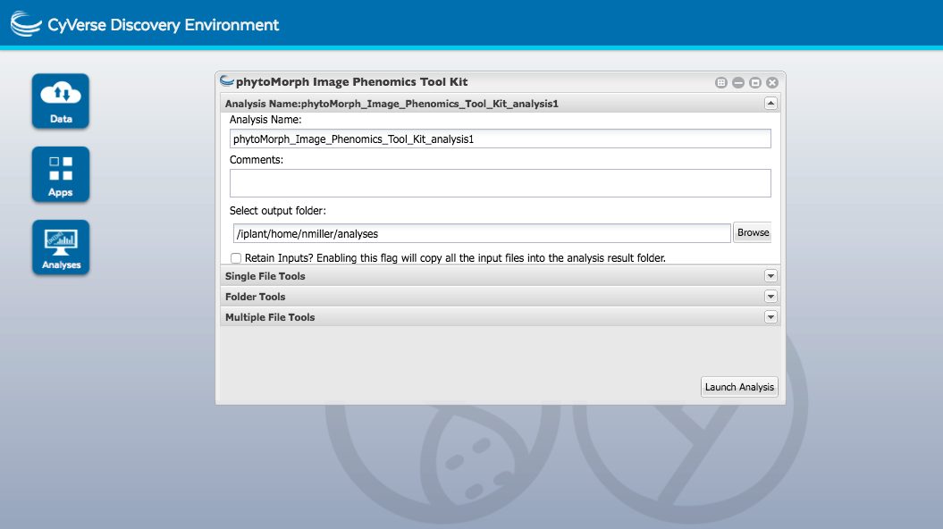
Single File Methods operate on single images
Folder Methods operate on image series
Results compiling tools

Slide 21
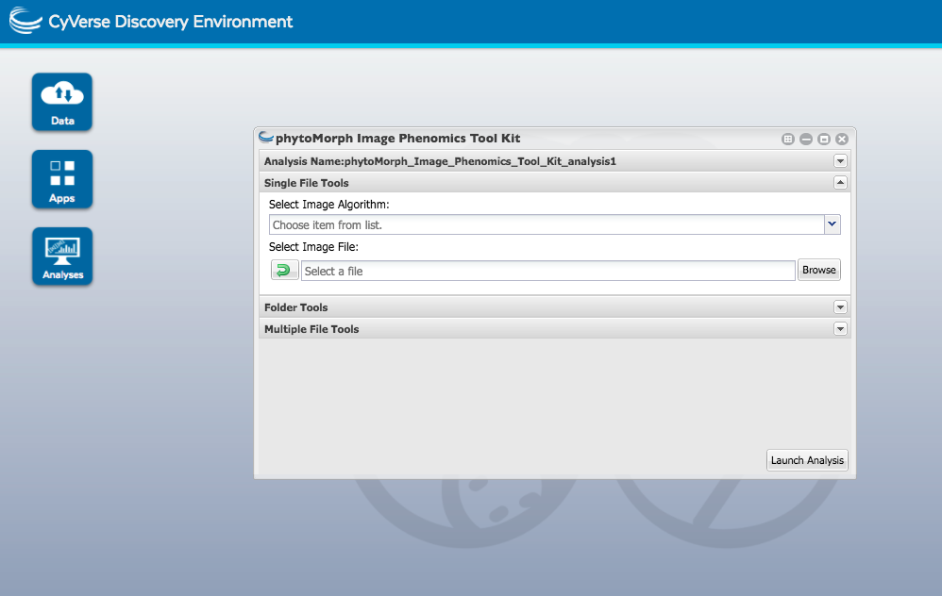
Select Algorithm from Pull Down Menu
Select Data from Data Store

Slide 22
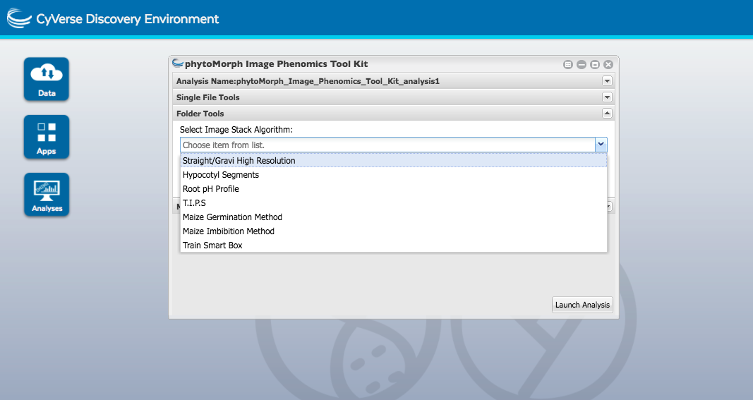

Slide 23
