Slide 1
Security in the OSG

Slide 2
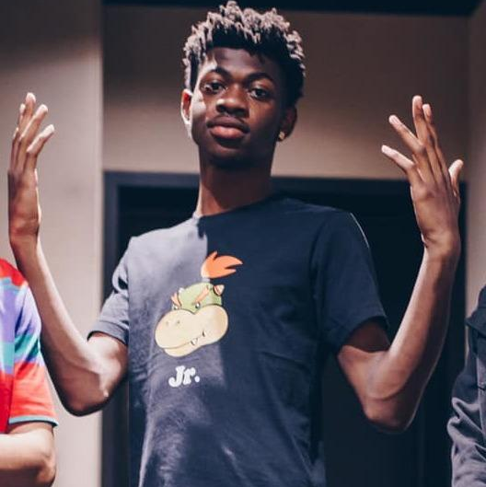
The Real Lil Nas X?
Image By DiFronzo - BiznessBoi, Lil Nas X & Boyband, CC BY 2.0, https://commons.wikimedia.org/w/index.php?curid=78262344

Slide 3
Security in the OSG
Brian Lin
OSG Software Team
University of Wisconsin - Madison

Slide 4
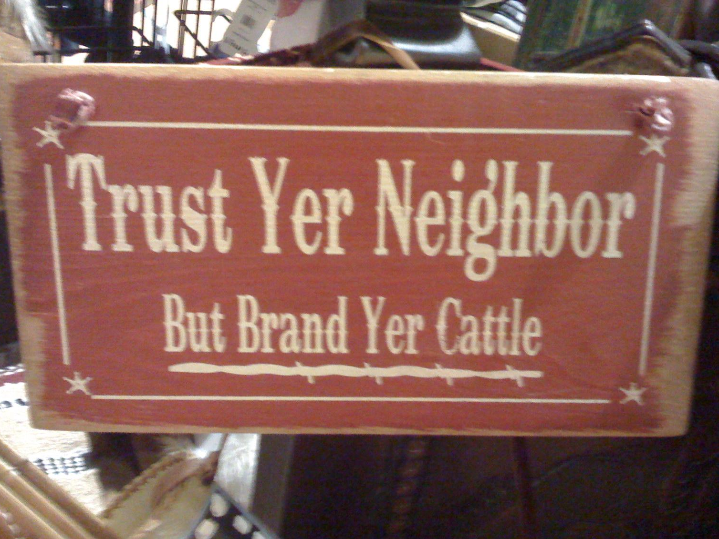
What is Trust?
Trust: reliance on the integrity or surety of a person or thing
Obtaining trust:
Prior knowledge and/or experience
Appeal to authority
Chains of trust
Photo by wfryerCC BY-SA

Slide 5
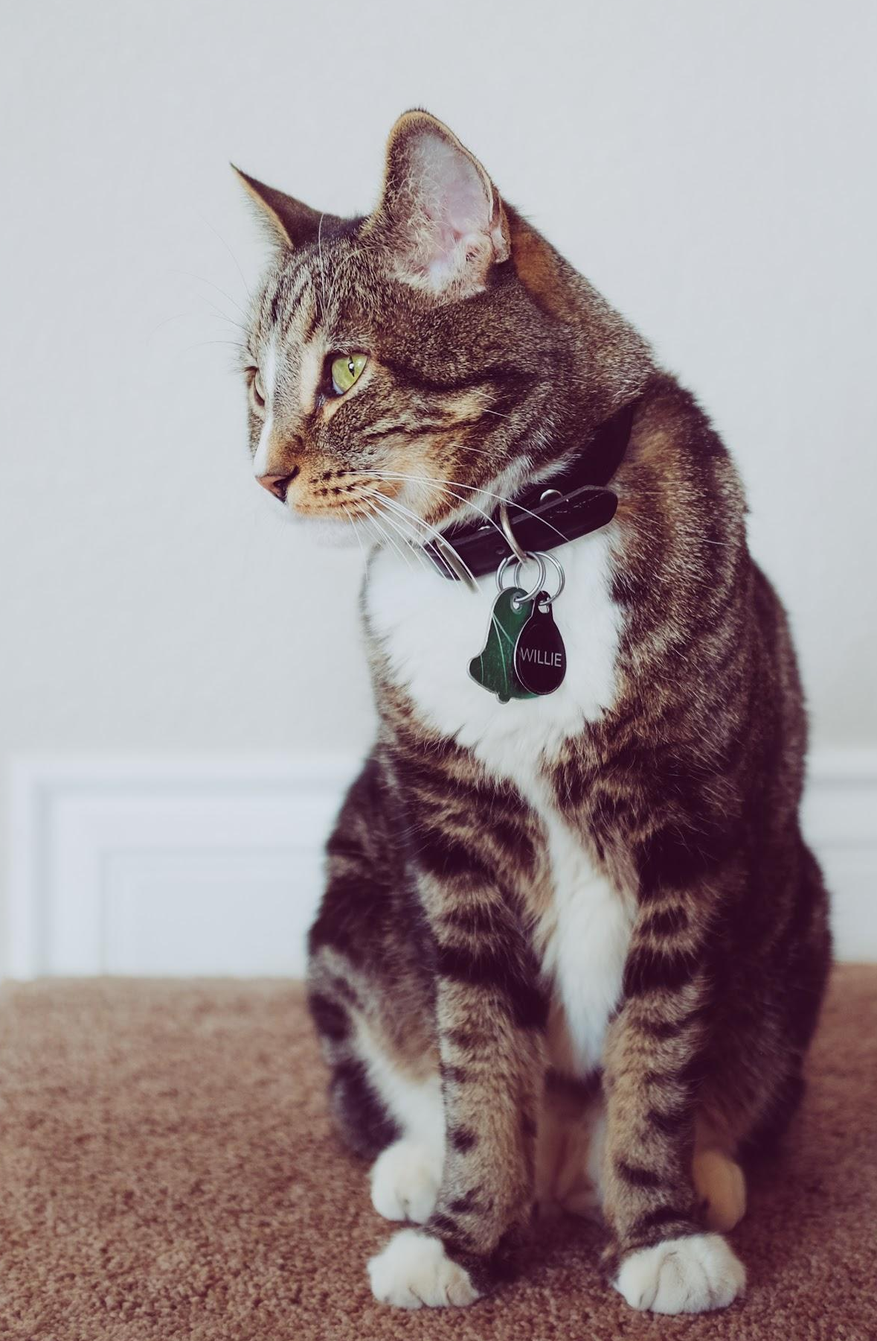
Identity and Identification
Identity: who someone is, Willie the Cat
Identification: proof of who someone is, Willie’s collar
Real word: photos, SSN, driver’s license, passport, etc.
Online: usernames (1i1nasx), certificates, tokens
Photo by NeONBRAND on Unsplash

Slide 6
Trust and Identities
Authentication: trusting identification
Username + password, shared secret (public key cryptography), two-factor, tokens, etc.
Authentication online often goes both ways
HTCondor authenticates both users and machines
Authorization: levels of trust for identities
A description of the privilege level of an identity
What are you authorized to do on our submit nodes?

Slide 7
OSG Security
Resources and pilots verify each other’s identities
Jobs in the same VO all run under the same user!
Containers can provide some separation between VO users (for sites that support it)
VOs vet users; system administrators vet servers
The OSG Security Team tracks software vulnerabilities and responds to security incidents

Slide 8
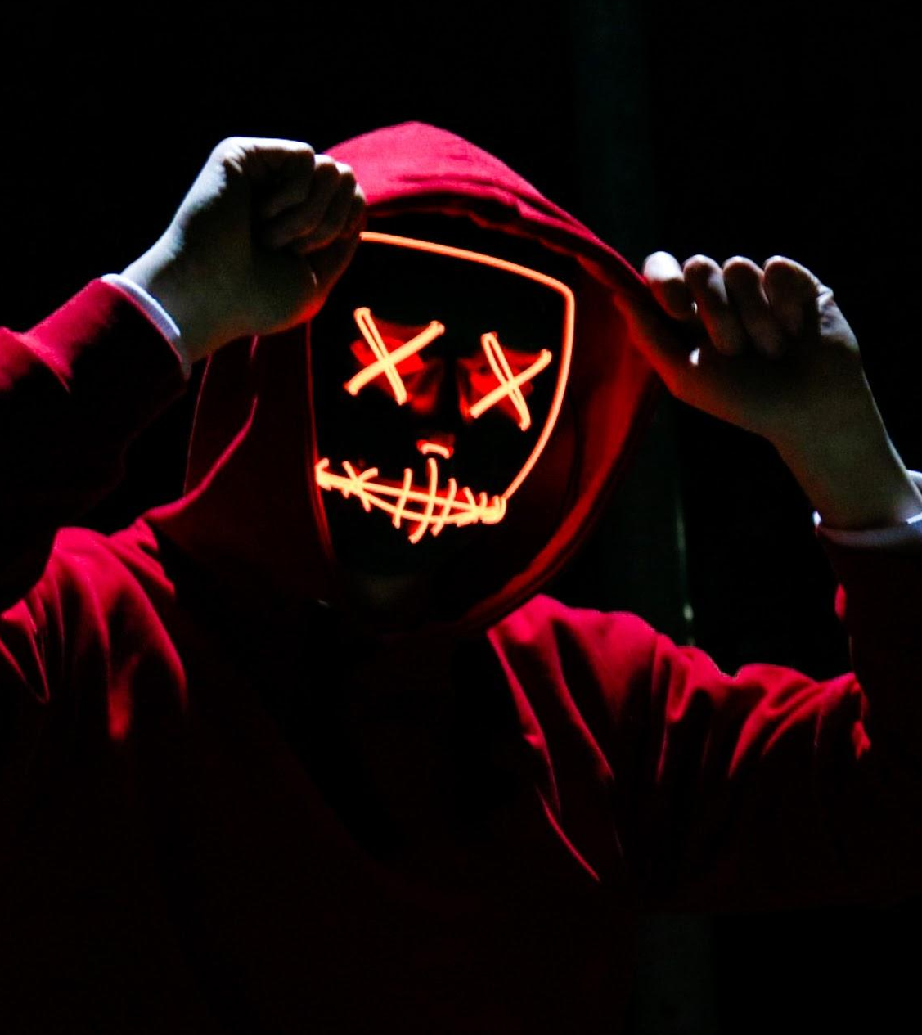
Is Your Data Secure?
You are using a shared computer that you don’t own so take basic precautions:
No sensitive data
No word-writable files
No data or code that CANNOT be copied
Photo by sebastiaan stam on Unsplash

Slide 9
So What Can You Do?
Protect your account
Do not share your account
Use good passwords
Even better, use a password store like KeePass or LastPass
Use SSH keys wherever possible
Trust but verify
Spot checking
Reproduce your results

Slide 10
Questions?
Coming next:
12:15 - 1:15 Lunch
This afternoon: Working with real software

