Slide 1
Large Output and Shared File Systems
Thursday PM, Lecture 1
Lauren Michael

Slide 2
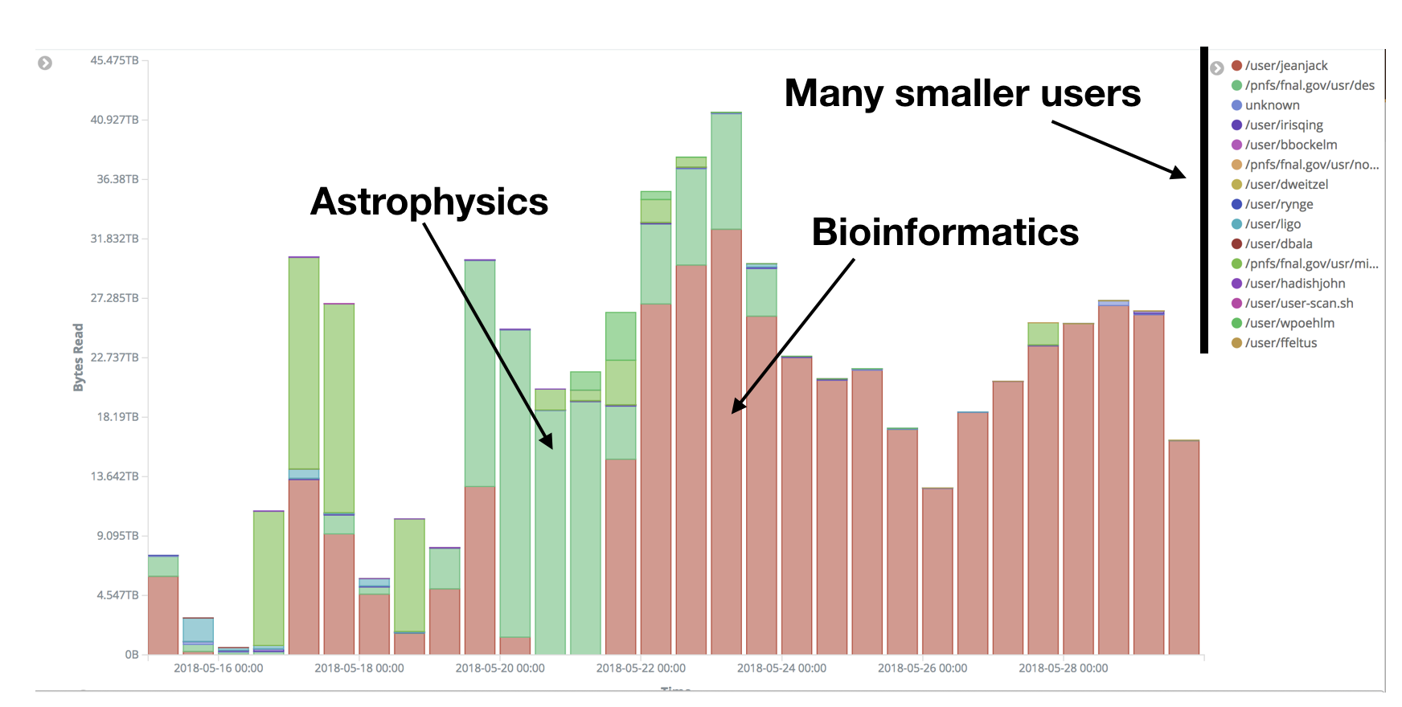
StashCache
Lots of experiments also use StashCache

Slide 3
Per-job transfer limits
<100MB/file, 1GB total
exec server
exec server
exec server
submit server
HTCondor
exec server
<1GB total
submit file
executable
dir/ input
output
(exec dir)/
executable
input
output

Slide 4

Transfers
More Planning
HTCondor
File Transfer
HTTP
Proxies
StashCache
Owned
Storage

Slide 5
What’s Different for Output?
always unique (right?), so caching won’t help
files not associated with your local username
security barriers outside of local context
security issues with world-writability
(versus okay world-readability for input)

Slide 6
Output
More Data
HTCondor
File Transfer
Writeable
StashCache
Owned
Storage

Slide 7
Output for HTC and OSG
exec server
file size | method of delivery
words | within executable or arguments?
tiny – 1GB | HTCondor file transfer (up to 1 GB total per-job)
1GB+ | shared file system (local execute servers)

Slide 8
Large input in HTC and OSG
exec server
file size | method of delivery
words | within executable or arguments?
tiny – 10MB per file | HTCondor file transfer (up to 1GB total per-job)
10MB – 1GB, shared | download from web proxy (network-accessible server)
1GB - 10GB, unique or shared | StashCache (regional replication)
10 GB – TBs, unique or shared | shared file system (local copy, local execute servers)

Slide 9
(Local) Shared Filesystems
data stored on file servers, but network-mounted to local submit and execute servers
use local user accounts for file permissions
Jobs run as YOU!
readable (input) and writable (output, most of the time)
MOST perform better with fewer large files (versus many small files of typical HTC)

Slide 10
Shared FS Technologies
via network mount
NFS
AFS
Lustre
Gluster (may use NFS mount)
Isilon (may use NSF mount)
distributed file systems (data on many exec servers)
HDFS (Hadoop)
CEPH

Slide 11
Shared FS Configurations
Submit directories WITHIN the shared filesystem
most campus clusters
limits HTC capabilities!!
Shared filesystem separate from local submission directories
supplement local HTC systems
treated more as a repository for VERY large data (>GBs)
Read-only (input-only) shared filesystem
Treated as a repository for VERY large input, only

Slide 12
Submit dir within shared FS
exec server
exec server
exec server
submit server
exec server
HTCondor
Shared FS
(submit dir)/
file.sub
input, software
log, error, output
Notes:
Don’t use HTCondor. Use the shared filesystem

Slide 13
Submit dir within shared FS
exec server
exec server
exec server
submit server
exec server
HTCondor
# file.sub:
should_transfer_files = NO
transfer_input_files =
Shared FS
(submit dir)/
file.sub
input, software
log, error, output

Slide 14
Separate shared FS
exec server
exec server
exec server
submit server
exec server
HTCondor
submit file
executable
dir/ input
output
(exec dir)/
executable
input
output
Separate FS

Slide 15
Separate shared FS - Input
exec server
exec server
exec server
submit server
exec server
HTCondor
(exec dir)/
1.Place compressed input into FS
Separate FS
/path/to/lgfile
lgfile

Slide 16
Separate shared FS - Input
exec server
learn.chtc.wisc.edu
exec server
exec server
submit server
exec server
HTCondor
(exec dir)/
lgfile
2. Executable copies and decompressesthe file
Separate FS
/path/to/lgfile
lgfile

Slide 17
Separate shared FS - Input
exec server
learn.chtc.wisc.edu
exec server
exec server
submit server
exec server
HTCondor
(exec dir)/
3. Executable must remove the file in the exec dir after use
Separate FS
/path/to/lgfile
lgfile

Slide 18
Separate shared FS - Output
exec server
learn.chtc.wisc.edu
exec server
exec server
submit server
exec server
HTCondor
(exec dir)/
lgfile
1.Executable creates and compresses the output file
Separate FS

Slide 19
Separate shared FS - Output
exec server
learn.chtc.wisc.edu
exec server
exec server
submit server
exec server
HTCondor
(exec dir)/
lgfile
2. Executable copies the file
Separate FS
/path/to/lgfile
lgfile

Slide 20
Separate shared FS - Output
exec server
learn.chtc.wisc.edu
exec server
exec server
submit server
exec server
HTCondor
(exec dir)/
3. Executable removes the file in the exec dir
Separate FS
/path/to/lgfile
lgfile

Slide 21
At UW-Madison (Ex. 4.1-4.2)
exec server
learn.chtc.wisc.edu
exec server
exec server
submit server
exec server
HTCondor
(exec dir)/
Separate FS
/mnt/gluster/user/lgfile
lgfile

Slide 22
Shared FS Configurations
Submit directories WITHIN the shared filesystem
most campus clusters
limits HTC capabilities!!
Shared filesystem separate from local submission directories
supplement local HTC systems
treated more as a repository for VERY large data (>GBs)
Read-only (input-only) shared filesystem
Treated as a repository for VERY large input, only

Slide 23
Large input in HTC and OSG
exec server
file size | method of delivery
words | within executable or arguments?
tiny – 10MB per file | HTCondor file transfer (up to 1GB total per-job)
10MB – 1GB, shared | download from web proxy (network-accessible server)
1GB - 10GB, unique or shared | StashCache (regional replication)
10 GB – TBs, unique or shared | shared file system (local copy, local execute servers)

Slide 24
Output for HTC and OSG
exec server
file size | method of delivery
words | within executable or arguments?
tiny – 1GB | HTCondor file transfer (up to 1 GB total per-job)
1GB+ | shared file system (local execute servers)

Slide 25
Review
Option | Input or Output? | File size limits | Placing files | In-job file movement | Accessibility?
HTCondor file transfer | Both | 10 MB/file (in), 1 GB/file (out); 1 GB/tot (either) | via HTCondor submit node | via HTCondor submit file | anywhere HTCondor jobs can run
Web proxy | Shared input only | 1 GB/file | specific to VO | HTTP download | anywhere, by anyone
StashCache | Shared and unique input | 10 GB/file (will increase!) | via OSG Connect submit server | via stashcp command (and module) | OSG-wide (90% of sites), by anyone
Shared filesystem | Input, likely output | TBs (may vary) | via mount location (may vary) | use directly, or copy into/out of execute dir | local cluster, only by YOU (usually)

Slide 26
Exercises
3.1 Shared Filesystem for Large Input
3.2 Shared Filesystem for Large Output

Slide 27
Questions?
Next: Exercises 3.1-3.2
Later: Job workflows

