Slide 1
Containers and GPUs
Christina Koch (ckoch5@wisc.edu)
Research Computing Facilitator
University of Wisconsin - Madison

Slide 2
GPUs

Slide 3

What is a GPU?
GPU = Graphical Processing Unit
Has hundreds to thousands of “cores” that can be used to parallelize work.

Slide 4
GPU Use Cases
Programs that map well to GPUs include:
Deep learning
Molecular dynamics
Anything with lots of number crunching (like matrix operations) and low(er) data load.

Slide 5
GPUs on the OSG
Scale: 10s (vs 100s-1000s of CPUs)
Variety of available GPU cards
Same restrictions as always: not sure what you’ll get, jobs can be interrupted
May take longer to start
Free!

Slide 6
Making robust GPU jobs
Use a software strategy that can run on different GPU types:
Container
Install inside the job
OR use job requirements to request certain kind of GPU (more limiting)

Slide 7
Submit File options
Request GPUs with “request_gpus”
Can use custom requirements
request_gpus = 1
requirements = (CUDACapability >= 6.0)

Slide 8
Containers

Slide 9





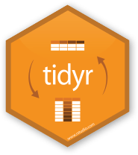
Containers
Containers are a tool for capturing an entire job “environment” (software, libraries, operating system) into an “image” that can be used again.
polaroid photos by Nick Bluth from the Noun Project

Slide 10


Container Types
Two common container systems:
Docker Singularity
https://www.docker.com/ https://sylabs.io/
The container itself will always be some version of Linux - but can be run on Linux / Mac / Windows if Docker or Singularity is installed

Slide 11
Focus on Docker
Docker has well-established and well-documented ways to build container images.
If you have a Docker image:
Can run with Docker
Can run with Singularity
Can convert to a Singularity image

Slide 12
Running Containers
docker run <container> <command>
$
docker run –it <container> /bin/sh

Slide 13

Docker Hub
docker push
docker pull
docker pull

Slide 14
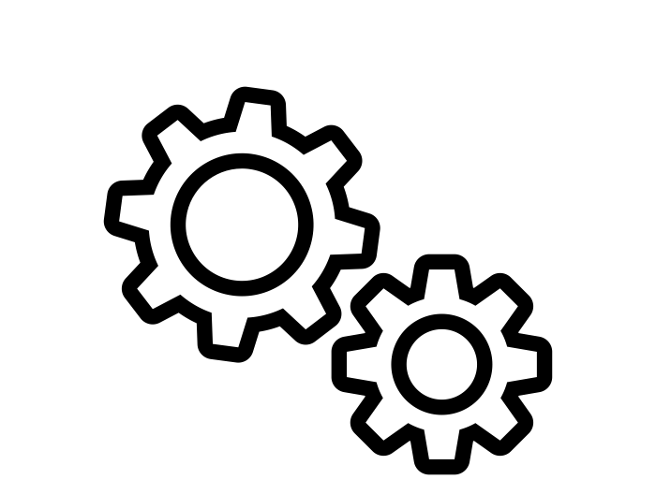

Building Containers
Dockerfile
docker build .
14

Slide 15
Sample Dockerfile
# Start with this image as a "base".
# It's as if all the commands that created that image were inserted here.
FROM continuumio/miniconda:4.7.12
# Use RUN to execute commands inside the image as it is being built up.
RUN conda install --yes numpy
# Try to always "clean up" after yourself to reduce the final size of your image.
RUN apt-get update \
&& apt-get --yes install --no-install-recommends graphviz\
&& apt-get --yes clean \
&& rm -rf /var/lib/apt/lists/*

