Slide 1
Let’s Get Started - ReactJS

Slide 2
Let’s Get Started - ReactJS
We will learn everything that we need to know in ReactJS library excluding hooks
Different use cases
Issues encountered by most React Developers
Learn to code the React Way!
We will use Create React App library which is a very powerful tool to get started with ReactJS development

Slide 3
SETUP ENVIRONMENT DEMO
NodeJS - https://nodejs.org/en/
Create react app - https://create-react-app.dev/docs/adding-typescript/

Slide 4
Components
let you split the UI into independent, reusable pieces, and think about each piece in isolation
Can only have 1 parent element
use Fragments(<React.Fragment> </React.Fragment> or <></>) to create an empty parent element
Name of your component should have first letter be capitalized (e.g. NewsFeed).
Cover Photo
Profile Picture
News Feed
About Me
Facebook Post
Facebook Post

Slide 5
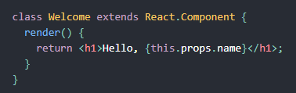
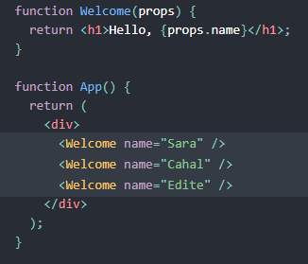
Types of Component
Class Component
Functional Component

Slide 6
Class component
need to use React.Component
called “smart” or “stateful” components
has state and lifecycle methods (e.g. componentDidMount).
can pass props down to class components and access them with this.props
can use refs to reference elements in the component

Slide 7
Functional Components
basic JavaScript functions (regular or arrow function)
referred as “dumb” or “stateless”
cannot use lifecycle methods like (e.g. componentDidMount)
does not have its own “refs”
no render method used in functional components
mainly responsible for UI and are typically presentational only (e.g. Input Component)
can accept and use props
mostly used if you do not need state management
Can use React Hooks!

Slide 8
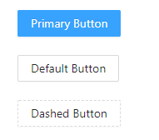
Props
input/parameters that component can accept
makes your component reusable
should be treated as an immutable object inside your component

Slide 9
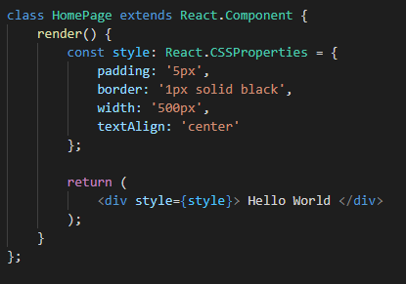
Style Attribute
accepts a JavaScript object with camelCased
react will automatically append a “px” suffix to certain numeric inline style properties
most often used in React applications to add dynamically-computed styles at render time (e.g. changing position “top/left”)
class is mostly recommended to be used but depends on your use case

Slide 10
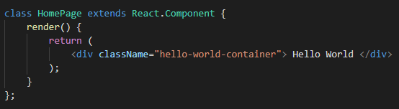
Class
pass a string as the “className” prop
most className depends on props/state to dynamically render UI
generally better performance than inline styles (e.g. caching of css files)

Slide 11

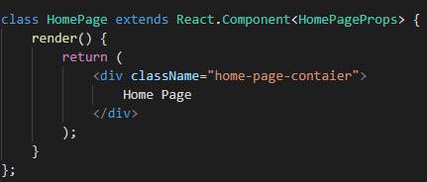
Typescript - Props
To use typescript for props we can use “interface”
Interface defines the schema of what properties an object can have
To define an optional property, just add a suffix “?”
Create an interface
Add the interface to component

Slide 12
Let’s Play With It!

Slide 13
Problem
do something or update the UI if the user clicks, hover, etc.
Fetch data and show it in the UI
When props data changes, we wanna do something
Etc…

Slide 14
State
similar to props, but it is private and fully controlled by the component
should be treated as immutable
to update state, use this.setState() which will trigger a rerender
if you update the state directly, it will not do a rerender
you can only update state directly in constructor

Slide 15
How setState function works?
Asynchronous
multiple calls may be batch for performance gain
first parameter can be a function or an object
object as first parameter, you only need to add the state you want to update
first parameter as a function should be used if we want to update based on the previous state
Second parameter is a callback function

Slide 16
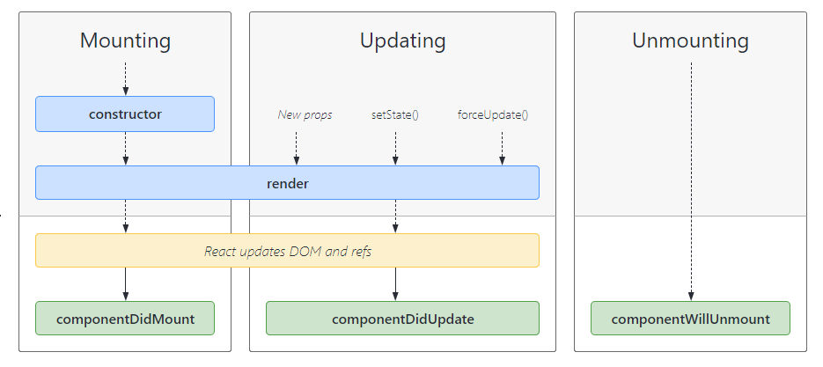
Lifecycle of Component

Slide 17
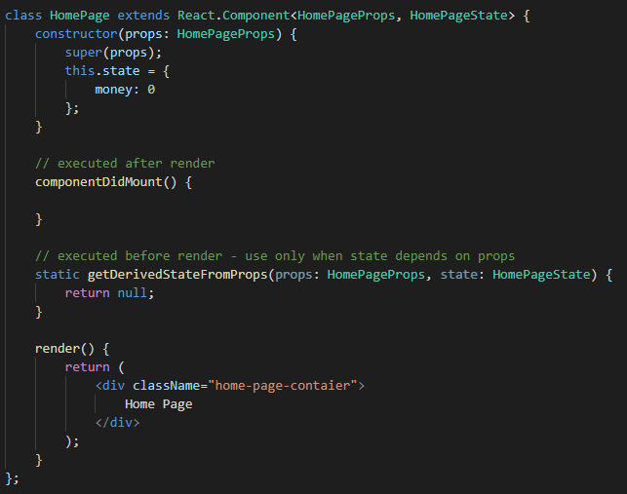
Lifecycle - Mounting
constructor – initialize class/component
static getDerivedStateFromProps - method exists for rare use cases where the state depends on changes in props over time
render – required as this should return the elements of your component
componentDidMount – called after render and react updates the DOM and Refs

Slide 18
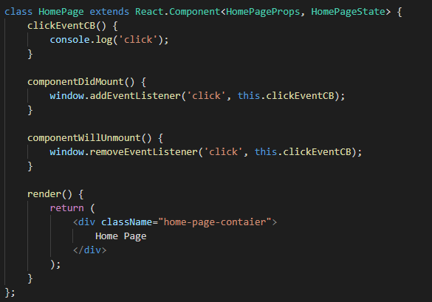
Lifecycle - Unmounting
invoked immediately before a component is unmounted and destroyed
perform any necessary cleanup in this method, such as invalidating timers, canceling network requests, or cleaning up any subscriptions that were created in componentDidMount()

Slide 19

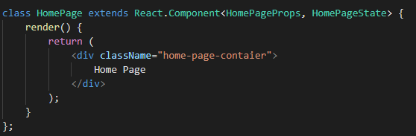
Typescript - State
To use typescript for state we can use “interface”
Interface defines the schema of what properties an object can have
To define an optional property, just add a suffix “?”
Create an interface
Add the interface to component

Slide 20
Let’s Play With It!

Slide 21
Lifecycle

Slide 22
Lifecycle - Updating
static getDerivedStateFromProps() – same with mounting, set the state depending on Props, called before shouldComponentUpdate
shouldComponentUpdate(nextProps, nextState) – let react know if the component is affected by new state or props
Invoke before render() method
Default is to always rerender (true)
Can compare current to new props/state
render() – render component

Slide 23
getSnapshotBeforeUpdate(prevProps, prevState)
invoked right before the most recently rendered output is committed to the DOM
enables your component to capture some information from the DOM (e.g. scroll position) before it is potentially changed
value returned by the function will be passed to componentDidUpdate
componentDidUpdate(prevProps, prevState, snapshot)
invoked immediately after updating occurs
may call setState but make sure it is wrap in a condition
mostly used if you want to do something when a property in previous and current props are not equal (e.g. userID has changed)

Slide 24
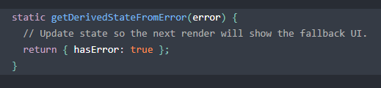
Lifecycle – Error Handling
called when there is an error during rendering, in a lifecycle method, or in the constructor of any child component
static getDerivedStateFromError(error)
invoked after an error has been thrown by a descendant component
receives the error that was thrown as a parameter and should return a value to update state
is called during the “render” phase, so side-effects are not permitted. For those use cases, use componentDidCatch() instead
cannot access component (this object) here

Slide 25
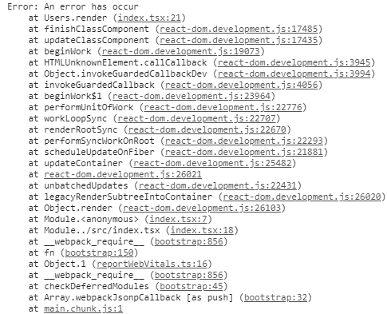
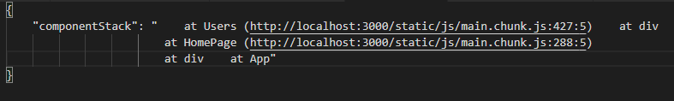
Error
componentDidCatch(error, info)
invoked after an error has been thrown by a descendant component
Parameters
error – error that was thrown (same with getDerivedStateFromError)
info - An object with a componentStack key containing information about which component threw the error
called during the “commit” phase, so side-effects are permitted
should be used for things like logging errors
Info

Slide 26
Let’s Play With It!

Slide 27
Extras – Lifecycle
UNSAFE_componentWillMount
UNSAFE_componentWillReceiveProps
UNSAFE_componentWillUpdate

Slide 28
Why?
In future versions of react they will fire more than once
Also a lot of people misuse this lifecycle
In future versions it will produce some bugs so they want you to avoid using this
Just use componentDidMount or componentDidUpdate
DO NOT USE THEM IN YOUR NEW CODES! IF YOU CAN, REFACTOR EXISTING CODE!

Slide 29
No Hands On

Slide 30
Problem
In some cases, we do not want to rerender our component for performance and efficiency
shouldComponentUpdate is available for class component, how about in functional component?

Slide 31
PureComponent
is similar to React.Component
difference is it implements shouldComponentUpdate() with a shallow prop and state comparison
if you have a nested data structure and it didn’t rerenders, use this.forceUpdate() to trigger a force update
better to use deep cloning before you update your state to prevent issues as this only do shallow comparison
performance boost in some cases

Slide 32
React.Memo
is a higher order component for functional component
if component renders same result given the same props, you can wrap it with this so it will not rerender
performance boost with some cases by memoizing the result
this only do shallow checks for prop changes
React.Memo(Component, compareFunction)
Component – component to memoize result
compareFunction(prevProps, nextProps) – used if you want to do your own comparison
Return true if will not rerender, false if will rerender. opposite of shouldComponentUpdate

Slide 33
Tip
This might cause your component not to rerender when you expect it to rerender, make sure you understand how to use it
Shallow comparison is NOT that CHEAP so DO NOT USE THEM EVERYWHERE
Check how big the object is and how often does your component rerenders
As a developer it will be our job to use it the right way because instead of improving performance, we might degrade it.
USE IT WISELY!

Slide 34
Let’s Play With It!

Slide 35
Problem
How to create reusable logic for your components?
E.g. tracking clicks, tracking mouse pointer, fetching data, etc..

Slide 36
RenderProps Pattern
refers to a technique for sharing code between React components using a prop whose value is a function
A function that returns a React Element/Component
render prop can negate the advantage that comes from using React.PureComponent if you create the function inside a render method
Track Click Component
Track Click Component (renderProps)
Profile Component
Track Click Component (renderProps)
NewsFeed Component

Slide 37
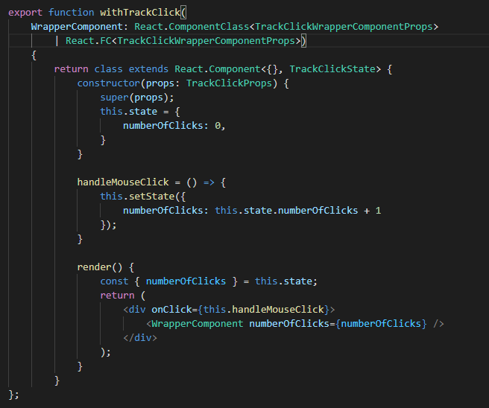
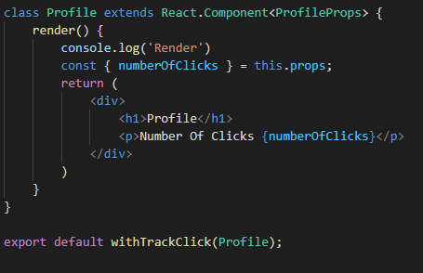
Higher Order Component
advanced technique in React for reusing component logic
not part of the React API, just a pattern that emerges from React’s compositional nature
As long as you can imagine, you can do it with HOC!

Slide 38
Let’s Play With It!

Slide 39
Problem
You have a reusable component and you wanna use that to render all your data
Example
User1 = <UserComponent user={user1} />
User2 = <UserComponent user={user2} />
And so on…

Slide 40
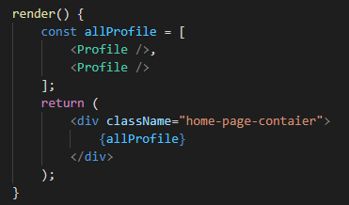
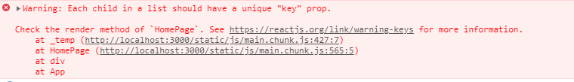
List
Can render multiple components by adding them in an array
Just add the array in your render method and all the elements will appear
When you run the code, you will see a warning about “key”

Slide 41
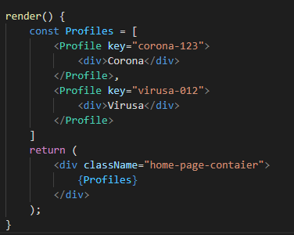
Keys
keys help React identify which items have changed, are added, or are removed
should be given to the elements inside the array to give the elements a stable identity
only has to be unique among its siblings
If you choose not to assign, React will default to using indexes as keys (using indexes is a bad practice)
only necessary to the top element in your array

Slide 42
Performance Boost
<div>Apple</div>
<div>Strawberry</div>
<div>Apple</div>
<div>Strawberry</div>
<div>Apple</div>
<div>Strawberry</div>
<div>Pineapple</div>
<div>Pineapple</div>
<div>Apple</div>
<div>Strawberry</div>

Slide 43
Let’s Play With It!

Slide 44
Problem
In some cases, you wanna access the node of your element to maybe do something (e.g. focus, get position, etc.)
You can use vanilla javascripts (e.g. querySelector) but there is a React Way of doing it!

Slide 45
Refs
provide a way to access DOM nodes or React elements created in the render method
Refs objects are updated in componentDidMount/componentDidUpdate
Some good use cases
Managing focus, text selection, or media playback.
Getting an element’s position.
Triggering imperative animations.
Integrating with third-party DOM libraries.
AVOID OVERUSING REFS! CONSIDER USING PROPS OR STATE FIRST!

Slide 46
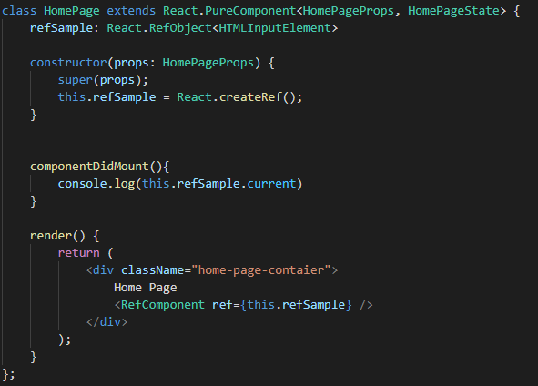
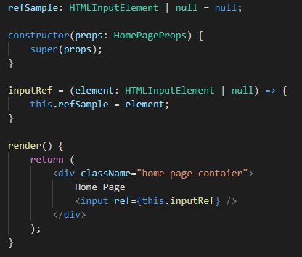
How to use Refs?
Just use the React.createRef and pass it to an element or component
Using callback refs – pass the element in the function’s parameter directly
React will call the ref callback with the DOM element when the component mounts, and call it with null when it unmounts

Slide 47
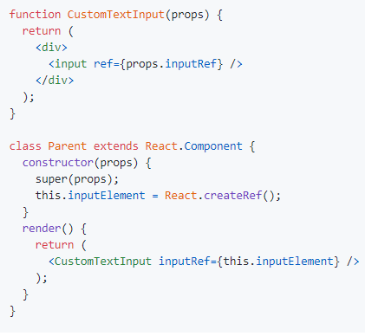
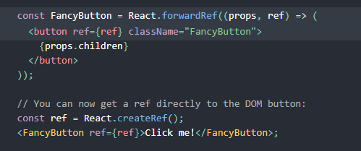
How to access child component’s element?
Just pass the ref as prop with a different name and assign that prop as a ref in an element or class
Ref prop is not accessible in the component even in props
Forwarding Ref – pass a “ref” prop to a functional component and use React.forwardRef to access that ref and assign it to an element or class

Slide 48
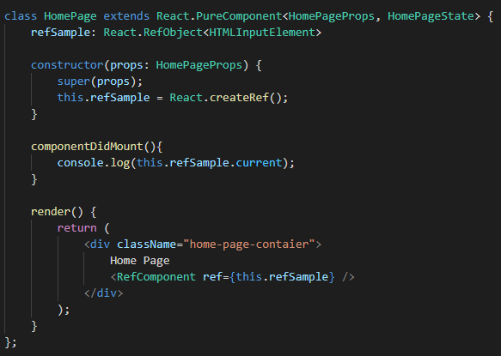
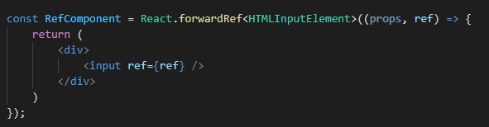
Typescript

Slide 49
Let’s Play With It!

Slide 50
Problem
pass props/data to many components
You would end up adding it to top level component and pass it to each and every component until you reach your target components
That’s a lot of manual work and refactor

Slide 51
Context
a way to pass data through the component tree without having to pass props down manually at every level
designed to share data that can be considered “global” for a tree of React components
Mostly used for current authenticated user, theme, or preferred language, etc.
apply it sparingly because it makes component reuse more difficult

Slide 52


Context API
createContext – create and returns a context Object
Context.Provider - context object comes with a Provider React for consumers to subscribe.
Context.Consumer - component that subscribes to context changes. This lets you subscribe to a context within a function component

Slide 53
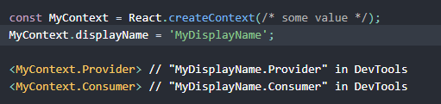


Context.displayName - React DevTools uses this string to determine what to display for the context
Class.contextType – determine which context to subscribe to
this.context – use to access context value inside a class

Slide 54
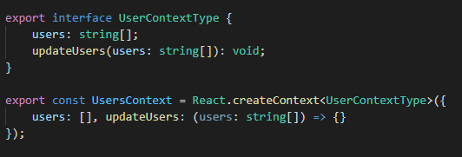


Typescript
Create Context:
Using contextType and context:
No changes needed for Consumer as it detects it automatically

Slide 55
High-level Overview
Context.Provider
MyUIComponent
Context.Consumer
contextType + this.context

Slide 56
Let’s Play With It!

Slide 57
Problem
Bundling is great, but as your app grows, your bundle will grow too. Especially if you are including large third-party libraries
This will make the initial load of your application slow depending on the users network speed and WE DON’T WANT THAT!

Slide 58
Code Splitting
can help you “lazy-load” just the things that are currently needed by the user
reduced the amount of code needed during the initial load and improve performance of your app

Slide 59
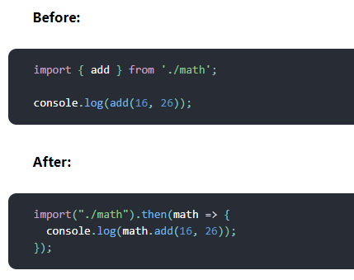
Dynamic Import
to introduce code-splitting into your app is through the dynamic import() syntax
When Webpack comes across this syntax, it automatically starts code-splitting your app and this is setup in Create React App already.

Slide 60
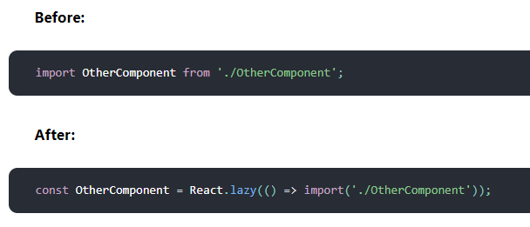
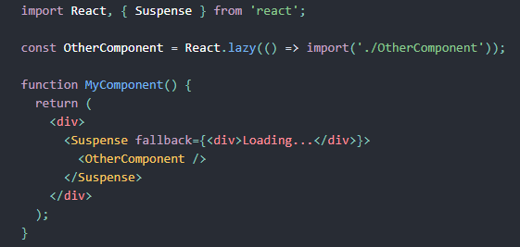
React Lazy & Suspense
lets you render a dynamic import as a regular component
will automatically load the bundle containing the OtherComponent when this component is first rendered
takes a function that must call a dynamic import()
should then be rendered inside a Suspense component, which allows us to show some fallback content (such as a loading indicator) while we’re waiting for the lazy component to load

Slide 61
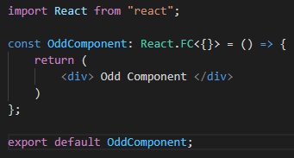
React.lazy and Suspense are not yet available for server-side rendering. You can use loadable components package.
React.lazy currently only supports default exports

Slide 62
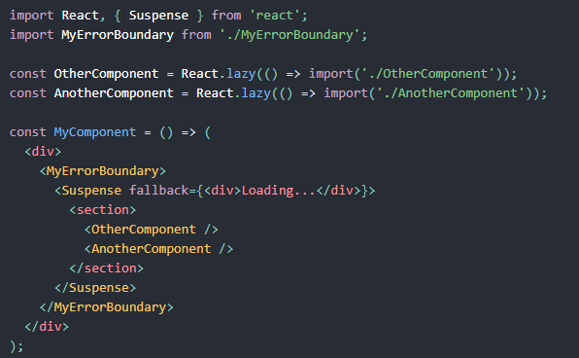
Error Boundaries
In case we experience issues when fetching the other components using Lazy and Suspense, we can use Lifecycles for Error handling (getDerivedStateFromError, componentDidCatch)
One way is to create a component that contains error handling and wrap the lazy and suspense with it

Slide 63
Let’s Play With It!

Slide 64
Problem
You have created a reusable component
You want to make it reusable by passing children into it and maybe customized it a little
Sometimes you want to override the props of those child components

Slide 65
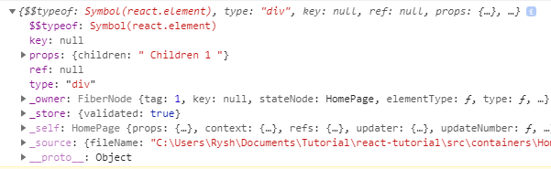
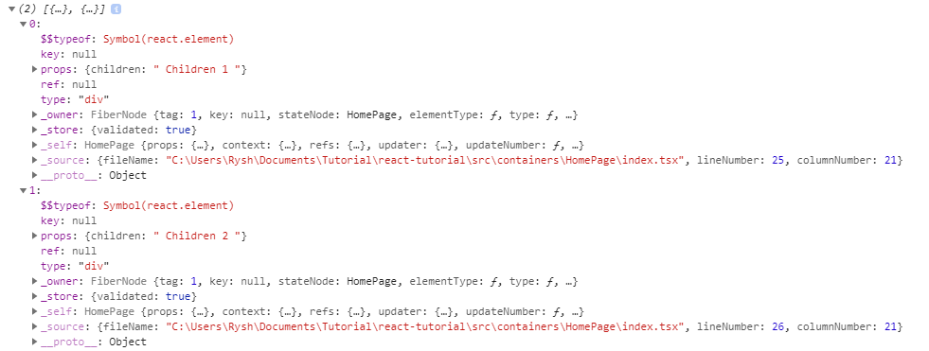
React.Children
provides utilities for dealing with the this.props.children opaque data structure
One Children
Two Children

Slide 66
React.Children API
React.Children.only(children) - this method throws an error if not only one
React.Children.count(children)
React.Children.map(children, function[(thisArg)])
React.Children.forEach(children, function[(thisArg)])
React.Children.toArray(children)

Slide 67
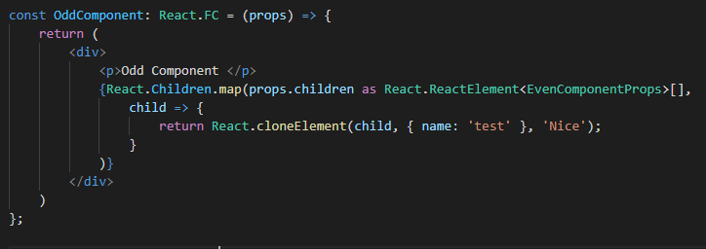
React.cloneElement
clone and return a new React element using element as the starting point
resulting element will have the original element’s props with the new props merged in shallowly
new children will replace existing children
key and ref from the original element will be preserved

Slide 68
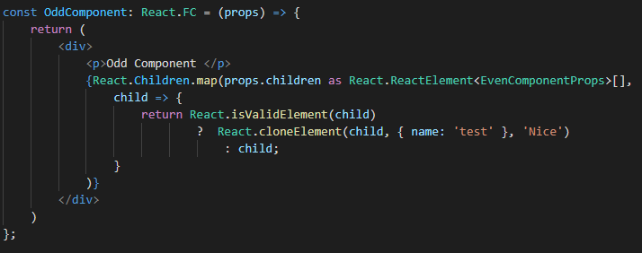
React.isValidElement
verifies the object is a React element
returns true or false

Slide 69
Let’s Play With It!

Slide 70
Summary
Component - let you split the UI into independent, reusable pieces, and think about each piece in isolation
Props - input/parameters that you can use to dynamically render your UI
State - data inside your component that will trigger a re-render when you update it
Lifecycle
Mounting
getDerivedStateFromProps
render
componentDidMount
Unmounting
componentWillUnmount
Updating
getDerivedStateFromProps
shouldComponentUpdate
render
getSnapshotBeforeUpdate
componentDidUpdate

Slide 71
Lifecycle
Error Handling
getDerivedStateFromError
componentDidCatch
Lifecycle – deprecated & unsafe
componentWillMount
componentWillReceiveProps
componentWillUpdate
Functional Component – without lifecycle, BUT WE WILL LEARN HOOKS LATER IN COURSE
Class Component – with state and lifecycle
React.PureComponent – implements shouldComponentUpdate with shallow checks for props and state
React.Memo – shallow check for props in functional component

Slide 72
Higher Order Component – a pattern to reuse component logic using function that will return a component
RenderProps – pattern to reuse component logic by passing component as a prop
List – can render elements/components in an array
Keys – mostly use in array of components/elements so React know which to add/update quickly
Refs – use to reference an element
createRef
callbackRef
Forwarding Ref
Context – to share data/props in multiple components
Lazy & Suspense – use for code splitting with fallback feature while waiting for the code
React.Children – to easily manage this.props.children
React.cloneElement – to clone an element/component
React.isValidElement – to verify that an object is an element

