Slide 1
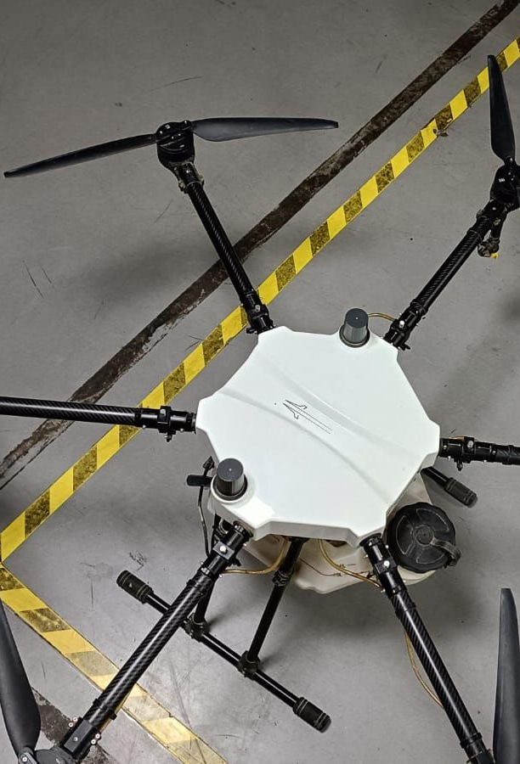
Payload Weight
Estimation
Final model, automated inference and field validation
Aryan Verma
GNC Intern | May–July 2026
General Aeronautics Pvt. Ltd.
Notes:
Open by framing this as the completed payload-estimation work: the final model, the automated test pipeline and what the field data demonstrated.
[Sources]
- Power_Consumption_Weight_Measurement.pdf, slide 1 (visual reference)
- General_Aeronautics_Internship_Log_FINAL.pdf, pages 55–61
[/Sources]

Slide 2
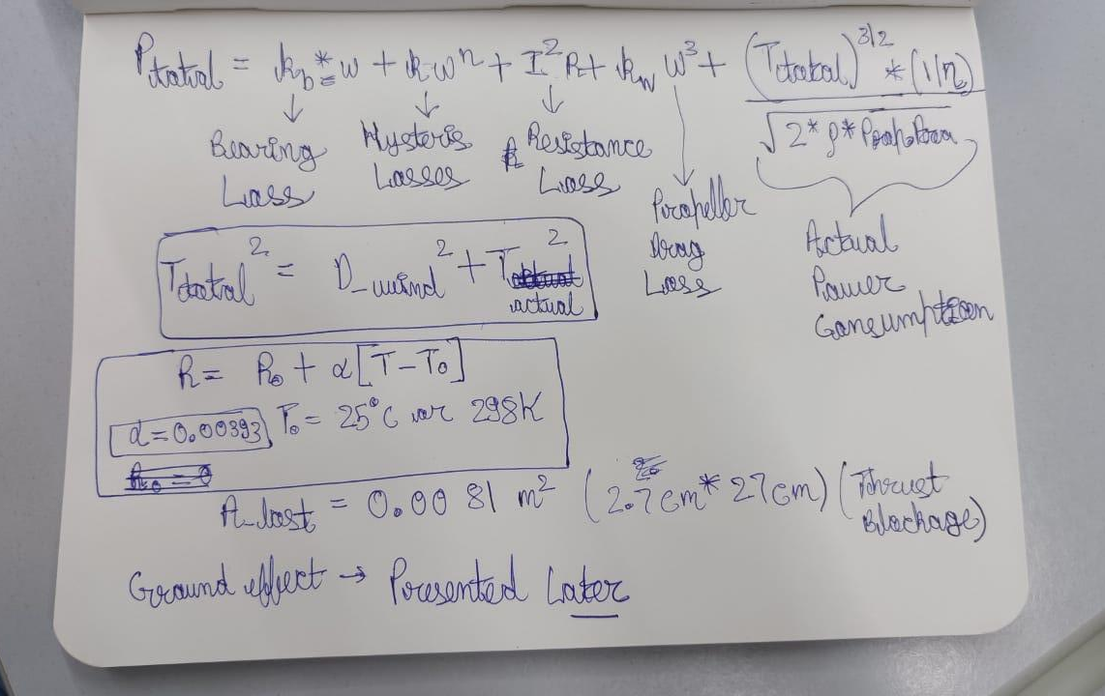
PAYLOAD WEIGHT ESTIMATION | FINAL INTERNSHIP REVIEW
From parameter-rich concept to tested estimator
FINAL STATE
Identifiable loss model
Automated BIN-log extraction, alignment and stable-hover selection
Final coefficients refitted with propeller efficiency fixed at 0.718
0–10 kg flight campaign with clean-trial MAPE of 5.89%
INTERIM REVIEW
Multiple loss terms, theoretical coefficients and no field-validation evidence
The key advance was not another equation—it was an auditable measurement and validation workflow.
General Aeronautics Pvt. Ltd. | GNC Internship
02
Notes:
Use this slide to distinguish the earlier presentation from the final internship outcome. The original deck ended at analytical modelling; the final work added identifiability, automation and field testing.
[Sources]
- Power_Consumption_Weight_Measurement.pdf, slides 3–9
- General_Aeronautics_Internship_Log_FINAL.pdf, pages 55–60
- Payload Weight Estimation technical report, Sections 5–9
[/Sources]

Slide 3
PAYLOAD WEIGHT ESTIMATION | FINAL INTERNSHIP REVIEW
Useful hover power can be inverted to payload
Actuator-disk theory supplies the physical inversion; fitted losses make it applicable to the real powertrain.
Pₑ = P_loss + T³ᐟ² / [ ηₚ √(2ρA_eff) ]
Flight-log inputs
Correct power
Model losses
Infer thrust
Infer payload
Voltage • current • PWM • altitude
Remove electronics baseline
Copper + speed-dependent loss
Invert the power balance
Six-rotor mass minus tare
Output: a post-processed payload estimate from existing ArduPilot telemetry—without adding a load cell.
General Aeronautics Pvt. Ltd. | GNC Internship
03
Notes:
Explain that measured electrical power contains both useful induced power and non-ideal losses. Once the losses are removed, the remaining power can be inverted to thrust and then mass.
[Sources]
- Payload Weight Estimation technical report, Sections 1 and 3
- General_Aeronautics_Internship_Log_FINAL.pdf, model-development entries
[/Sources]

Slide 4
PAYLOAD WEIGHT ESTIMATION | FINAL INTERNSHIP REVIEW
Every real-world factor had a defined treatment
MODELLED EXPLICITLY
CAPTURED IMPLICITLY
EXCLUDED / LIMITED
Air density
Battery state of charge
Steady wind
GPS altitude + tropospheric relation
Measured voltage × current captures sag
<0.3% power contribution in defined case
Ground effect
Thrust blockage
Powertrain condition
Filtered by SAlt > 3.5 m
0.0081 m² removed per rotor
Effective coefficients absorb installed-system behaviour
Motor temperature
Documented limitation; no telemetry
General Aeronautics Pvt. Ltd. | GNC Internship
04
Notes:
The factor study prevented the final model from becoming an unidentifiable collection of corrections. Only terms supported by sensors, geometry or engineering significance were retained.
[Sources]
- Power_Consumption_Weight_Measurement.pdf, slides 2 and 6–9
- Payload Weight Estimation technical report, Section 2
- General_Aeronautics_Internship_Log_FINAL.pdf, pages 33–46 and 55–60
[/Sources]

Slide 5
PAYLOAD WEIGHT ESTIMATION | FINAL INTERNSHIP REVIEW
The final implementation uses three equations
1 LOSS MODEL
P_loss = R_copper Iₘ² + k_linear N + kₑ N²
2 THRUST INVERSION
T = [ (Pₑ − P_loss) ηₚ √(2ρA_eff) ]²ᐟ³
3 PAYLOAD MASS
m_payload = 6T/g − 18.75 kg
N = RPM from manufacturer interpolation • A_eff = πr² − 0.0081 m² • ηₚ = 0.718
General Aeronautics Pvt. Ltd. | GNC Internship
05
Notes:
Walk through the implementation in the same order as the code: estimate loss, infer thrust, scale to six rotors and subtract the corrected empty-aircraft mass.
[Sources]
- Payload Weight Estimation technical report, Equations 6, 9 and 10
- General_Aeronautics_Internship_Log_FINAL.pdf, pages 57–60
[/Sources]

Slide 6
PAYLOAD WEIGHT ESTIMATION | FINAL INTERNSHIP REVIEW
Merging linear-speed terms made the fit identifiable
EARLIER FORM
FINAL IDENTIFIABLE FORM
… + kₕN + k_bω + kₑN²
R Iₘ² + k_linear N + kₑN²
Because ω = 2πN/60, kₕ and k_b occupy the same regression column.
Propeller efficiency was fixed first, then only the identifiable loss coefficients were fitted.
0.09667 Ω
4.322131e−3
1.603907e−6
0.718
R_copper
k_linear (W/RPM)
kₑ (W/RPM²)
ηₚ fixed
Manufacturer-data-based value
Manufacturer curve reconstruction: R² = 0.99979 | mean absolute residual = 6.06 W | max residual = 21.8 W
General Aeronautics Pvt. Ltd. | GNC Internship
06
Notes:
The key modelling correction was recognising that RPM and angular speed are deterministically related. Separate linear terms could not be identified, so they were merged before the final fit.
[Sources]
- General_Aeronautics_Internship_Log_FINAL.pdf, pages 57–60
- Payload Weight Estimation technical report, Sections 5.5–5.7
- Manufacturer X6 Plus power/current/RPM/thrust table supplied in the project files
[/Sources]

Slide 7
PAYLOAD WEIGHT ESTIMATION | FINAL INTERNSHIP REVIEW
Each BIN log becomes one auditable payload estimate
1
2
3
4
5
Parse logs
Align streams
Select hover
Evaluate model
Report payload
GPS • CTUN • RCOU • BAT
Nearest TimeUS within 60 ms
3.5 m cutoff • 2.5 s window
ρ • RPM • loss • thrust
Estimate • loss • power • error
Robustness built into the run
Missing message stream → skip file • no aligned samples → drop rows • useful power ≤ 0 → reject log • aligned CSV retained for audit
General Aeronautics Pvt. Ltd. | GNC Internship
07
Notes:
Describe the pipeline as a reproducible batch process. The intermediate aligned CSV is important because it makes the exact rows used by downstream calculations inspectable.
[Sources]
- Payload Weight Estimation technical report, Section 6 and Appendix B
- General_Aeronautics_Internship_Log_FINAL.pdf, code and test entries on pages 49–60
[/Sources]

Slide 8
PAYLOAD WEIGHT ESTIMATION | FINAL INTERNSHIP REVIEW
Final testing used a repeatable baseline–hover sequence
Six nominal payloads were tested on 30 July 2026: 0, 2, 4, 6, 8 and 10 kg.
ARM / START
~30 s DISARMED
TAKEOFF
~2 min HOVER AT 5 m AGL
LAND
A row qualified as stable hover only when
> 3.5 m
2.5 s
< P50
≥ 20
Representative values = medians of the selected stable-hover rows
SAlt cutoff
rolling window
rolling SAlt σ
samples
flight-specific threshold
General Aeronautics Pvt. Ltd. | GNC Internship
08
Notes:
The disarmed period provided the electronics baseline. The 5 m hover kept inference above the final 3.5 m cutoff. The 10 kg flight switched to RTL after roughly one minute and was marked botched.
[Sources]
- General_Aeronautics_Internship_Log_FINAL.pdf, pages 55–60
- Payload Weight Estimation technical report, Sections 6.4–6.6 and 9.1
[/Sources]

Slide 9
PAYLOAD WEIGHT ESTIMATION | FINAL INTERNSHIP REVIEW
Four corrections cut development error by more than half
Values below are the sequential console metrics during debugging of the loaded-payload matrix.
14.24%
8.72%
6.58%
6.46%
Initial flight-test algorithm
Tare + coefficient refit
Electronics baseline removed
Final identifiable fit
Systematic overestimate
18.75 kg and loss growth corrected
P_hover − P_aux
kₕ and k_b merged
54.6%
5.89%
reduction in development mean error
final clean-trial MAPE (2–8 kg)
excludes diagnostic 0 kg and botched 10 kg
General Aeronautics Pvt. Ltd. | GNC Internship
09
Notes:
Be precise about the two metrics: 6.4635% was the final console aggregation across loaded tests during development; 5.89% is the report's clean 2–8 kg validation MAPE after excluding the known botched flight.
[Sources]
- General_Aeronautics_Internship_Log_FINAL.pdf, pages 56–60
- Payload Weight Estimation technical report, Section 9.2
[/Sources]

Slide 10
PAYLOAD WEIGHT ESTIMATION | FINAL INTERNSHIP REVIEW
Four clean loaded trials track the ideal payload line closely
3 of 4
clean trials below 5% error
5.89%
clean 2–8 kg MAPE
10 kg test
Retained for transparency, but excluded from clean validation because the flight entered RTL.
General Aeronautics Pvt. Ltd. | GNC Internship
10
Notes:
The 0 kg result is a diagnostic rather than a percentage-error point. The 10 kg point is shown but marked as botched. The clean validation subset is 2, 4, 6 and 8 kg.
[Sources]
- General_Aeronautics_Internship_Log_FINAL.pdf, pages 58–60
- Payload Weight Estimation technical report, Section 9.2
[/Sources]

Slide 11
PAYLOAD WEIGHT ESTIMATION | FINAL INTERNSHIP REVIEW
One 4 kg outlier dominates the clean-trial payload MAPE
1.06%
mean total-mass error
clean 2–8 kg trials
Why payload error looks larger
Payload is the residual after subtracting an 18.75 kg tare mass.
A small supported-mass error becomes a large percentage of a 2–4 kg payload.
* 10 kg flight marked botched
General Aeronautics Pvt. Ltd. | GNC Internship
11
Notes:
Use the total-mass metric to explain why the physics estimator can be accurate on supported mass while payload percentage error remains sensitive at low payloads.
[Sources]
- Payload Weight Estimation technical report, Sections 9.2 and 9.4
- General_Aeronautics_Internship_Log_FINAL.pdf, pages 58–60
[/Sources]

Slide 12
PAYLOAD WEIGHT ESTIMATION | FINAL INTERNSHIP REVIEW
Loss rose with payload while its share stayed near 10%
316 → 665 W
corrected input / motor
34.6 → 64.9 W
modelled loss / motor
9.75–10.93%
loss fraction
absolute loss nearly doubled
General Aeronautics Pvt. Ltd. | GNC Internship
12
Notes:
This resolves the earlier concern that the loss estimate was not growing. In the final model, absolute loss rises from 34.6 W to 64.9 W per motor; its percentage remains near 10% because useful induced power rises at the same time.
[Sources]
- General_Aeronautics_Internship_Log_FINAL.pdf, pages 56–60
- Payload Weight Estimation technical report, Section 9.3
[/Sources]

Slide 13
PAYLOAD WEIGHT ESTIMATION | FINAL INTERNSHIP REVIEW
Remaining errors prevent a universal sub-5% claim
The estimator already recovers total supported mass accurately; payload error is amplified by tare subtraction and limited repeatability.
Tare sensitivity
Zero-load diagnostic
18.75 kg is configuration-corrected, but still needs direct calibrated-scale measurement.
−0.944 kg indicates sensitivity to baseline selection and low-load coefficient transfer.
4 kg outlier
Validation depth
12.92% APE cannot be attributed confidently from a single flight.
One run per payload; no confidence intervals or day-to-day repeatability yet.
General Aeronautics Pvt. Ltd. | GNC Internship
13
Notes:
Do not overclaim. The clean mean is close to the 5% target and three trials pass it, but repeat flights and a direct tare measurement are still required before calling the method universally sub-5%.
[Sources]
- Payload Weight Estimation technical report, Sections 7.4 and 9.4
- General_Aeronautics_Internship_Log_FINAL.pdf, pages 58–60
[/Sources]

Slide 14
PAYLOAD WEIGHT ESTIMATION | FINAL INTERNSHIP REVIEW
The internship delivered an auditable engineering workflow
Physics-informed model
1
Key fixes closed
Actuator-disk inversion, air-density correction, blockage and fitted losses
✓
Incorrect extraction
Automated software pipeline
✓
Noisy altitude signal
2
BIN parsing, timestamp alignment, hover selection, baseline correction and inference
✓
Wrong tare mass
✓
Unremoved baseline power
Field-validation evidence
✓
Collinear loss terms
3
Six payload configurations, aligned CSV outputs, charts and error analysis
Non-positive power guard
✓
Engineering documentation
4
Parameter rationale, bug-fix history, code traceability, limitations and roadmap
General Aeronautics Pvt. Ltd. | GNC Internship
14
Notes:
Use this slide to close the work-completed section: modelling, software, validation and documentation were all delivered. The code and testing logs accompany the final report.
[Sources]
- Payload Weight Estimation technical report, Sections 7 and 8
- General_Aeronautics_Internship_Log_FINAL.pdf, pages 55–61
[/Sources]

Slide 15
PAYLOAD WEIGHT ESTIMATION | FINAL INTERNSHIP REVIEW
Sub-5% needs better measurement—not more coefficients
1 CALIBRATE
2 VALIDATE
3 DEPLOY
Directly weigh the complete 18.75 kg configuration
Freeze ηₚ and the final model structure
Estimate each rotor separately where telemetry allows
Characterise electronics baseline versus battery voltage
Use held-out flights and different days
Add temperature and environmental inputs
Repeat 0–10 kg tests ≥3 times in random order
Report bias, repeatability and confidence intervals
Version coefficients and retain aligned audit outputs
Final takeaway
A functioning estimator is now demonstrated; repeatable sub-5% payload accuracy is the next validation milestone.
General Aeronautics Pvt. Ltd. | GNC Internship
15
Notes:
End on the concrete next milestone. The model structure should now stay fixed while measurement quality, repeatability and held-out validation improve.
[Sources]
- Payload Weight Estimation technical report, Section 10
- General_Aeronautics_Internship_Log_FINAL.pdf, pages 60–61
[/Sources]

