Slide 1
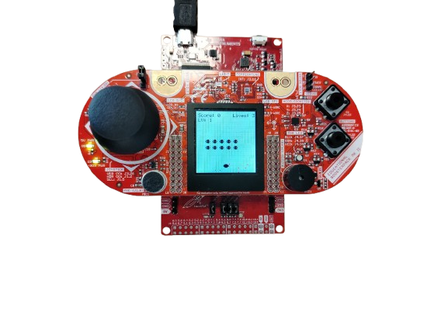
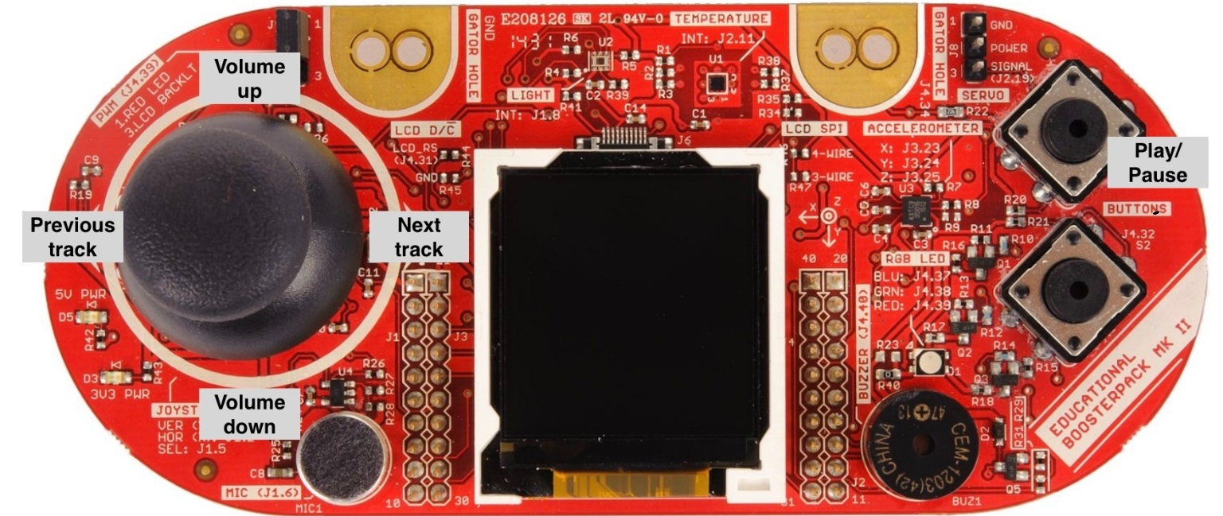

Slide 3
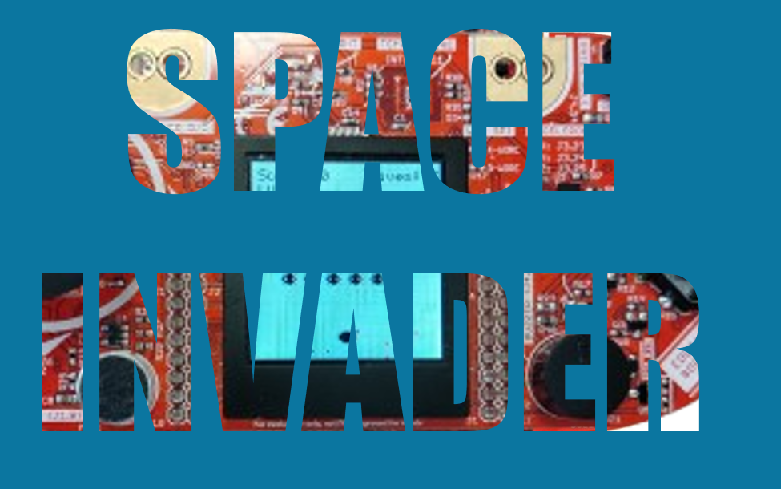



WORKING
FLOW
DATA
STRUCTURES
MEMBER
ROLES
IMPORTANT
CODE
FUTURE
WORK
TESTING

Slide 4
WORKING
FLOW
DATA
STRUCTURES
IMPORTANT
CODE
MEMBER
ROLES
FUTURE
WORK
TESTING

Slide 5
This project is a Retro arcade-style Space Invader
Input handling (ADC,GPIO interrupts)
Joystick ADC14, Port1 button
Game logic
Player, enemies, projectiles, collision detection, score system, 3 levels
Graphics
LCD display
Interrupts Used:Timer Interrupt (TA0_0_IRQHandler): Updates game logic at regular intervals.
GPIO Interrupt (PORT1_IRQHandler): Handles button presses for shooting and menu navigation.
ADC Interrupt (ADC14_IRQHandler): Reads joystick position to move the player.
WORKING
FLOW
DATA
STRUCTURES
MEMBER
ROLES
IMPORTANT
CODE
FUTURE
WORK
TESTING

Slide 6
Core Software Blocks of the System
Main Program (main.c)
Initializes hardware and game elements.
Manages game states (menu, playing, game over).
Calls update and draw functions for player, enemies, and projectiles.
Player Module (player.c / player.h)
Controls player movement and positioning.
Enemy Module (enemy.c / enemy.h)
Manages enemy formation, movement, and attacks.
Projectile Module (projectile.c / projectile.h)
Handles player and enemy projectiles.
Detects collisions with enemies and the player.
Graphics Module (graphics.c / graphics.h)
Draws game elements (player, enemies, projectiles, screen etc).
Updates the screen with score, lives, and explosions.
Draws game elements (player, enemies, projectiles, screen etc).
Updates the screen with score, lives, and explosions.
WORKING
FLOW
CORE SOFTWARE
MEMBER
ROLES
IMPORTANT
CODE
FUTURE
WORK
TESTING

Slide 7
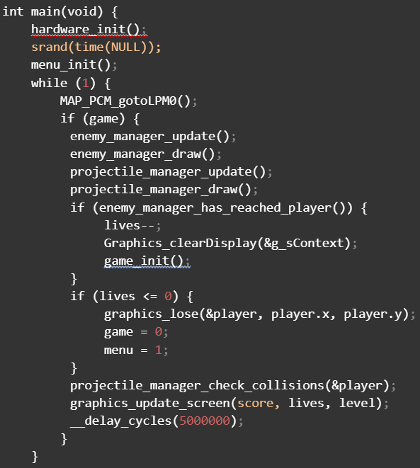
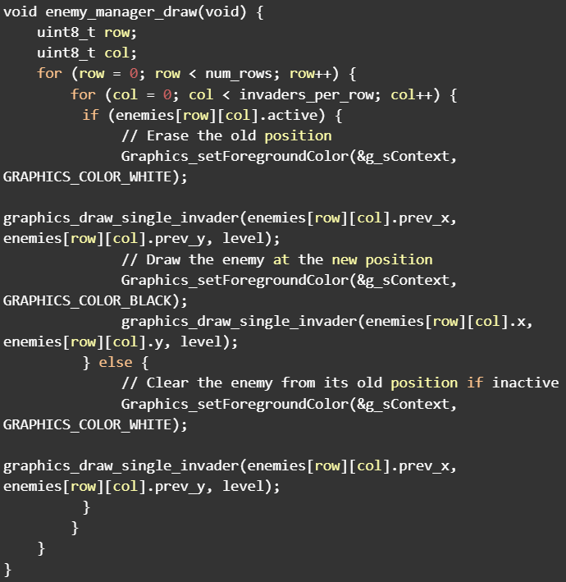
Main
Draw Enemy
WORKING
FLOW
DATA
STRUCTURES
MEMBER
ROLES
REPRESENTATIVE CODE
FUTURE
WORK
TESTING

Slide 8
WORKING
FLOW
DATA
STRUCTURES
MEMBER
ROLES
IMPORTANT
CODE
FUTURE
WORK
How did we test
Played a lot of times
Tested with different enemies, probability of shooting, lives, speed
Added print statements to check correctness.
Problems Encountered
Collisions
Projectiles bug
Graphic glitches
Variables overflow
TESTING

Slide 9
WORKING
FLOW
DATA
STRUCTURES
MEMBER
ROLES
IMPORTANT
CODE
FUTURE
WORK
TESTING
Alessio De Col
Collisions, Inputs (Buttons, Joystick), Game Logics, Enemy Logic
Antonio Amabile
Draft C Code, Game Logic, Player Logic, Enemy Logic
Marko Markovic
Collisions, Graphics, Game Logic, Projectile Logics, Enemy Logic

Slide 10
WORKING
FLOW
DATA
STRUCTURES
MEMBER
ROLES
IMPORTANT
CODE
FUTURE
WORK
TESTING
Conclusions and Future Work
New enemy types with different behaviors
Adding sound effects
Fixing additional instability

