Slide 1

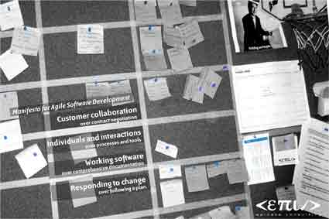


Do distribute!
The fallacies of Distributed Computing meets the Cloud...
Totto-11
totto@webstep.no
@javatotto/@tottoNOR

Slide 2






INTRO – BACKGROUND
Do distribute! (If not for scale so for availability..)

Slide 3

Totto
Distributed systems geek
Let the machines do the work..
Tired of seeing systems fail..
Been advocating and building recilliant systems for quite some time
“We can do much better”
‘It just makes sense’
«To revolutionize the world, you have to win the big fights»
Notes:
Bakgrunn - arkitektur og psykologi

Slide 4
Distributed System
A collection of independent computers that appears to its users as a single coherent system
  - Tanenbaum and Steen: Distributed Systems: Principles and Paradigms
You know you have a distributed system when the crash of a computer you’ve never heard of stops you from getting any work done.
  - Leslie Lamport : Security Engineering: A Guide to Building Dependable Distributed Systems
A distributed system is an application that executes a collection of protocols to coordinate the actions of multiple processes on a network, such that all components cooperate together to perform a single or small set of related tasks.
  - Introduction to Distributed System Design – Google Code University

Slide 5
Distributed Computing
is not GRID
    Grid is distributed SIMD
is not a Cluster
  Cluster looks like One Machine
    “Failure does not exist”
Is nothing like plain J2EE - think different!

Slide 6
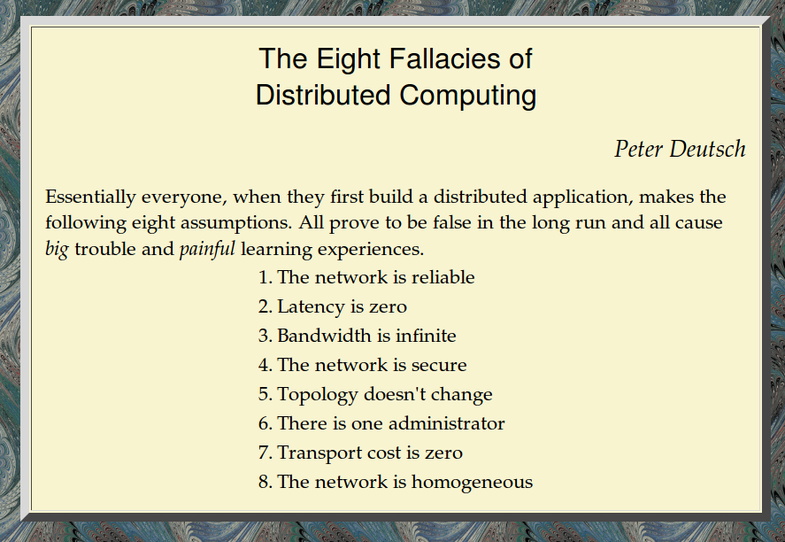
Notes:
Totto

Slide 7
Background
The Fallacies were coined 17 years ago, but they apply just as well today.
Back then folks might have been fooled into actually believing them, but we’re smarter than that, right?
Knowing what gotchas await our services in the cloud, can help us build better, resilient, faster and more performant applications.
Isn’t that what we all want?

Slide 8
Initial refections on developers
The two types of developers:
  application developer
  systems developer
The world of application developers
  driven by: $$$ == Business features
  (read: single thread, “perfect world”, “solved in
  infrastructure”)
  2011: RIP (examples: Altinn, NAV)
The world of systems developers
  driven by: Street-cred (coolest tech)
  (read: manual thread spawning, network=retry et all)
  2011: Dead by double errors
  (examples: Telenor, EDBErgogroup)

Slide 9

1. The network is reliable
As a developers we have a number of useful abstractions available for working with network requests. Unfortunately none of them can actually spare us from needing to consider the realities of an unreliable network. And since the abstractions try to hide the unreliability most developers tend to forget to handle unreliable situations resulting in component and system failure.
try {
URL url = new URL( args[0] );
BufferedReader in = new BufferedReader(new
InputStreamReader(url.openStream()));
String str;
while ((str = in.readLine()) != null) {
System.out.println(str);
}
in.close();
}
catch (MalformedURLException e) {}
catch (IOException e) {}
}

Slide 10

2. Latency is zero
Most network API and wrappers try to hide the fact that there can be latency in the network. I guess most of the developers in this room have experienced some kind of system failure being caused by sudden high increase in latency. If the system design does not take this law into account, you are certain to be bitten but such consequences.
Number of requests, size of message, lazy loading, movable code is techniques to consider..

Slide 11
3. Bandwidth is infinite
Bandwidth has never been as high as it is in 2011. But as the recent Telenor Mobil failure, the “askesky” problems and the yearly Altinn failures keeps reminding us on, high!=infinite. (you might add DoS/DDoS to that list).
If the system design does not account for this failure, spectacular crashes and service unavailabilities is always the result.

Slide 12
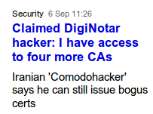
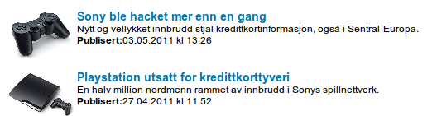
4. The network is secure
Statistics published at Aladdin.com shows that:
  "For 52% of the networks the perimeter is the only defense”
Through the continual 24x7 monitoring of hundreds of Fortune 1000 companies, RipTech has discovered several extremely relevant trends in information security. Among them:
  General Internet attack trends are showing a 64% annual rate of growth
  The average company experienced 32 attacks per week over the past 6 months
  Attacks during weekdays increased in the past 6 months"
The implications of network (in)security are obvious
  you need to build security into your solutions from Day 1.
  which 9 of 10 projects today still fail to do..

Slide 13

5. Topology does not change
That's right, it doesn’t--as long as it stays in the test lab.
When you deploy an application in the wild (that is, to an organization), the network topology is usually out of your control. The operations team (IT) is likely to add and remove servers every once in a while and/or make other changes to the network ("this is the new Active Directory we will use for SSO ; we're replacing RIP with OSPF and this application's servers are moving into area 51" and so on).
Lastly there are server and network faults which can cause routing changes. When you're talking about clients, the situation is even worse. There are laptops coming and going, wireless ad-hoc networks , new mobile devices. In short, topology is changing constantly

Slide 14
6. There is one administrator
At this point you may say "Okay, there is more than one administrator. But why should I care?" Well, as long as everything works, maybe you don't care. You do care, however, when things go astray and there is a need to pinpoint a problem (and solve it).
The famous developers versus operations battle

Slide 15
7. Transport cost is zero
The costs (as in cash money) for setting and running the network are free. This is also far from being true. There are costs--costs for buying the routers, costs for securing the network, costs for leasing the bandwidth for Internet connections, and costs for operating and maintaining the network running. Someone, somewhere will have to pick the tab and pay these costs.
Imagine you have successfully built a Google-killer search engine but you will fail if you neglect to take into account the costs that are needed to keep your service up, running, and responsive (E3 Lines, datacenters with switches, SANs etc.).
The takeaway is that even in situations you think the other fallacies are not relevant to your situation because you rely on existing solutions

Slide 16
8. The network is homogeneous
This fallacy was added to the original seven by James Gosling, creator of Java, in 1997.
It is worthwhile to pay attention to the fact the network is not homogeneous at the application level. The implication of this is that you have to assume interoperability will be needed sooner or later and be ready to support it from day one (or at least design where you'd add it later).
Do not rely on proprietary protocols--it would be harder to integrate them later. Do use standard technologies that are widely accepted; the most notable examples being JSON, XML or Web Services. By the way, much of the popularity of XML and Web Services can be attributed to the fact that both these technologies help alleviate the affects of the heterogeneity of the enterprise environment.

Slide 17
A few word on distributed systems
Distributed systems must deal with:
  Failure of part of the system
  Accumulation of outdated and unwanted information
Network:
  resilliant (motstandsdyktighet)
    Fallacies: 1, 4, 5, 6, 8
  discovery (fleksibilitet)
    Fallacies: 1, (2), (3), 4, 5, 6, (7), 8
Simplified:
  discovery
  lease (and extensions like mobile code)

Slide 18
A quick walk through the memory lane
Lets see how far we have come the last 15+ years..(and reflect of how we got where we are..)

Slide 19
A few words on distributed systems the last 20 years
1994: TCP/IP wrappers
  client-server, object models, memory leaks, homemade protocols
1998: (Com+/EJB)
  the year of containers. Application developers should write applications in server containers.
2000: Internet (IFrame)
  mostly mashups, frontend developers mix&match content
2008: REST
  resources (data) returned to the internet
2011: The Cloud
  Infrastructure as a Service. Hardware just another “software” service. The end of the SLA age..

Slide 20

REST is an architectural style which has 4 fundamental constraints:
* Identification of resources
* Manipulation of resources through representations
* Self-descriptive messages
* Hypermedia as the engine of application state
2008 – Let us have a look at the fallacies in the WEB/REST age
The year data/resources returned to the Internet
REF: Tim Bray: The Web vs. the Fallacies- 2009.

Slide 21
1. The network is reliable
HTTP helps here in a couple of different ways. Most obviously, connections are brief; I've never seen much in the way of measurements, but I'd expect the average connection lifetime to be under a second. Compared to a traditional networked system with connections whose lifetime approximates that of the application, this moves the likelihood of experiencing a damaging connection breakdown while application code is running from 'essentially always' to 'rather rarely'.
Second, the clarity about GET, PUT, and DELETE being idempotent, while POST isn't, helps hugely. Most obviously, if a GET gets a network blowup, just do it again. And if the breakage hits a POST, well, it probably only hits one, and this places very clear boundaries around the repair and recovery that an app needs to handle.

Slide 22
2. Latency is zero
The Web actually makes the latency problem worse, because every interchange, on average, requires connection setup/teardown.
Since it's not realistic to expect anything like keystroke-level latency across the Net, the correct engineering solution is to defuse the expectation.

Slide 23
3. Bandwidth is infinite
Here the Web has been a wonderful teacher of networking realities to the non-technical.
Time after time, you'll see messages, between computing civilians, of the form 'Sorry that this picture is so big' because they know perfectly well that it's going to slow down the experience of seeing it.

Slide 24
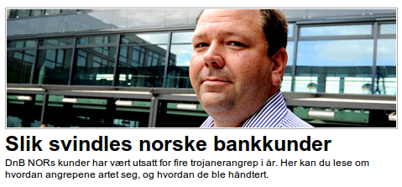

4. The network is secure
This is probably the fallacy least-well-addressed by the Web. True, people have become more aware that There Are Bad Guys out there, and they need to be careful. But not nearly enough.
Also, let's grant that TLS, properly deployed, has been pretty well Good Enough to run apps in a mostly-secure way in a hostile environment. But who among us would be surprised if someone turned up a catastrophic flaw, perhaps not in TLS itself, but in one or two widely-deployed implementations? Who's to say that someone hasn't, already?
Anyhow, the Web technologies mean that application builders can survive even while subject to one or more of The Fallacies. But not this one.

Slide 25
5. Topology does not change
By making almost all our apps Web-based, and thus having everyone address everything with URIs, we all agree to share solutions to routing and addressing problems; solutions provided by the DNS, the network stack, and the Internet backbone operators.
This doesn't mean the solutions are easy or cheap or perfect; it just means that application builders almost never have to think about the problem.

Slide 26
6. There is one administrator
Well yeah, there isn't. But who cares, any more? Web architecture makes addressing decentralized. Thus when an administrator screws up, or imposes policies that seem good to him or her and insane to you, the damage is limited to that person's URI space.
Also, Web architecture, which requires that you talk about things in terms of the URIs you use to address them and the data formats you use to transmit them, makes it a whole lot easier to achieve administrative coherence even when there are millions of administrators.

Slide 27
7. Transport cost is zero
Once again, the Web has been a wonderful teacher of networking realities to the non-technical. Time after time, you'll see messages, between computing civilians, of the form 'Sorry that this picture is so big' because they know perfectly well that it's going to slow down the experience of seeing it.

Slide 28
8. The network is homogeneous
This is perhaps the Web's single greatest triumph. For decades we thought we could extend object models and APIs and lots of other programming concepts over the network. This was a fool's errand, because all you can do with a network is send messages over it.
The Web doesn't do APIs and object models, it's just a set of agreements over what messages you're going to send and what messages expect back in return. Which, as a side-effect, makes heterogeneity a non-issue.

Slide 29
Fallacies and the Web/REST - recap
* The web has taught us some of the fallacies
* Security and reliability are still major flaws

Slide 30

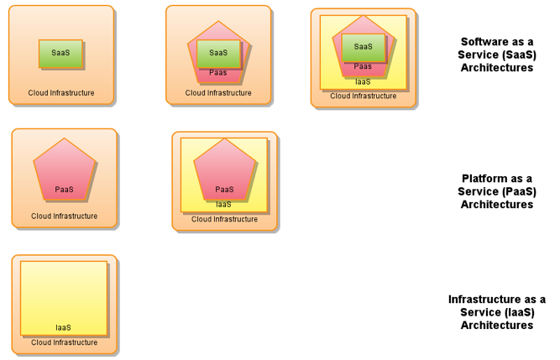

Q: What's the difference between
vitalization and Cloud?
A: Ask for 200 powerful workstations
for a month. Compare costs
and delivery time..
2011 – The Cloud
The year hardware stopped being different than any other Internet software service
REF: Brian Doll: The Fallacies of Distributed Computing Reborn: The Cloud Era

Slide 31
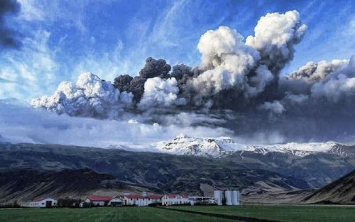
Fallacies and the Cloud, some observations...
“I knew to expect higher rates of individual instance failure in AWS, but I hadn’t thought through some of these sorts of implications.”
“AWS networking has more variable latency. We’ve had to be much more structured about “over the wire” interactions, even as we’ve transitioned to a more highly distributed architecture.”
“Co-tenancy can introduce variance in throughput at any level of the stack. You’ve got to either be willing to abandon any specific subtask, or manage your resources within AWS to avoid co-tenancy where you must.”
“We’re designing each distributed system to expect and tolerate failure from other systems on which it depends.”
– John Ciancutti, Vice President of Personalization Technology at Netflix, Inc

Slide 32
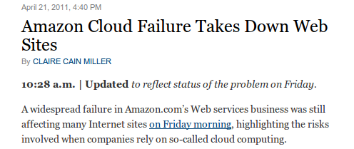
1. The network is reliable
Design your system as a resilient distributed system...
The network is not reliable. When you add up all the points of failure for all the various services and APIs you use, the odds of failure are not just high, they are a given. Instead, build an app that can function at reduced capacity when a given service is offline.

Slide 33
2. Latency is zero
The latency in the cloud is higher (often much higher) than in the traditional data-center. Latency will also vary much more in the cloud, where noisy neighbors is a fact of life.
Ignore latency online and you’re likely throwing away customers from half the globe.
Consider moving the service closer to the customer using CDN and multi-zone deployment

Slide 34
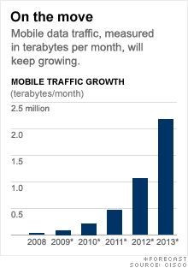
3. Bandwidth is infinite
Nowadays everyone has high-speed Internet access at home.
A few years ago something started to change.
  Web applications were being used not just over high-speed Internet connections, but over phone networks.
  Using web apps on mobile devices and tablets reminds us that the bandwidth problems did not disappear with the dial-up modem
Stay mindful of how much data you’re shipping across the
wire and all your users will be grateful.

Slide 35
4. The network is secure
The cloud is a good teacher, as the “perimeter security” excuse is dead.
Firesheep brought some necessary attention last year to the prevalence of private security tokens littering insecure connections.
The network is not secure, and the more we move our lives online the higher the risk of exposure.
Keep a security mindset when developing your apps and keep your users safe.

Slide 36
5. Topology does not change
One of the biggest benefits of moving applications to the cloud is the ability to change topology at will.
Upgrade the CPU on your database server in the middle of the day. Add reverse proxy servers, cache servers, change CDN providers, migrate availability zones.
Topology changes all the time. Depending on a static infrastructure design not only limits your ability to respond to change, it increases the likelihood of site-wide outages.

Slide 37
6. There is one administrator
Of course there isn’t just one administrator. Even with applications hosted in your own private data-center, your applications are likely interacting with systems outside your administrative control.
These systems may have performance, availability or security issues that you have no direct influence over.
Staying mindful that these systems are beyond your control can help you ensure they have minimal impact on your services when they are unresponsive.

Slide 38
7. Transport cost is zero
The cloud computing business models are a great tutor in learning that transport cost is not frree.
Not only is transport cost not zero, it’s priced like any other commodity and can be purchased per transaction, per gigabyte, per compute hour, etc.
Cloud storage costs (and transport of that storage) are a major component of application hosting costs, just ask anyone doing video streaming online how close to zero their transport costs are.

Slide 39
8. The network is homogeneous
The best part of this fallacy is that it might actually be true. Almost. Between REST and JSON APIs, have you ever had to think about the implementation of an external service, beyond satisfying your curiosity?
You’re much more likely to see libraries producing invalid messages than you are operating systems playing a role.

Slide 40
Fallacies and the cloud, recap
As the cloud pushes our architectures in the distributed system direction, the fallacies are now more important than ever
We can use the cloud providers SaaS and PaaS products to help us create resilient systems
Security is not optional
Perimeter defense is dead in 2011
“Service Level Agreements (SLA)” in the cloud means building distributed systems on the cloud platform (SLA handled in software)

Slide 41
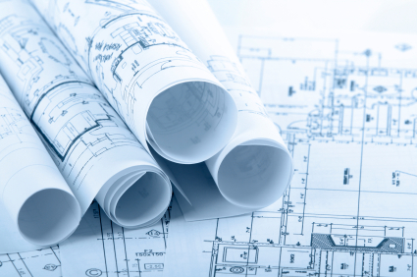
Some Cloud Design Blueprints
Some examples of how to pick smart from Cloud offerings without breaking the fallacies of distributed computing

Slide 42

Chaos Monkey
We’ve sometimes referred to the Netflix software architecture in AWS as our Rambo Architecture. Each system has to be able to succeed, no matter what, even all on its own. We’re designing each distributed system to expect and tolerate failure from other systems on which it depends.
If our recommendations system is down, we degrade the quality of our responses to our customers, but we still respond. We’ll show popular titles instead of personalized picks. If our search system is intolerably slow, streaming should still work perfectly fine.
One of the first systems our engineers built in AWS is called the Chaos Monkey. The Chaos Monkey’s job is to randomly kill instances and services within our architecture. If we aren’t constantly testing our ability to succeed despite failure, then it isn’t likely to work when it matters most – in the event of an unexpected outage.

Slide 43
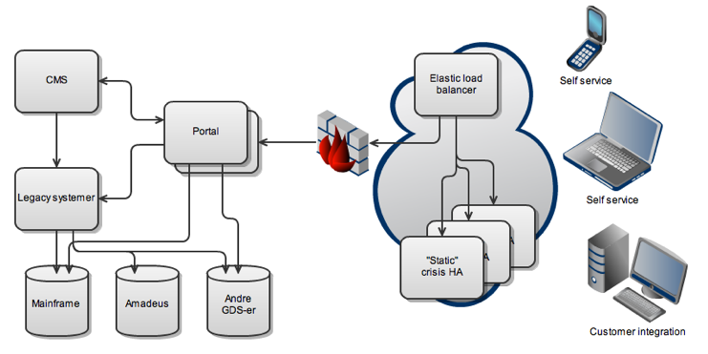
Blueprint: Crisis High Availability
CloudFlare/CDN

Slide 44
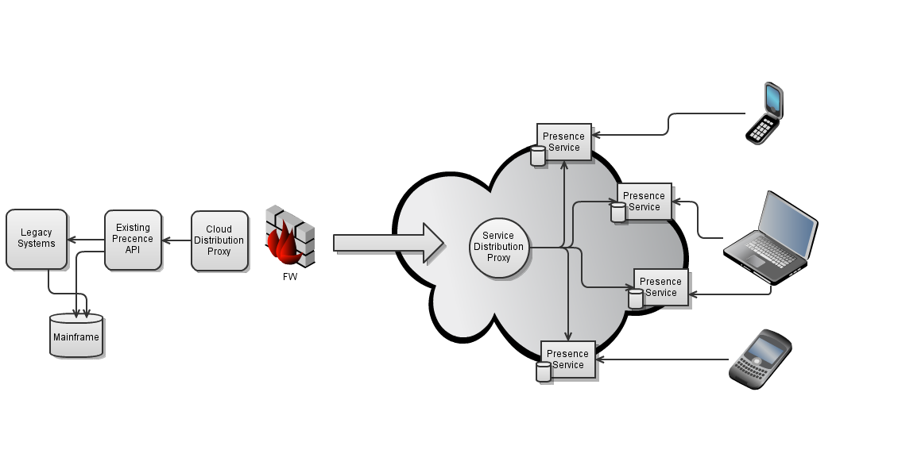
Blueprint: Cloud Distribution

Slide 45
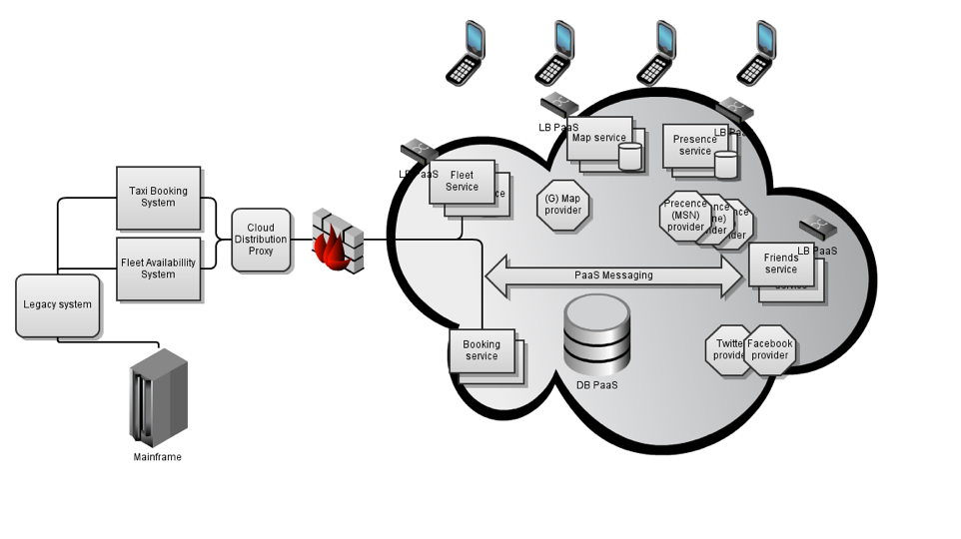
Enterprise Architecture in the Cloud

Slide 46
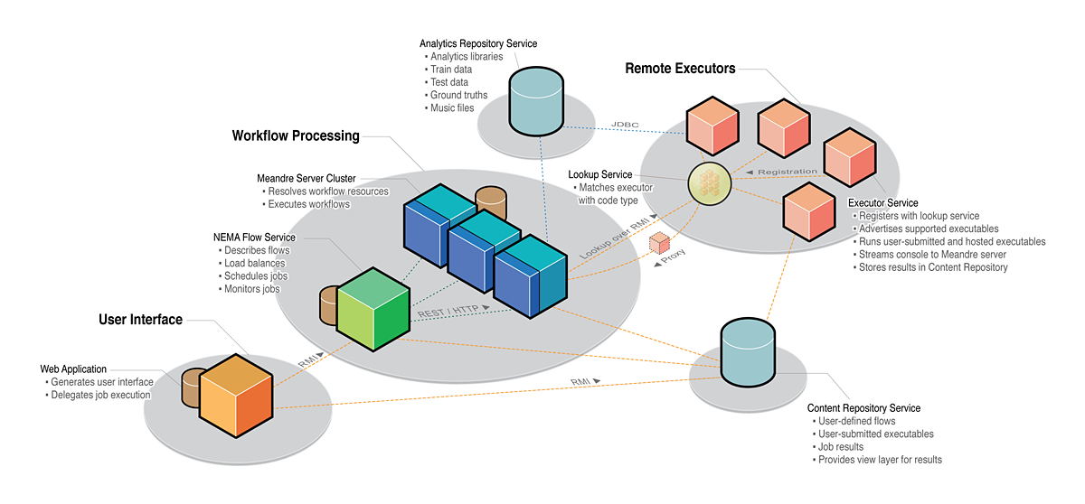
A real distributed system...

Slide 47
Where to go next?
Some literature, links and open source to get you going in the right direction.

Slide 48
Some links
http://techblog.netflix.com/2010/12/5-lessons-weve-learned-using-aws.html
www.rgoarchitects.com/Files/fallacies.pdf
http://blog.newrelic.com/2011/01/06/the-fallacies-of-distributed-computing-reborn-the-cloud-era/
REST in Practise
wiki.cantara.no

Slide 49
Q&A
This is today's last session, so we'll discuss as long as you please before continuing the discussion at AweZone.

