Slide 1

Skyen som systemplatform
- en gjennomgang for arkitekter og CTOs
Totto
IASA, 28. mai 2009
totto@webstep.no
Pust ut – Senk skuldrene

Slide 2
EXECUTIVE SUMMARY
“Making the best of the cloud requires that we take an architectural view, something that we've proven remarkably bad at over and over. Simply deploying an application unchanged to the cloud is unlikely to deliver much benefit.”
Pust ut – Senk skuldrene

Slide 3
Agenda
Definisjoner
Tankesmie
Systemplatform, hva legger vi i det
Eksempel case
Ikke glem..
Referanser
Pust ut – Senk skuldrene

Slide 4
DEFINISJONER
Pust ut – Senk skuldrene

Slide 5
A Working Definition of Cloud Computing
  Cloud computing is a pay-per-use model for enabling available, convenient, on-demand network access to a shared pool of configurable computing resources (e.g., networks, servers, storage, applications, services) that can be rapidly provisioned and released with minimal management effort or service provider interaction.
  This cloud model promotes availability and is comprised of five key characteristics, three delivery models, and four deployment models.
Notes:
Note 1: Cloud computing is still an evolving paradigm. Its definitions, use cases, underlying technologies, issues, risks, and benefits will be refined in a spirited debate by the public and private sectors. These definitions, attributes, and characteristics will evolve and change over time.
Note 2: The cloud computing industry represents a large ecosystem of many models, vendors, and market niches. This definition attempts to encompass all of the various cloud approaches.

Slide 6
5 Key Cloud Characteristics
  On-demand self-service
  Ubiquitous network access
  Location independent resource pooling
  Rapid elasticity
  Pay per use
Notes:
On-demand self-service. A consumer can unilaterally provision computing capabilities, such as server time and network storage, as needed without requiring human interaction with each service’s provider.
Ubiquitous network access. Capabilities are available over the network and accessed through standard mechanisms that promote use by heterogeneous thin or thick client platforms (e.g., mobile phones, laptops, and PDAs).
Location independent resource pooling. The provider’s computing resources are pooled to serve all consumers using a multi-tenant model, with different physical and virtual resources dynamically assigned and reassigned according to consumer demand. The customer generally has no control or knowledge over the exact location of the provided resources. Examples of resources include storage, processing, memory, network bandwidth, and virtual machines.
Rapid elasticity. Capabilities can be rapidly and elastically provisioned to quickly scale up and rapidly released to quickly scale down. To the consumer, the capabilities available for rent often appear to be infinite and can be purchased in any quantity at any time.
Pay per use. Capabilities are charged using a metered, fee-for-service, or advertising based billing model to promote optimization of resource use. Examples are measuring the storage, bandwidth, and computing resources consumed and charging for the number of active user accounts per month. Clouds within an organization accrue cost between business units and may or may not use actual currency.

Slide 7
3 Cloud Delivery Models
  Cloud Software as a Service (SaaS)
    Use provider’s applications over a network
  Cloud Platform as a Service (PaaS)
    Deploy customer-created applications to a cloud
  Cloud Infrastructure as a Service (IaaS)
    Rent processing, storage, network capacity, and other fundamental computing resources
  To be considered “cloud” they must be deployed on top of cloud infrastructure that has the key characteristics
Notes:
Cloud Software as a Service (SaaS). The capability provided to the consumer is to use the provider’s applications running on a cloud infrastructure and accessible from various client devices through a thin client interface such as a Web browser (e.g., web-based email). The consumer does not manage or control the underlying cloud infrastructure, network, servers, operating systems, storage, or even individual application capabilities, with the possible exception of limited user-specific application configuration settings.
Cloud Platform as a Service (PaaS). The capability provided to the consumer is to deploy onto the cloud infrastructure consumer-created applications using programming languages and tools supported by the provider (e.g., java, python, .Net). The consumer does not manage or control the underlying cloud infrastructure, network, servers, operating systems, or storage, but the consumer has control over the deployed applications and possibly application hosting environment configurations.
Cloud Infrastructure as a Service (IaaS). The capability provided to the consumer is to rent processing, storage, networks, and other fundamental computing resources where the consumer is able to deploy and run arbitrary software, which can include operating systems and applications. The consumer does not manage or control the underlying cloud infrastructure but has control over operating systems, storage, deployed applications, and possibly select networking components (e.g., firewalls, load balancers).

Slide 8
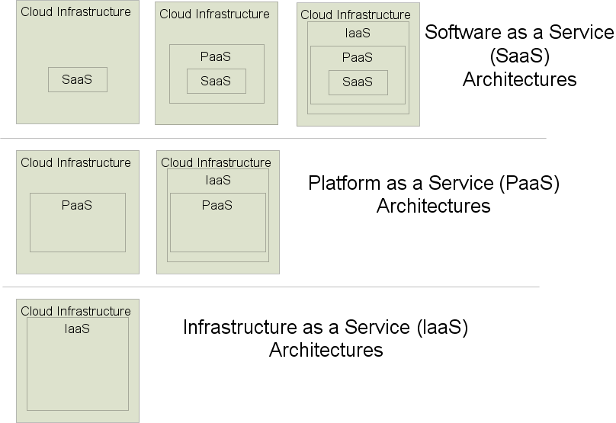
Delivery Model Architectures

Slide 9
4 Cloud Deployment Models
  Private cloud
    enterprise owned or leased
  Community cloud
    shared infrastructure for specific community
  Public cloud
    Sold to the public, mega-scale infrastructure
  Hybrid cloud
    composition of two or more clouds
  Two types: internal and external
Notes:
Private cloud. The cloud infrastructure is owned or leased by a single organization and is operated solely for that organization.
Community cloud. The cloud infrastructure is shared by several organizations and supports a specific community that has shared concerns (e.g., mission, security requirements, policy, and compliance considerations).
Public cloud. The cloud infrastructure is owned by an organization selling cloud services to the general public or to a large industry group.
Hybrid cloud. The cloud infrastructure is a composition of two or more clouds (internal, community, or public) that remain unique entities but are bound together by standardized or proprietary technology that enables data and application portability (e.g., cloud bursting).
Each deployment model instance has one of two types: internal or external. Internal clouds reside within an organizations network security perimeter and external clouds reside outside the same perimeter.

Slide 10
Common Cloud Characteristics
  Cloud computing often leverages:
    Massive scale
    Virtualization
    Free software
    Autonomic computing
    Multi-tenancy
    Geographically distributed systems
    Advanced security technologies
    Service oriented software

Slide 11
TANKESMIE
Pust ut – Senk skuldrene

Slide 12
Thoughts on Cloud Computing
  Galen Gruman, InfoWorld Executive Editor, and Eric Knorr, InfoWorld Editor in Chief
    “A way to increase capacity or add capabilities on the fly without investing in new infrastructure, training new personnel, or licensing new software.”
    “The idea of loosely coupled services running on an agile, scalable infrastructure should eventually make every enterprise a node in the cloud.”
Notes:
Source: InfoWorld Quote, http://www.infoworld.com/article/08/04/07/15FE-cloud-computing-reality_2.html

Slide 13
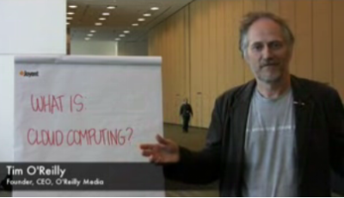
Thoughts on Cloud Computing
  Tim O’Reilly, CEO O’Reilly Media
  “I think it is one of the foundations of the next generation of computing”
  “The network of networks is the platform for all computing”
  “Everything we think of as a computer today is really just a device that connects to the big computer that we are all collectively building”
Notes:
Source: CNET video interview 5/7/08 http://news.cnet.com/8301-13953_3-9938949-80.html?tag=mncol

Slide 14
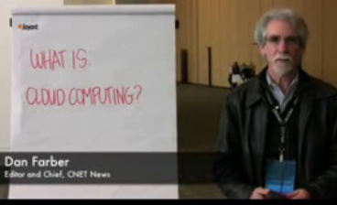
Thoughts on Cloud Computing
  Dan Farber, Editor in Chief CNET News
  “We are at the beginning of the age of planetary computing. Billions of people will be wirelessly interconnected, and the only way to achieve that kind of massive scale usage is by massive scale, brutally efficient cloud-based infrastructure.”
Notes:
CNET Article written by Dan Farber 6/26/08
http://news.cnet.com/8301-13953_3-9978153-80.html?tag=mncol

Slide 15
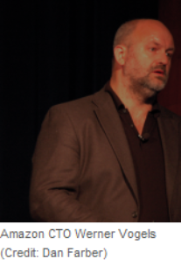
Core objectives of Cloud Computing
  Amazon CTO Werner Vogels
  Core objectives and principles that cloud computing must meet to be successful:
    Security
    Scalability
    Availability
    Performance
    Cost-effective
    Acquire resources on demand
    Release resources when no longer needed
    Pay for what you use
    Leverage others’ core competencies
    Turn fixed cost into variable cost
Notes:
Source: http://news.cnet.com/8301-13953_3-9977100-80.html?tag=mncol

Slide 16

A “sunny” vision of the future
  Sun Microsystems CTO Greg Papadopoulos
    Users will “trust” service providers with their data like they trust banks with their money
    “Hosting providers [will] bring ‘brutal efficiency’ for utilization, power, security, service levels, and idea-to-deploy time” –CNET article
    Becoming cost ineffective to build data centers
    Organizations will rent computing resources
    Envisions grid of 6 cloud infrastructure providers linked to 100 regional providers
Notes:
Data source: CNET article 6/25/08 http://news.cnet.com/8301-13953_3-9977517-80.html?tag=mncol

Slide 17
HVA MENES MED SYSTEMPLATFORM
Pust ut – Senk skuldrene

Slide 18

Free and Open Source Software
  External ‘mega-clouds’ must focus on using their massive scale to reduce costs
  Usually use free software
    Proven adequate for cloud deployments
    Open source
    Owned by provider
  Need to keep per server cost low
    Simple commodity hardware
      Handle failures in software

Slide 19
EKSEMPEL CASE
Pust ut – Senk skuldrene

Slide 20
Case Study: FExampleacebook’s Use of Open Source and Commodity Hardware
  Jonathan Heiliger, Facebook's vice president of technical operations
  80 million users + 250,000 new users per day
  50,000 transactions per second, 10,000+ servers
  Built on open source software
    Web and App tier: Apache, PHP, AJAX
    Middleware tier: Memcached (Open source caching)
    Data tier: MySQL (Open source DB)
    Thousands of DB instances store data in distributed fashion (avoids collisions of many users accessing the same DB)
  “We don't need fancy graphics chips and PCI cards," he said. “We need one USB port and optimized power and airflow. Give me one CPU, a little memory and one power supply. If it fails, I don't care. We are solving the redundancy problem in software.”
Notes:
Data taken from CNET news article and interview 8/18/08
http://news.cnet.com/8301-13953_3-10027064-80.html?tag=mncol

Slide 21
Amazon Cloud Users:
New York Times and Nasdaq (4/08)
  Both companies used Amazon’s cloud offering
  New York Times
    Didn’t coordinate with Amazon, used a credit card!
    Used EC2 and S3 to convert 15 million scanned news articles to PDF (4TB data)
    Took 100 Linux computers 24 hours (would have taken months on NYT computers
    “It was cheap experimentation, and the learning curve isn't steep.” – Derrick Gottfrid, Nasdaq
  Nasdaq
    Uses S3 to deliver historic stock and fund information
    Millions of files showing price changes of entities over 10 minute segments
    “The expenses of keeping all that data online [in Nasdaq servers] was too high.” – Claude Courbois, Nasdaq VP
    Created lightweight Adobe AIR application to let users view data
Notes:
Source: Infoworld, http://www.infoworld.com/article/08/04/07/15FE-cloud-computing-utility_1.html

Slide 22
IKKE GLEM…
Pust ut – Senk skuldrene

Slide 23
Cloud Economics
  Estimates vary widely on possible cost savings
  “If you move your data centre to a cloud provider, it will cost a tenth of the cost.” – Brian Gammage, Gartner Fellow
  Use of cloud applications can reduce costs from 50% to 90% - CTO of Washington D.C.
  IT resource subscription pilot saw 28% cost savings - Alchemy Plus cloud (backing from Microsoft)
  Preferred Hotel
    Traditional: $210k server refresh and $10k/month
    Cloud: $10k implementation and $16k/month
Notes:
Source: Gartner stat, ComputerWeekly, 4/11/2008, http://www.computerweekly.com/galleries/233192-8/Gartner-fellow-Brian-Gammage-Align-IT-with-business-and-look-for-cost-savings-in-the-cloud.htm
Source: Alchemy Plus, 12/3/08, http://www.infoworld.com/article/08/12/03/Scotland_hotbed_for_green_datacenters_1.html
Source: Preferred Hotel, 11/24/08, http://www.computerworld.com/action/article.do?command=viewArticleBasic&articleId=9121485
Source: CTO DC, Mike Bradshaw, Google talk at the Booz Allen Hamilton Cloud Computing Summit, 11/20/2008.
Patrick Marshall, The power of the cloud. Government Computer News, 9/29/08. http://www.gcn.com/print/27_24/47228-1.html

Slide 24
Cloud Economics
  George Reese, founder Valtira and enStratus
    Using cloud infrastructures saves 18% to 29% before considering that you no longer need to buy for peak capacity
Notes:
Source: Reese, http://broadcast.oreilly.com/2008/10/the-economics-of-cloud-c.html

Slide 25
REFERANSER
Pust ut – Senk skuldrene

Slide 26
Referanser
http://wiki.cantara.no
http://www.nist.gov/public_affairs/contact.htm
Pust ut – Senk skuldrene

