Slide 1
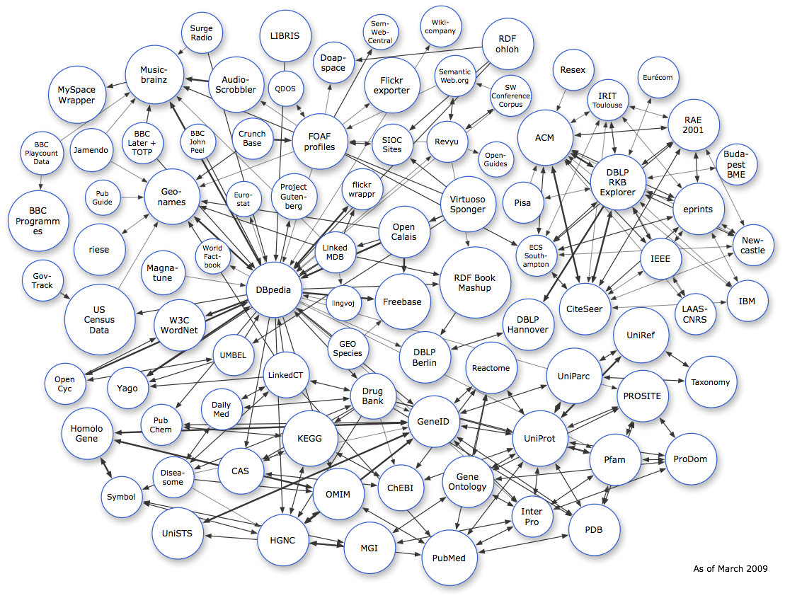
A case for Open Data

Slide 2

CONTENT
MATTERS

Slide 3

Why isn’t it enough?
Open source only covers the software
Open source doesn’t require open formats
Data often lasts longer than software
Data is more valuable when accessible
Any code will be acceptable, any data won’t
Graphic by Open Source Initiative, CC BY

Slide 4

Open data – real gold
Canadian GoldCorp Inc. was near collapse in the late 90’ies.
It’s Red Lake mine showed reduced output after 50 years of production
Then something previously unheard of happened:
Inspired by the crowd-sourcing of Linux and Open Source, Rob McEwen announced The GoldCorp Challenge: a competition to find new gold in the mine. The full geological dataset from Red Lake was made available to contestants.
And the result?
110 targets were suggested by contestants from around the world
80% of the targets submitted yielded substantial quantities of gold
GoldCorp got first look a wealth of new technologies for mine analysis
Production at Red Lake increased tenfold while mining costs dropped to 1/6th

Slide 5

What is Open Data?
Open Knowledge Definition (http://www.opendefinition.org/)
Open data/content/information must:
Be Available and Accessible at Reproduction Cost “As a Whole”
Permit Free Redistribution
Permit Reuse Under Same Terms
Be Absent of Technological Restrictions
Be Attributed as Required
Keep Source Integrity
Not Discriminate Against Persons or Groups
Not Discriminate Against Fields of Endeavor
Be Distributed with only the Original License
Must Not Be Licensed Specific to a Package
Must Not by License Restrict the Distribution of Other Works
Graphic by ronin691 @ Flickr, CC BY-SA

Slide 6
Why should we create open data?
Restrictions on data re-use can create an anti-commons and its related tragedy.
Sponsors of research may not get full value unless the results are freely available.
Some data are required for the smooth operation of communal human activities.
In research, the rate of discovery is accelerated by better access to data.

Slide 7

If you love something…
Set it free!
Photo by keltanen @ Flickr, CC BY-NC

Slide 8
When should we demand Open Data?
The data belongs to the human race
Public money was used to fund the creation of the data
The data was created by or at a government institution
The data is independently verifiable facts or common knowledge

Slide 9

Current opportunities
Norwegian Medicines Agency
Open medical databases can aid both research and healthcare.
Data on approved medicines in Norway were made available online in 2008.
Norwegian Mapping Authority
Open maps can prevent fatal accidents, especially at sea.
The ”Rocknes”-wreck were caused by 3rd party electronic maps. 18 died.
The official maps are still not available to Norwegian pilotage authorities.
In the United States, official nautical maps are freely available online.
Norwegian Pollution Control Authority
A central database of information on various materials can improve safety.
Many databases on hazardous chemicals are outdated and of limited scope.
No single source of up to date and complete information are available.

Slide 10
Graphic by W3C SWEO Linking Open Data, CC BY-SA

Slide 11


Linked Data is about using the Web to connect related data that wasn't previously linked, or using the Web to lower the barriers to linking data currently linked using other methods.
Wikipedia defines Linked Data as “a term used to describe a recommended best practice for exposing, sharing, and connecting pieces of data, information, and knowledge on the Semantic Web using URIs and RDF.”
http://linkeddata.org/
Graphic by semanticwebcompany @ Flickr, CC BY-NC-SA

Slide 12


DBpedia is a community effort to extract structured information from Wikipedia and to make this information available on the Web. DBpedia allows you to ask sophisticated queries against Wikipedia, and to link other data sets on the Web to Wikipedia data.
The DBpedia knowledge base currently describes more than 2.6 million things, including at least 213,000 persons, 328,000 places, 57,000 music albums, 36,000 films, 20,000 companies. The knowledge base consists of 274 million pieces of information (RDF triples).
http://dbpedia.org/
DBpedia and all other linked data is searchable with SPARQL
http://en.wikipedia.org/wiki/SPARQL

Slide 13
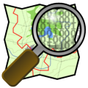
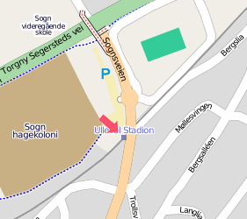
Open Streetmap
OpenStreetMap is a free editable map of the whole world. It is made by people like you.
OpenStreetMap allows you to view, edit and use geographical data in a collaborative way from anywhere on Earth.
www.openstreetmap.org
GeoNames
The GeoNames geographical database is available for download free of charge under a creative commons attribution license. It contains over eight million geographical names and consists of 6.5 million unique features.
www.geonames.org

Slide 14

Creating Open Data
Public Domain – Only after the expiration of copyright
Science Commons protocol for open data
Creative Commons Zero (Link)
Public Domain Dedication & Licence with Community Norms (Link)
Avoid Technical protection measures
Give credit where credit’s due
Use Open formats
Let others know!
Share your work too!
Photo by suttonhoo @ Flickr, CC BY-NC-SA

Slide 15
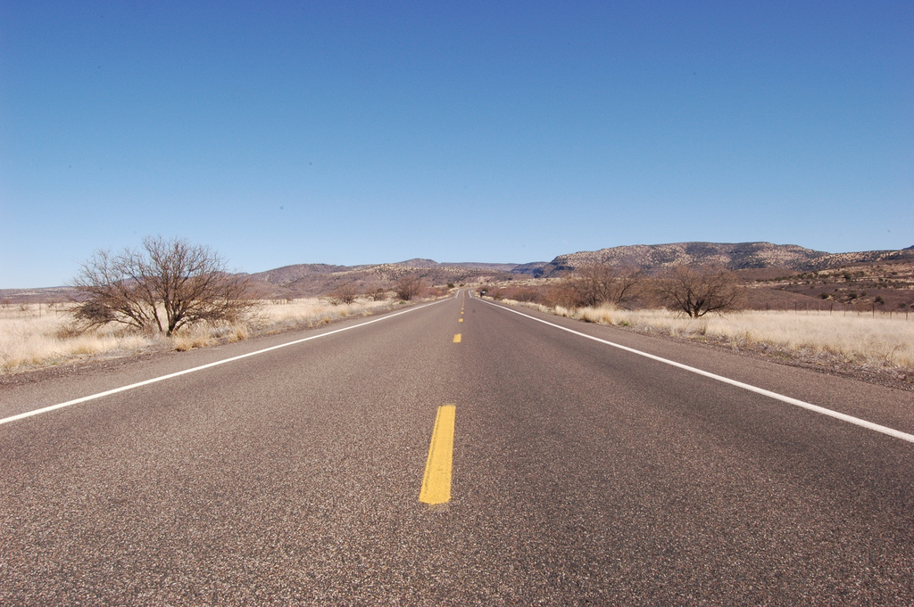
The road to open knowledge
starts here!
Photo by danesparza @ Flickr, CC BY-ND

Slide 16

Svein-Magnus Sørensen
Master of Science in Communications Technology from NTNU
Graduate from the Norwegian School of Entrepreneurship (Gründerskolen)
Worked 2 years at Computas AS as a webdeveloper
Currently working at Objectware AS as a business analyst
Weblog: http://blog.menneske.org
Twitter: http://twitter.com/sveinmagnus

