Slide 1
The Divide-and-Conquer Strategy
5-1 The 2-Dimensional maxima finding problem
5-2 The Closest pair problem
5-3 The Convex hull problem
指導教授：徐熊健 教授
報告者：陳琨

Slide 2
Divide-and-Conquer
精神 :
分裂並各個擊破
什麼樣的問題適用 ?
一個問題如果能切割成兩個獨立的小問題，且解小問題與解原始問題是一樣的，差別只在於 size 的大小時

Slide 3
A General Divide-and-Conquer Algorithm
Step 1: If the problem size is small, solve this problem directly; otherwise, split the original problem into 2 sub-problems with equal sizes.
Step 2: Recursively solve these 2 sub-problems by applying this algorithm.
Step 3: Merge the solutions of the 2 sub-problems into a solution of the original problem.

Slide 4

A General Divide-and-Conquer Illustration - 1
Step 1
If small
else
直接解

Slide 5
A General Divide-and-Conquer Illustration - 2
Step 2

Slide 6
A General Divide-and-Conquer Illustration - 3
Step 3

Slide 7
Time Complexity of the General Algorithm
Time Complexity
time of splitting
time of merging
constant

Slide 8
A Simple Example
Finding the maximum
29
14
15
01
06
10
32
12
29
14
15
01
06
10
32
12
29
14
15
01
06
10
32
12

Slide 9
A Simple Example (cont.)
Finding the maximum
32
29
32
29
15
10
32
29
14
15
01
06
10
32
12

Slide 10
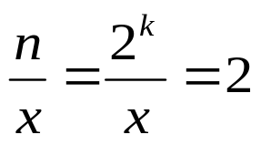

Time Complexity
Time Complexity
Assume n = 2^{k}
T(n/2) = 2T[(n/2)/2]+1
T(n) = 2T(n/2)+1
= 2(2T(n/4)+1)+1
= 4T(n/4)+2+1
…
= 2^{k-1}T(2)+2^{k-2}+…+4+2+1
= 2^{k-1}+2^{k-2}+…+4+2+1
= 2^{k}-1 = n-1

Slide 11
5-1 The 2-Dimesional Maxima Finding Problem
何謂 Dominates ?
A point (x1, y1) dominates (x2, y2) if x1 > x2 and y1 > y2.
Y
A
A dominates B
B
X

Slide 12
5-1 The 2-Dimesional Maxima Finding Problem (cont.)
何謂 Maxima ?
A point is called a maxima if no other point dominates it.
Y
兩兩比較
Time Complexity：O(n²)
X

Slide 13
Maxima Finding Algorithm
Input: A set S of n planar points.
Output: The maximal points of S.
Step 1: If S contains only one point, return it as the maxima. Otherwise, find a line L perpendicular to the X-axis which separates S into S_{L}and S_{R}, with equal sizes.
Step 2: Recursively find the maximal points of S_{L} and S_{R} .
Step 3: Find the largest y-value of SR, denoted as y_{R}. Discard each of the maximal points of SL if its y-value is less than y_{R}.

Slide 14
Maxima Finding Algorithm Illustration - 1
Step 1
If only one point
else
Time Complexity：O(n)
Y
Y
L
S_{L}
S_{R}
maxima
X
X

Slide 15
Maxima Finding Algorithm Illustration - 2
Step 2
Time Complexity：2T(n/2)
Y
L
L
S_{L}
S_{R}
X

Slide 16
Maxima Finding Algorithm Illustration - 3
Step 3
Time Complexity：
=> O(nlogn)
Y
L
S_{L}
S_{R}
=> O(n) (presorting)
X

Slide 17
Maxima Finding Time complexity
Time complexity: T(n)
Step 1: O(n)
Step 2: 2T(n/2)
Step 3: O(nlogn)
Assume n = 2^{k}

Slide 18
Maxima Finding Time complexity (cont.)
After presorting Time complexity: O(nlogn)+T(n)
Step 1: O(n)
Step 2: 2T(n/2)
Step 3: O(n)
Assume n = 2^{k}
Time complexity = O(nlogn)+T(n) = O(nlogn)+O(nlogn) = O(nlogn)

Slide 19
5-2 The Closest Pair Problem
何謂 Closest Pair ?
Given a set S of n points, find a pair of points which are closest together
(在一個有 n 個點的集合 S 中，找最靠近的兩個點)
1-D version:
2-D version:
Y
X
Time Complexity：O(nlogn)
X

Slide 20
Closest Pair Algorithm
Input: A set S of n planar points.
Output: The distance between two closest points.
Step 1: Sort points in S according to their y-values.
Step 2: If S contains only one point, return infinity as its distance.
Step 3: Find a median line L perpendicular to the X-axis to divide S into S_{L} and S_{R}, with equal sizes.
Step 4: Recursively apply Steps 2 and 3 to solve the closest pair problems of S_{L} and S_{R}. Let d_{L}(d_{R}) denote the distance between the closest pair in S_{L} (S_{R}). Let d = min(d_{L}, d_{R}).

Slide 21
Closest Pair Algorithm Illustration - 1
Step 1
先針對每個點X軸的值和Y軸的值做排序
Step 2
Step 3
If only one point
Time Complexity：O(n)
Y
Y
L
S_{L}
S_{R}
d = ∞
X
X

Slide 22
Closet Pair Algorithm Illustration - 2
Step 4
Time Complexity：2T(n/2)
Y
L
L
S_{L}
S_{R}
X

Slide 23
Closet Pair Algorithm Illustration - 3
Step 5
Y
L
S_{L}
S_{R}
d_{L}
d_{R}
X
L-d
L+d
d=min(d_{L},d_{R})

Slide 24
Closet Pair Algorithm Illustration - 4
Y
P
2d
d
X

Slide 25
Closest Pair Time complexity
Time complexity:
Step 1: O(nlogn)
Step 2~5: T(n) = 2T(n/2)+S(n)+M(n)
Total time-complexity = O(nlogn)+T(n) = O(nlogn)+O(nlogn) = O(nlogn)

Slide 26
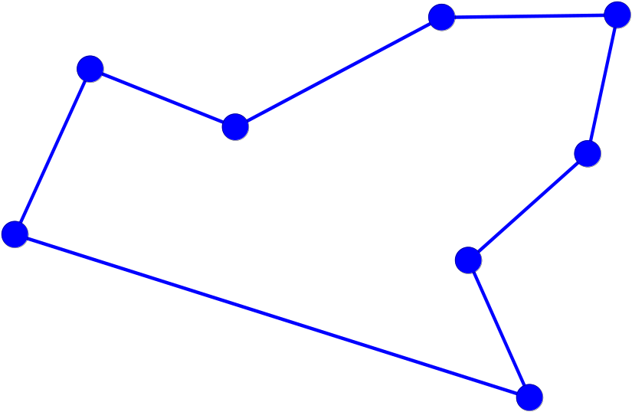
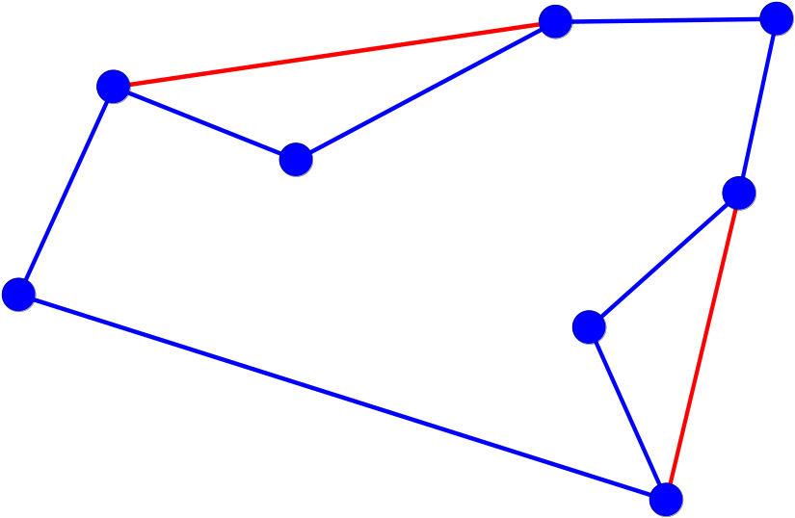
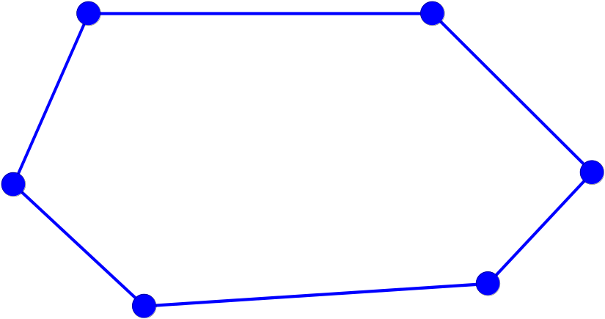
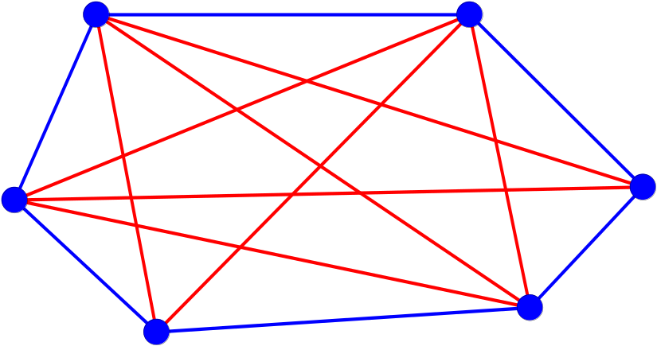
5-3 The Convex Hull Problem
何謂 Convex polygon (凸多邊形) ?
Concave polygon (凹多邊形):
Convex polygon :

Slide 27
5-3 The Convex Hull Problem (Cont.)
何謂 Convex Hull ?
The Convex hull of a set of planar points is defined as the smallest convex polygon containing all of the points.
(在平面上的一組點，用最小面積的凸多邊形將所有點包起來)

Slide 28
Convex Hull Algorithm
Input : A set S of planar points
Output : A convex hull for S
Step 1: If S contains no more than five points, use exhaustive searching to find the convex hull and return.
Step 2: Find a median line perpendicular to the X-axis which divides S into S_{L} and S_{R}, with equal sizes.
Step 3: Recursively construct convex hulls for S_{L} and S_{R}, denoted as Hull(S_{L}) and Hull(S_{R}), respectively.
Step 4: Apply the merging procedure to merge Hull(S_{L}) and Hull(S_{R}) together to form a convex hull.

Slide 29
Use Divide-and-Conquer to Solve
L
Y
S_{L}
S_{R}
Use Graham scan
X

Slide 30
Graham Scan Algorithm
Step 1: Select an interior point as the origin.
Step 2: Each other point forms a polar angle, and all points sorted by polar angles
Step 3: Examines the points cause reflexive angles
Step 4: The remaining points are convex hull vertices

Slide 31
The Graham scan (Illustration)
Y
P₂
P₁
P
P₀
P₃
P₅
P₄
X

Slide 32
Eliminates points (Illustration)
Y
令 P₀,P₁,P₂ 座標各為 (x₀,y₀) (x₁,y₁) (x₂,y₂)
P₄
P₃
P₂
P₅
If det < 0 than 逆時針
If det > 0 than 順時針
If det = 0 than 三點共線
P₁
P₀
X

Slide 33
Use Divide-and-Conquer to Solve
L
Y
找小於π/2 最大的
S_{L}
S_{R}
j
d
i
e
c
k
p
f
h
g
a
b
找大於 3π/2 最小的
X

Slide 34
Use Divide-and-Conquer to Solve
L
Time Complexity：
T(n) = 2T(n/2) + O(n)
= O(nlogn)
Y
S_{L}
S_{R}
j
d
i
e
c
k
f
h
g
a
b
X

Slide 35
The End

