Slide 1


Service categorization and SOA patterns 911
A short roundup of key Business Values delivered to our customers
3.12-2008
Totto
totto@objectware.no

Slide 2
Agenda
SOA in 2 slides
System strategy
Laws of SOA
Service categorization
Motivation
Categories
Design rules
Real Business Value Delivered - Business Cases
Harvest value from existing investments with EDR/EDR-MDS
Architecture axiom - clear and consistant..
EDR-MDS 101
Real Business Value Delivered - Business Cases

Slide 3
SOA in 2 slides
What nobody seems to understand, and still remains the most important aspects of success with Service Oriented Architecture

Slide 4
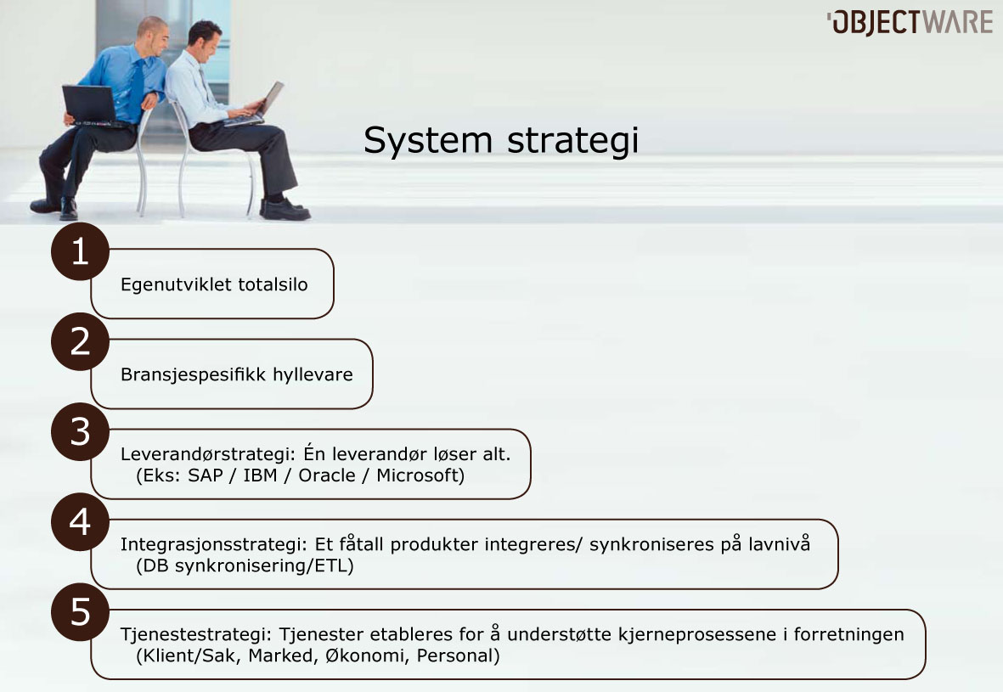

Slide 5
Laws of SOA
0. Forget about focusing WS and products
1. Establish service categories and service universe
2. Find and decompose services
3. Establish service ownership and Key Performance Indicators for your services
4. Establish design rules for your service categories up-front
5. Start limited and controlled
6. Establish lean and agile deployment routines
7. Versioning is not optional in SOA
8. Security is not optional in SOA
9. Reflect and work strategically against SOA Maturity Model.

Slide 6
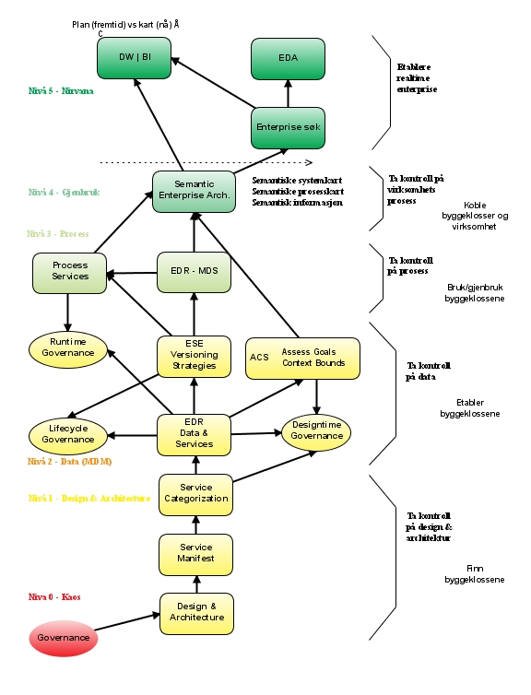
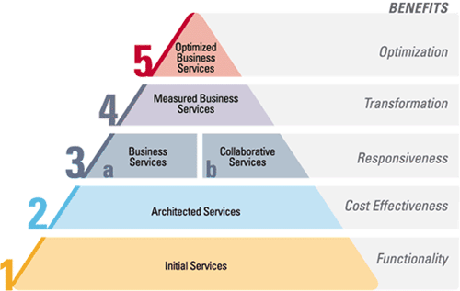
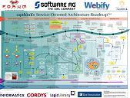
SOA Maturity Models
SOAMM
..
..
2: Data
1: Design
0: Chaos
Level 2
Level 2
Level 2

Slide 7
SerVice Categorization
Why and how we reduce complexity by segmentation

Slide 8
Motivation
When we started designing SOA solutions, we experienced that nobody knew what a service was...
200+ definitions on the web
None of which made any sense
We needed a precise way to discuss, design, implement and govern services

Slide 9
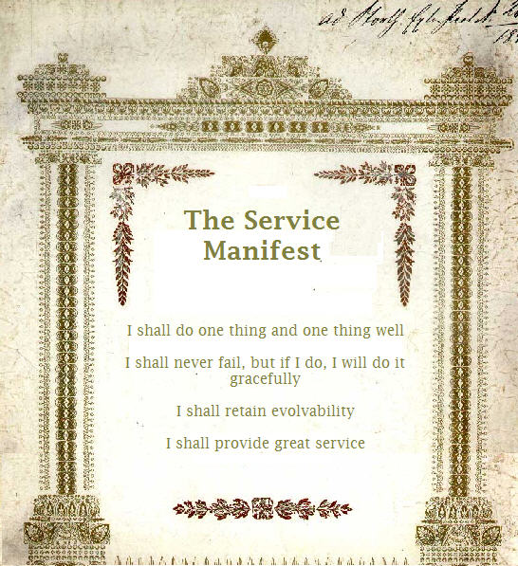

Slide 10
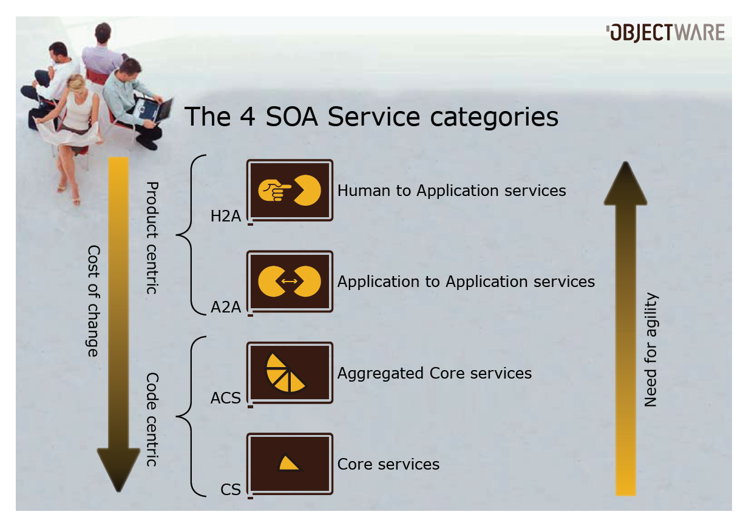

Slide 11
Design rules

Slide 12
Categorization Business Value
SOA Maturity Model Level 1 i all about bringing design and architecture into the SOA Strategy, and to establish a goverable service universe.

Slide 13
IT Strategy
Established a modern, flexible Service Oriented Architecture aligned with its business processes.
The SOA implementation provides standardized and simple interfaces for internal, system and external parties
Established Enterprise Portal based on "best of breed" portal framework which enables efficient multi-channel publishing and functionality extensions
Established "software factory" based upon Enterprise Maven Infrastructure to enable efficient, frequent and high quality deployment of new features, services and processes
is a knowledge-worker company which ensures its employees a high flexibility in applications and tools to increase quality and productivity.

Slide 14
State of SOA Adoption
Decision of SOA establishment made late 2004
"Architectural Pain"-driven through multiple mergers & acquisition with ad-hoc systems integration
Completed phase 4 (release 60) significantly more cost-efficient than competition
+120 H2A services delivered
+80 A2A services delivered
+30 ACS services delivered
+25 CS delivered
+50 (+65, +55..) data sources integrated

Slide 15
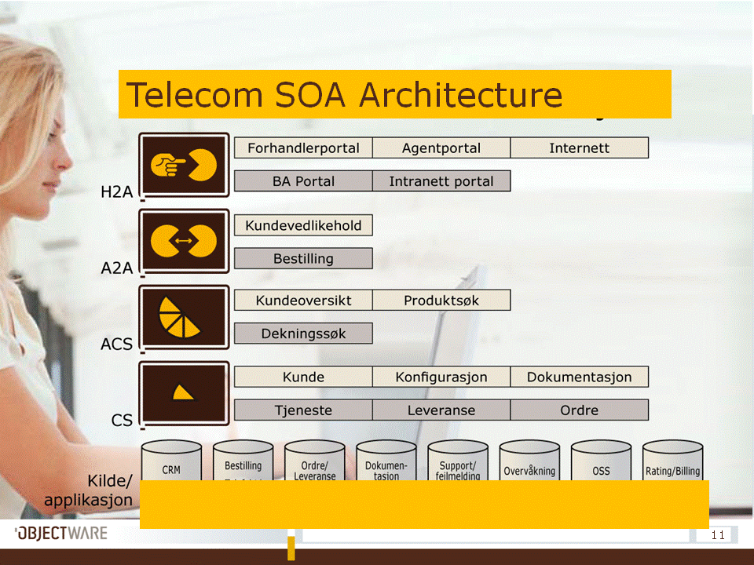
Telecommunication Company

Slide 16
Service Categorization values
Established an Enterprise Portal based on "Best of Breed" portal frameworks.
Provides cost-efficient publishing, functional enhancements and administration
Provides linear cost-efficientness in service development
+300 services in 4 years
Linear development and service cost (not exponential!)
Proof-of-evolve ability
H2A services delivered and configured in multiple channels
Typically 3-6 channels for essential services
A2A services exposed for 3rd party partners and subcontractors

Slide 17
Summary
Enterprise Domain Repository is vital to IT Strategy today
Categorized services provides the foundation for continuous IT-driven business value
The evolve ability promise of SOA is delivered and proven over several years
A service universe based on efficient building blocks enables rapid business opportunity
new products, acquisition & mergers, new markets

Slide 18
Mainframe integration and abstraction through Categorized Services starts SOA initiative in Norwegian Bank
State of SOA Adoption
Decision of SOA establishment made early 2006
Project-driven by the "Kundebilde" (CustomerDashboard) application
Completed phase 1 with 2 developer resources from Objectware in approx 1 calendar year.
+10 H2A services delivered
+15 categorized CS/ACS services delivered
+20 data sources integrated

Slide 19
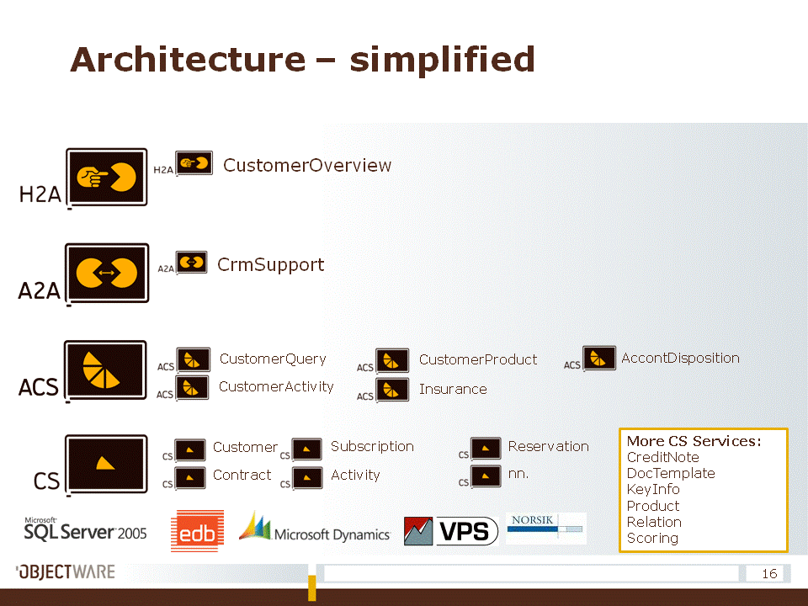
Bank

Slide 20
Governance
All CS and ACS services complies to sets of core governance policies, including;
Implements same patterns
Complies to same request response patterns
Supports evolve ability
Coherent failover and operational capabilities
Ensures great service through a common usage pattern across +15 services in first phase delivery

Slide 21
Summary
Service Oriented Architecture established in 1 year development time
Large integration challenges tackled
Project value realized at the same time
Major challenges lies ahead: complete SOA vision cannot be completed in scope of single project
Further potential can be realized through agile evolution of the service stack and implementation of additional services

Slide 22
Business Data Patterns
Todays enterprises have lost controll of their key asset – their bisiness data. SOA Maturity Model Level 2 is all about data.

Slide 23
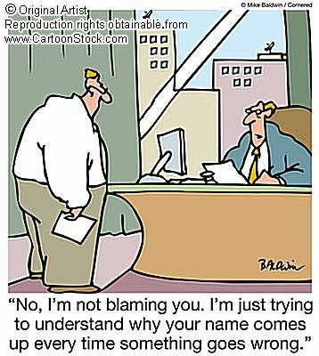
Architecture Axiom
Clear and consistant responsibillity powers all great architectures

Slide 24
EDR MDS 101
Mission Statement
To allow standard software to coexist nicely with SOA and to reach SOA Maturity Level 2, we need to master our Business Objects.‏ EDR is the natural, lean, simple and inexpensive choice for a Master Data Management Services.
Simplest possible route to managed data
Reduced complexity by zooming in to one single Business Object at a time
All non-business object relations handled as resource references.
Simple first generation implementation within 2-3 months
By adding support for managed Business Objects in your SOA, you facilitate and enable event-driven architectures and real- time enterprise.

Slide 25
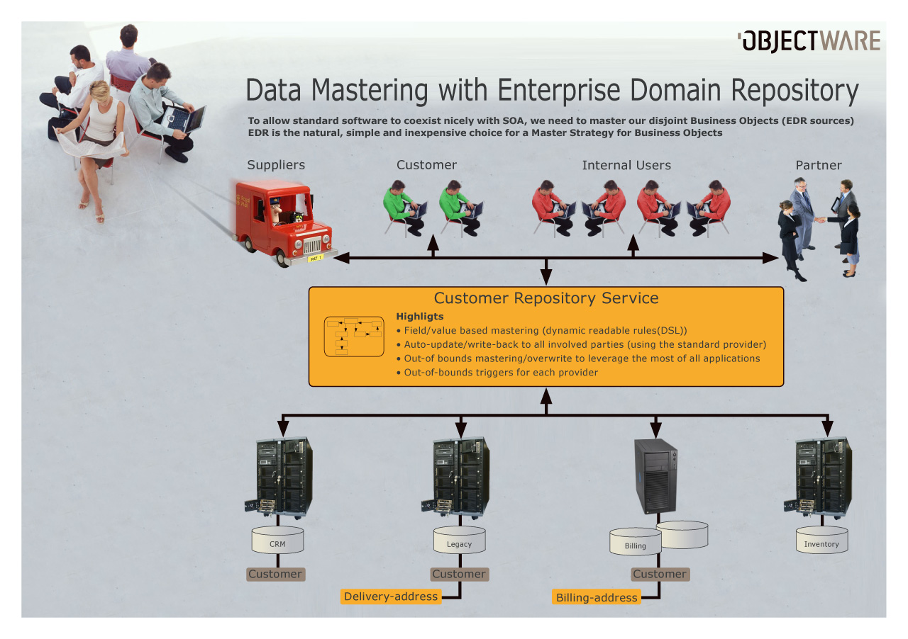

Slide 26
EDR MDS – Key takeaways
Simplest possible route to managed data
Reduced complexity by zooming in to one single Business Object at a time
All non-business object relations handled as resource
references.
Simple first generation implementation within 2-3 months
By adding support for managed Business Objects in your SOA, you facilitate and enable event-driven architectures and real- time enterprise.
Its no magic – just common sense (and can be implemented in your favourite technology, container, product ☺
Notes:
26

Slide 27
Business Data Patterns Business values

Slide 28
Telecom Company - Values
SOA provides a standardized and easy-to-use interface for integration both internally and towards business partners
Changed CRM system in one week without breaking any of the existing services
Open-ended EDR provider
Multi-master strategy on the Customer Domain Object between CRM, the order system and the billing system.
Integration costs less than 10% of main competitors
Automation costs less than 20% of main competitors
Uses extensions to EDR pattern
Recording Proxy
Open-ended Integration pattern
Field-based Mastering Strategy

Slide 29
Summary
Enterprise Domain Repository is vital to IT Strategy today
Categorized services provides the foundation for continuous IT-driven business value
The evolvability promise of SOA is delivered and proven over several years
A service universe based on efficient building blocks enables business opportunity

Slide 30
Bank case – EDR values
Integration
Extend business entities with data that are not in core system
Provide ad-hoc storage for service-required data not yet discovered or decided
Service targeted "datamarts“
Existing data warehouse provide useful information for services
Especially select aggregate data and data hierarchies
Loaded into service-owned "datamarts" for consumption
New business processes enabled by Microsoft CRM standard software
Provides special support for customer follow-up for the business market
Shift of responsibility of existing functionality
Business data previously owned by mainframe moved to Microsoft CRM
Significant lower cost of integration than mainframe platform
Future potential of moving further responsibility from mainframe to standard software
High agility and time to market

Slide 31
Bank case –Summary
Service Oriented Architecture established in 1 year development time
Large integration challenges tackled
Project value realized at the same time
Major challenges lies ahead: complete SOA vision cannot be completed in scope of single project
Further potential can be realized through agile evolution of the service stack and implementation of additional services

Slide 32
APPENDIX

Slide 33
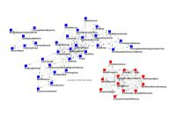
Auto-Taxonomy and Categorization As A Service
Taxonomy strategies hold great promises, and we nowadays understand that we need some kind of meta-data strategy to automatically and dynamically (loose coupling) connect bits of information. Today´s taxonomy strategies have struggled hard to provide positive return of investment (ROI). Projects experience frequently that their taxonomy changes and they have to keep re-investing in their taxonomy and categorization.
We believe that since the internet search engines started to rule the world, we need to rethink they way we look at information and categorization. With the new and up-coming auto-categorization services, we see a potential of shifting the effort from people to machines in taxonomy and categorization in the same way that the search engines shifted the information gathering from catalogs to search.

Slide 34
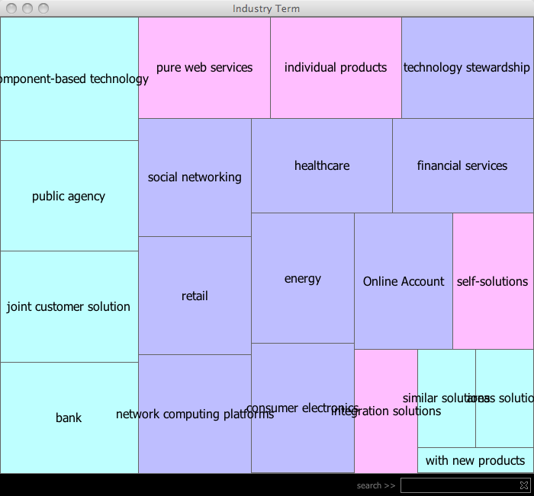
Auto-Taxonomy and Categorization As A Service (ATaCAAS)
Pimp my CustomerService-style service extension, where we use free auto-taxonomy services and object-graphs to generate web 2.0 social-network graphs/presentations of customer clusters to enable pin-point direct mailings to specific interest-areas of the customer clusters.
Value proposition
Low initial investment (less than a months effort)
Auto-learning/auto-updating taxonomy (we get the new features from the auto taxonomy services for free)
No extra maintenance and product cost

Slide 35
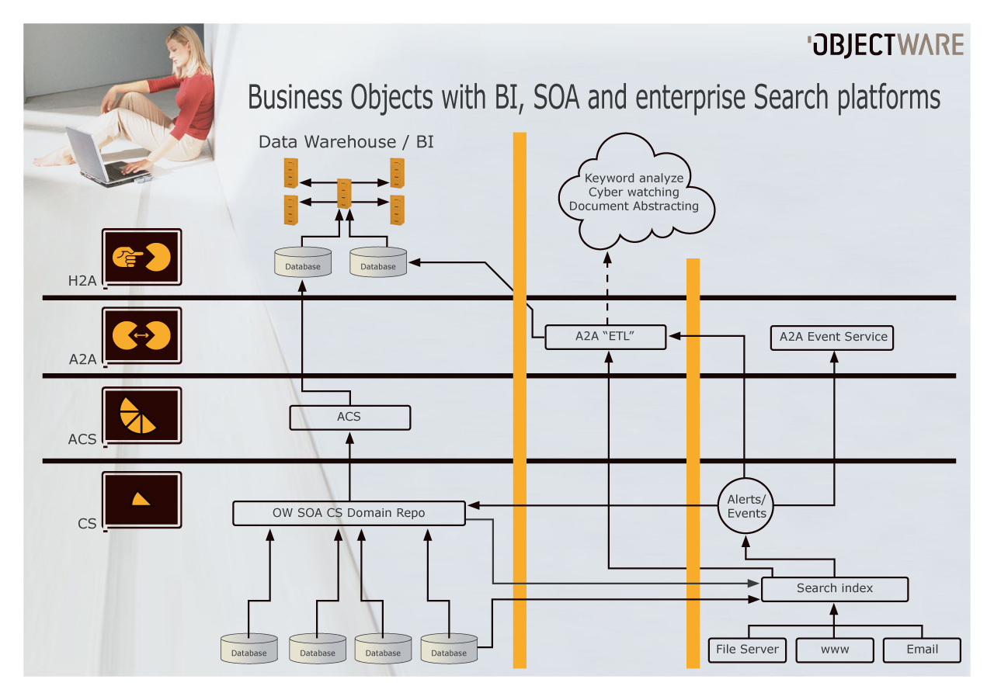
Real-time enterprise.. Just a dream?
Realtime BI
EDA
EDR-MDS
EDR-MDS
EDR-MDS
Enterprise Search

Slide 36
SOA – hype?
Governance
Hype
Design-time Governance
ESB
Mule
SAML 2.0
PAB
BAM
WS ducktyping
REST
Run-time
Governance
ESE
WS-*
Tjeneste kategorisering
OW SOA
Endpoint
Web
Services
CFX/ XFire
AXIS
EDR
Business value

