Slide 1
OW SOA empowered Shipbrokers
Øystein Garshol & Olle Paulsson
Objectware AS

Slide 2
Agenda
About Shipbroking
Architecture
Service Samples
Governance
Value realized

Slide 3
About shipbroking
Objectware have delivered Service Oriented Shipbroker applications to two major Norwegian ship brokers.
Common for both companies are
Own company + joint venture with others = complex organization
Sharing and separating information (crucial!)
Geographically disparate (Europe/Asia)
24/7/365
Different departments/markets – different needs
Cargo
Spot-markets: high intensity, large volumes of contracts
Long running contracts: 5 – 15 years to complete
Sales & Purchase / Newbuilding
Very few, but very complex negotiations, contracts and follow-up
Close cooperation with many parties over a long period of time (ship owners, investors, shipyards, shippers)
Consultancy and advisory services
Highly proficient Information workers
Notes:
Øystein

Slide 4
Architecture Strategy
Architectural goal
Continuously retain evolvability aligned with the business
Support agile process management with auditability according to rules and regulations
Support analysis and reporting on business data (Business Intelligence)
Harvest value from standard software suites through continuous upgrades of best-of-breed software
Service oriented architecture (SOA)
Based on Objectwares categorization framework for services
Business services expose information from several data sources (internal and external)
Complete business process management with K2 Blackpearl
Notes:
Øystein

Slide 5


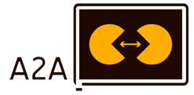








Architecture overview
SharePoint
WebForms
Outlook
Fixture Registration
Invoicing
Fixture Maintenance
Invoice Planning
Organization
Fixture Query
Account
Fixture Persistence
Vessel
Contact
Invoice Persistence
Employee
Notes:
Olle

Slide 6
Service Examples
Notes:
Olle

Slide 7
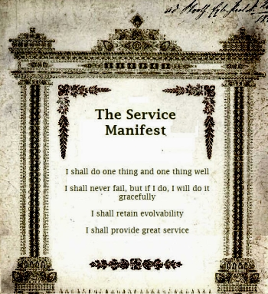
Core Service
Core Services adds value to consumers
Domain Model Specific
Provide Master Data Management
Implemented with EDR pattern
Evolving, version agnostic clients
ESE pattern implemented – flexible support for long running workflows
Provides solutions for integration challenges, authentication and caching
Logical id’s provide anti-corruption towards clients
Notes:
Olle

Slide 8
Core Service Samples
Account
CRM and ERP
Vessel
AxsMarine
FixturePersistence
Database and CRM
Notes:
Olle
Typiske Core Services i skipsmegling, som har ansvaret for sine respektive domene objekter
Eksempel Account: Henter sentrale verdier fra CRM og regnskapssystem
Vessel: Henter skipsdata fra ekstern kilde (AxsMarine SAAS provider for shipping)
Kan også trekke på interne data eller flere eksterne kilder siden domeneobjektet er uavhengig av kilden
FixturePersistence: Komplekst domeobjekt mange ulike slutningstyper / kontraktsformer.
-Oppdater egen database med innhold, men supplerer CRM (Salgssystem) med sentral kontraktsinformasjon (Mellom hvem er avtalen gjort og til hvilken pris)
- Har referanser til alle andre Core Service objekter

Slide 9
Aggregated Core Service
Aggregates multiple core services
Query
Context specific (Use Case based)
Complex Business Logic
… and everything from a Core Service
Notes:
Olle

Slide 10
Aggregated Core Service Sample
Invoice Planning
Creates an invoice plan with a fixture as input
Fixture Query
Query fixtures on properties that are not present on the fixture domain object
Notes:
Olle
Query – Søk på feks alle slutninger gjort mot Islandske Accounts
Context Specific – Kunde vs. Kundebehandler
Complex Business Logic – En tjeneste trekker på ulike CS for å beregne input til en ny tjeneste

Slide 11
Application to Application Service
Orchestrates collaboration between human or computer actors
Relies heavily on Evolving Service Endpoints
Notes:
Øystein
Hvorfor menneskelige actors?
- Ved prosessautomatisering kjenner man ikke grunnlag for automatisering (hvor mye tid tar det før en oppgave påbegynnes og hvor lang tid tar oppgaven)
- Mechanical turk http://en.wikipedia.org/wiki/Amazon_Mechanical_Turk

Slide 12
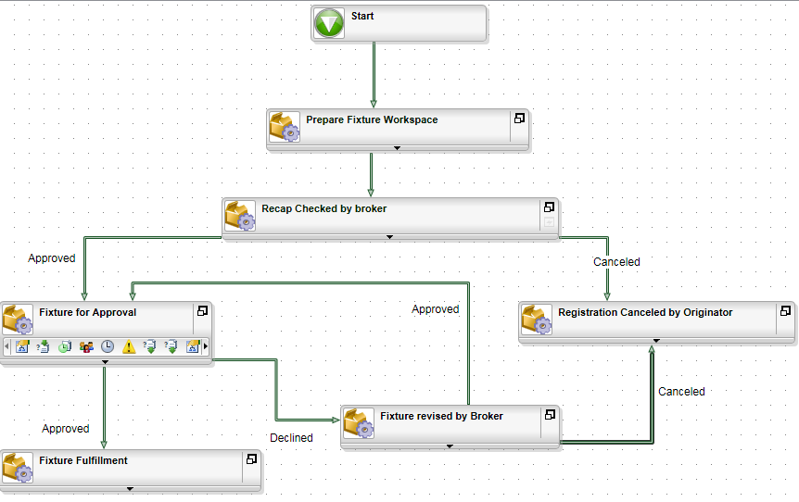
A2A: Fixture Registration Process
Process according to ISO certification
K2 Workspace
Reports
Status & Followup
Activity escalation based on ”Human Service Level Agreement”
Timing on task-completion against baseline
Startingpoint for process optimization
Notes:
Øystein
Forretningstermer i flytboksene
K2 Workspacet er tilgjengelig for adminsitratorer og sluttbrukere
K2 Workspace gir grunnlagsdata for rapportering på business performance

Slide 13
Human to Application Service
The implementation of a Use Case with one human actor
Uses A2A, ACS and CS to assemble information in the form
Automated based on ROI or Business Rules Coverage
Notes:
Øystein
H2A tjeneste er konsumenten av CS/ACS
Eksempel på autmatisering:
Fakturaplan blir produsert av en ACS
Fakturaplan Godkjennes I en H2A tjeneste av en menneskelig aktør
Dersom forretningsregler dekker alle tenkelig og utenkelig avvik vil behovet for H2A tjenesten bortfalle, da hele denne prosesseringen kan gjøres “maskinelt”
Mennesket som en tjeneste:
Du skal gjøre en ting (om gangen) og den skal gjøres godt
Du skal ikke feile, men om du gjør det utfør også det på en håndterbar måte
Du bør være endringsdyktig
Du skal tilby en fantastisk tjeneste

Slide 14
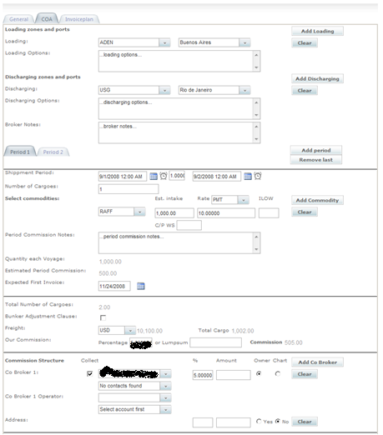
H2A: Fixture Registration Form
Mainly used by brokers who have closed a deal
Advanced ASP.NET based form
Complex validation
Dynamic rendering based on user-selection
AJAX based controls for improved user experience
Notes:
Øystein

Slide 15
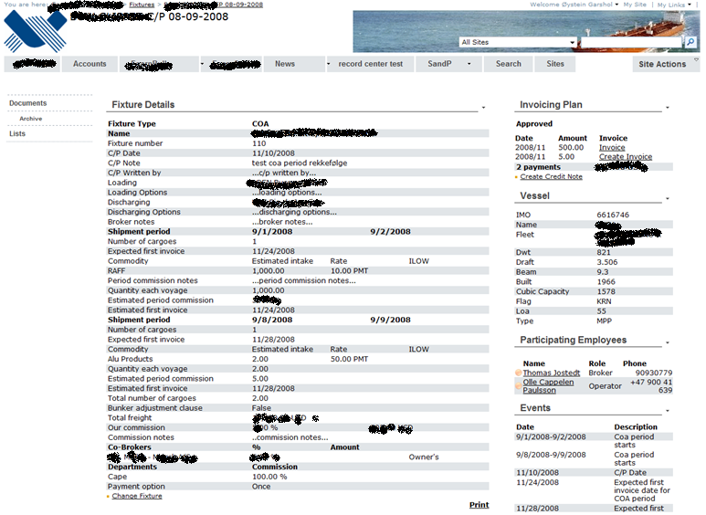
H2A: SharePoint Fixture Workspace
Notes:
Øystein
Arbeidsflate for operatører tilpasset hver enkelt kontraktstype
Nøkkeldata fra Fixture tjenesten og Account tjenesten
Kontaktdata fra CRM via Account tjenesten
Tilgang til å starte forretningsprosesser
Tilgang til BI rapporter
Bruk av standard SharePoint for dokumenter og lister
Lagring av epost i sharepoint

Slide 16
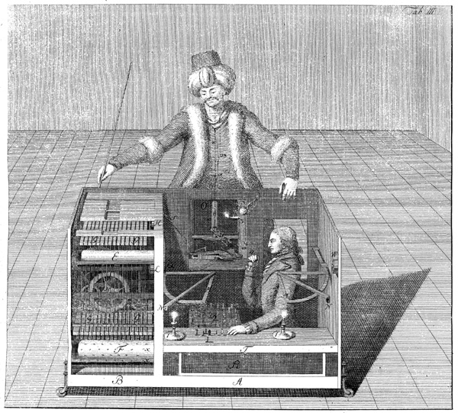
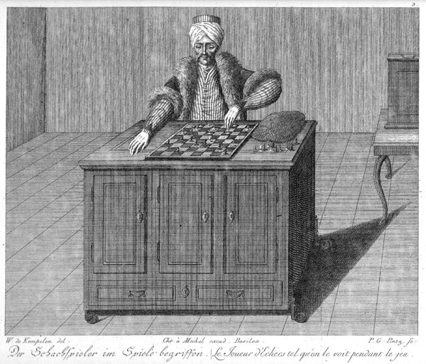
The greatest H2A Service ever built
The Turk or Automaton Chess Player was a chess-playing machine constructed in the late 18th century, and exhibited from 1770 for over 84 years
The Turk was revealed as a hoax in January 1857
Amazon Mechanical Turk launched in November 2005 emulates the Turk by exposing a Web Service API that allows tasks requiring Human Intelligence to be Outsourced for a small payment
Notes:
Eksempel på Mturk oppgave: Velg det beste blant flere bilder av samme motiv
Dette kunne vært en Mturk oppgave: Strukturering av ustrukturerte data nødvendig for å få karakteristika rundt et Verft

Slide 17
Governance
Notes:
Olle

Slide 18
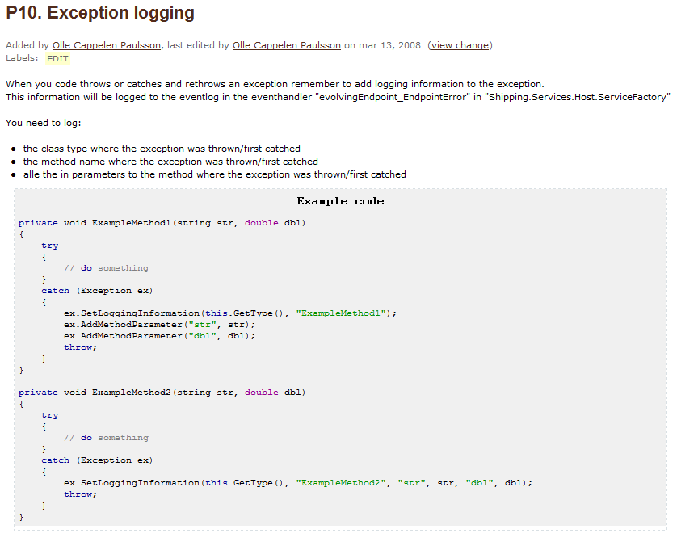
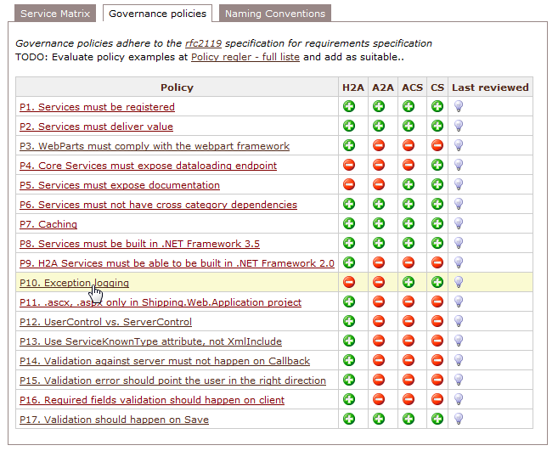
Categorized services are governable by rules
Notes:
Øystein

Slide 19
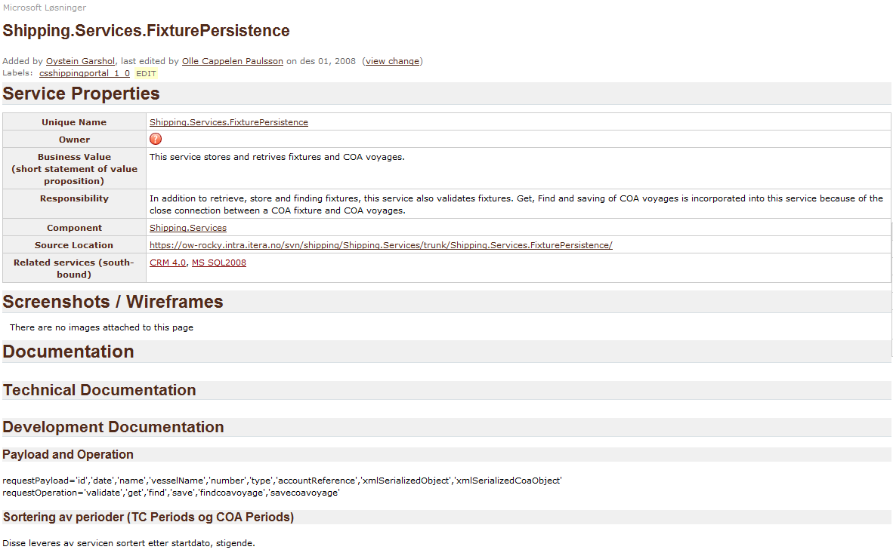
Governance
Notes:
Olle

Slide 20
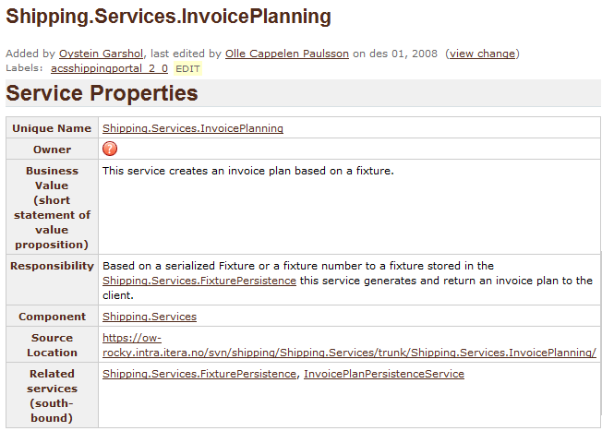
Governance
Notes:
Olle

Slide 21
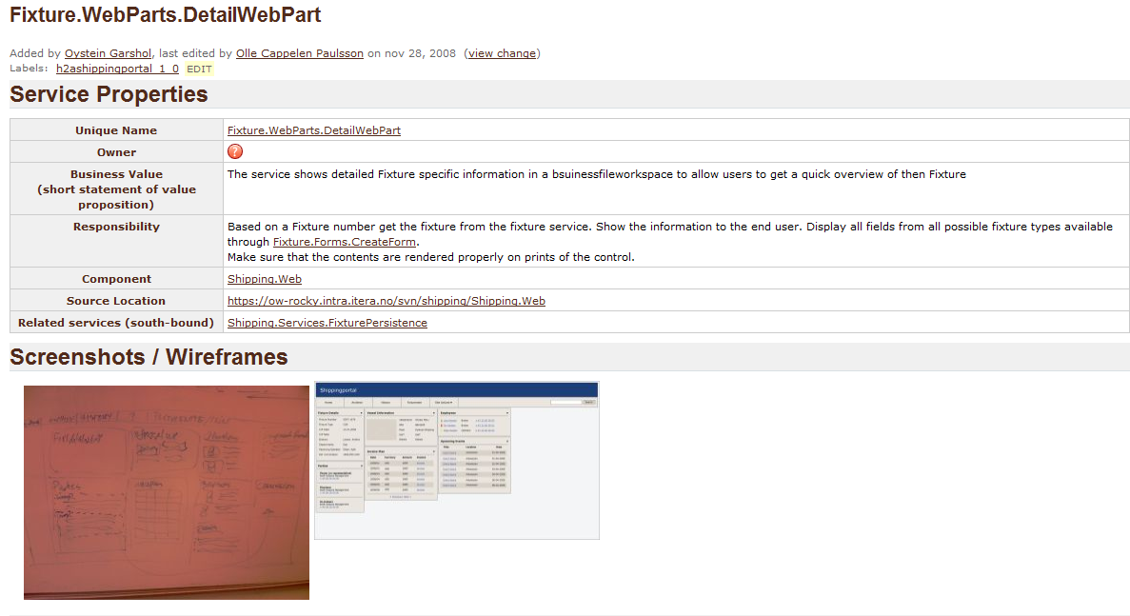
Governance
Notes:
Øystein

Slide 22
SOA Business Value Realized
Support for complex joint venture business model. Highly competitive flexibility.
Full ISO certification of contract registration process -> complete end-to-end replacement of paper-based process
3-5 legacy business applications completely phased out by 01.01.2008
New field-office opened Q307 -> full integration of new office <1 month, including invoicing and operations
Notes:
Øystein

Slide 23
SOA Technical Value Realized
The Categorization model forces developers to build maintainable services
The service does one thing only (well)
Evolveability empowers flexibility in asynchronous processes
Categorized services are governable
Governance rules are applied on each service level
Notes:
Olle

Slide 24
Key Takeaways
Both customers support their IT Strategy with standard Microsoft-based software.
A best-practice architecture provides a evolvable foundation for agile business process management and optimization through H2A services in K2 BlackPearl and MOSS.
A platform of standard software that supports a wide range of the core processes is a cheap target for future IT investments.
Process management and services opens Business Intelligence and Reporting opportunities.
Low cost of evolution through maximizing value in new releases of standard software.
Microsoft Office Sharepoint Server 2007
Microsoft Dynamics CRM 4.0
K2 ”BlackPearl”
Notes:
Øystein

