Slide 1
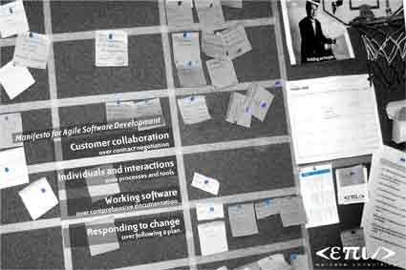
An agile tragedy
the agile practitioner visits the wine store
Totto-10
Twitter: @javatotto
totto@webstep.no
Note: This is a culture experience report based “solely” on the Norwegian agile communities, so your mileage will vary...
Pust ut – Senk skuldrene
Notes:
1

Slide 2

Intro - The agile fairytale revisited…
A critical experiment to see how far different Agile “techniques” will get you in a simple real-world experiment.
The though experiment
Observe how typical Agile development stereotypes handle the same task
Task: bring wine for a my special dinner date
Context (menu):
starter: foie gras
main course: high quality grilled Sirloin steak
dessert: cheese platter
Pust ut – Senk skuldrene
Notes:
Intro
to see how different agile practitioner solve real work, I set up an observing experiment task: get me wine for a nice late dinner for two, menu 1. fois grais 2. high quality groilled sirloin steak 3. cheese platter
2

Slide 3
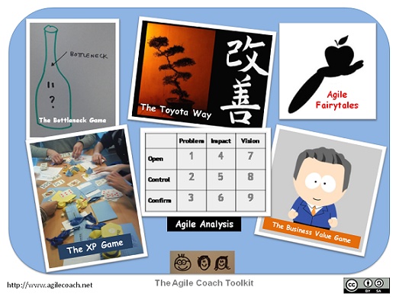
The contenders
The freshman agile practitioner
The Kanban practitioner
The peer-programming team
The code dojo evangelist
The agile code-nazi / code quality geek
The "hot-shot wannabee
The pomodoro enthusiast
The value-stream agile practitioner
"Kent Beck"
Pust ut – Senk skuldrene
Notes:
Intro
to see how different agile practitioner solve real work, I set up an observing experiment task: get me wine for a nice late dinner for two, menu 1. fois grais 2. high quality groilled sirloin steak 3. cheese platter
The freshman agile practitioner
first wine bottle
quickest route non-deterministic
The Kanban practitioner
did never enter the liquor store (tax-free store or one of his own wines?)
returned common Italian red wine
deterministic, no learning circle
The peer-programming team
discussion on type
one got a bottle, the other went into the line at the counter
discussion about the selection at the counter, no change in result
gets red wine deterministically
The agile code-nazi
spend time in the store looking at the design of the bottles
buys a wine in a nice bottle non-deterministic except for flower pots in the living room
The pomodoro enthusiast
buy wine, time to spare
go back to the store to refine purchase
exchanges to another wine with nicer bottle non-deterministic
The "hot-shot wannabee
talked a lot about techniques
ended up sending a team member to the liquor store
result: same as "The freshman agile practitioner"
The value-stream agile practitioner
selects the most alcohol/price wine deterministic
"Kent Beck"
buy his favorite wine based upon years of experience deterministic usually hit the targets
Final remarks
what is wrong with Agile practitioner's today?
Post agile / Smidig 2.0
determinism
to be able to learn value
what about serving temperature, decanting the wine (maintenance aspects)
what food? (organizational scope, system of systems)
3

Slide 4
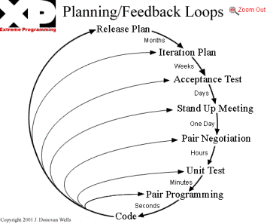
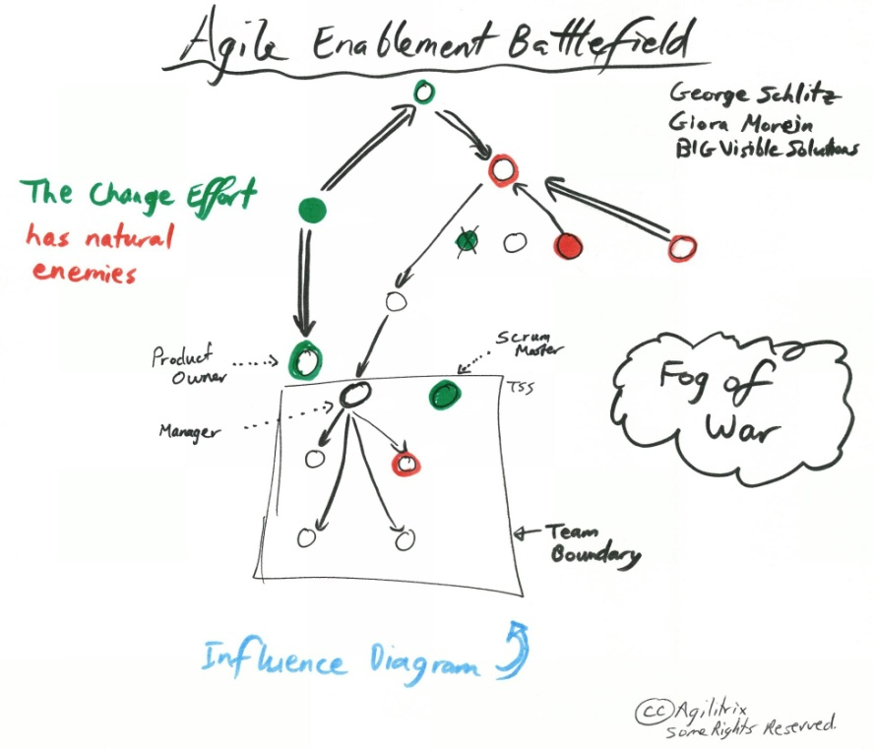
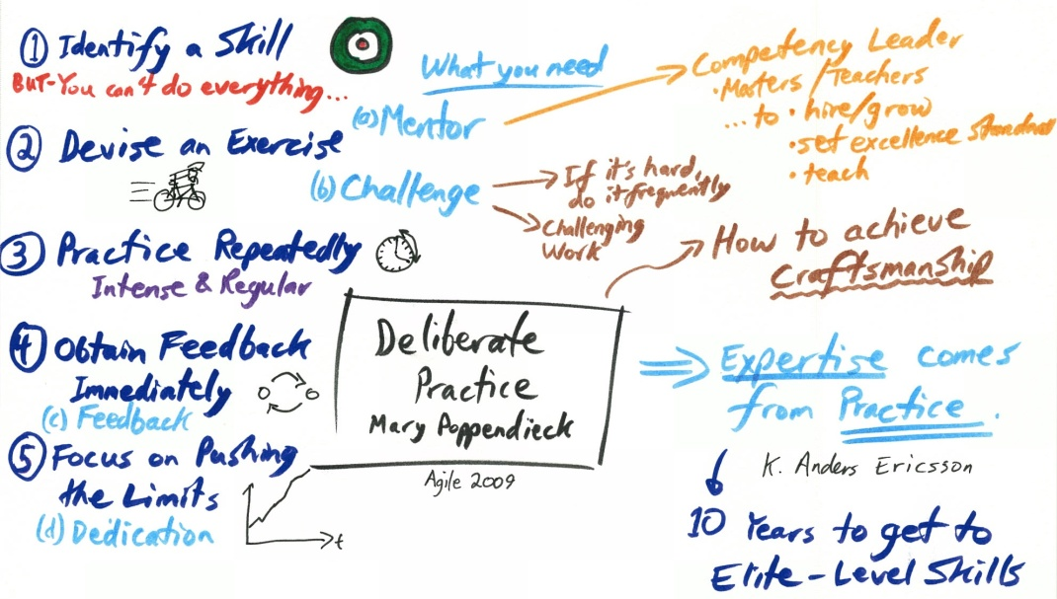
The freshman agile practitioner
Poor and confused son-of-a-bitch…..
Tries helplessly to maximize productivity…..
Notes:
first wine bottle
quickest route non-deterministic

Slide 5
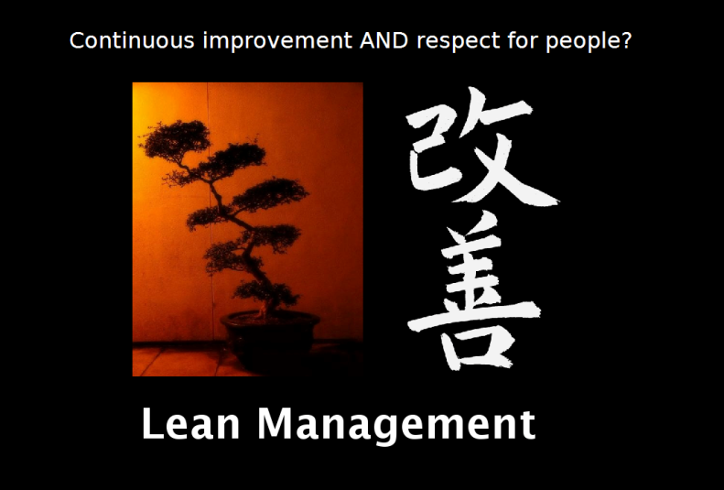
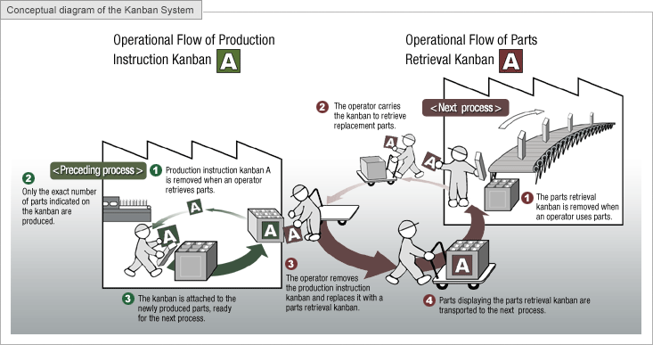
The Kanban practitioner
Cool guy with “hip” glasses…
Snappy dresser…
Walk the talk…
Feel the flow…
We need to eliminate waste
..and what happens..
Notes:
Returns in a few seconds with a common Italian red wine..
did never enter the liquor store (tax-free store or one of his own wines?)
deterministic, no learning circle

Slide 6
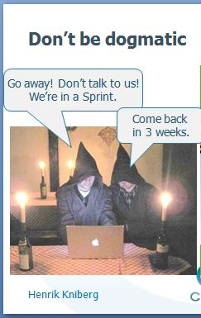
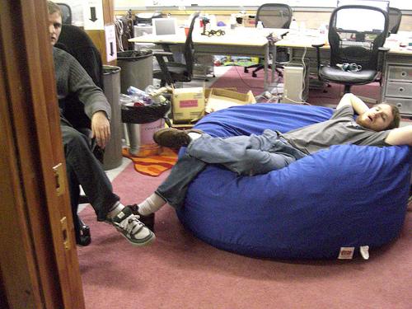
The peer-programming team
The driver and the rubber-duck…
Notes:
discussion on type
one got a bottle, the other went into the line at the counter
discussion about the selection at the counter, no change in result
gets red wine deterministically

Slide 7
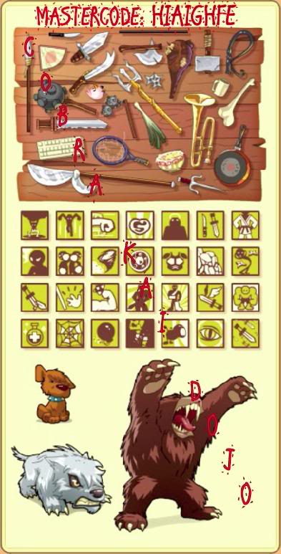
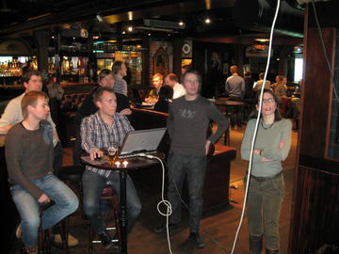
The code dojo evangelist
I’m just a programmer
I want to learn
-100 new ways to develop simple applications
Completely lost focus
Notes:
Tries 40 different routes to the store
Forget why he was on his way to the store
Returns empty handed

Slide 8
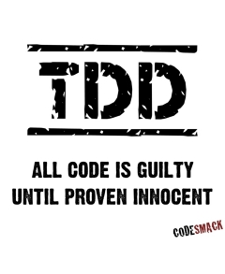
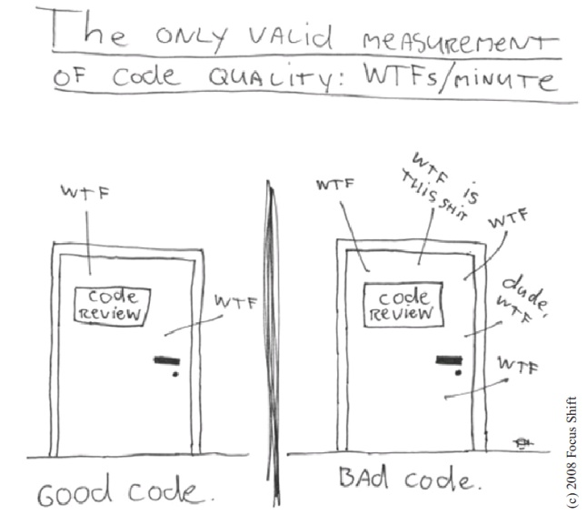
The agile code-nazi
The agilified tech-lead..
Self-proclaimed expert..
My way is THE way..
Quality tool fascist..
Notes:
spend time in the store looking at the design of the bottles
buys a wine in a nice bottle non-deterministic except for flower pots in the living room

Slide 9
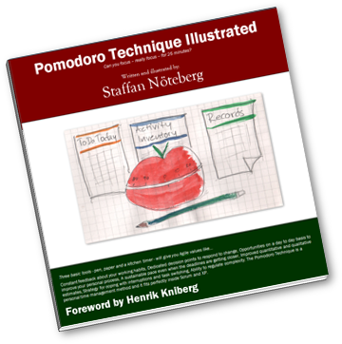
The pomodoro enthusiast
Re-inventor of common sense
By working hard and focused, you get results
Self-centric evangelist
You have to adopt my new revolution.. It’s named after tomato in Italian..
It’s the coolest thing in the universe…
Notes:
buy wine, time to spare
go back to the store to refine purchase
exchanges to another wine with nicer bottle non-deterministic

Slide 10
The "hot-shot” wannabee
Know everything there is on Agile
Follow the Agile hotshots in every medium
Quotes hotshots on a regular basis
Go to all the cool conferences and workshops
A talker who believe he is God’s local representative
Still codes 2.5 layer db driven web-apps…
Typically found on XP meetup/Lean meetups, Smidig 2009 and XP 2010…
Lack the interest in analyzing consequences
Everyone else is doing Agile wrong!!!
Notes:
talkes a lot about techniques
ended up sending a team member to the liquor store
result: same as "The freshman agile practitioner"

Slide 11
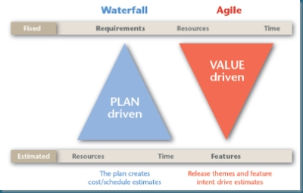
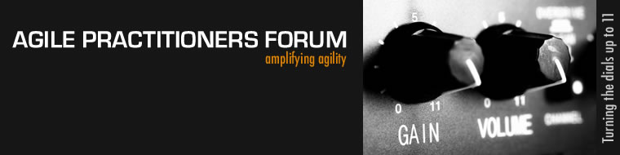
The value-stream agile practitioner
Experienced SW developer and Agile practitioner
Analytical
Wannabie manager, does not code..
Frustrated of not delivering project successes
Notes:
selects the most alcohol/price wine deterministic

Slide 12
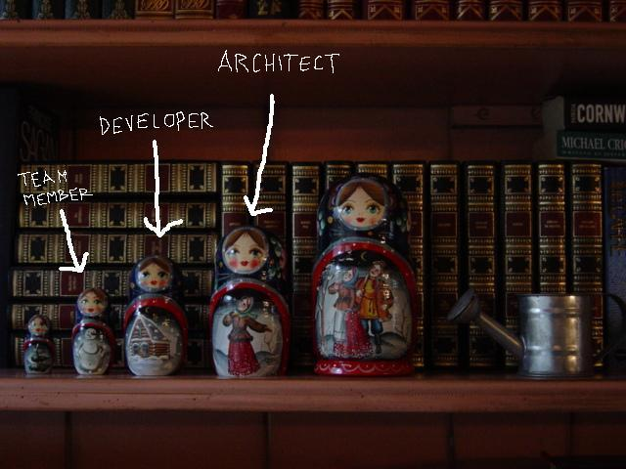
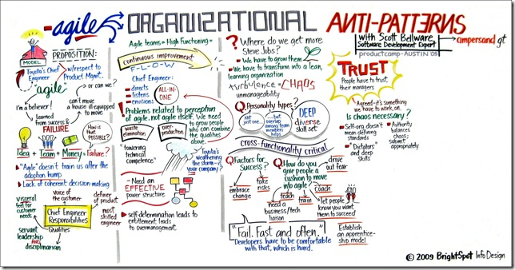
"Kent Beck"
WTF?
Does not give a damn, just deliver…
Notes:
buy his favorite wine based upon years of experience deterministic usually hit the targets

Slide 13
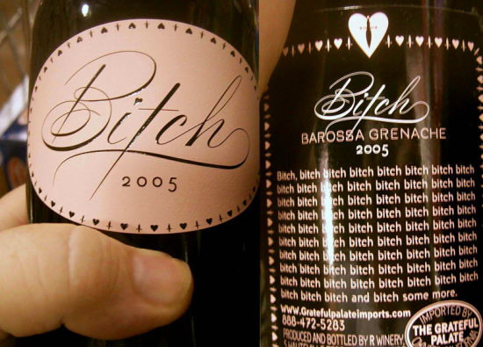
Final remarks
What is wrong with Agile practitioner's today?
Deterministic?
Did anyone learn? – how did my date go... :)
Pust ut – Senk skuldrene
Notes:
determinism
To be able to learn and predict
value
What about serving temperature, decanting the wine (maintenance aspects)
What food? (organizational scope, system of systems)
How did the date go…
13

Slide 14
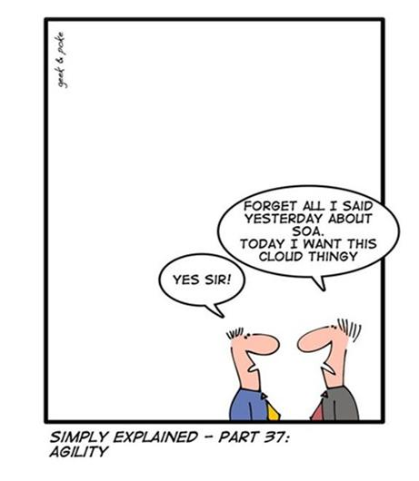

What we need…
I strongly believe that we need some extension to Agile to…
Try to address a deterministic route to answer the real question favorably:
How did the date go…
Notes:
determinism
To be able to learn and predict
value
What about serving temperature, decanting the wine (maintenance aspects)
What food? (organizational scope, system of systems)
How did the date go…

Slide 15
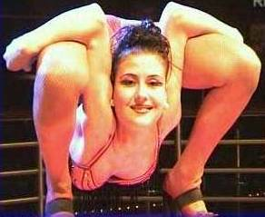

What happpened to people over processes…
Summary
Agile techniques are great, but they only help you part of the way
Be aware of how the different agile techniques skew the results
There is STILL no silver bullets or golden shortcuts
Its not the techniques which fail, it is the PEOPLE!!
Pust ut – Senk skuldrene
Notes:
15

Slide 16
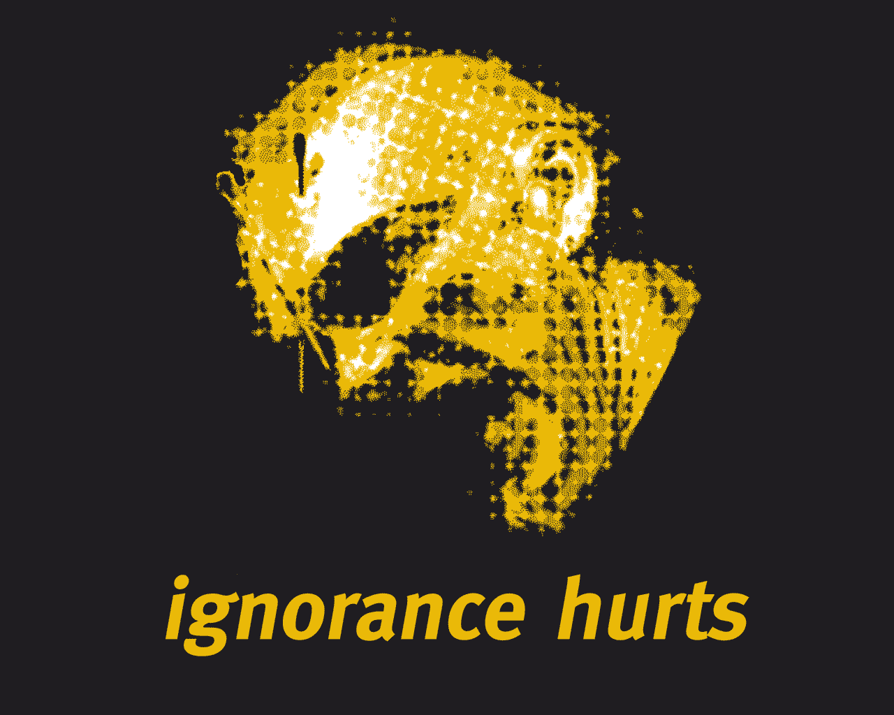

Takk for oppmerksomheten!
Totto-11
Twitter: @javatotto totto@webstep.no

