Slide 1


Event driven architecture
the scalable middleware or just fluff
by Ørjan Markhus Lillevik

Slide 2

http://www.flickr.com/photos/emeryway/

Slide 3
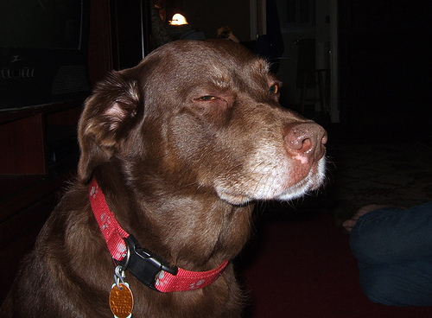
http://www.flickr.com/photos/untitled13/

Slide 4


Slide 5
But what is it?
Event driven architecture

Slide 6
Realising we were already doing it
A real world example of EDA - NAV messaging SPK
  Started out with a synchronous WS call
  Added a message queue (Active MQ)
    the service at SPK can be taken down for maintenance
    better performance

Slide 7
Scalable middleware
  Queuing helps take care of peaks
  Communicating with a stateless server enables load balancing

Slide 8
The fluffy part
EDA is just a fancy acronym. It has never needed such an acronym and is not new technology or a new way of thinking. It is what developers do when they discover that synchronous communication is causing unnecessary latency in their system.

Slide 9
The exciting conclusion
Fluff:
  Phrase to reinvent SOA
  Adds implementation to architecture concept
  Is not a new paradigm of thinking
The scalable middleware:
  Queuing messages or events is useful for scaling
  Load balancing is useful for scaling
  Events are a useful way of thinking when we wish to decouple services and remove latency.

Slide 10
Thank you for listening

