Slide 1
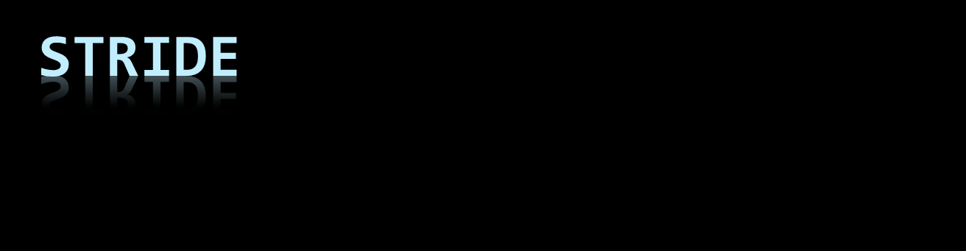
Shiraz Bhaiji, Avenir

Slide 2
How can you be attacked
Spoofing
Tampering
Repudiation
Information Disclosure
Denial of Service
Elevation of Privilages

Slide 3
What can be attacked
Data flows
Data stores
Processes
Interactors

Slide 4
What can be used Where
 | Spoofing | Tampering | Repudiation | Information Disclosure | Denial of Service | Elevation of Privilege
Data Flows
Data Stores
Processes
Interactors

Slide 5
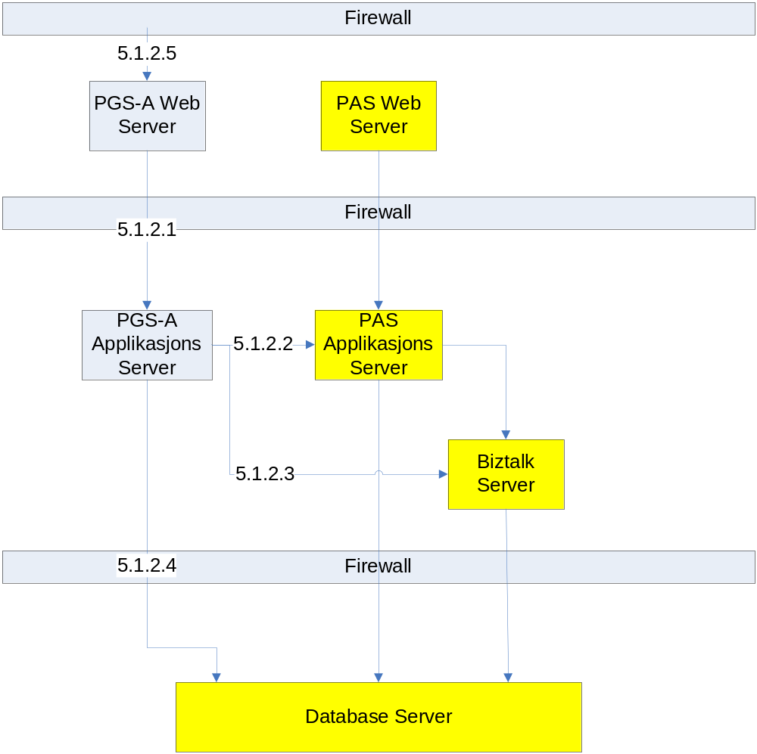

Slide 6

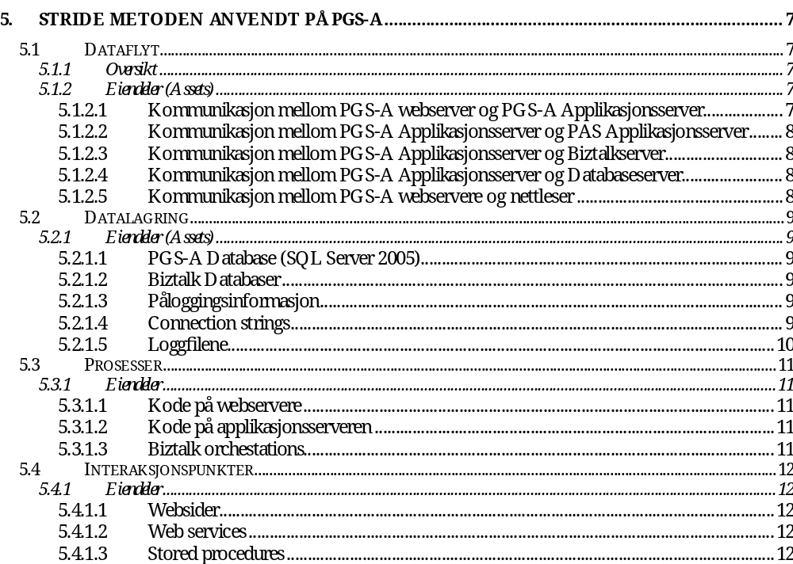

Slide 7
?

