Slide 1


Slide 2

Learn touch really well
Know your HTML5 markup
IDE Code assist for HTML 5

Slide 3

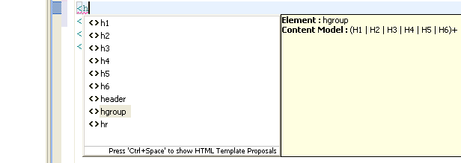
  WTP 3.2.2 added initial support
  Released in Eclipse Helios SR1 (sept.2010)

Slide 4

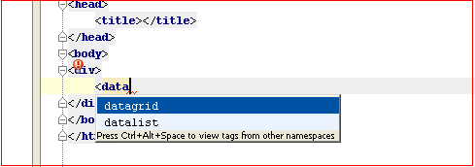
Version 9.0.3 released July 2010
  Initial support

Slide 5

Claims it will be available as of version 6.10
(current version is 6.9)

Slide 6

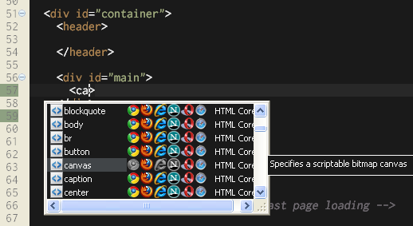
Aptana Studio 3 BETA
Also available as an Eclipse plugin

Slide 7

3 claims to have initial support
1 don’t
Q&A

