Slide 1


EDR-MDS a less is more approach to Master Data Management
17.9-2008
Totto
totto@objectware.no

Slide 2
Agenda
Problem statement
Service Oriented Architecture revisited
Master Data Management revisited
Master Data Service (MDS) revisited
Enterprise Domain Repository – Master Data Service
From CIO "Demystifying Master Data Management"
Unfortunately, most companies don't have a precise view about their customers, products, suppliers, inventory or even employees.
Data is really your revenue... Do you treat is as such?

Slide 3

Who is Totto?
Totto
Key interest areas
Sun Java Champion
Chief Consultant Objectware
  Architect, dveloper, mentor
  J2EE since 1997, J2SE/J2ME, AOP, Jini/JavaSpaces, UML, RUP, Agile
  More than 30 year developer experience
Ex President i javaBin
Ex Community Leader, java.net
Solve the really tough stuff
Provide real business value
Free knowledge and building a better software marked/industry.
Capital A architect

Slide 4

The problem...
Companies don't
have a precise view
about their data
Projects define data
reconciliation outside
project scope
Developers do not
care about data
Vendors always try to
solve to much at once
The Data warehouse guys have beards and funny accents

Slide 5
Everyone have their own ideas of what SOA is, so let us establish a baseline...
SERVICE ORIENTED ARCHITECTURE - revisited

Slide 6
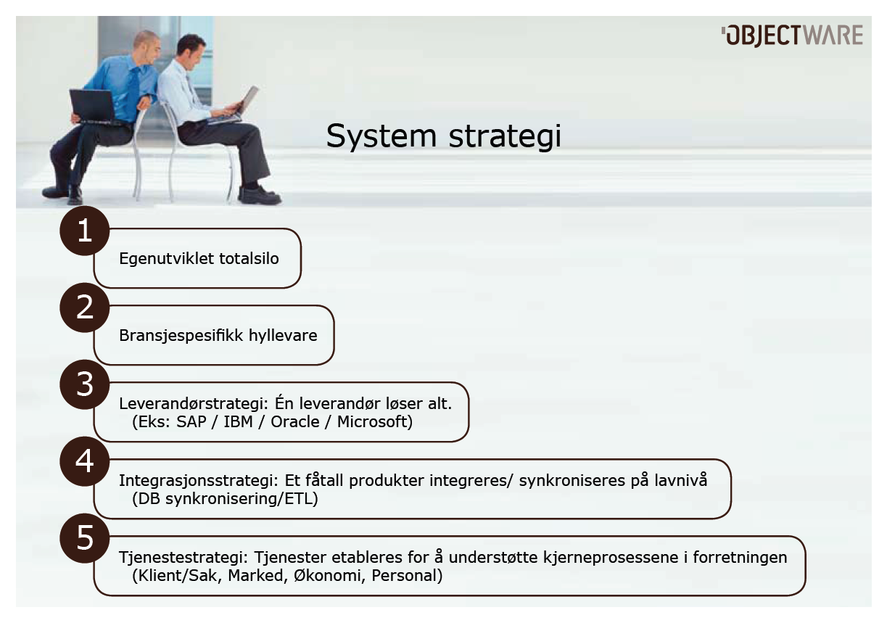

Slide 7
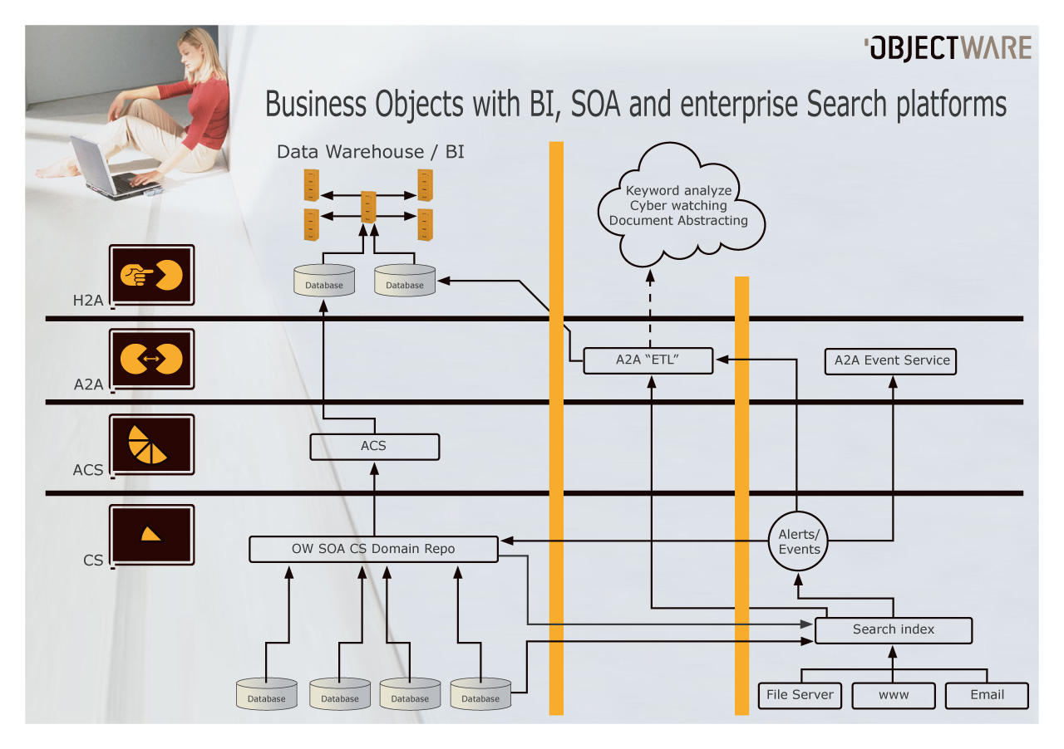
Real-time enterprise.. Just a dream?
Realtime BI
EDA
EDR-MDS
EDR-MDS
EDR-MDS
Enterprise Search

Slide 8
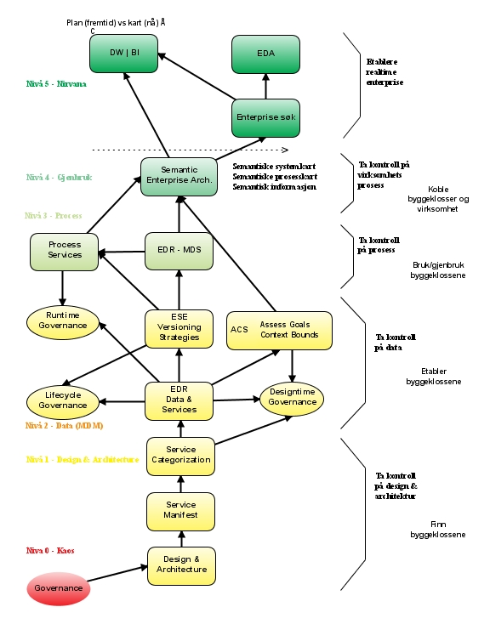
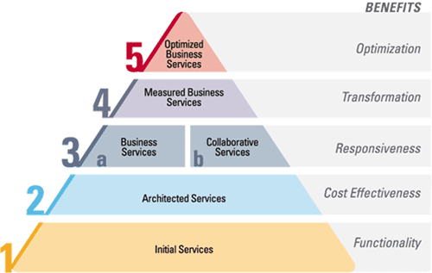
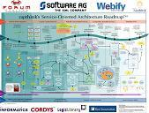
SOA Maturity
Models
SOAMM
..
..
2: Data
1: Design
0: Chaos
Level 2
Level 2
Level 2

Slide 9
SOA – hype?
Governance
Hype
Design-time Governance
ESB
Mule
SAML 2.0
PAB
BAM
WS ducktyping
REST
Run-time
Governance
ESE
WS-*
Tjeneste kategorisering
OW SOA
Endpoint
Web
Services
CFX/
XFire
AXIS
EDR
Business value

Slide 10
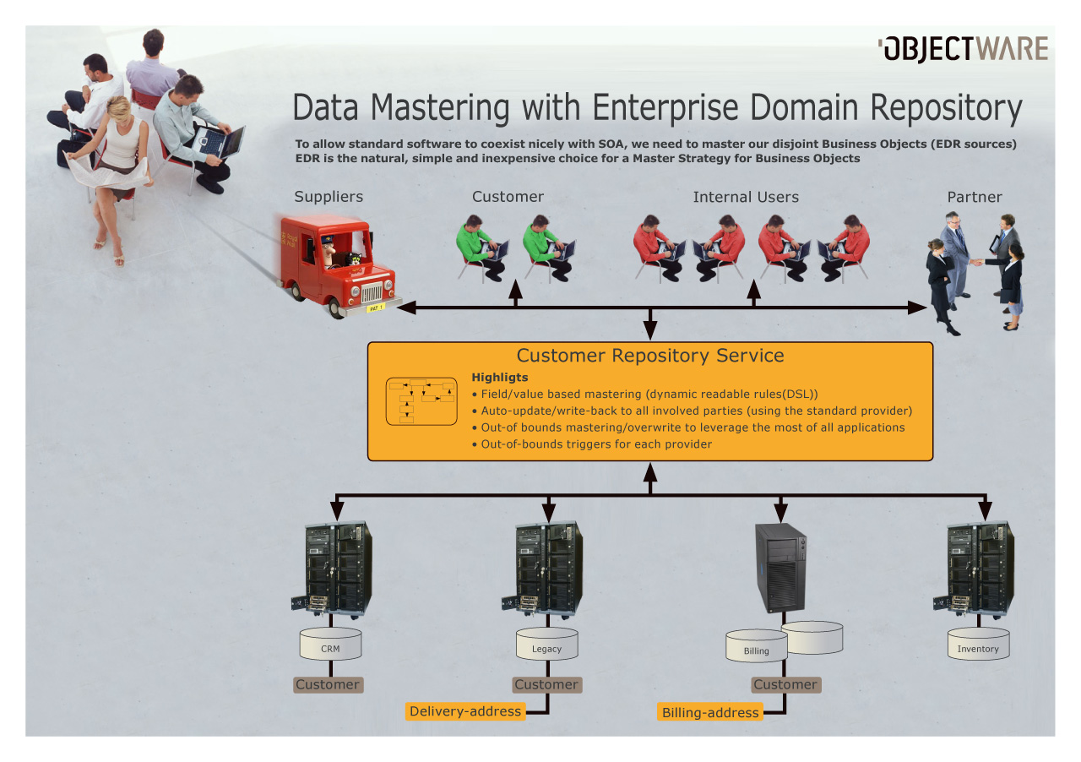

Slide 11
The (N=8) laws of SOA
Forget WS* and products
  SOA is design and architecture. The WS-* standards is not much more than candidate technology for decorating your service endpoints...
Establish service categories and service universe
  Without defining/typing your services, you are building your SOA universe with simple blocks. (We have different types of buildingblocks for building houses, why not in SOA..)
Find and decompose services
  Focus on the responsibillity aspect of your services.
  Split and rule. Remember to satisfy both explicit and implicit consumer expectations
Establish service ownership and Key Performance Indicators for your services
  SOA is challenging on an organization, and as services should provida business value, its a dead giveaway to visualize this value in a graphical dashboard.

Slide 12
The (N=7) laws of SOA
Establish design rules for your service categosies up-front
  Basically design-time governance...
    SOA Center of Excellence - Policy Advisory Board
    Do not forget pre-production service QA
Start limited and controlled
  Start with a vertiucal, stay 100 % faitfull to your architecture and design rules.
    Use mocks/adaptors when you have to take shortcuts
Establish lean and agile deployment routines
  Goal: from test to production-test, and from prod-test to production in less than 20 minuttes.
    This is a major change, which will take a lot of effort, but you have to plan for 10 times as many deployments, so there is really no option

Slide 13
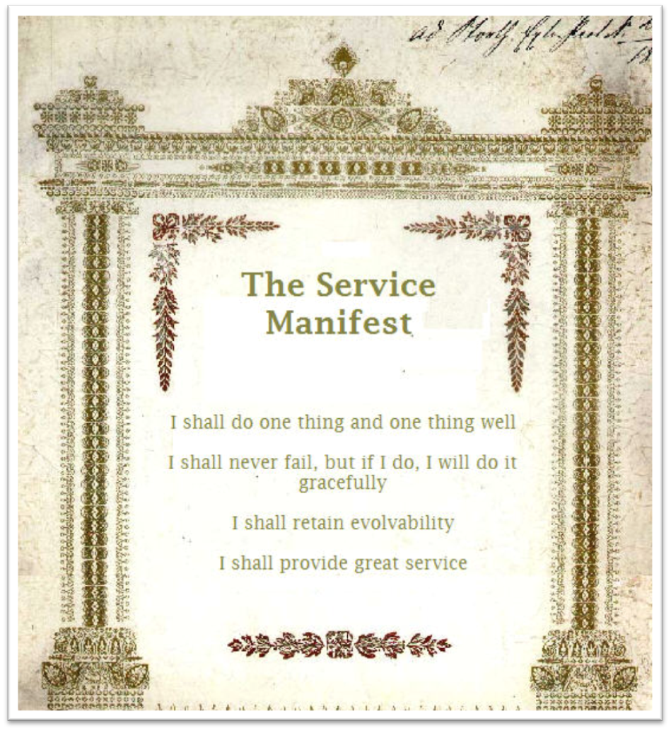

Slide 14
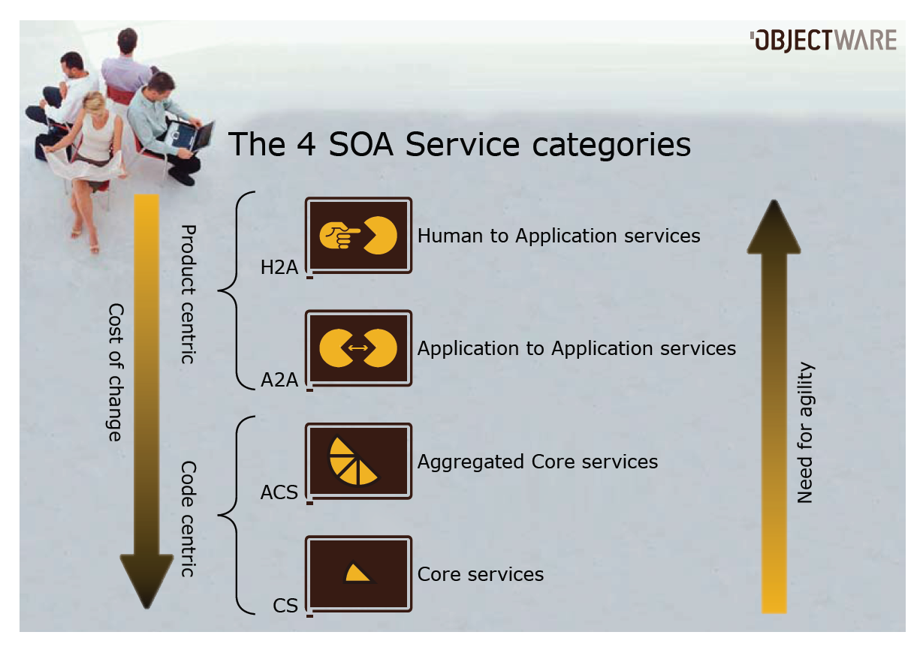

Slide 15
Data is really your revenue... Do you treat is as such?
MASTER DATA

Slide 16
Data strategies
- Data mastering in 2008
Today, we are experiencing a huge battle for the ownership of your enterprise data between huge IT platforms
  Data Warehouse/Business Intelligence platforms
  Enterprise Search platforms
  Service Oriented Architecture/SOA platforms
On top of this, the “new kid on the block” arrives as the much over-hyped MDS platforms..

Slide 17
Master Data – key definitions
Master data should not contain:
  Parent-child relationships
  Degenerate dimensional information
  Junk
  Data that is unrelated or weakly related to the business
  key.
  multi-part business keys that represent relationships in the business world.
Master data structures should contain:
  The business key, the whole business key and nothing
  but the business key.
  In addition to the business key, all descriptive data
  about the business key (to provide the business key
  current context)
  1 to 1 relationship with a surrogate generated number
  to the business key.
  Load date, create date, last updated date, original
  record source, updated record source

Slide 18
Master data management, or MDM, is quietly sneaking up on SOA as the most overused IT buzzword—though vendors have yet to agree on exactly what MDM means.
MASTER DATA MANAGEMENT
Notes:
Master data management, or MDM, is quietly sneaking up on SOA as the most overused IT buzzword—though vendors have yet to agree on exactly what MDM means.

Slide 19
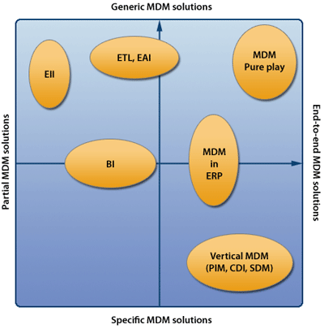
MDM – definition
Master data management (MDM) comprises a set of processes and tools which centrally and persistently define the non-transactional entities of an organization (also called Reference data). The objective of MDM is to collect from, and supply to various processes, unique instances of each entity.
Uniqueness in this context is an aspect of data normalization which eliminates outright redundancy due to collection of instances from dissimilar sources.
The processes include source identification, data collection, data transformation, normalization, rule administration,data storage, a service-oriented architecture, and data governance.
EDR-MDS

Slide 20
MDM – best practices
Get business involved - or better - in charge.
Allow ample time for evaluation and planning.
Have a big vision, but take small steps.
Consider potential performance problems.
Institute data governance policies and processes.
Carefully plan deployment.
Consider the transition plan.

Slide 21
What’s the Answer? Master Data Service(s)
MASTER DATA SERVICE
(MDS)

Slide 22
Solving the SOA Data Dilemma with Master Data Services (MDS)
Tultimate goal of strategic information management
cannot be fully achieved unless specific care is taken
to understand and manage the underlying data
as a strategic asset
Unless special attention is paid to shared data, SOAs
run the risk of failure because the proliferation of “bad”
data can actually lower the overall quality of a company’s
most critical information.

Slide 23
MDS – success checklist
Manage Data Quality Rules in One Place
Control Data Redundancy
  Write back to source
Resolve Semantic and Structural Variations
  Write back to source
Require Autonomy
Enforce Data Governance Policies

Slide 24
Master Data Service (MDS) - conslusion
An MDS provides
seamless interoperability
dramatically reduced complexity and brittleness of IT systems
increases the scalability of the environment
adapts more easily to new data sources
perform and scale to handle the ever-increasing data volumes
Enterprises that are migrating to an SOA and want to reduce costs
and complexity, while ensuring the accuracy and completeness of
data, are well advised to consider an MDS as part of their overall
strategy and technology implementation
Notes:
An MDS provides seamless interoperability across disparate
systems throughout the enterprise, dramatically reduces the
complexity and brittleness of IT systems, and increases the
scalability of the environment. Because it is decoupled and
autonomous, an SOA adapts more easily to new data sources
as the business requires, and provides performance and scale
to handle the ever-increasing volumes of master data.
Enterprises that are migrating to an SOA and want to reduce costs
and complexity, while ensuring the accuracy and completeness of
data, are well advised to consider an MDS as part of their overall
strategy and technology implementation

Slide 25
EDR - MASTER DATA SERVICE (EDR-MDS)

Slide 26
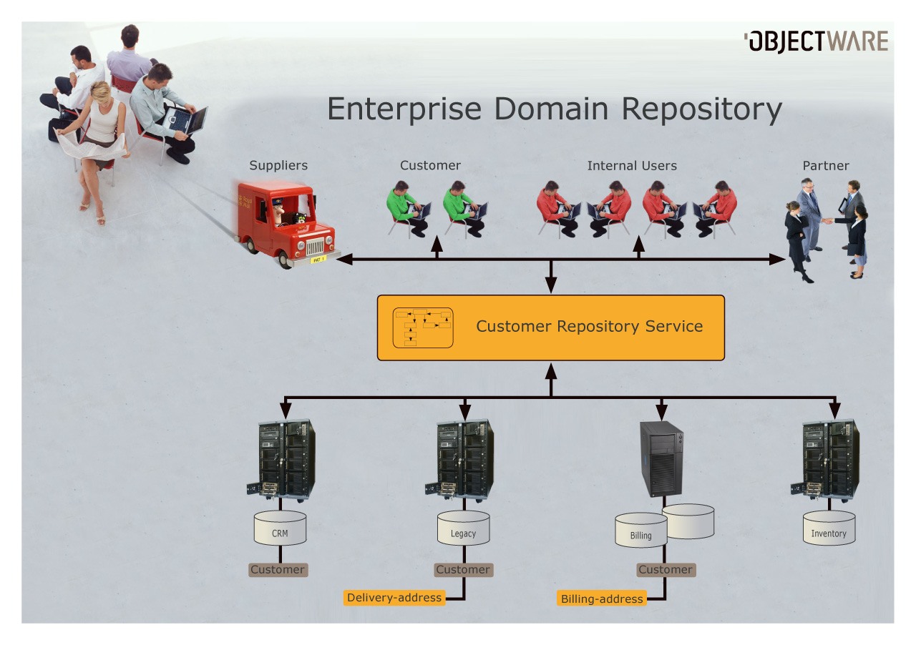

Slide 28
EDR with MDS
To allow standard software to coexist nicely with SOA, we need to master our disjoint Business Objects (EDR sources)‏
EDR is the natural, simple and inexpensive choice for a Master Strategy for Business Objects
Highlights
  Field/value based mastering (dynamic readable rules(DSL))‏
  Auto-update/write-back to all involved parties (using the standard provider)‏
  Out-of bounds mastering/overwrite to leverage the most of all applications
  Out-of-bounds triggers for each provider

Slide 29
EDR Mastering Strategies
Initial discussions identified some core concepts related to mastering strategies. These concepts requires definitions in this context:
* Master
* Synchronization
* Mapping
* Complex Validation
All mastering strategies are primarily focused towards categorized Core Services implementing Enterprise Domain Repository and utilizing multiple providers.

Slide 30
EDR MDS – Key takeaways
Simplest possible route to managed data
Reduced complexity by zooming in to one single Business
Object at a time
All non-business object relations handled as resource
references.
Simple first generation implementation within 2-3 months
By adding support for managed Business Objects in your SOA,
you facilitate and enable event-driven architectures and real-
time enterprise.
Its no magic – just common sense (and can be implemented in your favourite technology, container, product ☺

Slide 31
Master Data Management anno 2008:
Possibly solution?

Slide 32
Common sceptisms
Q: I do not want to introduce a single point of control/failure
A: EDR-MDS does scale both horizontally and vertically and is far less a single point of failure than all alternatives.
Q: This is to complex..
A: True, but companies need help to get back control of their data. EDR-MDS is the less complex and expensive than all the alternatives I know of.
Q: Simplification is king, lets simplify instead
A: If possible, simplification is usually the best strategy. If simplification is impossible or too expensive, EDR-MDS might help you.

Slide 33

EDR-MDS – get involved...
Open Community Wiki:
  wiki.community.objectware.no
  project on java.net in Q4ish
Future of enterprise Pojos – Geek cruise
  Wiki.community.objectware.no
EDR on java.net NOW
E-mail me: totto@objectware.no

