Slide 1


EDR-MDS a less is more approach to Master Data Management
6.5-2008
Totto

Slide 2
Agenda
Service Oriented Architecture
Master Data Management
Master Data Service
EDR – Master Data Service
From CIO "Demystifying Master Data Management"
Unfortunately, most companies don't have a precise view about their customers, products, suppliers, inventory or even employees. Whenever companies add new enterprise applications to "manage" data, they unwittingly contribute to an overall confusion about a corporation's overall view of the enterprise. As a result, the concept of master data management (MDM)-creating a single, unified view of an organization{-}--is growing in importance.
.

Slide 3
It’s all about services... and services relies upon architecture.... but all the world seems to care about is remiting infrastructure products..
Service Oriented Architecture

Slide 4
The (N=8) laws of SOA
Forget WS* and products
  SOA is design and architecture. The WS-* standards is not much more than candidate technology for decorating your service endpoints...
Establish service categories and service universe
  Without defining/typing your services, you are building your SOA universe with simple blocks. (We have different types of buildingblocks for building houses, why not in SOA..)
Find and decompose services
  Focus on the responsibillity aspect of your services.
  Split and rule. Remember to satisfy both explicit and implicit consumer expectations
Establish service ownership and Key Performance Indicators for your services
  SOA is challenging on an organization, and as services should provida business value, its a dead giveaway to visualize this value in a graphical dashboard.

Slide 5
The (N=7) laws of SOA
Establish design rules for your service categosies up-front
  Basically design-time governance...
    SOA Center of Excellence - Policy Advisory Board
    Do not forget pre-production service QA
Start limited and controlled
  Start with a vertiucal, stay 100 % faitfull to your architecture and design rules.
    Use mocks/adaptors when you have to take shortcuts
Establish lean and agile deployment routines
  Goal: from test to production-test, and from prod-test to production in less than 20 minuttes.
    This is a major change, which will take a lot of effort, but you have to plan for 10 times as many deployments, so there is really no option

Slide 6
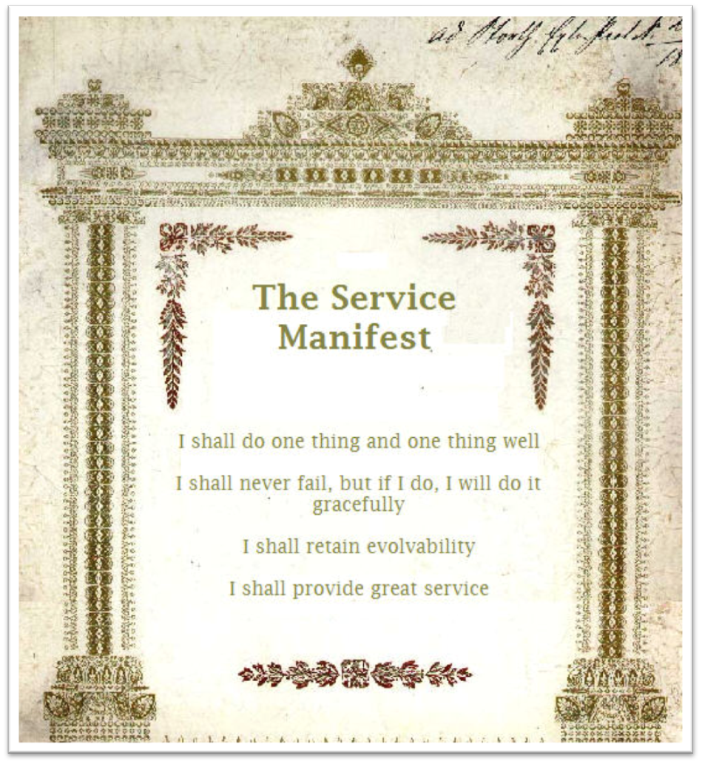

Slide 7
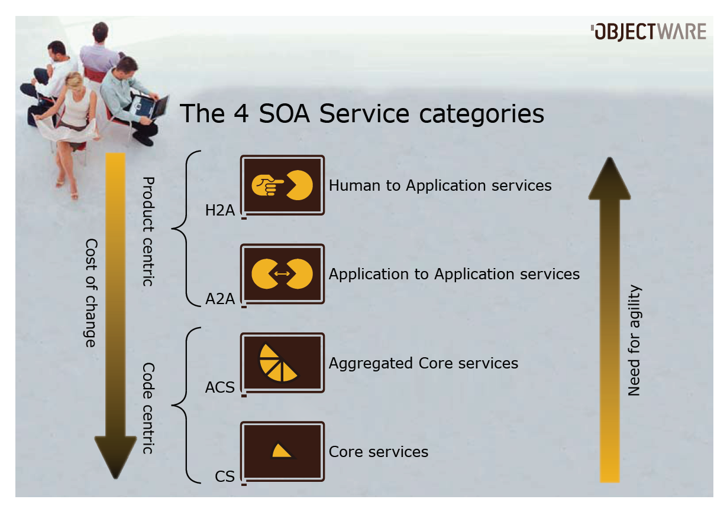

Slide 8
Data is really your revenue... Do you treat is as such?
MASTER DATA

Slide 9
Data strategies
- Data mastering in 2008
Today, we are experiencing a huge battle for the ownership of your enterprise data between huge IT platforms
  Data Warehouse/Business Intelligence platforms
  Enterprise Search platforms
  Service Oriented Architecture/SOA platforms
On top of this, the “new kid on the block” arrives as the much over-hyped MDS platforms..

Slide 10
Master Data – key definitions
Master data should not contain:
  Parent-child relationships (other than recursive hierarchies
  to itself).
  Degenerate dimensional information
  Junk
  Data that is unrelated or weakly related to the business
  key.
  multi-part business keys that represent relationships in the business world.

Slide 11
Master Data – key definitions
Master data structures should contain:
  The business key, the whole business key and nothing
  but the business key.
  In addition to the business key, all descriptive data
  ABOUT the business key (to provide the business key
  CURRENT CONTEXT)
  1 to 1 relationship with a surrogate generated number
  to the business key.
  Load date, create date, last updated date, original
  record source, updated record source

Slide 12
Master data management, or MDM, is quietly sneaking up on SOA as the most overused IT buzzword—though vendors have yet to agree on exactly what MDM means.
MASTER DATA MANAGEMENT
Notes:
Master data management, or MDM, is quietly sneaking up on SOA as the most overused IT buzzword—though vendors have yet to agree on exactly what MDM means.

Slide 13
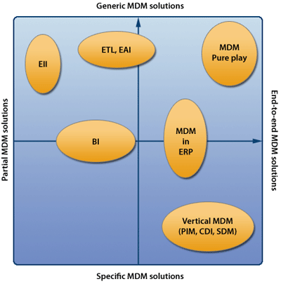
MDM – definition
Master data management (MDM) comprises a set of processes and tools which centrally and persistently define the non-transactional entities of an organization (also called Reference data). The objective of MDM is to collect from, and supply to various processes, unique instances of each entity.
Uniqueness in this context is an aspect of data normalization which eliminates outright redundancy due to collection of instances from dissimilar sources.
The processes include source identification, data collection, data transformation, normalization, rule administration,data storage, a service-oriented architecture, and data governance.

Slide 14
MDM – best practices
Get business involved - or better - in charge.
Allow ample time for evaluation and planning.
Have a big vision, but take small steps.
Consider potential performance problems.
Institute data governance policies and processes.
Carefully plan deployment.
Consider the transition plan.

Slide 15
What’s the Answer? Master Data Service(s)
MASTER DATA SERVICE
(MDS)

Slide 16
Solving the SOA Data Dilemma with Master Data Services (MDS)
Using an SOA-based approach, the ultimate goal of
strategic information management cannot be fully
achieved unless specific care is taken to understand
and manage the underlying data as a strategic asset
Unless special attention is paid to shared data, SOAs
run the risk of failure because the proliferation of “bad”
data can actually lower the overall quality of a company’s
most critical information.

Slide 17
MDS – success checklist
Manage Data Quality Rules in One Place
Control Data Redundancy
  Write back to source
Resolve Semantic and Structural Variations
  Write back to source
Require Autonomy
Enforce Data Governance Policies

Slide 18
Master Data Service (MDS) - conslusion
An MDS provides seamless interoperability across disparate
systems throughout the enterprise, dramatically reduces the
complexity and brittleness of IT systems, and increases the
scalability of the environment. Because it is decoupled and
autonomous, an SOA adapts more easily to new data sources
as the business requires, and provides performance and scale
to handle the ever-increasing volumes of master data.
Enterprises that are migrating to an SOA and want to reduce costs
and complexity, while ensuring the accuracy and completeness of
data, are well advised to consider an MDS as part of their overall
strategy and technology implementation

Slide 19
EDR - MASTER DATA SERVICE (EDR-MDS)

Slide 20
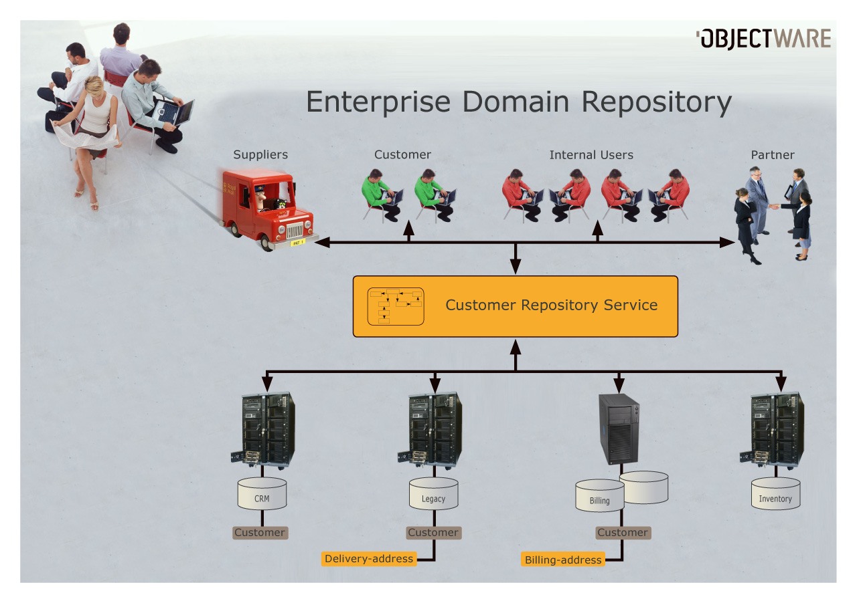
Enterprise Domain Repository

Slide 21
EDR with MDS
To allow standard software to coexist nicely with SOA, we need to master our disjoint Business Objects (EDR sources)‏
EDR is the natural, simple and inexpensive choice for a Master Strategy for Business Objects
Highlights
  Field/value based mastering (dynamic readable rules(DSL))‏
  Auto-update/write-back to all involved parties (using the standard provider)‏
  Out-of bounds mastering/overwrite to leverage the most of all applications
  Out-of-bounds triggers for each provider

Slide 22
EDR Mastering Strategies
Initial discussions identified some core concepts related to mastering strategies. These concepts requires definitions in this context:
* Master
* Synchronization
* Mapping
* Complex Validation
All mastering strategies are primarily focused towards categorized Core Services implementing Enterprise Domain Repository and utilizing multiple providers.

Slide 23
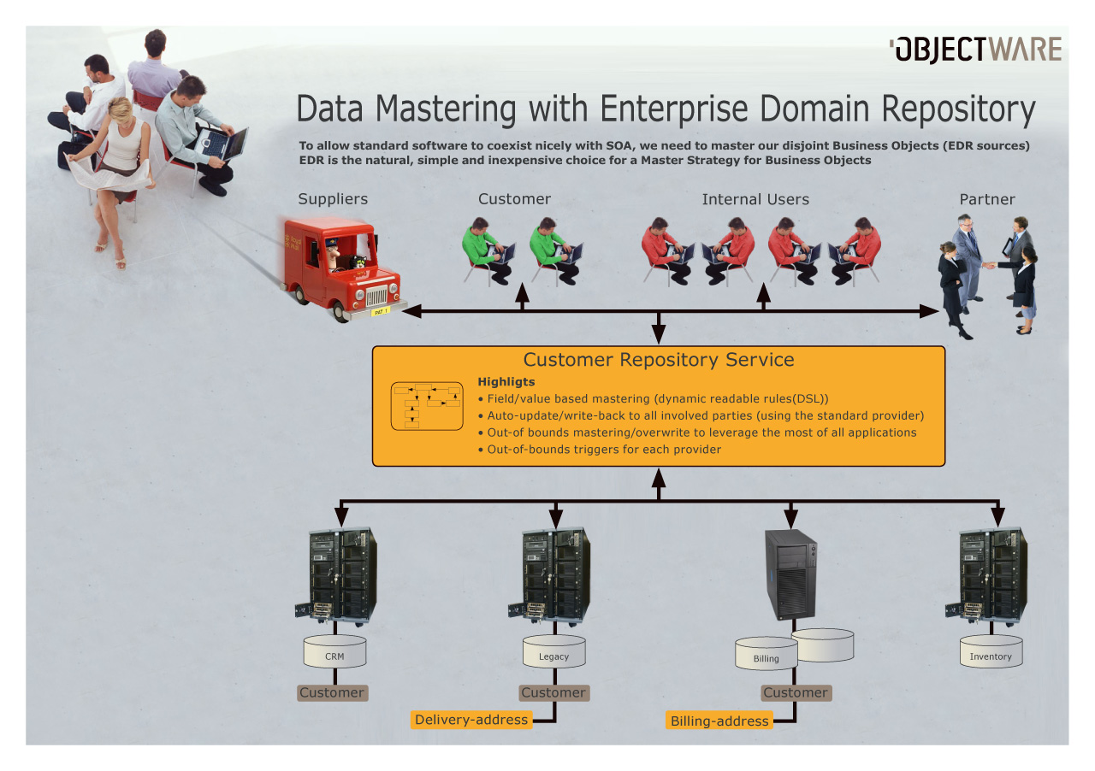

Slide 24
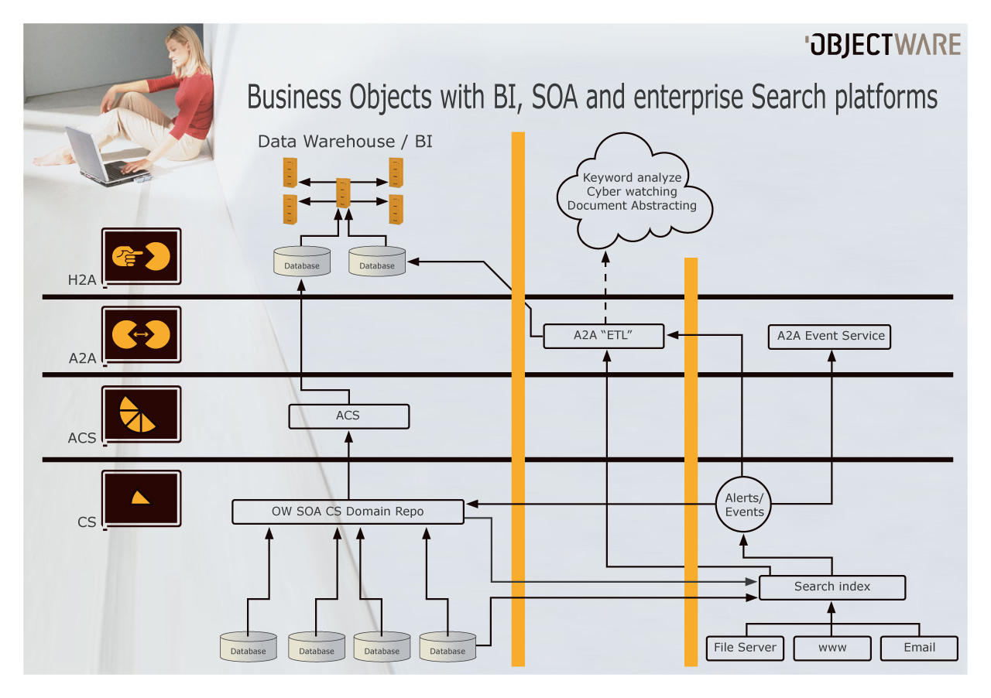
Master Data Management anno 2008:
Possibly solution?

Slide 25
EDR-MDS – get involved
project on java.net in Q3
EDR on java.net NOW
E-mail me: totto@objectware.no

