Slide 1

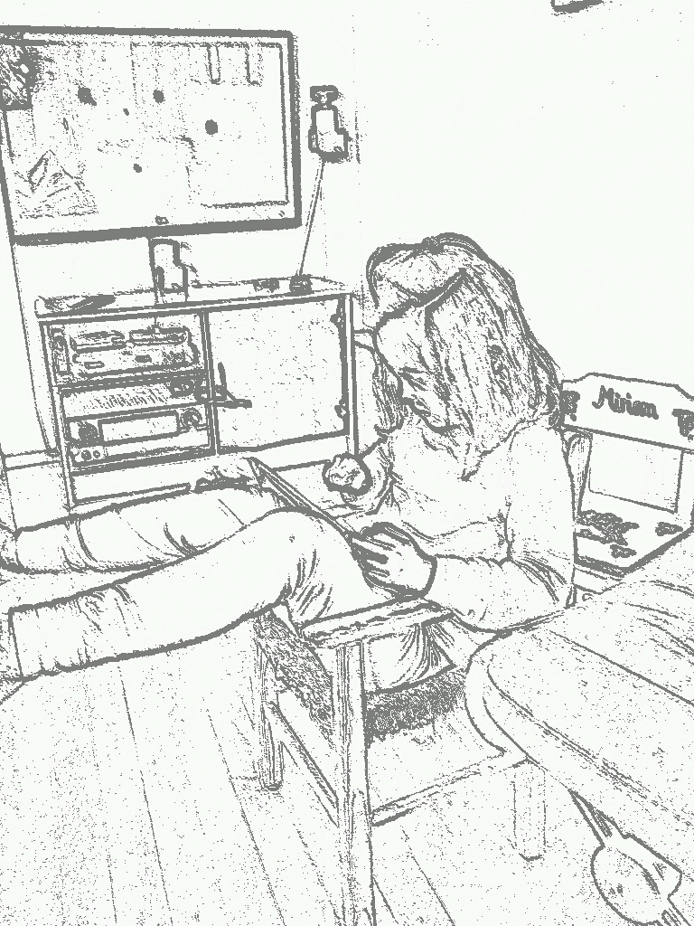


Nyere forskningsresultater som er viktige for arkitekten
Totto-12
CIA 2012 @javatotto
Notes:
Also a researcher at the University of Oslo

Slide 2
Motivation
Stort sett er vi i bransjen veldig opptatt med å bygge software. Noen ganger kan det lønne seg å heve blikket.
Idag er planen å heve blikket og ta et titt på nyere forskning for å se om det finnes resultater der som kan hjelpe oss i vårt daglige virke.

Slide 3
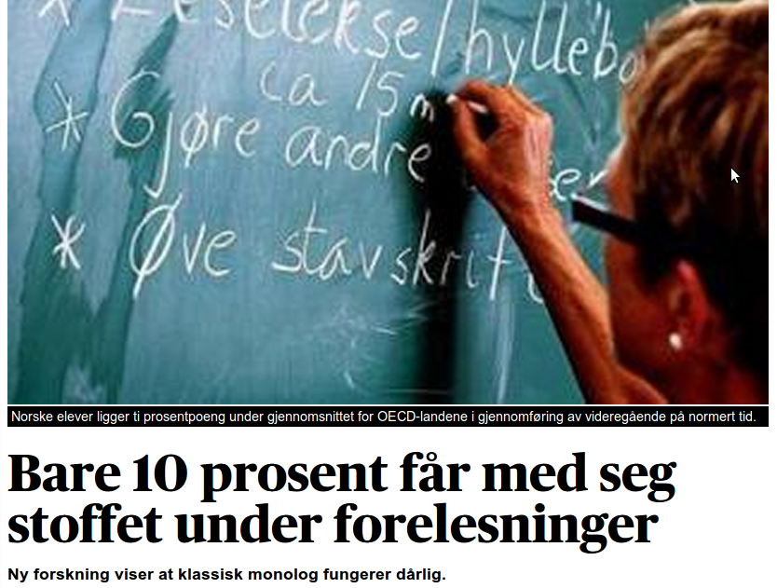
Disclaimer!

Slide 4
Dagens knippe
kobling mellom teknologivalg - erfaring og kvalitet
kobling mellom ferdigheter - erfaring med fokus på standardavvik
Senior-paradokset
koblingen mellom "gode" versus "årlige" systemer og erfaring

Slide 5
Erfaring versus ferdigheter

Slide 6

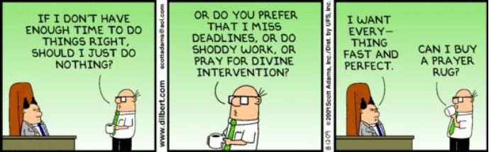
Practical implications of different levels of skill
2/6/2012

Slide 7
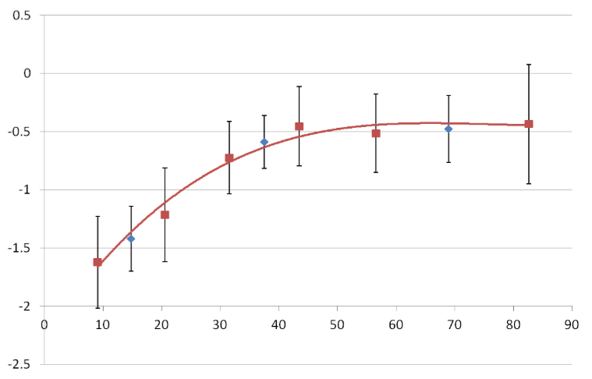
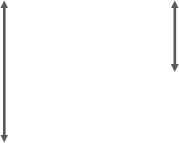
Acquisition of skill as a function of experience follows the expected (theoretical) trend*, however …
1:3 odds
1:7 odds
Programming skill
Months of Java programming experience
2/6/2012
Bergersen et al. (unpublished)

Slide 8
Seniorparadokset

Slide 9
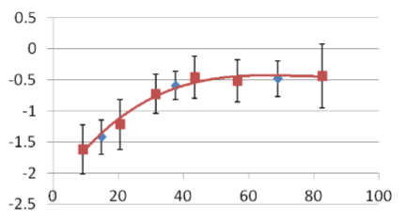

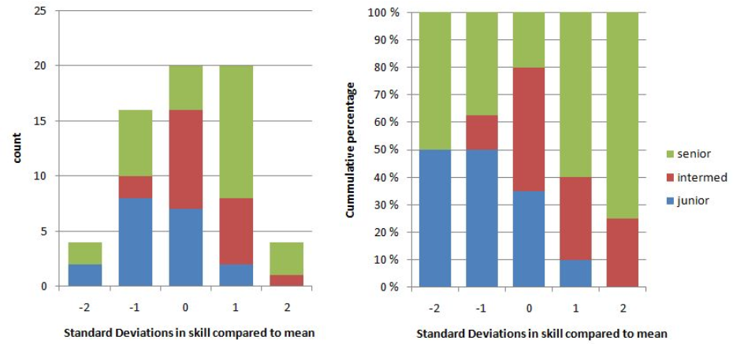
2/6/2012
Bergersen et al. (unpublished)

Slide 10
“On the job training”

Slide 11
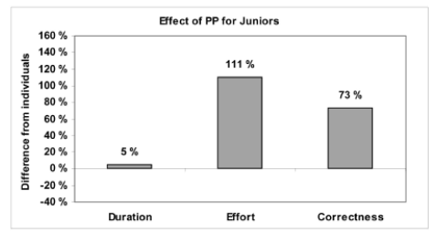
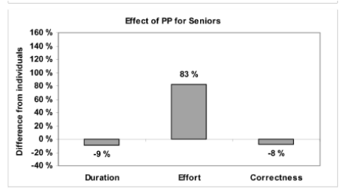
Juniors should pair program when faced with a complex task, whereas seniors should (probably) not
2/6/2012
*Arisholm et al. (2007)

Slide 12
Cohesion/kobling
– er det elefanten i rommet?

Slide 13


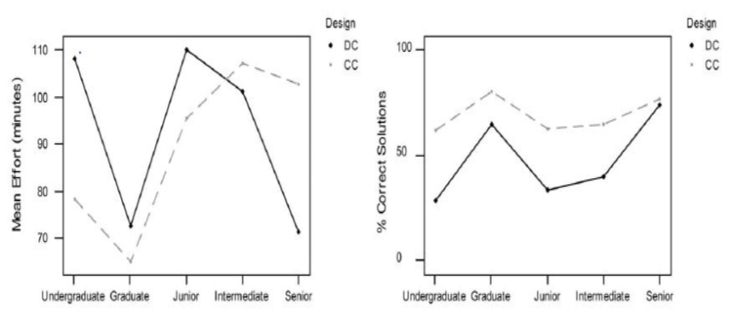
In a study, seniors performed best on the “good” system; the rest performed best on the “bad” system*
2/6/2012
*Arisholm & Sjøberg (2004)

Slide 14
Om teknologivalgene vi gjør

Slide 15
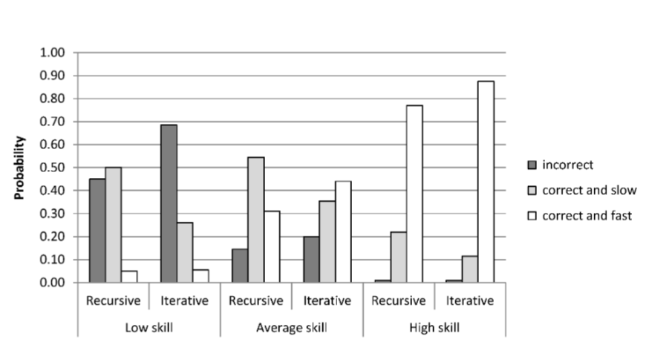
Technology X is better for low-skilled individuals, technology Y is better for those with high skill
X Y X Y X Y
2/6/2012
*Bergersen & Sjøberg (unpublished)

Slide 16
Discussions
Coupling
* "single class"
** juniors: productivity and correct
** seniors: not that high productivity and higher error rate
Why?

Slide 17
Critique
Limitations?
* size of "system" used in research
* is coupling correlated to complexity and size?

Slide 18
Explanations
Can we recognize this result elsewhere?
* Anti-JEE movement (KISS)?
* Agile-cultured projects (YAGNI)?
* Pattern → Anti pattern ecossytem?
Have we forgot that KISS, YAGNI also have context?

Slide 19
Observations
what does this mean for architects?
* high coupling not considered harmful for offshore projects (ie. 2-3 years as developer culture in India)
* systems with planned maintenance of juniors/students (ie. for low-cost maintenance)

Slide 20
AboutProgrammers (2011),“The 2011 Reddit r/programming survey”. [Cited 2012 January, 26]; Available from: http://aboutprogrammers.org/ 2012/01/introduction-to-and-data-from-2011.html
Arisholm, E., & Sjøberg, D. I. K. (2004). Evaluating the effect of a delegated versus centralized control style on the maintainability of object-oriented software. IEEE Transactions on Software Engineering 30(8): 521–534.
Arisholm. E., Gallis, H., Dybå, T., & Sjøberg, D. I. K. (2007). Evaluating pair programming with respect to system complexity and programmer expertise. IEEE Transaction on Software Engineering 33(2): 65–86.
Bergersen, G. R, & Gustafsson, J.-E. (2011). Programming skill, knowledge and working memory among professional software developers from an investment theory perspective. Journal of Individual Differences 32(4): pp. 201–209.
Bergersen, G. R, & Sjøberg, D. I. K. (unpublished). Evaluating methods and technologies in software engineering with respect to developer’s skill level.
Bergersen, G. R., Sjøberg, D. I. K., & Dybå, T. (unpublished). Construction, validation, and application of an instrument for measuring programming skill.
Chilton, M. A., & Hardgrave, B. C. (2004). Assessing information technology personnel: Toward a behavioral rating scale. Advances in Information Systems 35(3): pp. 88–104.
Schmidt, F. L. & Hunter, J. E. (1998). The validity and utility of selection methods in personnel psychology: Practical and theoretical implications of 85 years of research findings. Psychological Bulletin 124(2): 262–273.
Unsworth, N., Redick, T., Heitz, R. P., Broadway, J. M., & Engle, R.W. (2009). Complex working memory span tasks and higher-order cognition: A latent-variable analysis of the relationship between processing and storage. Memory 17: 635–654.
Waldman, D. A. & Spangler, W. D. (1989). Putting together the pieces: A closer look at the determinants of job performance. Human Performance 2(1): 29–59.
2/6/2012

Slide 21
Takk for oppmerksomheten...
Totto-12
CIA 2012 @javatotto
Notes:
Also a researcher at the University of Oslo

