Slide 1
Scrum
Common sense?
Thomas Ferris Nicolaisen
thomas.nicolaisen@objectware.no

Slide 2
Beware Scrum evangelists
(like myself!)
70% of projects that attempt to do Scrum fails..
You probably won’t get 100X productivityt
Some of these things are old stuff in new wrapping
Beware the emperor-effect*

Slide 3
About me
(or any other typical ”agile” developer)
Started doing eXtreme Programming in 2004
Did my first Scrum project in 2006
Did a second project
I’m a ”certified” Scrum-master, hoo-ray
Did Lean in a third project
And another Scrum project this year 2008

Slide 4

Short story of Scrum
1976: Tom Gilb: Iterative and Evolutionary
1986: ”New Product Development” – Takeuchi and Nonaka
1989: Lean (Toyota)
1990: Jeff Sutherland
1995: Kent Beck does eXtreme Programming
1995: Ken Schwaber joins in
2001: Agile Manifesto gets made
2003: Scrum starts taking over the world

Slide 5
Before we do more Scrum, we should explain Agile.

Slide 6
Agile Manifesto 1
Kent Beck Mike Beedle Arie van Bennekum Alistair Cockburn Ward Cunningham Martin Fowler | James Grenning Jim Highsmith Andrew Hunt Ron Jeffries Jon Kern Brian Marick | Robert C. Martin Steve Mellor Ken Schwaber Jeff Sutherland Dave Thomas
[2001]
”We are uncovering better ways of developing
software by doing it and helping others do it.
Through this work we have come to value...

Slide 7
Agile Manifesto 2
Individuals and interactions
over processes and tools
Working software
over comprehensive documentation
Customer collaboration
over contract negotiation
Responding to change
over following a plan
That is, while there is value in the items below,
we value the items above more.
(http://agilemanifesto.org)

Slide 8
Agile in Norwegian: Smidig
2004: XP-meetup
2004: Tom Gilb at JavaZone
More and more consultants begin..
2005: M. Poppendieck at JavaZone
2007: Method track at JavaZone
Smidig 2007, Smidig 2008

Slide 9
So, who are agile?
Scrum (Sutherland)
Lean (Poppendiecks)
eXtreme Programming (Beck)
DSDM
Crystal (Alistair Cockburn)
(And everyone who are willing to incrementally change in order to get better?)
2nd Annual ”State of Agile Development” Survey June – July 2007
Over 70% of the companies were using XP and/or Scrum

Slide 10
Scrum specifics
Sprint
  Reflection
  Planning
Product Backlog
  Items
  Tasks
  Effort
Velocity
Burndown
Daily Scrum
Team
Product Owner
(ScrumMaster)

Slide 11
Your specifics
Iteration
  Post-mortem
  Planning
Todo-list
  Items
  Tasks
  Ideal hours
Speed
Burndown
Morning standup meeting
Team
Customer
(Project manager)

Slide 12
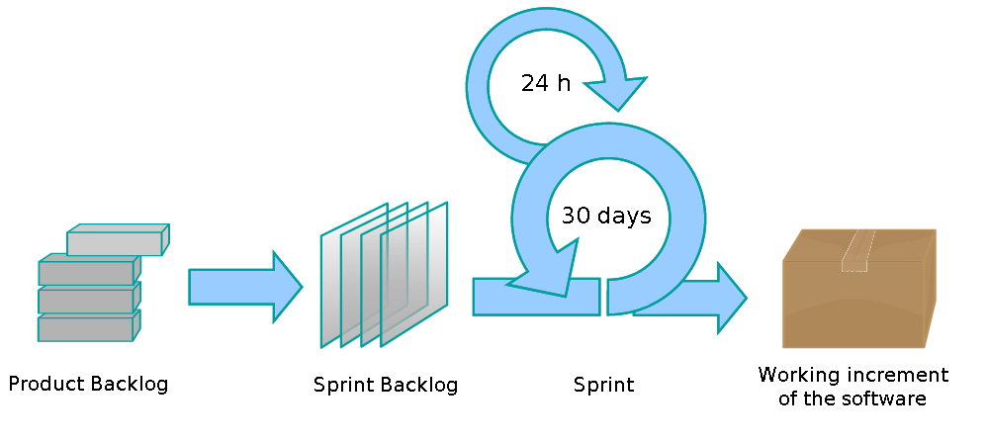
A couple of Sprints..
We’ll come back to this snowman diagram later..

Slide 13
Sprint zero
  Teams are assembled
  Developer environment is estabilshed
  Product Owner creates a vision or value, and communicates this to the team
  The most important functionalities (stories) are made concrete in a product backlog
  The team does some planning poker on the backlog to get some rough ideas on scope for the first sprint.

Slide 14
Sprint 1
Sprint planning
(half a day)
  Product owner maps value to items
  Team estimates task efforts
  Product owner decides the order of the items
Product Backlog
Tp | Functionality | Value
5 | As an insurance applicant, I want to see all available insurance options online | 100
5 | I want to search for car insurance on google and find [company]’s website | 200
? | As a potential customer, I want to see how much my car insurance will cost online without actually buying it | 1000
5 | As a customer manager, I want to know when an insurance is bought online | 200
 | ....

Slide 15
Sprint 1 cont.
Team commits to a sprint
and assigns hours to each task
Product backlog
Tp | Funksjonalitet | Verdi
 | ….
5 | I want to search for car insurance on google and find [company]’s website | 200
? | As a potential customer, I want to see how much my car insurance will cost online without actually buying it | 1000
5 | As a customer manager, I want to know when an insurance is bought online | 200
 | ....
Sprint 1 backlog
As an insurance applicant, I want to see all available insurance options online Set up logging (10 t) Set up production build script (20 t) Initialize web application (5 t)
...

Slide 16
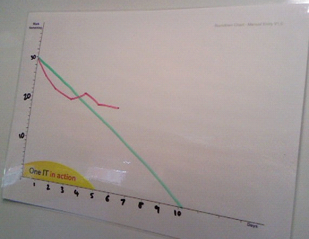
Sprint 1 cont.
  Sprint (two weeks)
    Daily Scrum: 10 minute team meeting
      What did I do yesterday
      What will I do today
      Obstacles: Stuff that is hard, tricky or heavy
    Team gets left alone (avoid cognitive overload)
    Remaing hours on tasks..
    And you get burndown

Slide 17
Sprint 1 complete!
Sprint Reflection
Stop | Keep | Try
4 week long sprint was too long. Other stakeholders have been bothering the team. Product Owner is not getting enough insight into the development process (and is getting nervous!). | Daily scrum right before lunch. Stakeholders present at daily scrum (but no voice). Estimate with Tricky Points (TP). Code reviews (after some discussion). | Gather the team in one room/landscape. Deploy the latest build nightly.
Sprint 1 – some numbers
Sprint lenght: 4 weeks
Estimated speed: 18 TP
Actual speed: 20 TP
Number of people: 3,5 (560 timer)
TP per person per Sprint: 20/3,5 = 6
TP per person per week: 6/4 = 1,5

Slide 18
Sprint 2
Sprint 2 planning
Sprint lenght: 3 weeks (let’s try shorter sprints)
Number of people: 5 (team is growing)
TP per person per week: 1,5 (from last sprint)
Suppose we can manage 1,5 VP x 5 pers x 3 weeks = 22,5
Let us say 20 VP this sprint.

Slide 19
Life continues...

Slide 20
And continues...
Backlog grows, but we slice off big pieces every sprint
Velocity increases
The team finds its rythm
Estimation gets better
We remove bad practices..
and add good practices.

Slide 21
Why is it so hard then?
ALOT of projects attempt to do Scrum.
You need to shatter some classic SE illusions
You need a set (a) budget or (b) date. Not both.
An organization that is willing to change.
Demands openness and honesty.
You need to know basic maths and be realistic.

Slide 22
Challenges – project managers
Either you have to become part of the team
Or if you’re on the business side: Product Owner
Maybe you should be the ScrumMaster?
(maybe not)

Slide 23
Challenges – Stake holders
You need to trust the team
You have to work alot with the backlog
Tightly coupled with the team
You need to throw the numbers around to get them on ”budget format”.

Slide 24
Challenges – IT (drift)
Budget driven..
Lacks the team and roles around them.
(but stabler projects are easier to scrum’ify)

Slide 25
What makes a good ScrumMaster
Inspires openness and collaboration
Experience from agile projects
Recognises a good backlog
Asks the right questions
Understands the technical challenges of the team
Understands the business nature challenges of the product owner
Can handle several projects at once.

Slide 26
Summary
Scrum – Don't use it if you don't mean it
Easy to learn, hard to do
Find the organization’s way of doing things
Lead by example, not by force
Evanglist are great for creating enthusiasm
(but with a grain of salt)

Slide 27
Questions?

