Slide 1
23/2/29
Update:
Paper research: deeplabcut + contrastive learning
Naïve idea
Problem:
Target of the task?
part of someone’s research or independent project?
Dataset
Compute resource

Slide 2
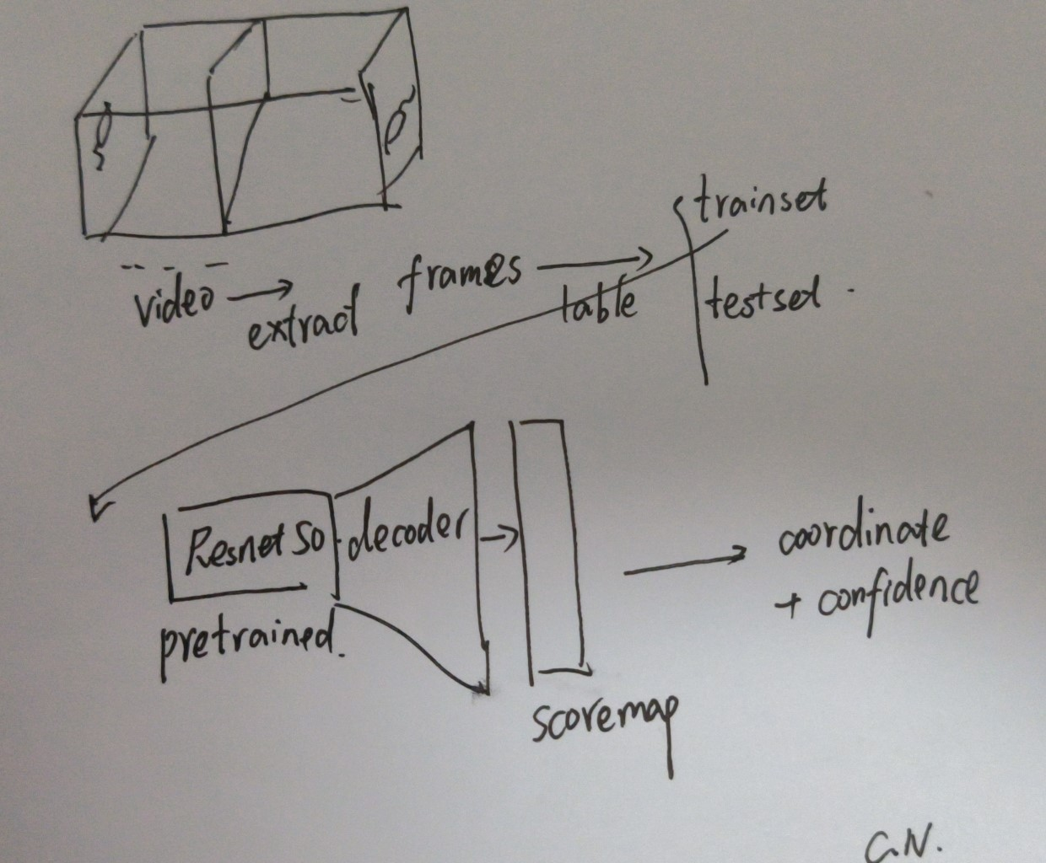
Deeplabcut

Slide 3
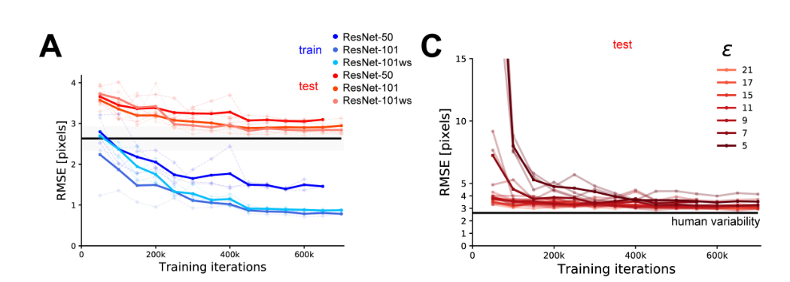
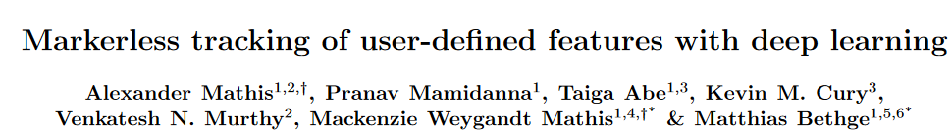
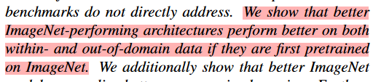
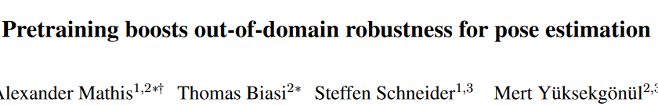

Slide 4

Latest improvement should be research about pose estimation
Deeplabcut should be run as benchmark

Slide 5
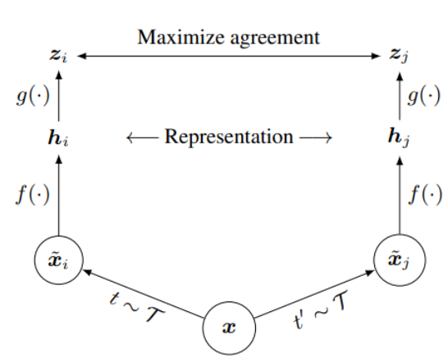
Contrastive learning
SimCLR framework, ICML 2020

Slide 6
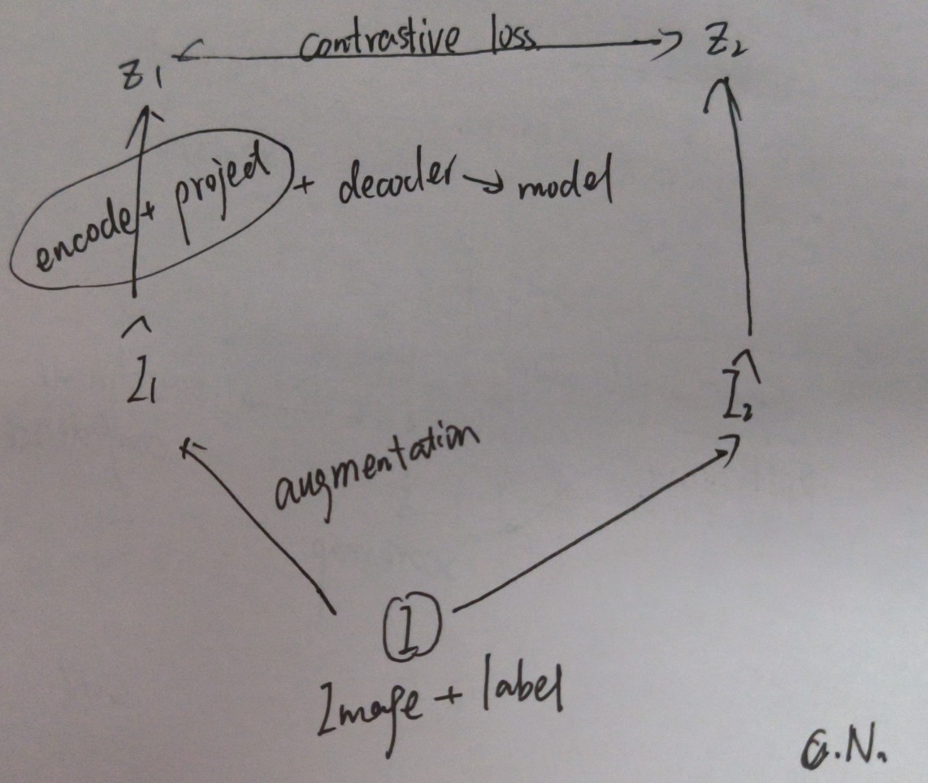
Naïve thinking

Slide 7
Very very naïve, someone must have done
Related paper reading

Slide 8
This week:
Contrastive learning paper research
Pose estimation paper research
DLC benchmark

Slide 9
23/3/10
Update:
Paper research: contrastive learning, anomaly detection
Question:
How to define normal?
Dataset.

Slide 10
Contrastive learning Paper Research
InstDist/CPC/CMC
Moco/ SimCLR（Video Moco, CVPR2021?）
SimSam

Slide 11
Anomoly detecion
Prediction based?
Key points of human body →a time series, time series prediction
Normal: similar with prediction results before
Abnormal: unsimilar
Hierarchical?
Muscle/ bone abnormal?
Explainability?

Slide 12
23/3/16
Update:
DLC test on public dataset: bad performance

Slide 13
23/3/24
Update:
Windows openpose test set
Model design

Slide 14
23/3/31
Update:
Dataset: NO more need of taking videos
Find baseline models for unsupervised time series representation
Repeat the model
Next Week:
Waiting for dataset
Reading source code

Slide 15
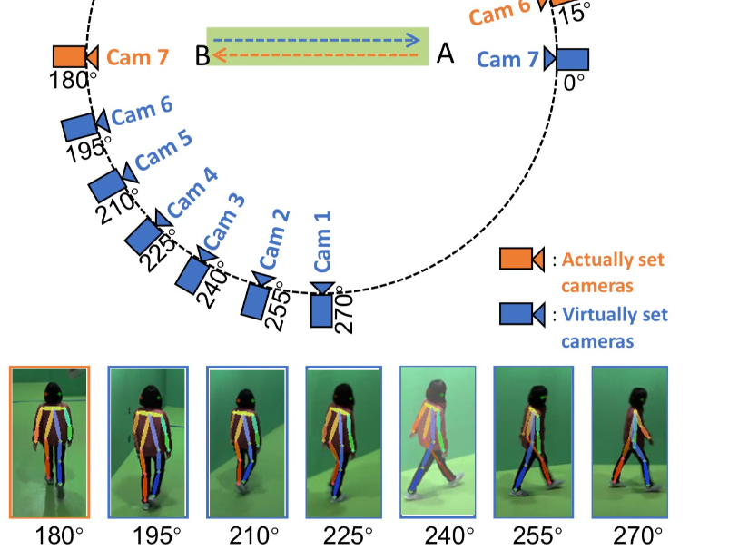
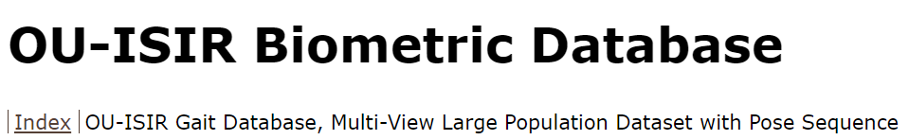
Dataset
http://www.am.sanken.osaka-u.ac.jp/BiometricDB/GaitLPPose.html

Slide 16
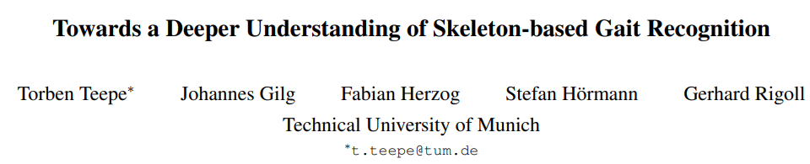
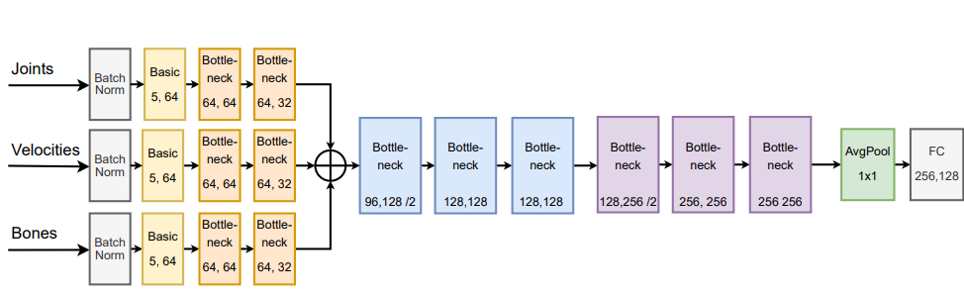
Interesting paper
2022, supervised skeleton based
Data preprocess
Multi-branch

Slide 17
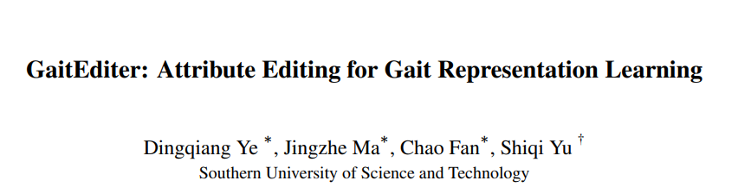
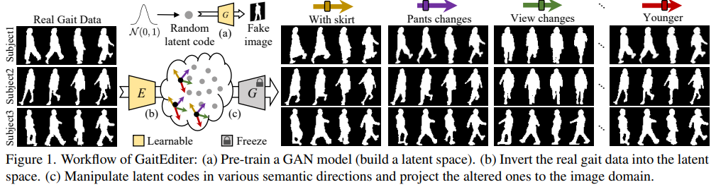
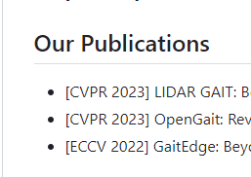
Interesting paper
New paper on March 9, GAN
Still reading
Most gait SOTA is from
https://paperswithcode.com/paper/gaitediter-attribute-editing-for-gait

Slide 18
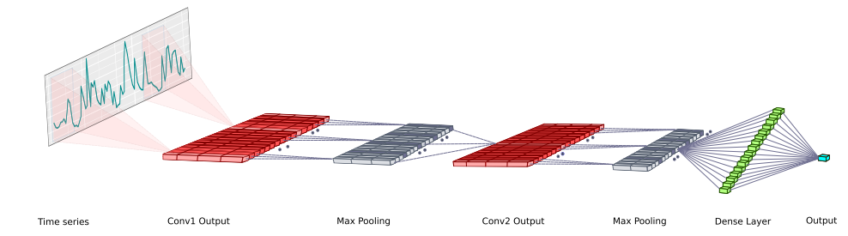
Baseline
IEEE 2018 DeepAnT
Anomaly detection based on prediction
CNN, small dataset needed
good periodic performance

Slide 19
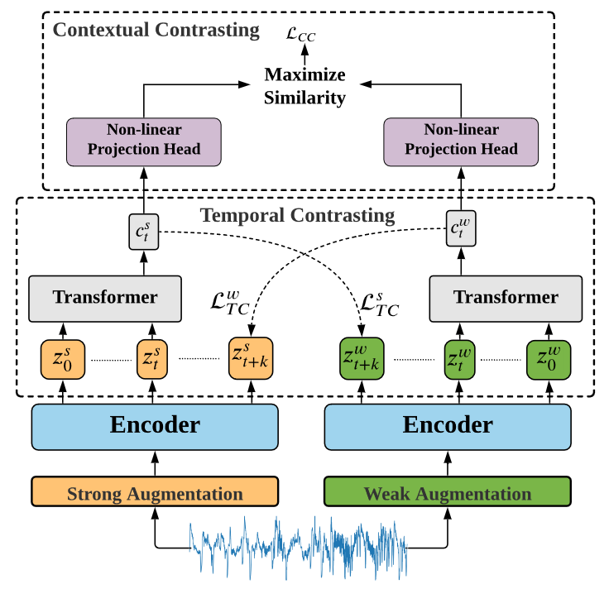
Baseline
IJCAI 2021(updated version in 2023) TSTCC
SOTA
Contrast learning for TS embedding

Slide 20

TSTCC on UCI HAR
Supervised
Self-supervised + linear prediction head

Slide 21
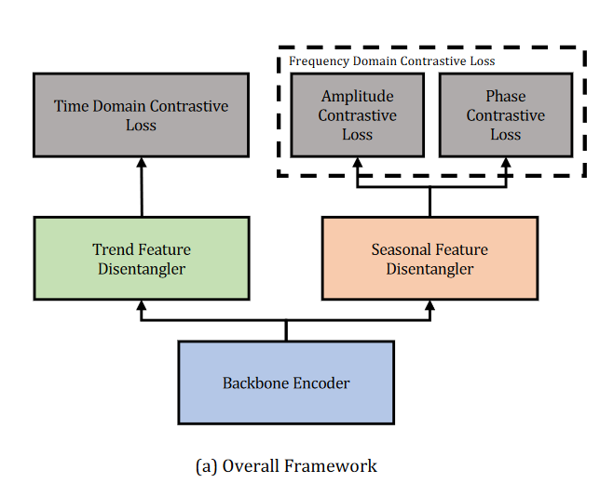
Baseline
ICLR 2022 COST
SOTA
periodic
Contrast learning for prediction
Still reading

Slide 22
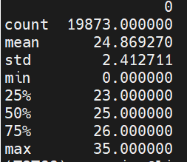
23/4/7
Update
Data Preprocessing, ready to use, turn into metrix
TSTCC code is too long, unfinished reading
Sorry for wasted some time, but after understand is easy to modify on that code

Slide 23

23/4/14
Update
Do sequence embedding use TSTCC
Bad performance, not able to cluster

Slide 24
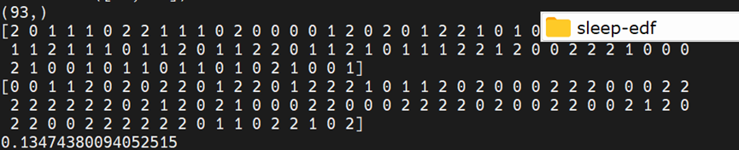
Reason Discuss
Hyperparameters:
Epochs, lambda, hidden dimensions
Overfitting
What really change performance: downsample

Slide 25
Reason Discuss
Train set & val set different distribution
25 frames & 100~300 frames
Eliminate influence of length of sequence
Meaning : speed of walking
Design new augmentation method:
Strong aug: noise+ permutation --→cut & even interpolation
Weak aug: noise +scale

Slide 26
Reason discuss
Kmeans alright？
Contrast learning get Non-Euclidean embedding
How to cluster?

Slide 27
23/4/21
Update
Data Preprocessing/Visualize
Classification Result

Slide 28
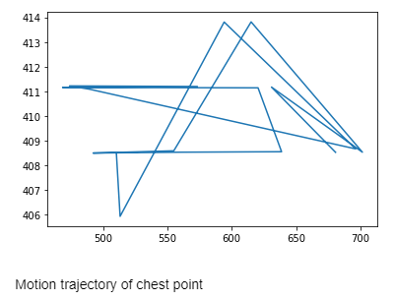
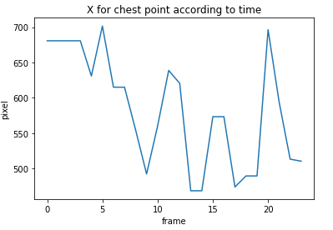
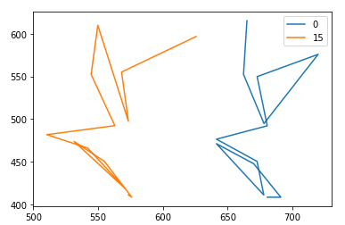
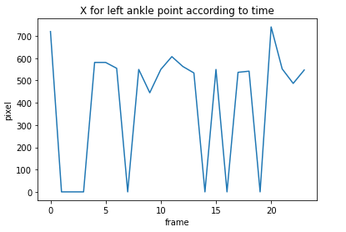
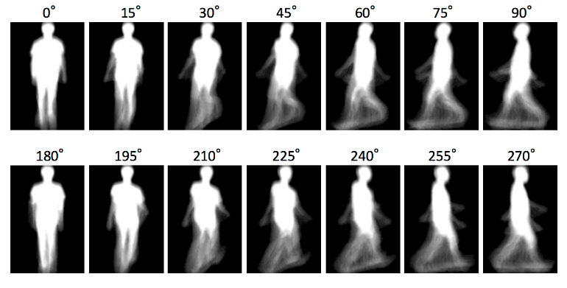
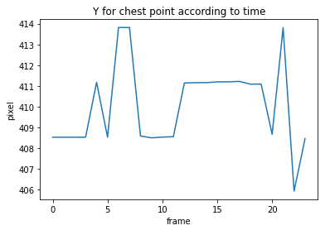
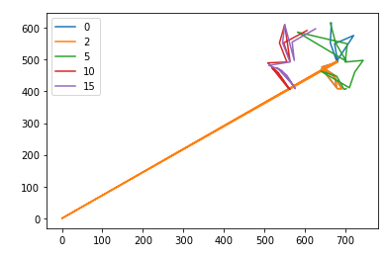
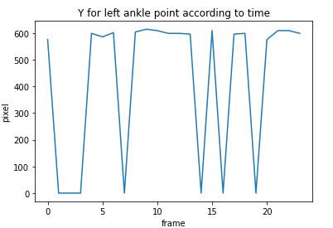
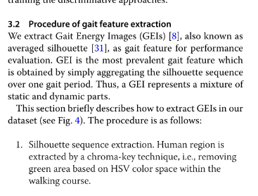
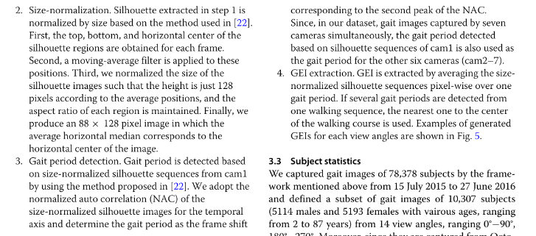
Extremely bad Japanese Train Set
Randomly choose sequence 2032 as example:
Estimate more than 40% skeleton wrong
Some noise deal: >700 is noise , use last time point
http://www.fanyigou.com/trans/translate/readDocs.html?tid=45694756

Slide 29
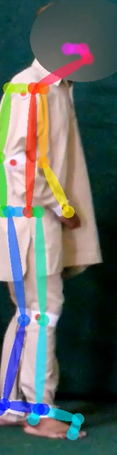
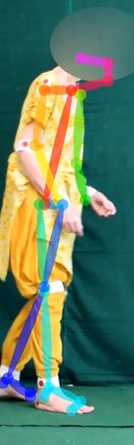
Some kind of bad Test Set
Preprocess: Normalize: set chest always 0,0,
Another thought: remove opposite limbs from camera
Hard to find period manually: tried Fourier method

Slide 30
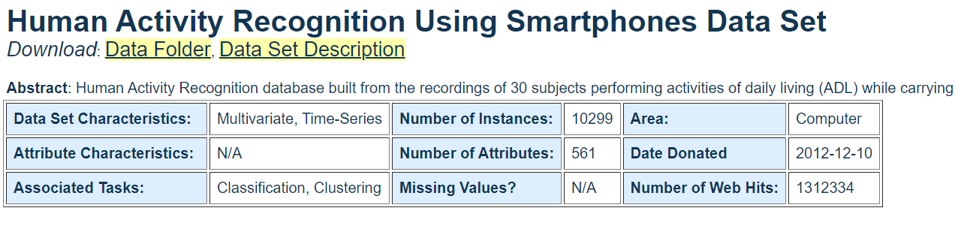
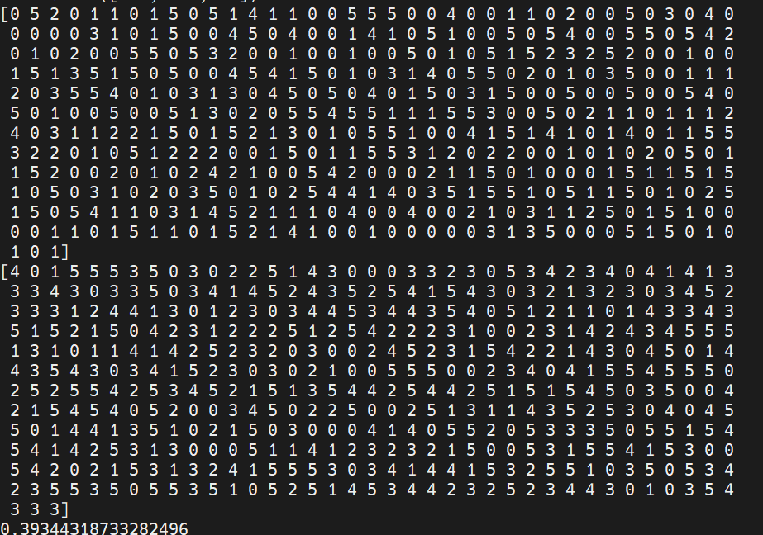
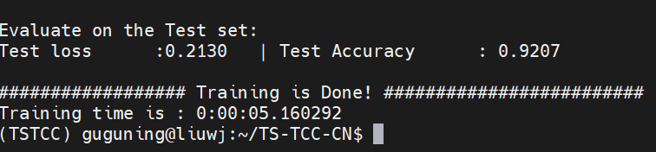
About cluster
NO cluster
Maybe misunderstanding

Slide 31
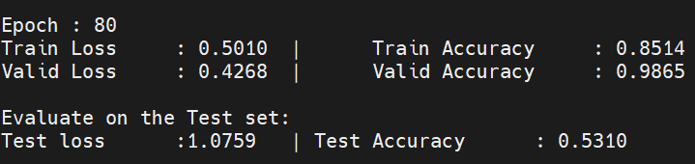
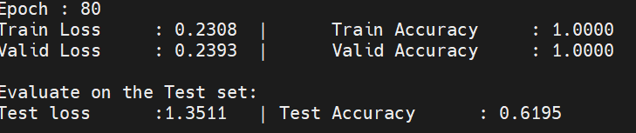
Experiment Result
Conclusion: unsupervised pretrain + linear head > random initial supervise

Slide 32
Next Step
Start writing thesis, related works, introduction so on, DDL at May 16th
(may need only one week because of chatGPT, bad English.)
Look at what is wrongly classified.
Can 3*cov1d fully get information? Try new backbone model
Preprocessing: Throw away opposite side limb?
Modify contrastive model?

Slide 33
23/5/9
Writing thesis
conclusion

Slide 34
conclusion
A stupid toy: because of data quality, accuracy not better than 75%
Experiments:
Dataset: for supervised: 18 training data (after augmentation by scaling+jitter: 900), 162 test data, for self-supervised: 18000 training
Method | CNN | LSTM | transformer | CNN+spatial
Base acc | 0.559 | 0.553 | 0.529 | 0.629
Pretrained acc | 0.591 | 0.572 | 0.554 | 0.712

Slide 35
conclusion
More information in spatial.
Contrast learning pretrain can improve performance:
More information, not similar as CV

Slide 36
abstract
This thesis proposes a deep learning model to accurately classify knee osteoarthritis (KOH), Parkinson’s disease (PD), and normal (NM) gait based on human skeleton data extracted by a popular human body keypoints detection tool, OpenPose from walking videos. The primary challenge addressed in this task is building a highly accurate model with an extremely limited and noisy training set, which is a common issue in the medical domain due to the difficulty of obtaining patient data. To overcome this challenge, we propose a novel approach that leverages a contrastively pretrained model to transfer knowledge from a differently distributed dataset, significantly enhancing the model's performance when handling small and low-quality training sets. This work shows the feasibility of using pretrained deep learning models in medical analysis, even with limited and noisy training dataset.

