Slide 1
Hierarchical Contrast for Unsupervised Skeleton-based Action Representation Learning
CAO NING 2023/05/09

Slide 2
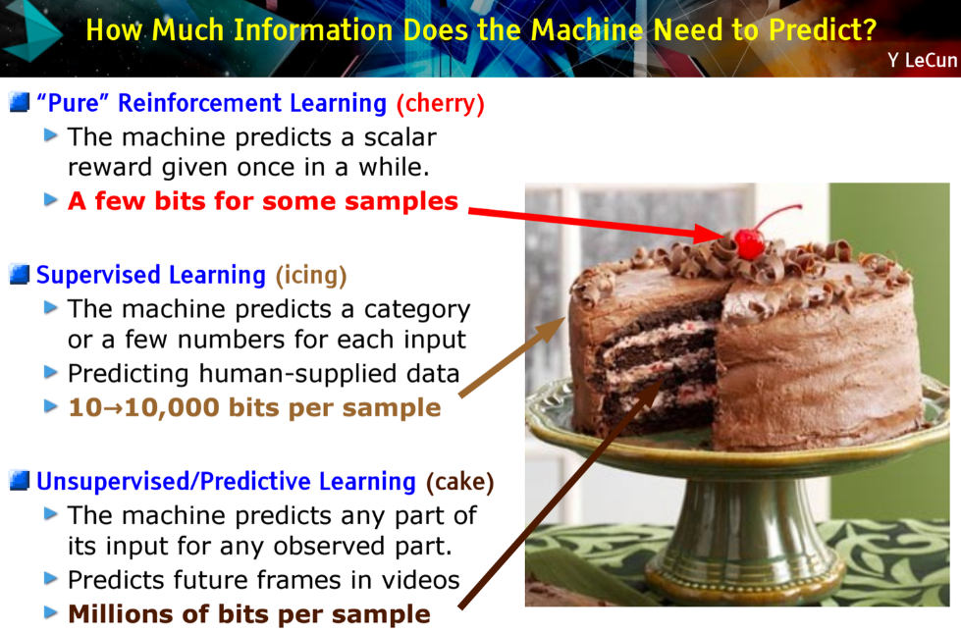

Slide 3
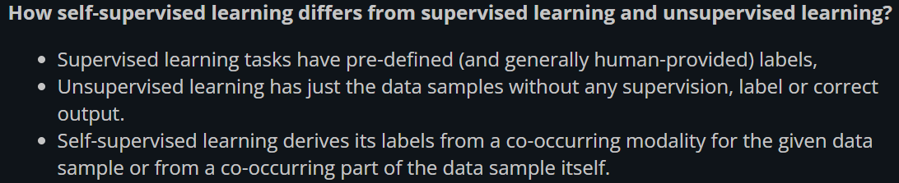
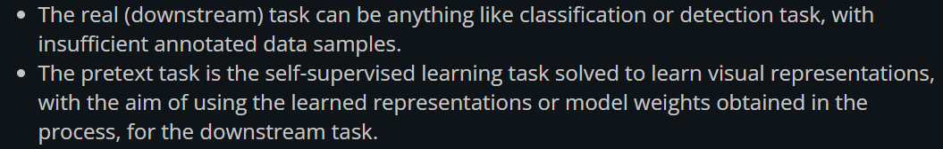
https://atcold.github.io/pytorch-Deep-Learning/en/week10/10-1/
DS-GA 1008 · SPRING 2020 · NYU CENTER FOR DATA SCIENCE

Slide 4



Pretext Task Example
Model
F1
F2
F3
F1
F3
F2

Slide 5
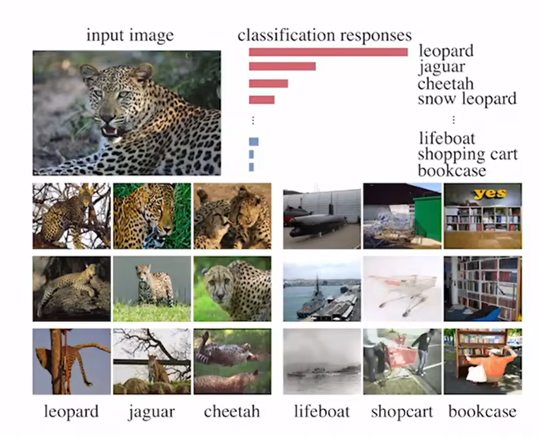
Contrast learning
Unsupervised feature learning via Non-Parametric Instance Discrimination（InstDisc, CVPR 2018）
Take class wise supervision to extreme and learn a feature representation that discriminates among individual feature

Slide 6
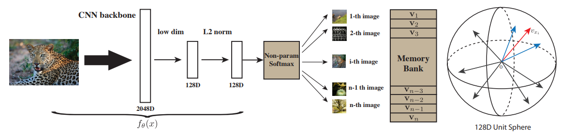
InstDisc
Positive sample：128D representation from CNN model
Negative sample：randomly choose 4096 from memory bank
Contribution： pretext + memory bank

Slide 7
InstDisc
Update of memory bank
Size of memory bank

Slide 8
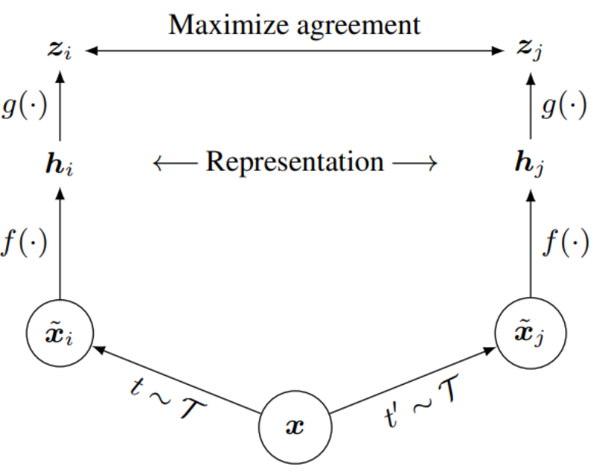
SimCLR
A Simple Framework for Contrastive Learning of Visual Representations(Ting Chen, 2020)
Positive sample: zi, zj, negative sample: other pictures in same batch(2*(batch size - 1))
Contribution: big TPU + linear projection

Slide 9
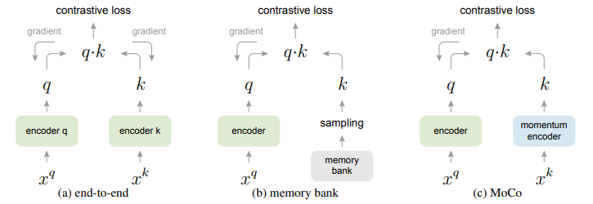
Moco
Momentum Contrast for Unsupervised Visual Representation Learning(2020 CVPR best paper, He Kaiming)
Dictionary query problem: hypothesize that it is desirable to build dictionaries that are: (i) large and (ii) consistent as they evolve during training.

Slide 10
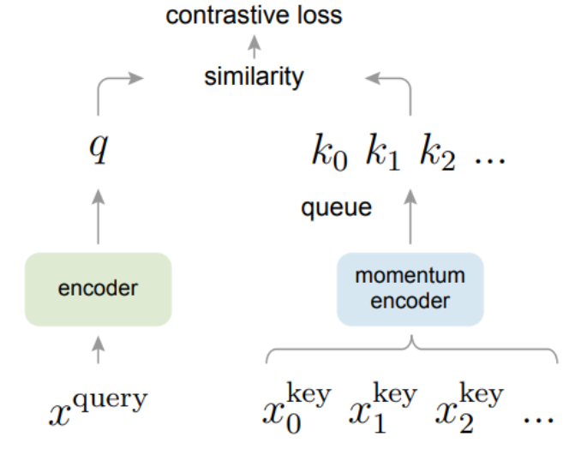
Moco
Queue: separate batch size in forward process with dictionary size
Momentum encoder: change dictionary encoder with small step
Pretext task: InstDisc, mapping clips of the picture

Slide 11
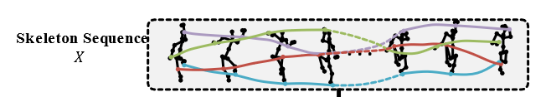
Hierarchical Contrast for Unsupervised Skeleton-based Action Representation Learning
3D skeleton-based action recognition

Slide 12
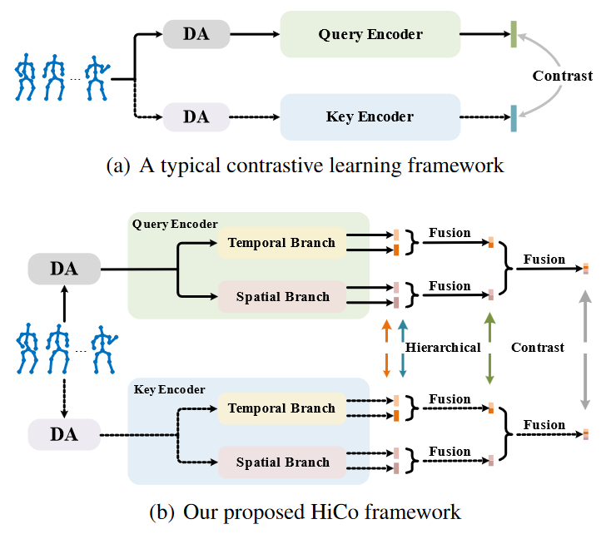
HICO:

Slide 13

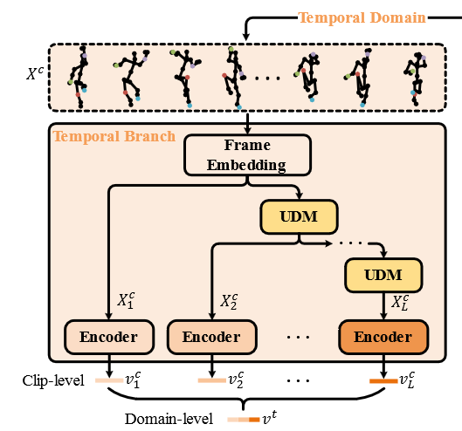



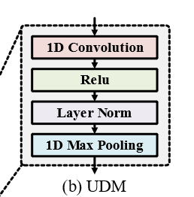
Clip-level Representation(Temporal)
UDM: 1d CNN downsampling
TMP: pooling
S2S: seq to seq model

Slide 14

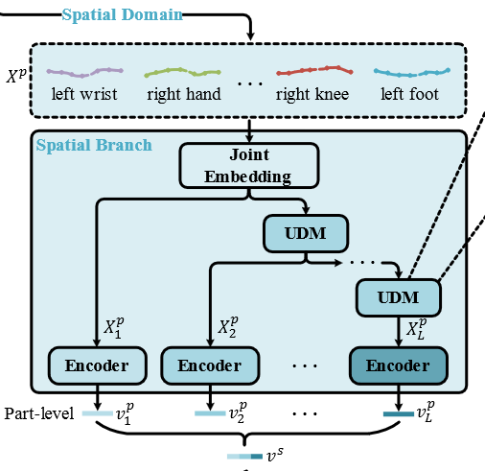
Part-level Representation(Spatial)
UDM: 1d CNN downsampling
TMP: pooling
S2S: seq to seq model

Slide 15
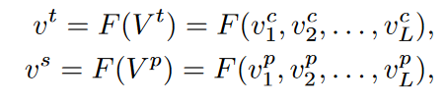

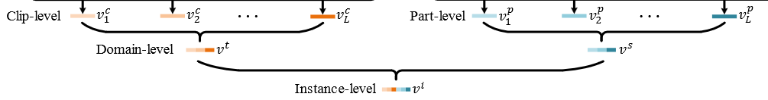
Domain-level & Instance-level Representation
F: concatnate

Slide 16
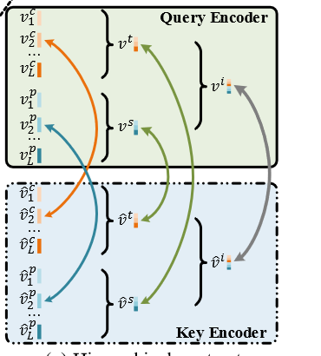
Hierarchical Contrast
Clip/Part-level Contrast: different granularities of the same input instance positive
Domain-level Contrast: temporal-domain and spatial-domain representations similar in high-level semantics
Instance-level Contrast:
NCEloss

Slide 17
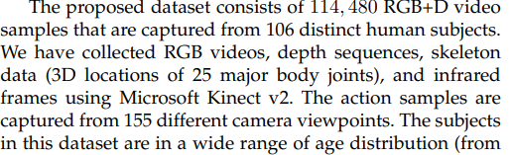
Experiments
Dataset : NTU-60 (Shahroudy et al. 2016), NTU-120 (Liu et al. 2019), PKU-MMD I, and PKU-MMD II (Liu et al. 2020)
High qualitied Kinect 3D skeleton data, NOT openpose!!!!

Slide 18
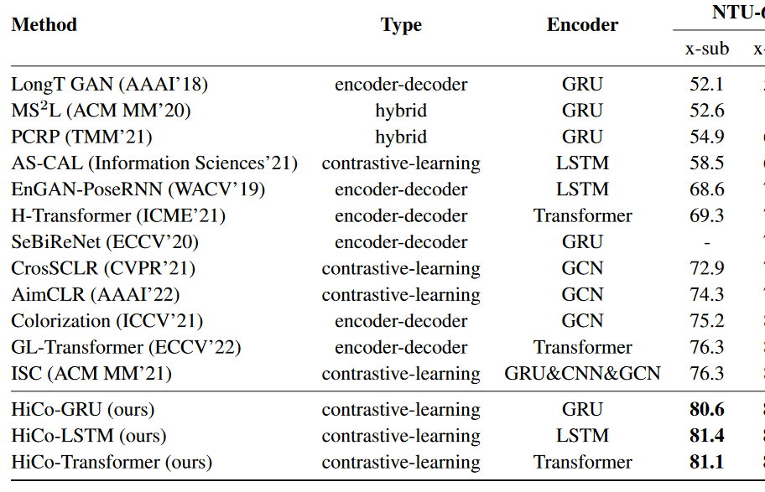
RESULTS

Slide 19
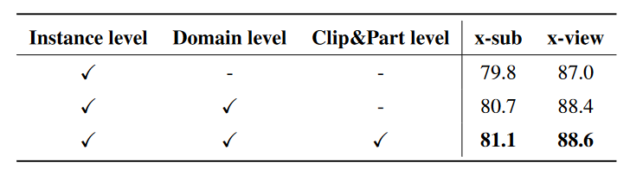
Rethinking
Data quality: High data accuracy is required because complex comparisons amplify noise, hard to converge
Ablation: is clip/part level really meaningful?
Spatial domain: no need to use 1d conv, multi-head attention better
Change clip/part contrast to prediction?
USE MOCO IS VERY GOOD, but why?

