Slide 1
Android Boot Camp for Developers Using Java, 3E
Chapter 7: Reveal! Displaying Pictures in a GridView

Slide 2
Objectives
In this chapter, you learn to:
Create an Android project using a GridView control
Add a GridView to display two-dimensional grid of images
Reference images through an array
Create an ImageAdapter class
Code an OnItemClickListener
Display a custom toast message
Define a Context resource
Understand the use of constructors

Slide 3
Objectives (continued)
Return a value from a method
Determine the length of an array
Assign an ImageView control using setImageResource
Change the scale and layout size of the GridView

Slide 4
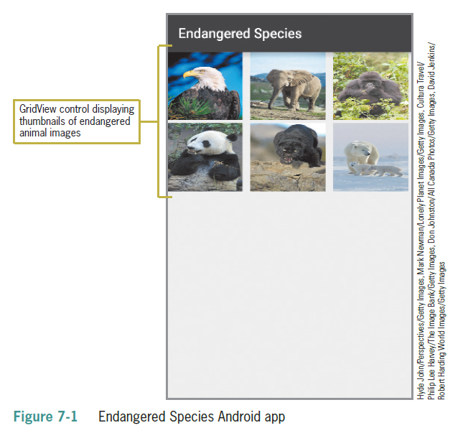
Adding a GridView Control
A View container is a rectangular area of the screen that displays an image or text object
A GridView is a center-locked horizontally scrolling list
Adds Visual Appeal
Clean, Professional Effect
Flip Photos with Fingers
Tap for full-size

Slide 5
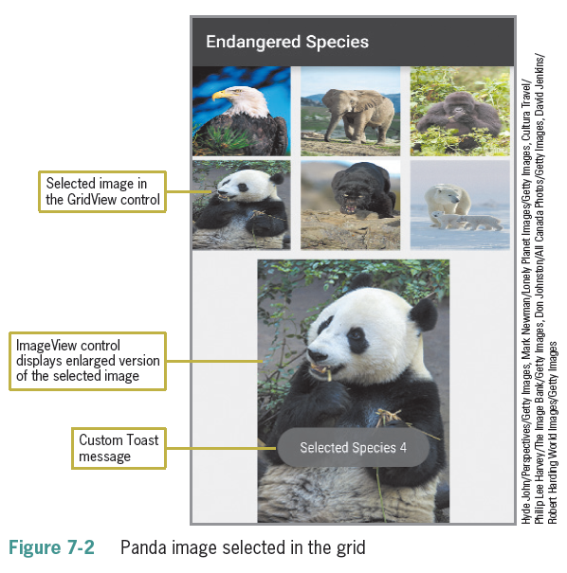
Adding a GridView Control (continued)

Slide 6
Adding a GridView Control (continued)
Steps to complete the App:
1. Add a GridView control and an ImageView control to the emulator.
2. Update the XML code for an ImageView control not linked to a particular image.
3. Place six images in a drawable folder.
4. Define an array to hold the image files.
5. Instantiate the GridView and ImageView controls.
6. Create an ImageAdapter class.
7. Display a custom toast message.
8. Display the selected image.
9. Customize the ImageAdapter class.
10. Define the layout using the getView( ) method.

Slide 7
Adding a GridView Control (continued)
A View container is a rectangular area of the screen that displays an image or text object
Can include layouts such as GridView, RadioGroup, ScrollView, TabHost, and ListView
Photos can be sized as thumbnail images or full-screen images
The GridView container displays a horizontal list of objects with the center item displaying the current image
Photos can be stored in the drawable folders, in a phone’s storage, or on a Web site such as Picassa

Slide 8
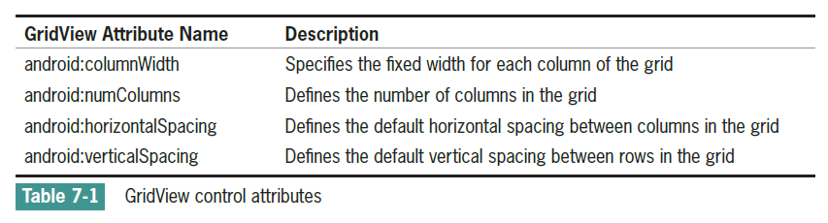
Adding a GridView Control (continued)

Slide 9
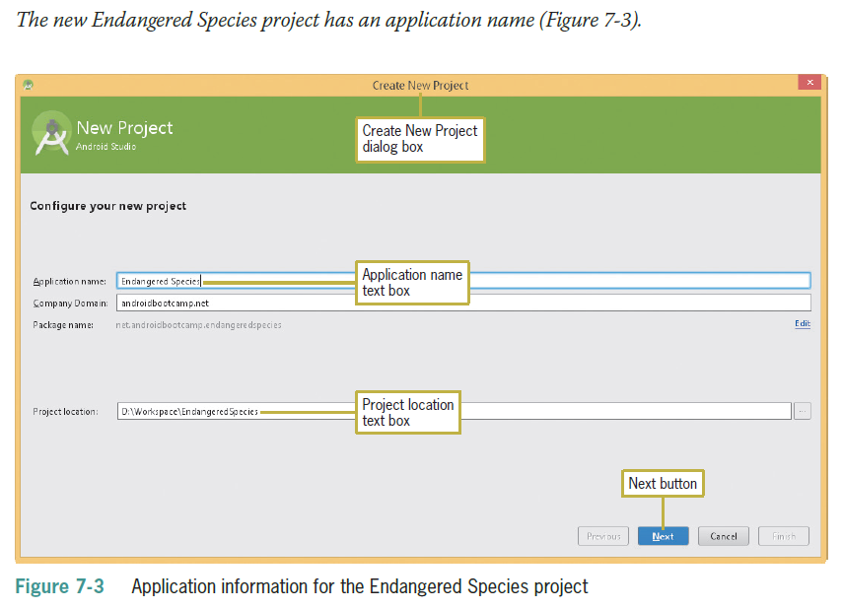
Adding a GridView Control (continued)

Slide 10
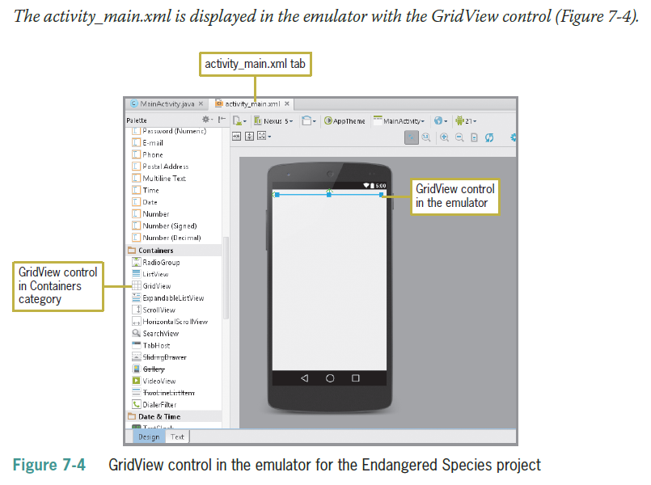
Adding a GridView Control (continued)

Slide 11
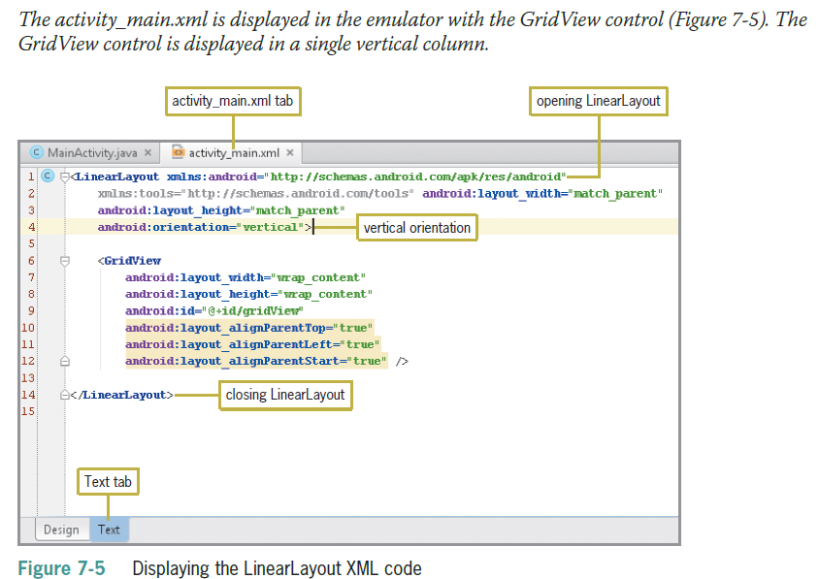
Adding a GridView Control (continued)

Slide 12
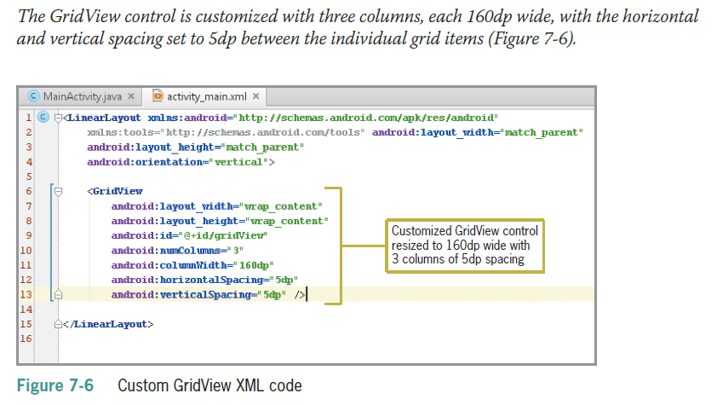
Adding a GridView Control (continued)

Slide 13
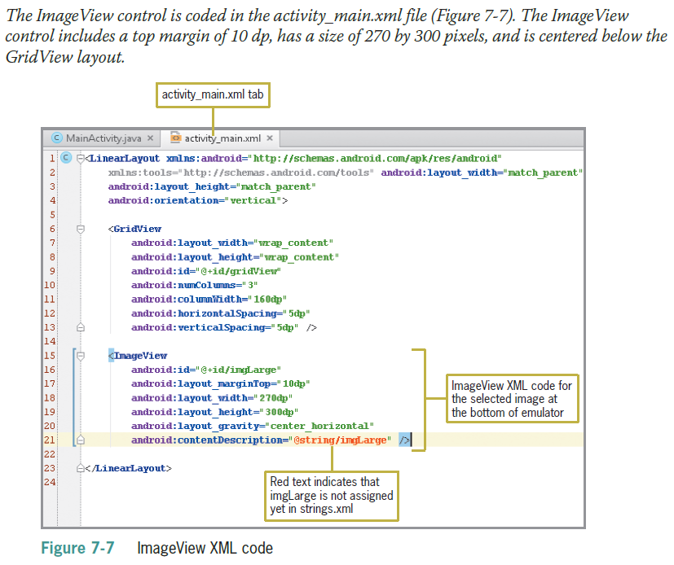
Adding the ImageView Control and Image Files

Slide 14
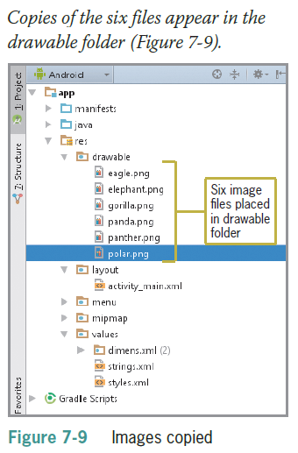
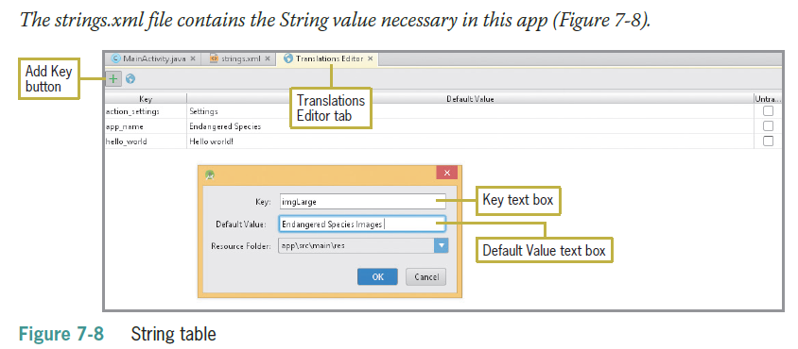
Adding the ImageView Control and Image Files

Slide 15
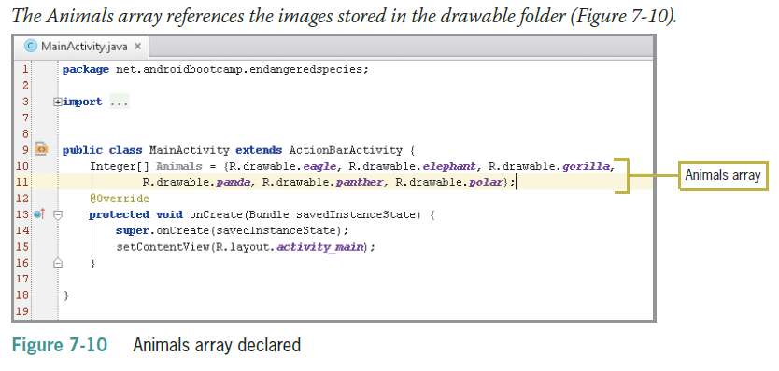
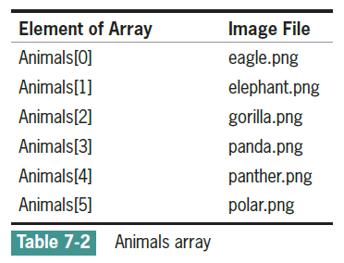
Creating an Array for the Images

Slide 16
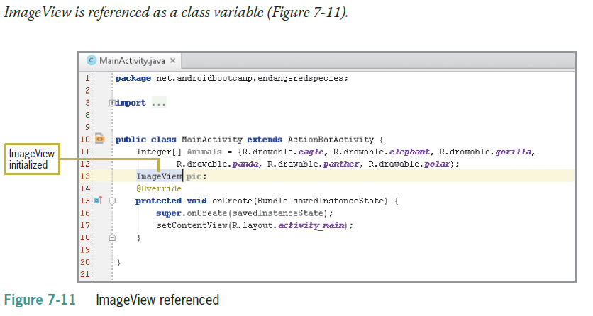
Creating an Array for the Images (continued)

Slide 17

Creating an Array for the Images (continued)
Images must be placed in the drawable folder
Must be referenced in the code
Must be assigned to an array

Slide 18
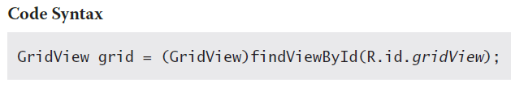
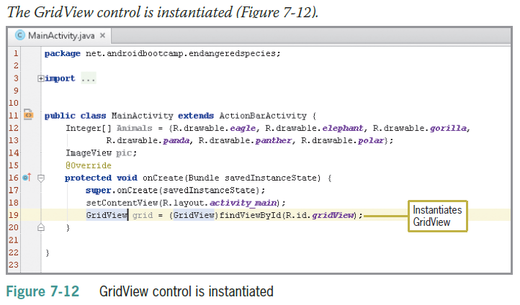
Instantiating the GridView and ImageView Controls

Slide 19
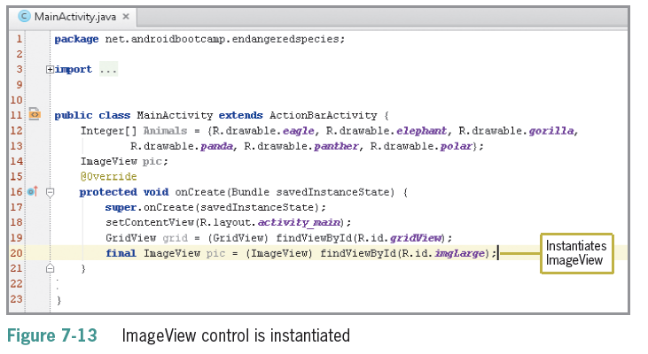
Instantiating the GridView and ImageView Controls (Continued)

Slide 20
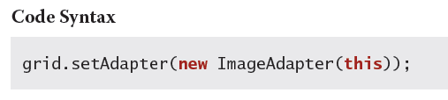
Using a setAdapter with an Image Adapter
A setAdapter provides a data model for the GridView layout
ImageAdapter must be instantiated
ImageAdapter class must be added to extend the custom BaseAdapter class

Slide 21
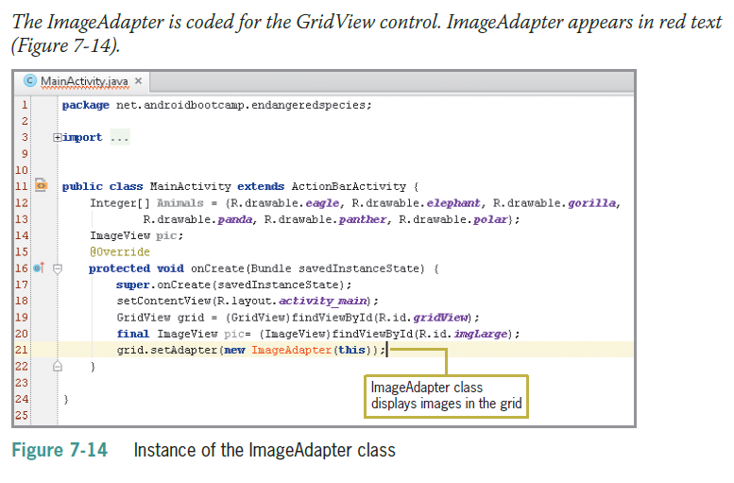
Using a setAdapter with an Image Adapter (Continued)

Slide 22
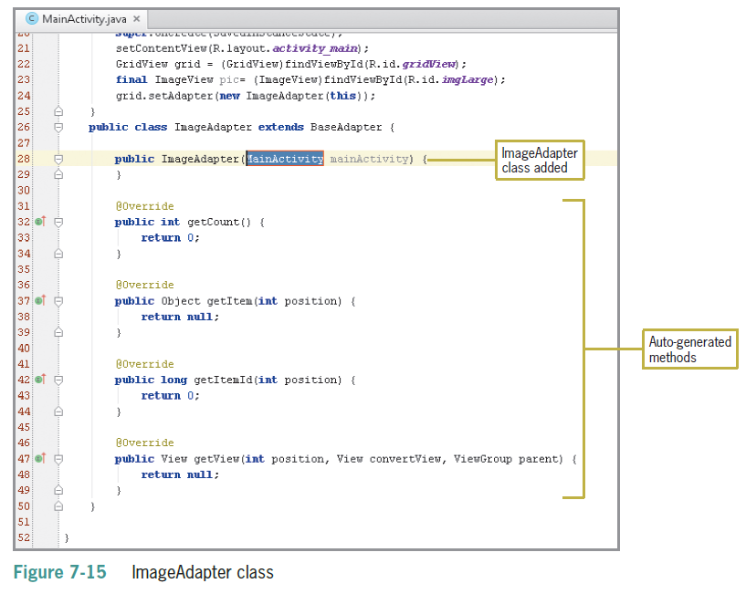
Using a setAdapter with an Image Adapter (Continued)

Slide 23
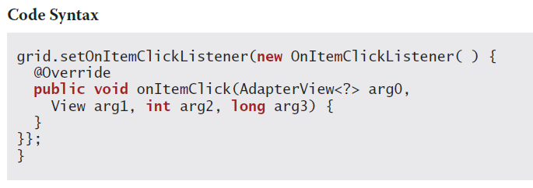
Coding the OnItemClickListener
Recall that the OnItemClickListener awaits user interaction within the GridView Control
The onItemClick method is the event the listener responds to
ListView and GridView enable the Android device to monitor for click events

Slide 24
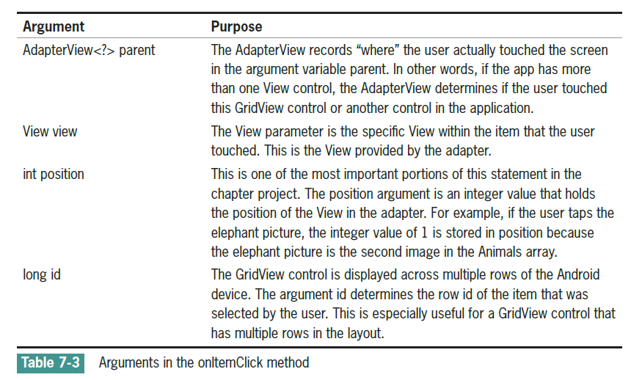
Coding the OnItemClickListener (continued)

Slide 25
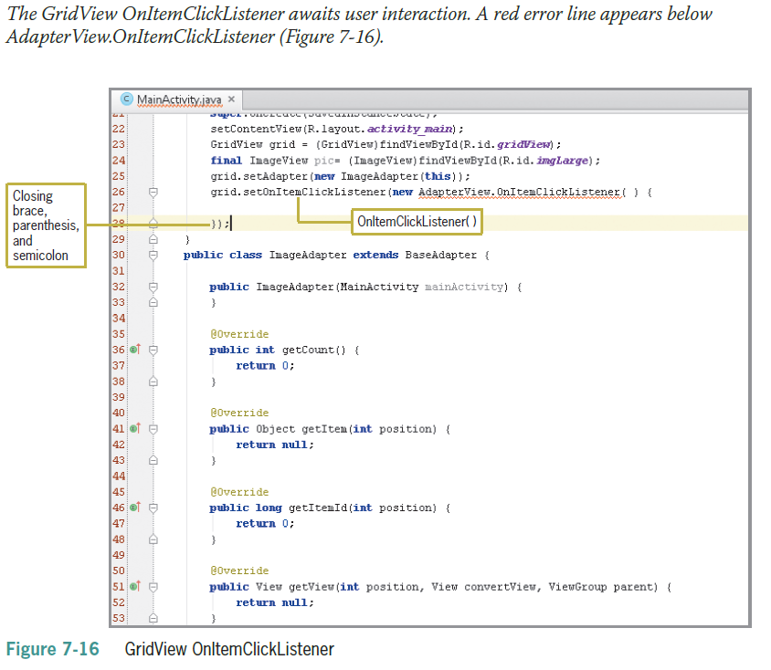
Coding the OnItemClickListener (continued)

Slide 26
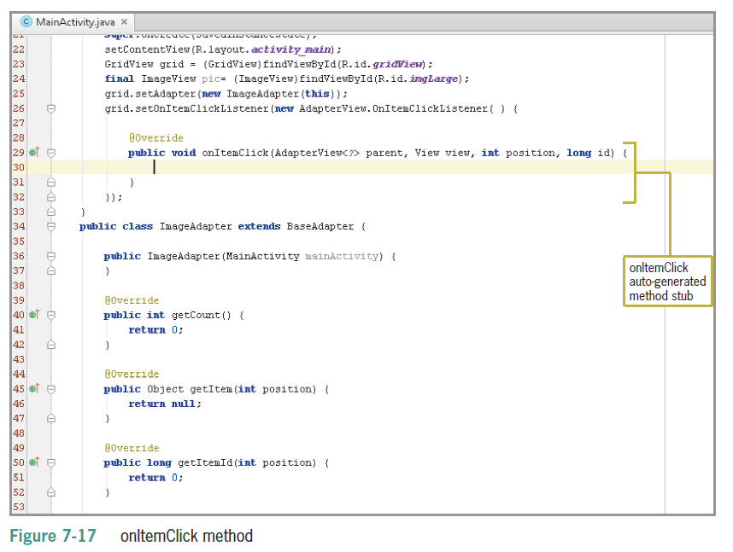
Coding the OnItemClickListener (continued)

Slide 27
Coding a Custom Toast Notification
Recall that toast notifications provide feedback to the user
Previous toast notification code:
Since notification above would be in the onItemClick method, it is not used in Main Activity, so the reference to MainActivity.this creates an error
In Android programs, you can place the getBaseContext( ) method in another method (such as onItemClick) that is triggered only when the user touches the GridView control
If you do, the getBaseContext( ) method obtains a Context instance

Slide 28
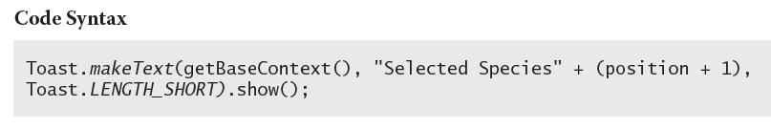
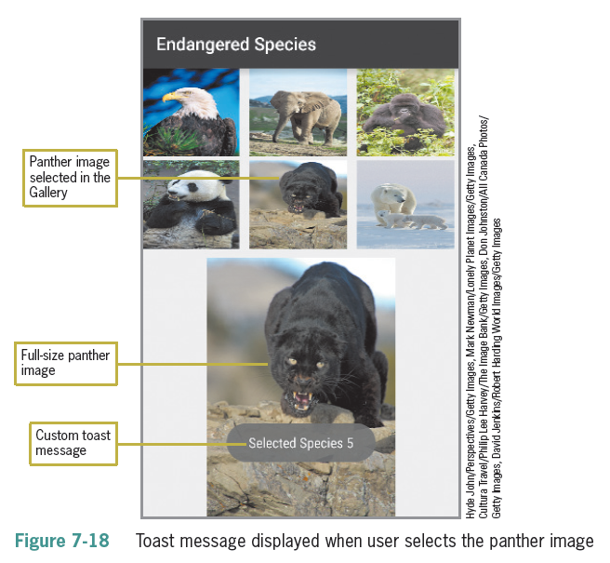
Coding a Custom Toast Notification (continued)
Notice that even though the panther is in position Animals[4] in Table 7-2, the custom toast message states “Selected Species 5”
Array position 4 is really the fifth image because the array values begin with 0

Slide 29
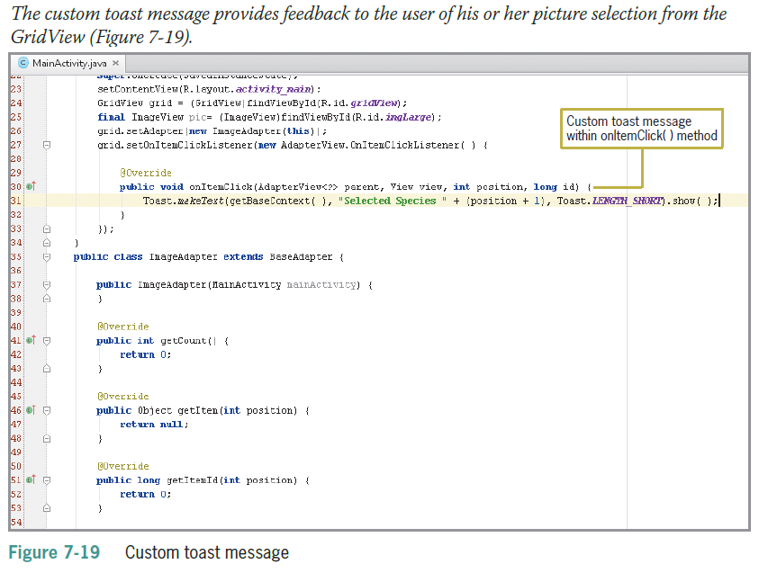
Coding a Custom Toast Notification (continued)

Slide 30
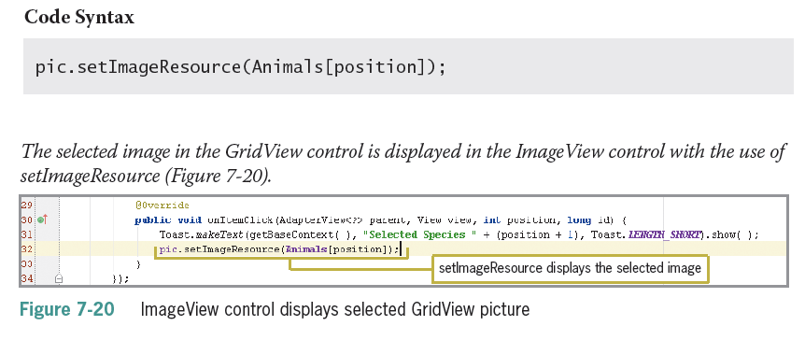
Displaying the Selected Image
When the user selects a picture, a toast message appears and the ImageView control displays the selected image

Slide 31
Customizing the ImageAdapter Class
The ImageAdapter class was called with this line of code:
gr.setAdapter(new ImageAdapter (this));
The ImageAdapter class determines the layout of the GridView
The context and images of the GridView need to be referenced within the ImageAdapter class
The tasks to complete inside the ImageAdapter class:
Manage the layout of the GridView
Connect the data sources from the array for display within the GridView control

Slide 32
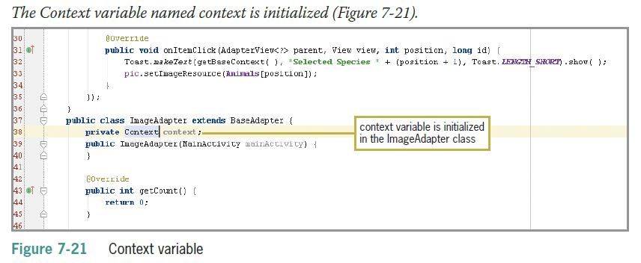
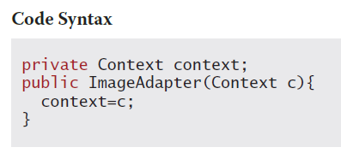
Defining the Context of the ImageAdapter Class
Constructors are used to initialize the instance variables of an object

Slide 33
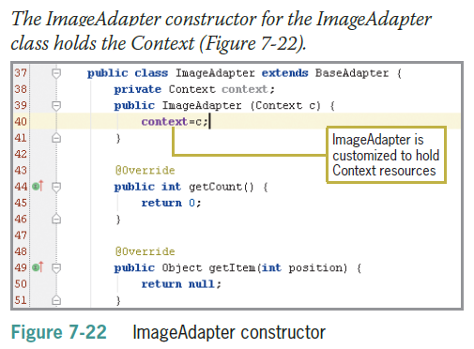
Defining the Context of the ImageAdapter Class (continued)

Slide 34
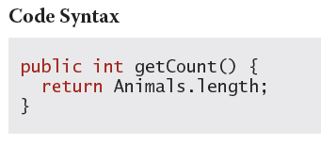
Calculating the Length of an Array
The length of an array is determined by the number of elements in the arrayImageAdapter class includes methods called:
getCount() which determines how many pictures to display
length() which returns the number of pictures in the array
A Java method is a series of statements that perform some repeated task

Slide 35
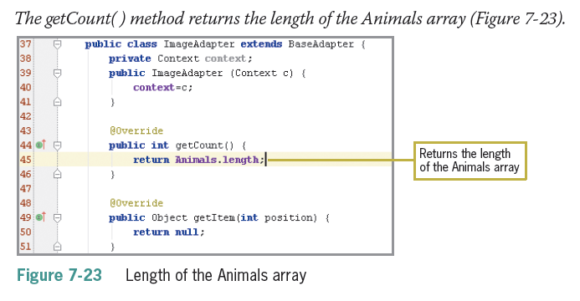
Calculating the Length of an Array (Continued)

Slide 36
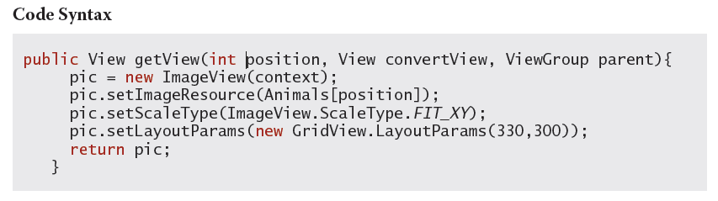
Coding the getView Method
getView method uses Context to create a new ImageView instance to temporarily hold each image displayed in the GridView
The returned pic is a scaled, resized image, ready to display in the GridView

Slide 37
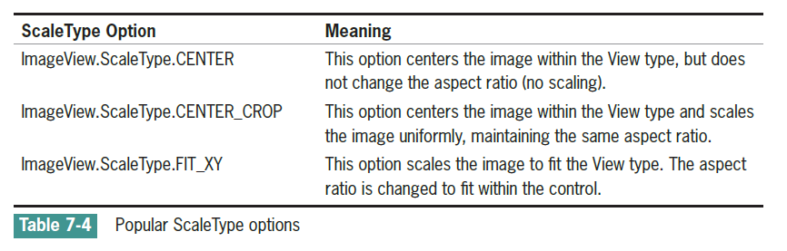
Coding the getView Method (continued)
Scaling keeps or changes the aspect ratio of the image to the bounds of the ImageView

Slide 38
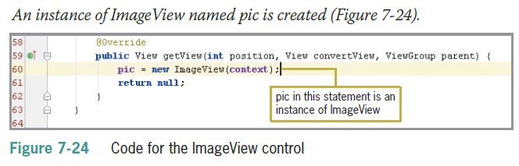
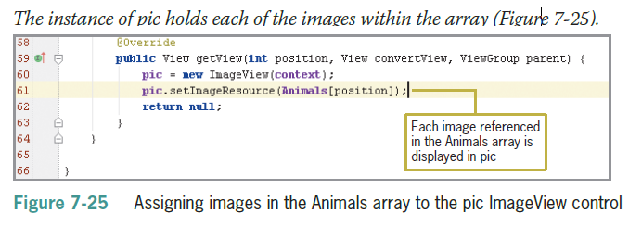
Coding the getView Method (continued)

Slide 39
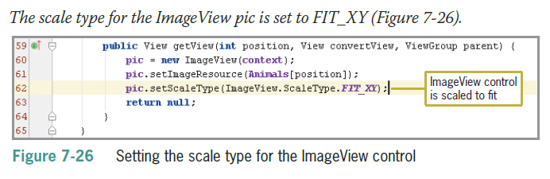
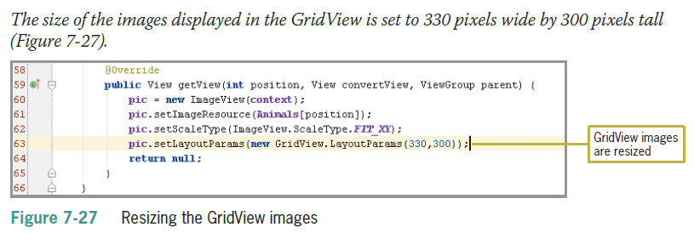
Coding the getView Method (continued)

Slide 40
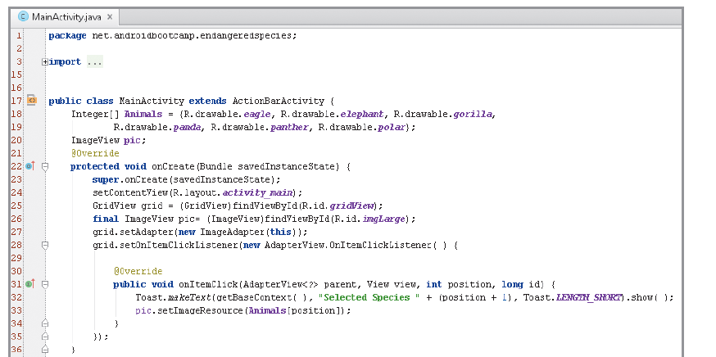
Completed Code

Slide 41
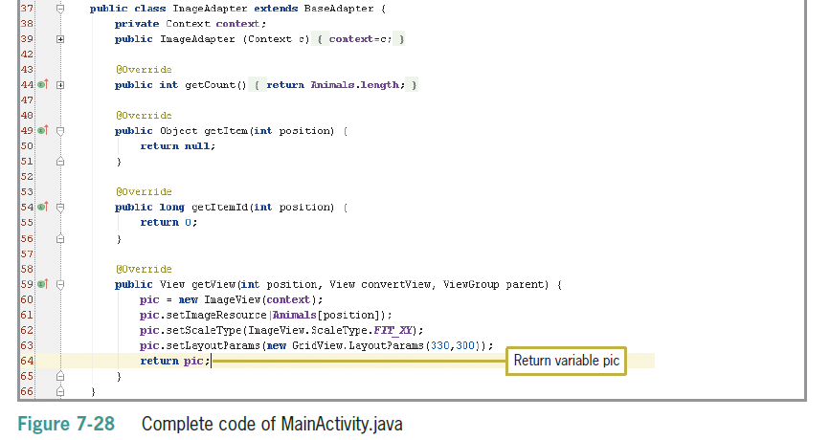
Completed Code (continued)

Slide 42
Summary
A View container is a rectangular area of the screen that displays an image or text object
A GridView layout displays a horizontal list of objects
Users can scroll the GridView list and select an object
XML code needed in mail.xml to display an image in the ImageView control
Array variables can store multiple images and assign them to the GridView control

Slide 43
Summary (continued)
A setAdapter provides a data model for the GridView layout
The OnItemClickListener waits for user interaction in a GridView control
Including a toast notification displays a message indicating which image is selected in the GridView control
Must use getBaseContext() method instead of main.this.

Slide 44
Summary (continued)
Use setImageResource() method to insert an ImageView control
Use the Context class to load and access resources for the application
Use getCount() to determine how many pictures to display in the GridView and length() to determine the number of elements in the GridView
getCount() returns an integer
getView() created a new ImageView instance to hold each images displayed in the GridView

