Slide 1
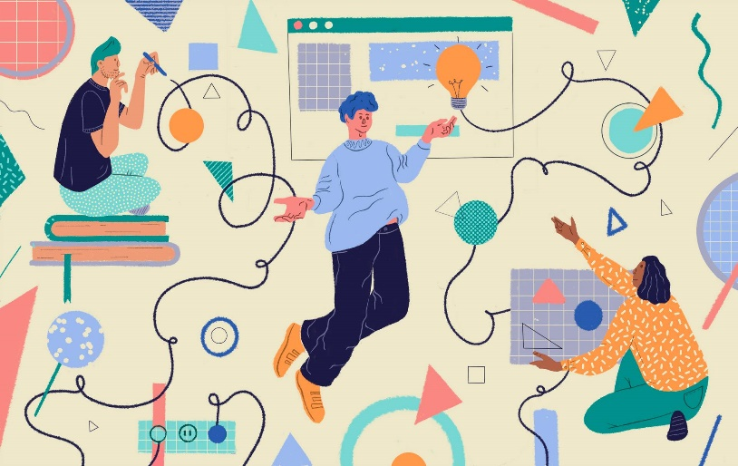
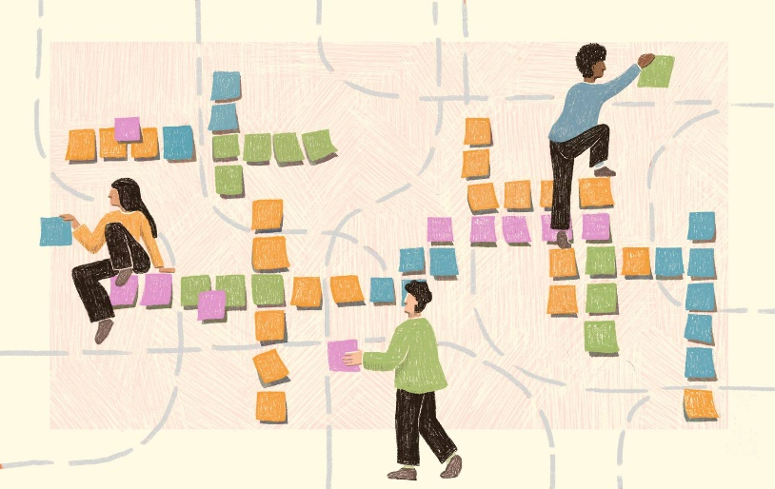

“the quantified self”
Caoimhe O’Brien

Slide 2
The background research
Spotify
BitePal
Snapchat
GitHub
I made a list of different platforms I thought I could get data from because I didn’t want to start collecting data from the start of the project because I felt I wouldn’t have enough data to create a good dataset.

Slide 3
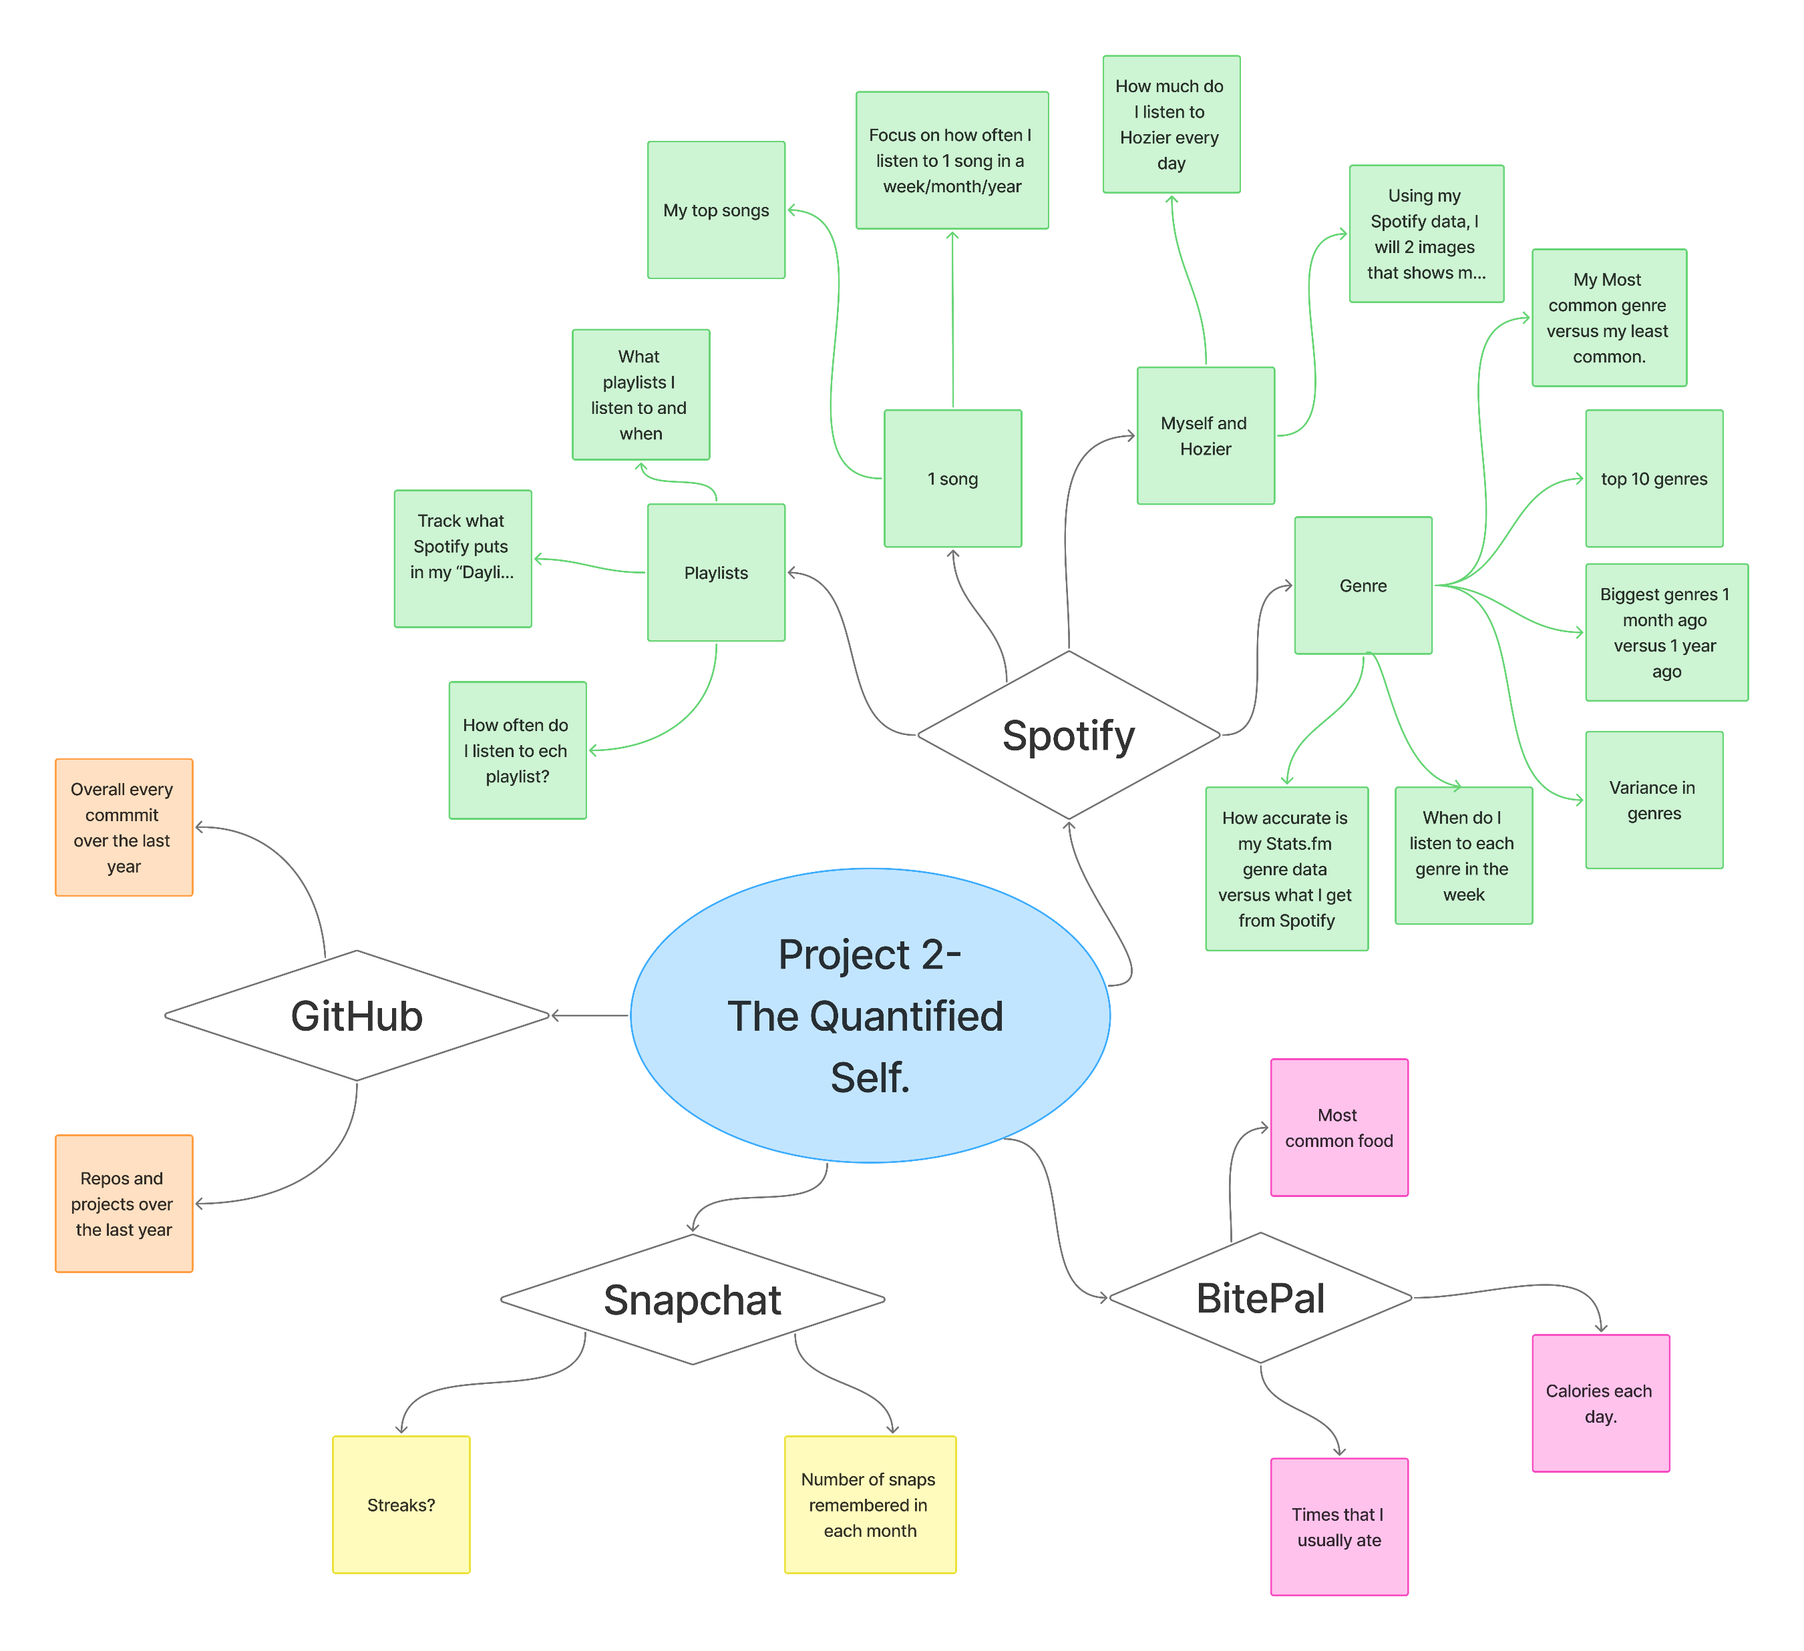
Brainstorm
I took the platforms I knew I could get data from and delved further into the ideas and put them into a brainstorm.

Slide 4

preferred ideas
Spotify
Hozier and Me
Variance in Genre
My top Songs
GitHub
Commits over the last year
Snapchat
Streaks

Slide 5

Visualization ideas
Hozier and Me → 2 images, one with Hozier albums in it and one without to show the gap of how much I listen to him
Variance in genre → Bubbles to show how much/ little I listen to different genres.
My top Songs → Bar chart or their Spotify code to vertical to make a bar chart
GitHub → Binary code?
Snapchat → Bigger fire for bigger streak

Slide 6

My top 3 ideas
Hozier and Me → I think this is a really unique idea that will allow me to show my musical interests. I also have a unique idea for how to show this data
Variance in Genre → This dataset will also be very interesting so I think it will be a good way to see how diverse my genre interests are.
Snapchat → I really like this idea and I think it could be interesting to see how much I talk to different people but I don’t know how I would access this data/ if I would have to create it manually.

Slide 7
Thank you!

